Slide 1


CMR TECHNICAL CAMPUS
UGC AUTONOMOUS
ACCREDITED BY NBA & NAAC WITH A GRADE
APPROVED BY AICTE, NEW DELHI AND AFFILIATED TO JNTU, HYDERABAD
DEPARTMENT OF COMPUTER SCIENCE AND ENGINEERING
TECHNICAL SEMINAR ON
Smart Voting System Using Facial Rcognition
PRESENTED BY
M . RAVI TEJA
197R1A0587
CSE -B

Slide 2
Abstract
In India, currently there are two types of voting system in practice.
They are secret Ballet paper and Electronic Voting Machines (EVM),
but both of the process have some limitation or demerits.
In India online voting has not been yet implemented.
The current voting system is not safe and secure too.
In this project we have to propose a system or way for voting which is very
effective or useful in voting.
In our approach we have three level of security in voting process.
Verification of unique id number (UID)
Verification of election id number (EID)
Face recognition

Slide 3
Introduction
Now a day in India two types of method are used for voting :
Secret ballot paper
EVM (electronic voting machine)
Online Voting System, which provides accuracy, security, flexibility, mobility etc.
An online voting System in a web based application to use in the election process.
Face recognition authentication to make the voting process more secure and reduce the time taken in the voting process.
By the use of this, the electorate can solidify their vote for his or her preferred candidate through the use of their system.
Most higher learning establishments in Kenya conduct elections routinely to elect an understudy leadership to choose them.

Slide 4
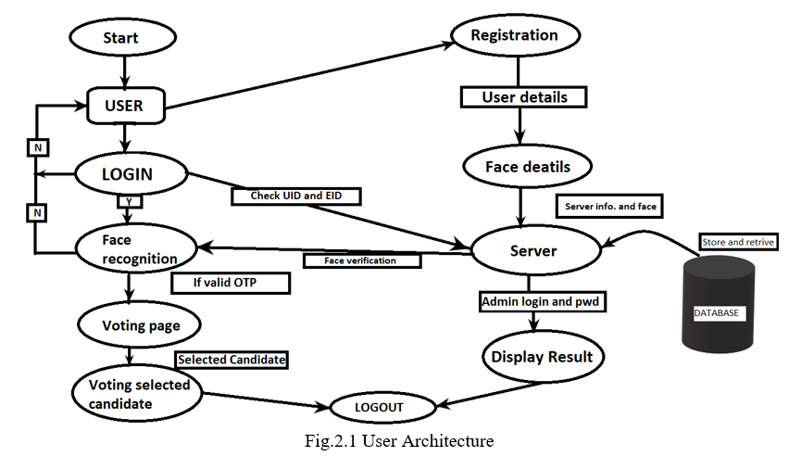
Objective
An online voting System in a web based application to use in the election process.
The aim is to develop an application that seeks to use various stages of security authentication to enhance the election process.
To create a secured voting platform where authenticity of votes and voters are ensured with the use of mechanisms such as facial recognition and one – time password.
To enhance Voter’s identity due to the fact that biometric functions can not be shared.
To ease the trouble of queuing in the course of balloting duration in elections.

Slide 5
Functionality
In this System, Face recognition is playing main role for authentication. Live image will be captured by the web camera .
This camera image will be sent to the server for futher processing.By using this image,server checks whether user is authorized or not.User is permitted for voting only if he is authorised.
In facial recognition there are 2 types :
Verification :
The system compares the given indivual with who they are and gives a yes or no decision.
Identification :
The system compares thre given individual to all the other individuals in the
database and gives a ranked list of matches.

Slide 6
Functionality
Some Algorithms used in facial recognition :
Grayscale Algorithm
Threshold Algorithm
Blurring Algorithm
Scaling Algorithm
Template gene ration and Matching

Slide 7
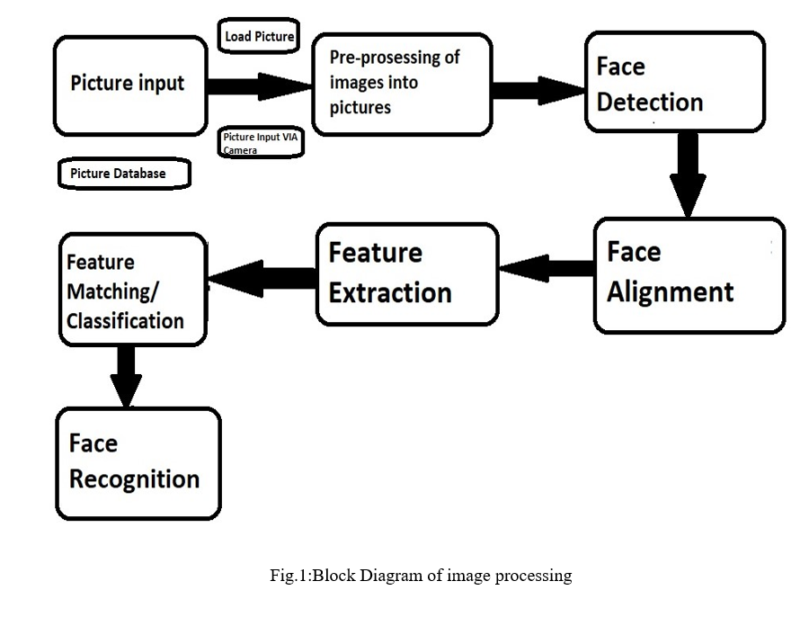
Architecture

Slide 8
Architecture

Slide 9
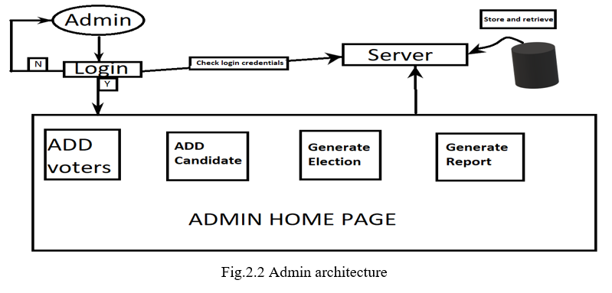
Architecture

Slide 10
Advantages and Disadvantages :
Disadvantages :
Huge Storage requirements
Vulnerable Detection
Potential Privacy issues
Advantages :
Better security
Easy Integration
Automated Identification

Slide 11
Conclusion
This analysis of development of Smart-voting system on an android platform.The usability of this system is very high if it will use in real life election process.It will definitely helpful for the users who wish use to vote and the voting process will be made very easy by using this application.
However,after having tested the system, in future we,tend to add additional functionality of image validation for the security condtraint and uniqueness which will provide very strong for the confidential information vote.

Slide 12


Slide 13


