Slide 1
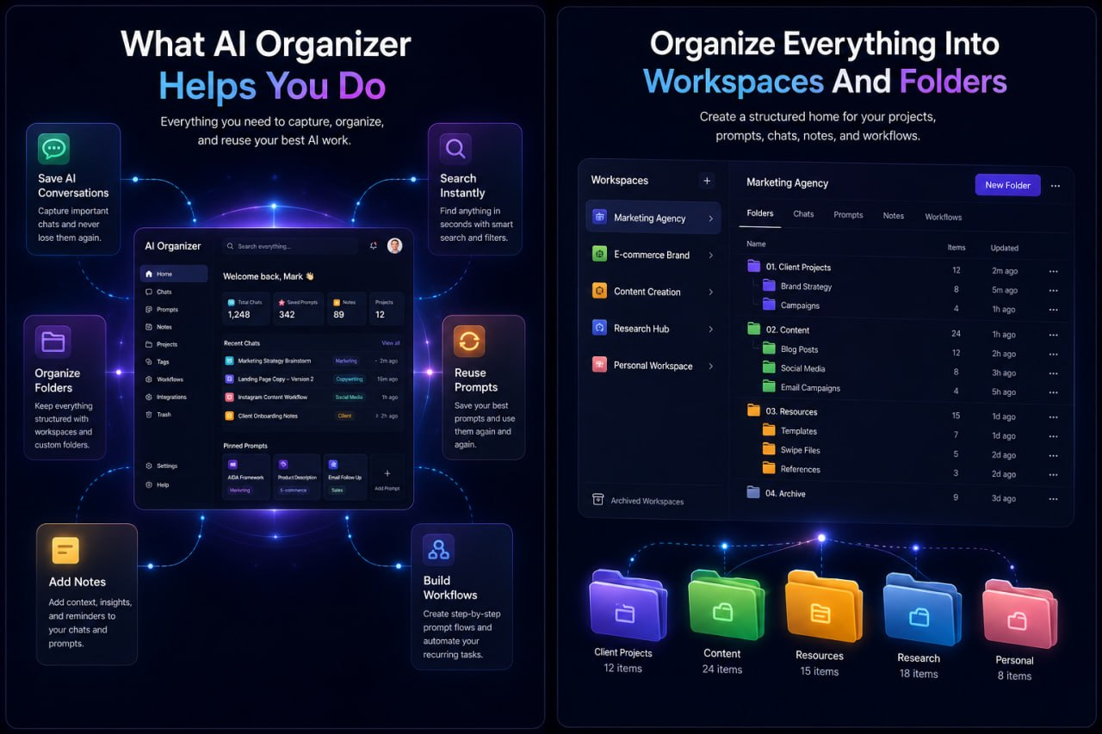
Stop Losing Your Best AI Work
Prompts, chats, workflows, ideas — gone when you need them most
Buried chats
Lost prompts
Repeated work
AI Organizer

Slide 2
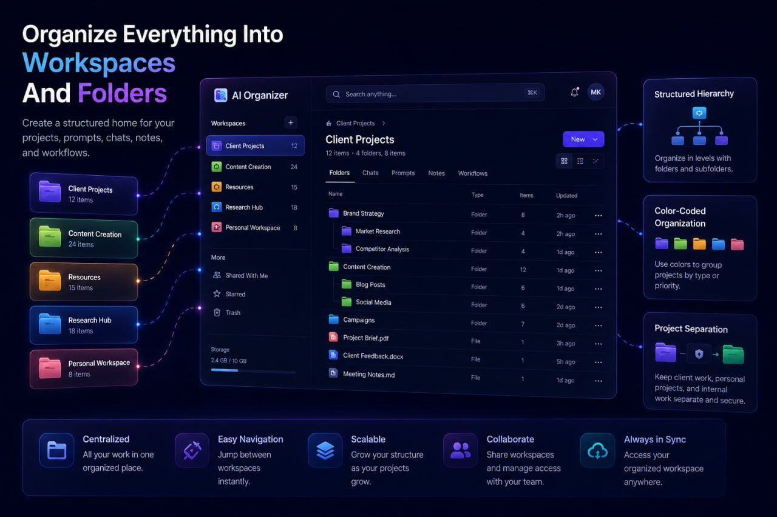
Great prompts disappear fast
•
Important chats get buried
•
Good prompts vanish
•
You rebuild instead of reuse

Slide 3
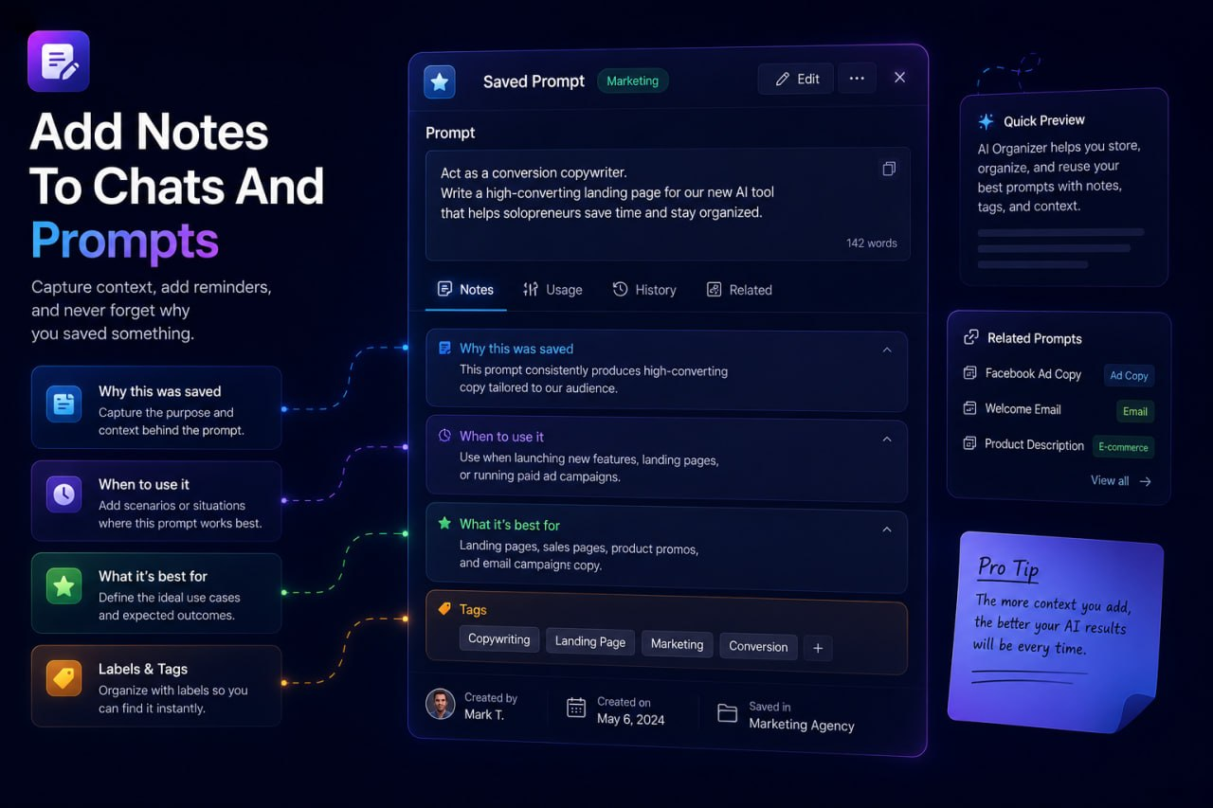
That costs more than time
It breaks momentum and makes AI feel harder than it should.
When your best work is hard to find, AI stops feeling efficient.

Slide 4
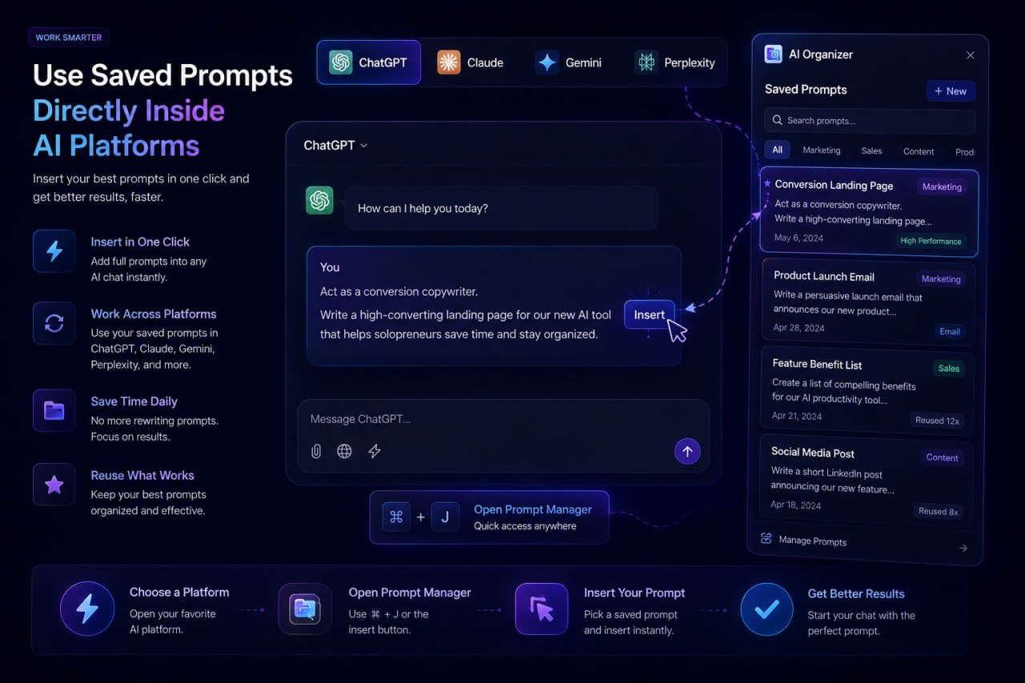
What if all your AI work lived in one place?
Searchable. Organized. Reusable.
Searchable
Organized
Reusable

Slide 5
Meet AI Organizer
Your central workspace for prompts, chats, notes, and workflows
One system for everything you create with AI.

Slide 6
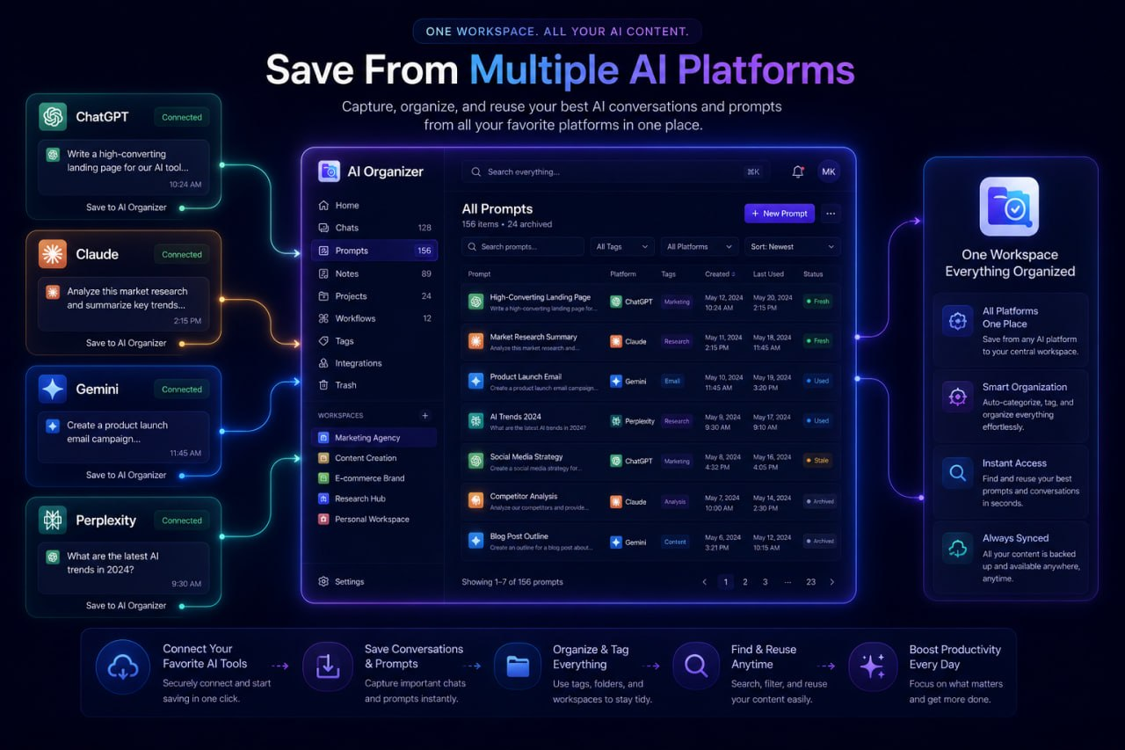
Save everything worth keeping
Store prompts and conversations from ChatGPT, Claude, Gemini, Perplexity, and more
ChatGPT
Claude
Gemini
Perplexity

Slide 7
Find what you need instantly
Search prompts, notes, and even long conversations fast
Search your AI work...
Instant results. No digging.

Slide 8
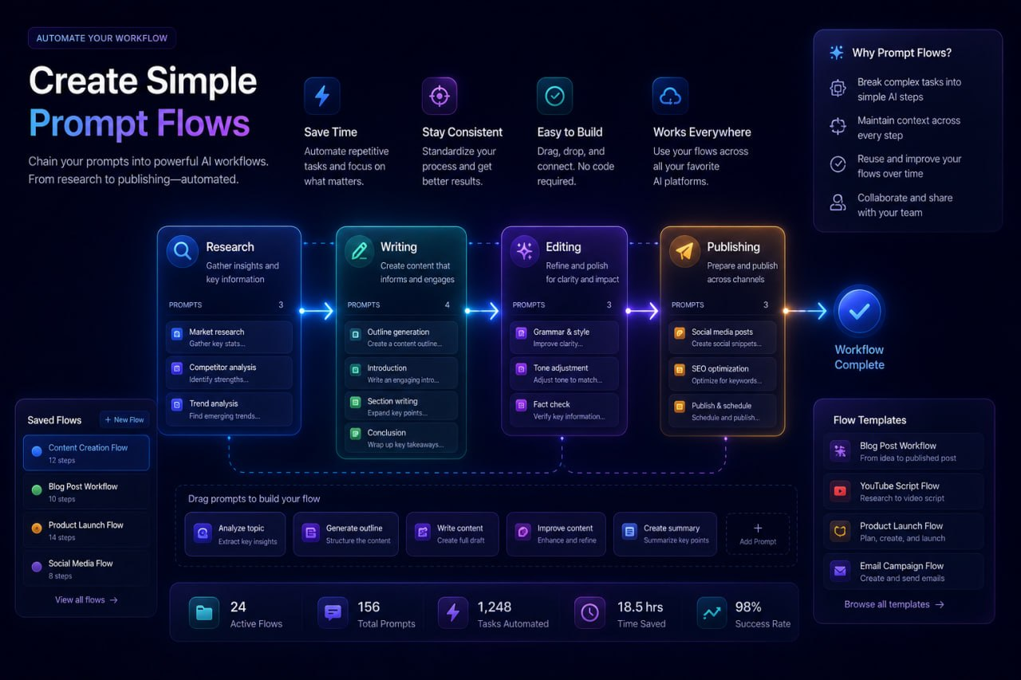
Organize it your way
Workspaces, folders, subfolders, and tags that fit how you actually work
Workspaces
Folders
Subfolders
Tags

Slide 9
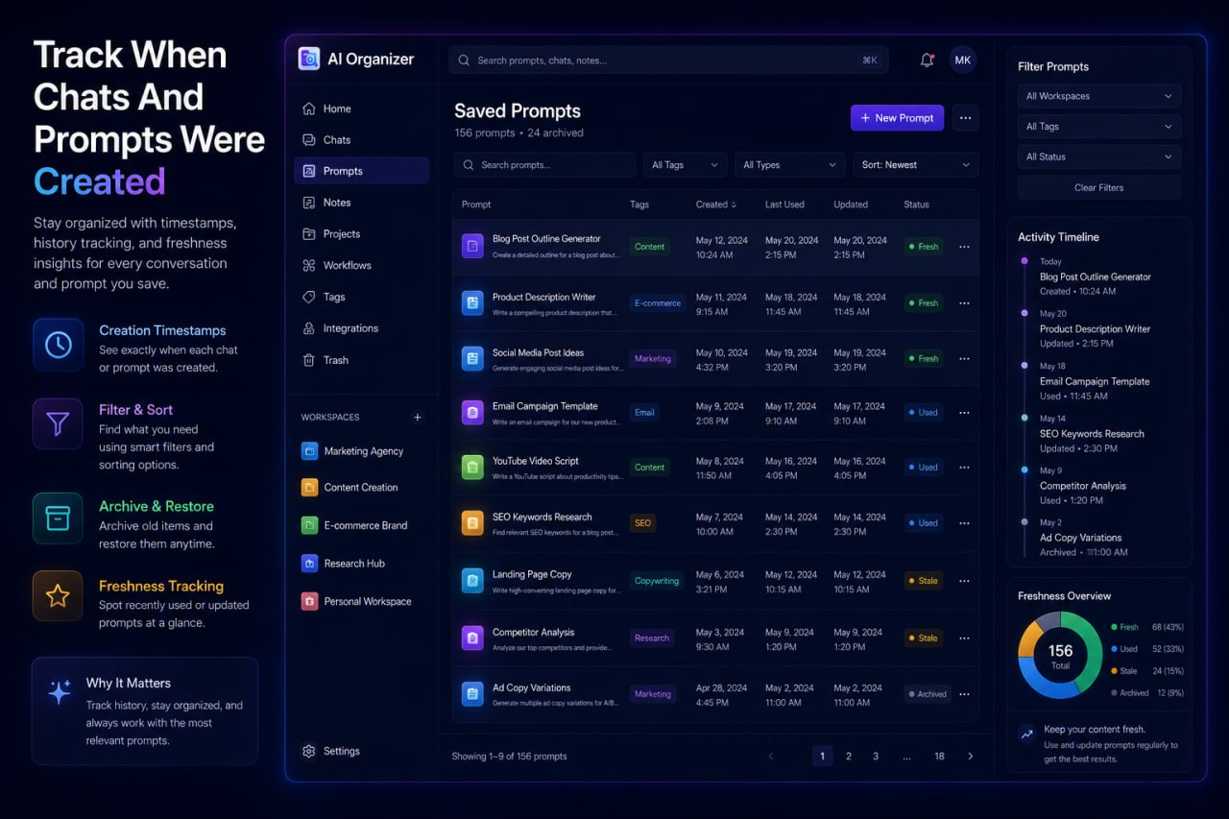
Reuse prompts in one click
No more copying, pasting, or switching tabs
Save once. Reuse anytime.
Build a library of prompts that keeps paying you back.

Slide 10
Less chaos. More momentum.
Before
After
Buried chats
Lost prompts
Repeated work
Saved
Searchable
Reusable

Slide 11
Built for people who actually use AI to work
Solopreneurs, marketers, freelancers, and creators
Solopreneurs
Marketers
Freelancers
Creators

Slide 12
Give your best AI work a permanent home
Save it. Search it. Reuse it.
Get AI Organizer Now
Stop rebuilding work you already did.

