Slide 1
Introduction
Natural Language Processing (NLP) is performed on the text to
complete certain tasks like
    Opinion mining
    Sentiment analysis
    Automatic question, and answers generation, etc
Text classification, distinct from Named Entity Recognition (NER), a
machine learning algorithm that serves the purpose of categorizing
entire texts or documents into predefined classes or groups.
Unlike NER, which focuses on identifying specific entities within the
text.
Text classification takes a holistic view of the content to make
judgments about its overall characteristics.

Slide 2
Introduction…..
Multiclass Classification is where each data sample is assigned one
and only one label from more than two classes.
Multiclass text classification serves as a foundational step in Question-answer
generation, facilitating the production of relevant Questions and answers.
In the Past research was done using BERT, BART, GPT, etc.
In our research, the model was developed using LLMS like GPT. Fine-tuning
was carried out in the process to get the desired outcomes.
Using the fine-tuning process in the NLP pipeline, our model has achieved
superior accuracy compared to other models.

Slide 3
Literature Review
1. Ankita Dhar et al, Classification of Text Documents Through Distance
Measurement: An Experiment with Multi-Domain Bangla Text Documents, IEEE
Access Multidisciplinary, Rapid Review, Open Access Journal, Vol.11, 2017
Algorithm used: TF-IDF for classification of text into sentences based on results.
Result: Performs better for Bangla Text document classification
Limitation: It is restricted to a specific language.
2. Xian She et al, Text Classification Research Based on Improved SoftMax Regression,
IEEE Access Multidisciplinary, Rapid Review, Open Access Journal, Vol.8,2018
Algorithm used: Soft max regression algorithm
Result: Improves the classification accuracy rate even for non-linear texts
Limitation: Can’t handle both linear and non-linear text at a time

Slide 4
Literature Review....
3. W. Wu, “Binary Output Layer of Feedforward Neural Networks for Solving
Multi-Class Classification Problems”, IEEE Access Multidisciplinary, Rapid Review,
Open Access Journal, Vol.7, 2019, 5085-5094.
Algorithm used: feedforward neural networks (FNN), Binary approach.
Result: This model works well with classification problems up to 5-class classification.
Limitation: It does not work well with the problems having more than 5 classes.
4. Shanshan Yu and Jindian Su, “Improving BERT-Based Text Classification
With Auxiliary Sentence and Domain Knowledge”, IEEE Access Multidisciplinary,
Rapid Review, Open Access Journal, Vol.7, 2019, 176600-176612.
Algorithm used: BERT, BERT4TC
Result: Accuracy (87% to 99%) based on the dataset.
Limitation: Less accuracy for specific domain datasets. (IMDB)

Slide 5
Literature Review....
5. Y. Chen and H. Chen, “A Novel Class-Center Vector Model for Text Classification
Using Dependencies and a Semantic Dictionary ”, IEEE Access Multidisciplinary,
Rapid Review, Open Access Journal,2019,24990-25000.
Algorithm used: Class-Center Vector Method, TFIDF
Result: The Classification effect achieves the best, in which the F1 value reaches 90.74%.
Limitations: The model only performed well up to 6 clustered layers, but did not perform
well When the layers have been increased more than 6.
6. K. Xia,” Convolutional Neural Network Based Classification of App Reviews”, IEEE
Access Multidisciplinary, Rapid Review, Open Access Journal,2020, 185619- 185628.
Algorithm used: Encoders, Decoders, Multi-Label Text classification, Hierarchical Text
Classification). (75.72% to 95.49%)
Result: The proposed approach outperforms the baseline approaches in handling
the classification of police case texts.
Limitations: If one previous Prediction gets wrong then entire prediction becomes wrong.

Slide 6
Literature Review....
7. K. A. Qureshi,” Un-Compromised Credibility: Social Media Based Multi-Class
Hate Speech Classification for Text”, IEEE Access Multidisciplinary, Rapid
Review, Open Access Journal,2021, 109465- 109477.
Algorithm used: Support Vector Machine (SVM), Logistic Regression, Multi- Layer
perceptron.
Result: The result produced by our final proposed features modal has achieved
89.0% accuracy.
Limitations: Misclassification of context-aware hate speeches.
8. Xian She et al, Text Classification Research Based on Improved SoftMax
Regression Algorithm, IEEE Access Multidisciplinary, Rapid Review, Open Access
Journal,2021 Vol.8,2018
Algorithm used: Soft max regression algorithm
Result: Improves the classification accuracy rate even for non-linear texts
Limitation: Can’t handle both linear and non-linear text at a time

Slide 7
Literature Review....
9. Khan Md Hasib et al, MCNN-LSTM: Combining CNN and LSTM to Classify
Multi-Class Text in Imbalanced News Data, vol.11,2023
Algorithm used: MCNN-LSTM
Result: It can learn phrase-level features and characteristics to learn long-term
dependencies
Limitation: This model is not compatible with deep neural networks (such as
principal component analysis, or PCA), and other variants of neural network
models.
10. Shrehar Joshi et al, Multiclass Text Classification Using Machine Learning
Models for Online Drug Reviews, Vol. 3,2021
Algorithm used: Linear SVC
Result: It is found to be more effective in predicting medical conditions
regarding the accuracy
Limitation: It is restricted to the medical domain

Slide 8
Research Gaps
Handling Imbalanced Data: There is a need for research focusing on techniques to effectively handle imbalanced data to ensure fair and accurate classification across all classes.
Transfer Learning: While transfer learning has shown promise in improving performance in various NLP tasks, its application to multiclass text classification has not been extensively explored.
Domain Adaptation: Text classification models often struggle when applied to domains different from the one they were trained on. Research gaps exist in exploring domain adaptation techniques tailored specifically for multiclass text classification, especially in scenarios where labeled data in the target domain is limited
Incorporating External Knowledge: There is a gap in research focusing on methods to effectively incorporate external knowledge into multiclass text classification models to improve performance and generalization.

Slide 9
Research Problem Definition (Abstract)
In present days, many industries are incorporating text classification in their ordinary tasks for consistency, scalability, and timeliness it brings in. However, while working with real data there are several obstacles to overcome during conducting the classification modeling. Natural Language Processing (NLP) is the key component in the extraction and analysis of textual data. Multi-Class Text Classification (MCTC) plays a vital role in categorizing textual data into more than two predetermined classes to avoid ambiguity. Most of the issues faced by previous MCTC models are imbalanced datasets, selecting appropriate algorithms, ensuring model generation, and working with high-dimensional data. A model is developed to overcome these challenges by applying Prompt Engineering, NLP pipeline algorithm, and fine-tuning methods along with GPT-3.0 for the existing MCTC model. This model achieved better results with performance metrics of 0.85 F1 score which shows the best accuracy when compared with all other models, including BERT, Bart, and GPT.

Slide 10
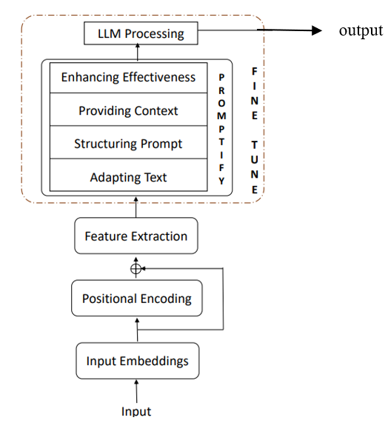
Architectural Diagram
Fig: The architectural diagram

Slide 11
Methodology for Multiclass text classification:
Inputs
Input Embeddings
Positional Encoding
Feature extraction
5. Implementation of Fine Tuning
  Adapting text
  Structuring Prompt
  Providing context
  Enhancing Effectiveness
6. LLM processing

Slide 12
Methodology……
7. Performance Evaluation of the system:
  The F-1 score test has been used to know accuracy and reliability of the system
8. Deployment:
  Develop a user-friendly interface where users can input text and get relevant classes according to the data.
  Deploy the system as a web application
9. Tools and Technologies:
  GPT 4: Utilize the GPT-based model to generate classes to the given data.
  Promptify: Use Promptify to generate prompts for multi class text classification.
  Python: Main programming language for implementation.

Slide 13
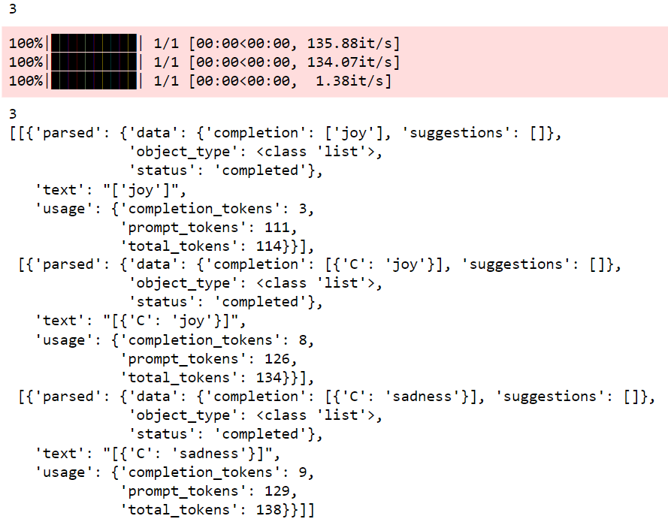
Results
Sample Input = " There is something about you that makes my body come to life. There are no words to express how it makes me feel, but it is a feeling that puts me on top of the world. Having you in my life has opened up great things, but bad which is why I look forward to every day with you, and feel very bad."
Output:

Slide 14
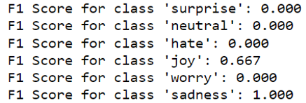
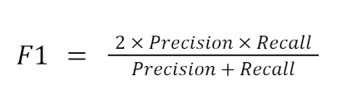
Results….
F1-score:

Slide 15
Multiclass Text Classification (F1 Score)
PARAGRAPHS | BERT | BART | GEMINI | GPT | FINE TUNING
P1 | 0.34 | 0.45 | 0.67 | 0.74 | 0.83
P2 | 0.17 | 0.44 | NA | 0.71 | 0.86
P3 | 0.25 | 0.57 | NA | 0.77 | 0.81
P4 | 0.39 | 0.38 | 0.69 | 0.79 | 0.89
The fine-tuning model demonstrates superior performance compared to existing NLP models such as BERT, BART, GEMINI, and GPT, achieving an average F1-Score of 0.87

Slide 16
Conclusion
The proposed model evolved through the fine-tuning of GPTs and LLMs. To enhance its capabilities, we incorporated fine-tuning technology, which facilitated the execution of various intricate tasks. Notably, the library's pipe fit module enabled the model to effectively extract entities and relationships, further augmenting its proficiency in handling diverse text processing requirements.
While previous attempts have tackled similar tasks, they often struggled with low accuracy rates. However, our proposed model has achieved a notable 80% accuracy, representing a significant performance improvement. This enhanced accuracy underscores the effectiveness of our approach, distinguishing it from previous endeavors and highlighting its potential for robust and reliable text classification tasks.
As our model is built upon the foundation of GPTs and LLMs, future advancements in this technology hold promise for further improvements. With the introduction of new iterations, the model's accuracy and capacity to handle diverse datasets may see significant enhancements.

