Slide 1
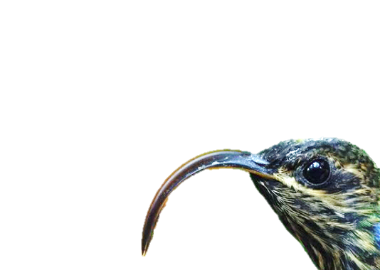
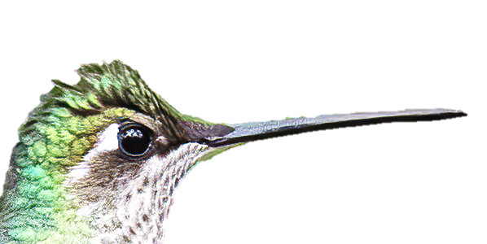
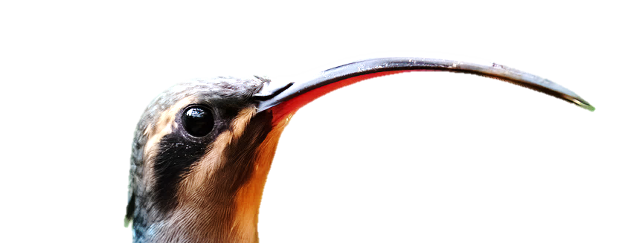
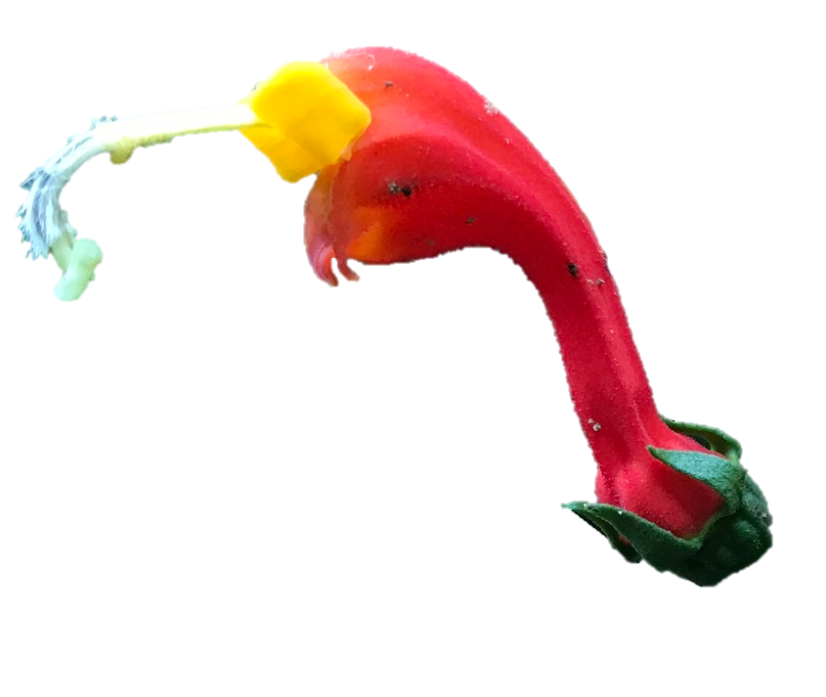
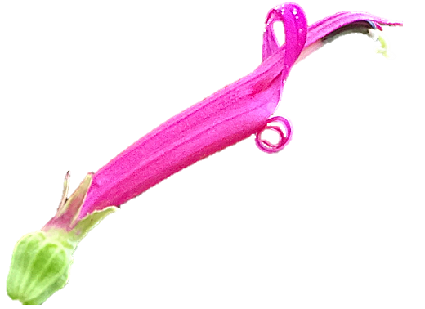
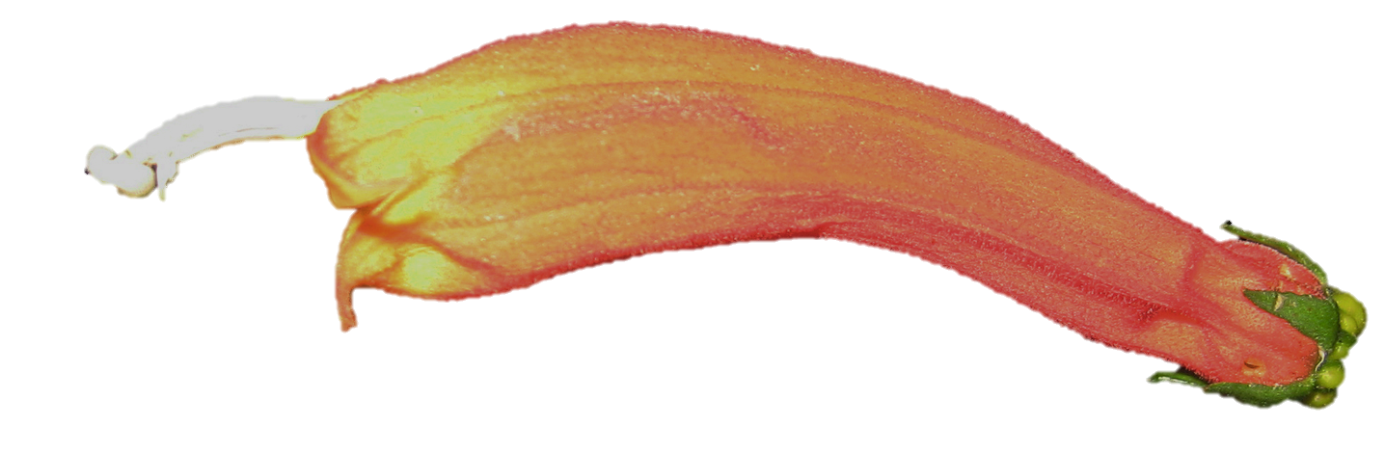
A
B
C
K_{tot} = 1.7°
K_{tot} = 51.8°
K_{tot} = 101.0°
D
E
F
K_{tot} = 16.0°
K_{tot} = 23.1°
K_{tot} = 121.0°
Wide (generalists)
Narrow (specialists)
Pollination Niche Width
Figure X. Pollination niches within hummingbird-adapted centropogonids. K_{tot} is ‘total curvature’ in degrees as defined in Boehm et al (2021); measurement protocols are described in the Supp. Mat. All photos used with permission from their owners. A: Eugenes fulgens (photo: Ronald E. Thill). B: Phaethornis guy (photo: Mike Hooper). C: Eutoxeres condamini (photo: Julian Heavyside). D: Centropogon talamancensis (photo: Nancy Overholtz). E: Centropogon solanifolius (photo: Terry Gosliner). F: Centropogon granulosus (photo: Josh Vandermeulen). Evidence for pollination in each species pair are presented in (from left to right): Colwell 1973, The American Naturalist; Snow 1977, The Wilson Bulletin; this study.

