Slide 1
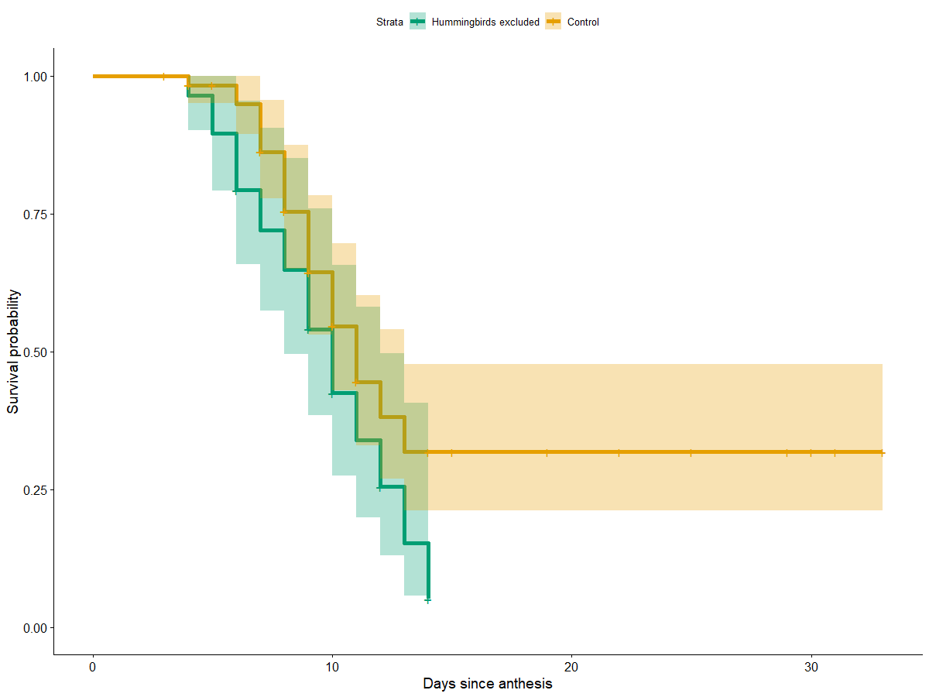
Hummingbirds excluded
Control
Survival probability
Time (days from anthesis)

