Slide 1

Automating the annotation and stacking of JV rasters
Mannfred Masahiro Asada Boehm
Impact Assessment Fellow
Boreal Avian Modelling Project, UofA

Slide 2
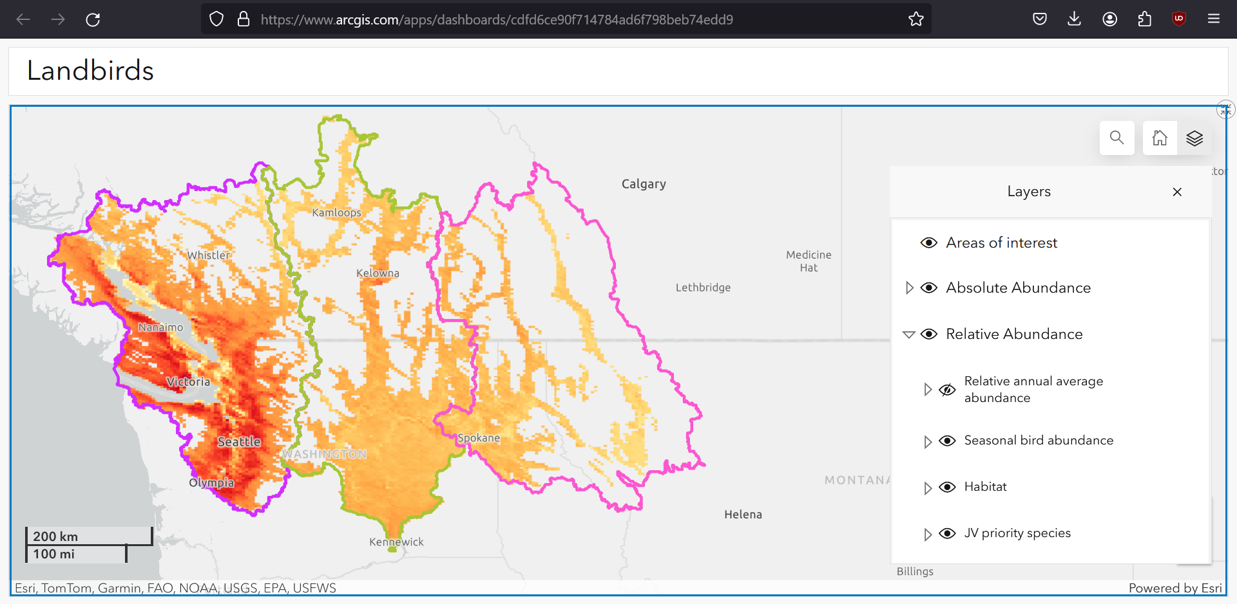
Problems:
(1) How can we efficiently attach ecological and management data to rasters scattered across multiple folders?
(2) How can we automate the sorting of these raster data by ecological or management variables of interest?
Lili Simon, Devin de Zwaan

Slide 3
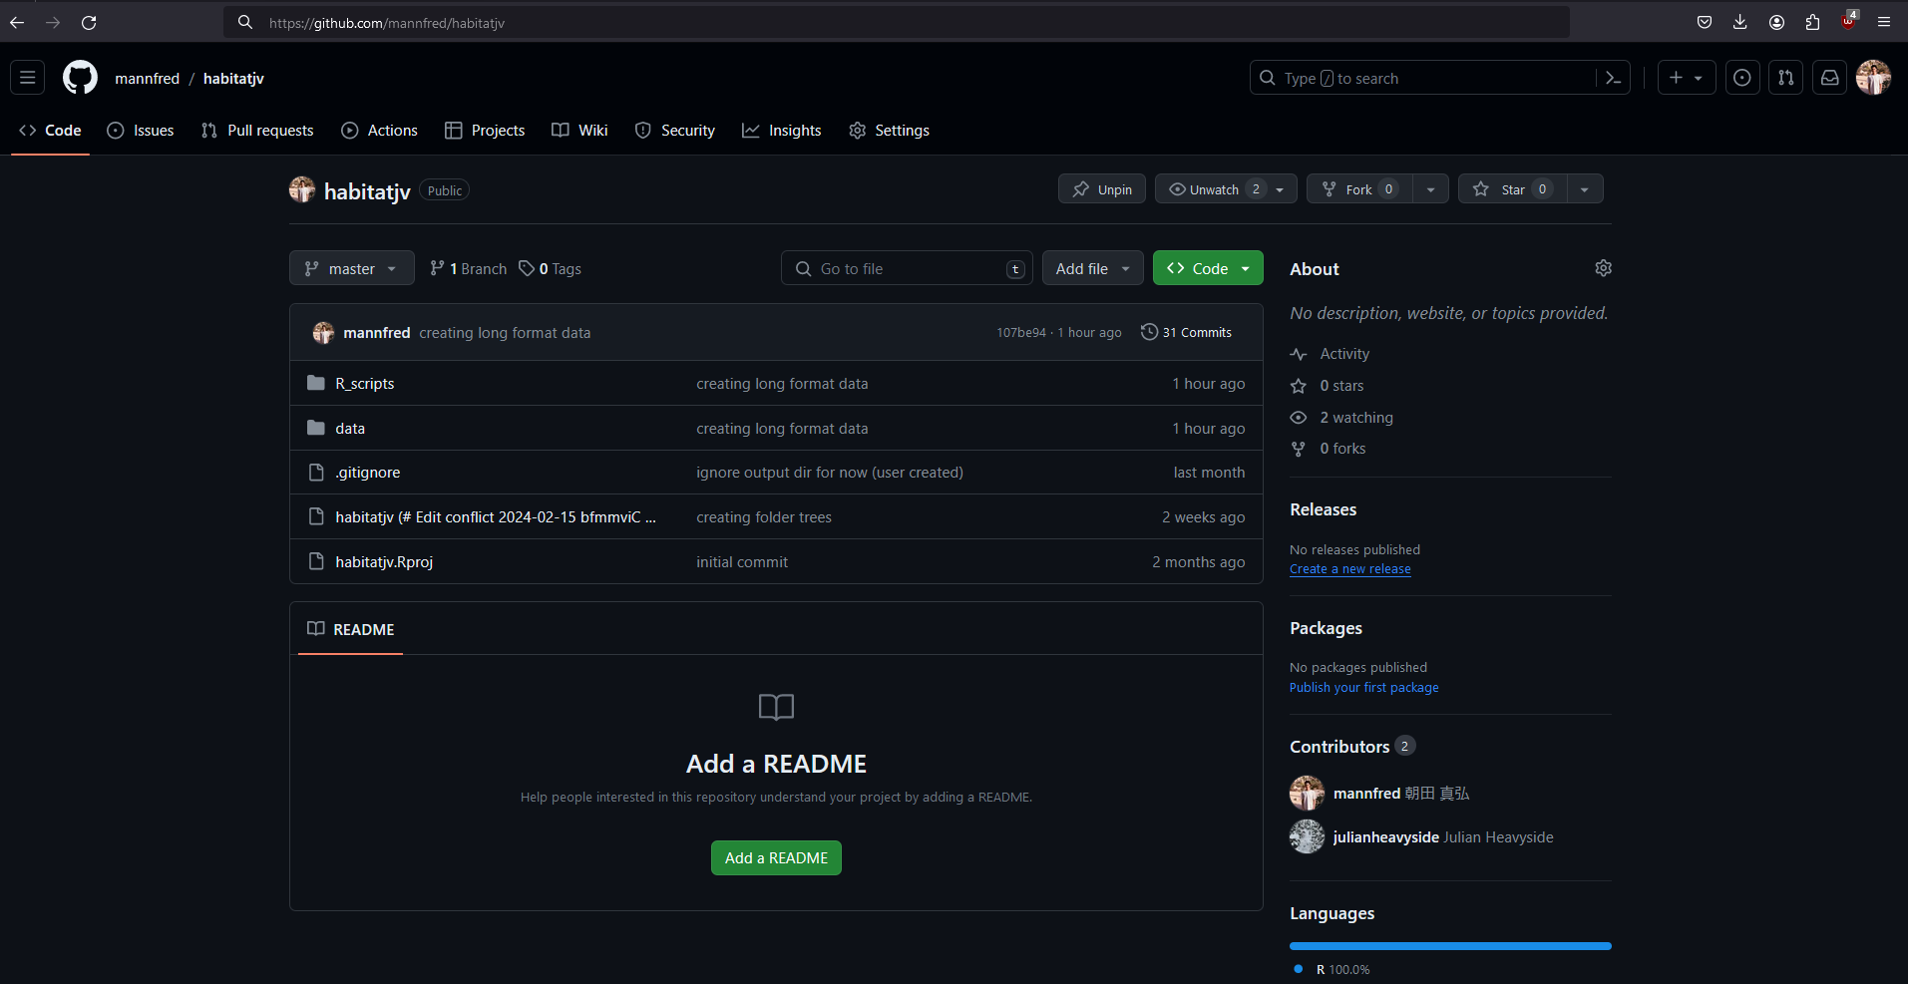
Problems:
(1) How can we efficiently attach ecological and management data to rasters scattered across multiple folders?
(2) How can we automate the sorting of these raster data by ecological or management variables of interest?
github.com/mannfred/habitatjv

Slide 4
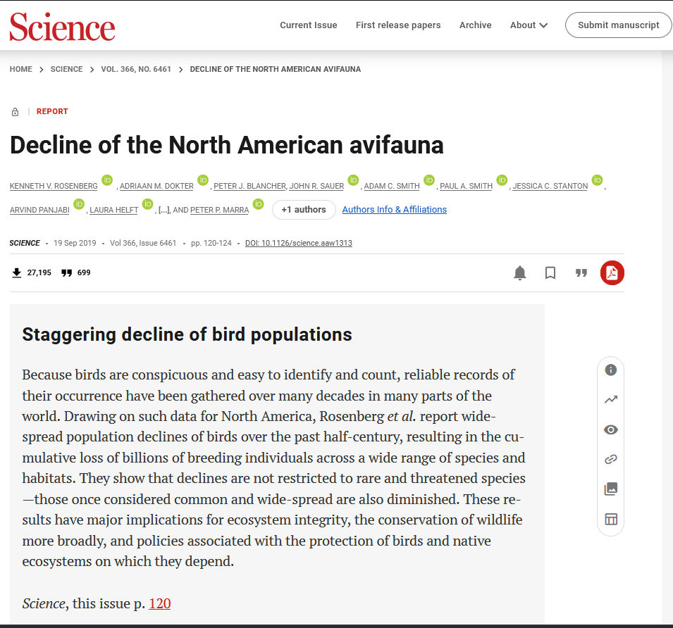
Problems:
(1) How can we efficiently attach ecological and management data to raster files scattered across multiple folders?
> sourcing ecological data from Rosenberg et al (2019) Science
> `joining` to JV abundance data

Slide 5
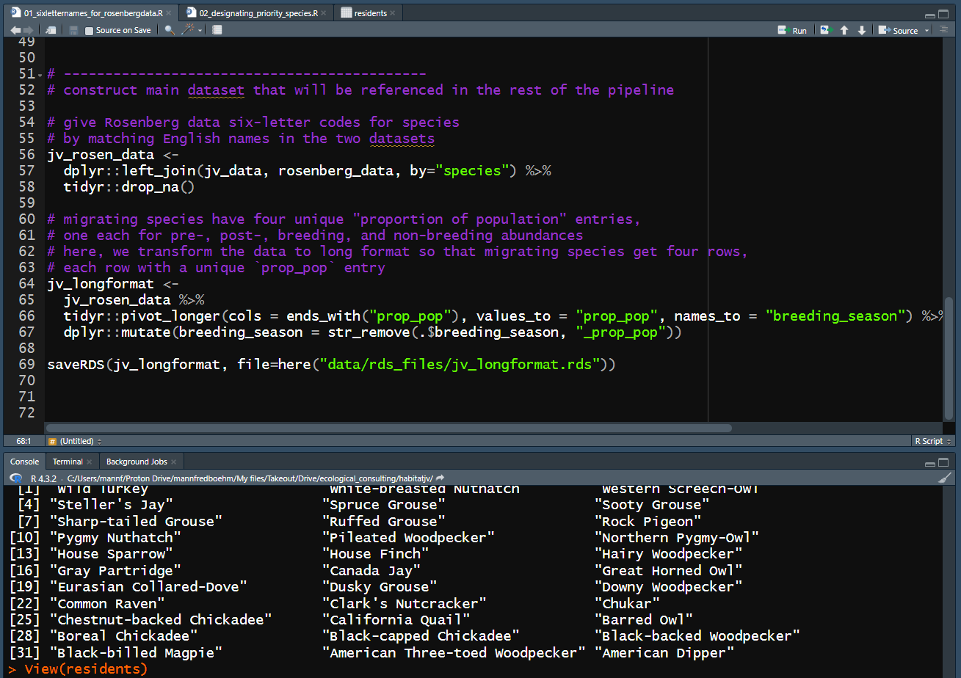
Problems:
(1) How can we efficiently attach ecological and management data to raster files scattered across multiple folders?
> generating a long format `data.frame` that treats breeding season as an observation of the smallest sampling unit (species)

Slide 6
Problems:
(1) How can we efficiently attach ecological and management data to raster files scattered across multiple folders?
> assigning stewardship responsibility (logical) to each observation (row) using a threshold of >0.90 proportion of global population

Slide 7
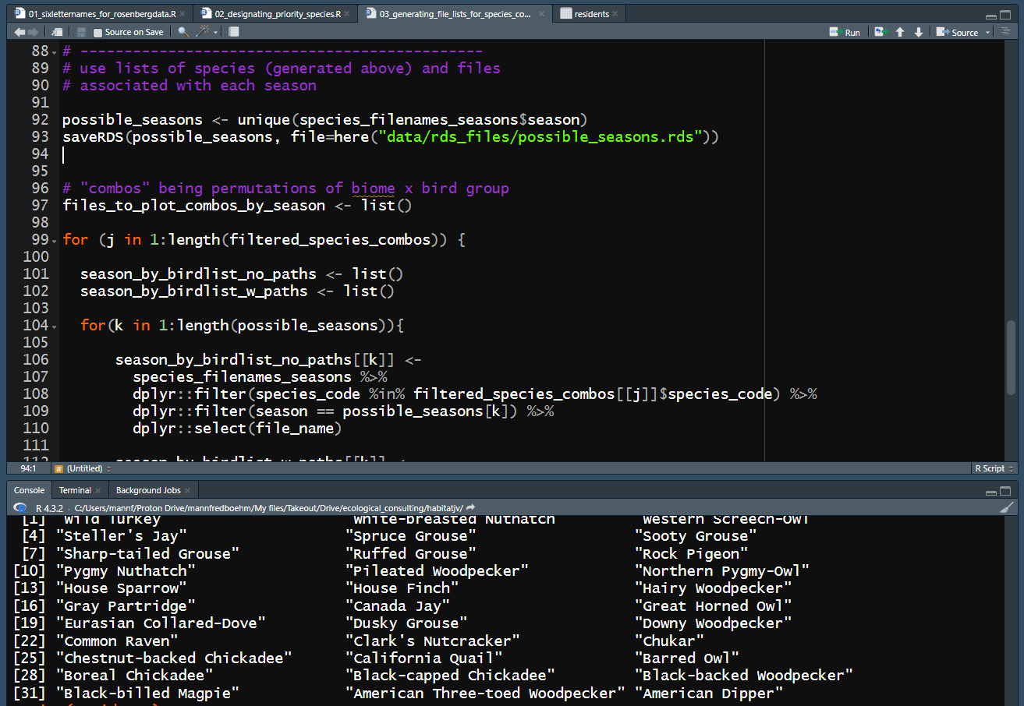
Problems:
(2) How can we automate the sorting of these raster data by ecological or management variables of interest?
> generating lists of file paths that capture every permutation of the variables of interest (breeding biome, bird group, stewardship responsibility, JV, etc.)

Slide 8
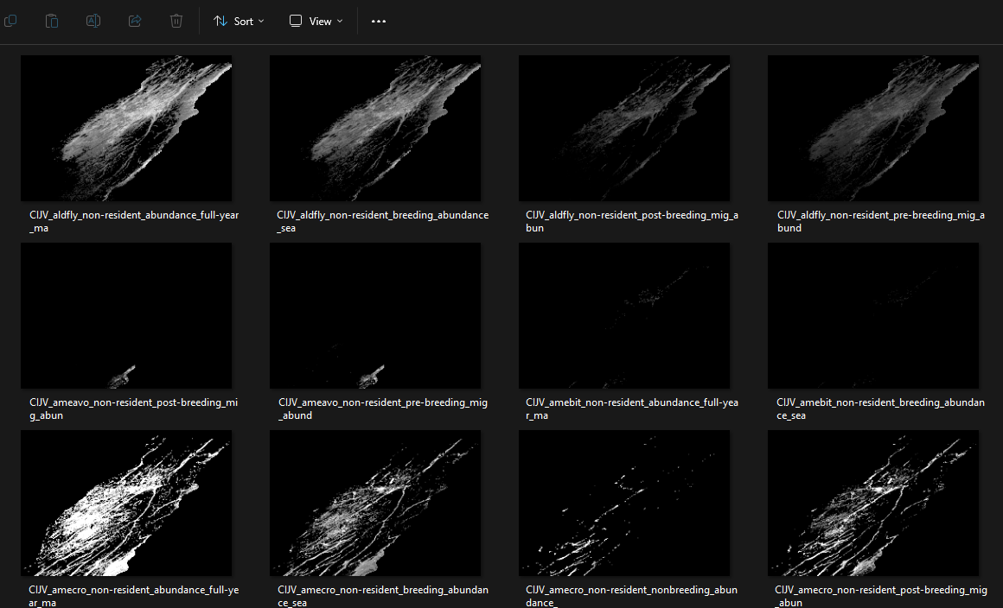
Problems:
(2) How can we automate the sorting of these raster data by ecological or management variables of interest?
> generating a local folder tree that can house the sorted data, and automating the copying of the right files to the right folders

Slide 9
Problems:
(2) How can we automate the sorting of these raster data by ecological or management variables of interest?
> `CIJV` &`Forest_Generalist` & `landbird`& `Resident` & `seasonal_mean`
> 7 spp: dowwoo, haiwoo, rufgro, whbnut, …
bkcchi
brdowl
wiltur

