Slide 1
Strategy
Dr. Koninika Mukherjee

Slide 2
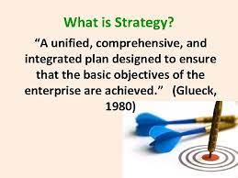

Slide 3
Strategic Management
The strategic management process of four phases:
i) Strategic Assessment
ii) Strategic Planning
iii) Strategy Implementation
iv) Performance Evaluation

Slide 4
Strategic Assessment
a. Anticipating Environmental Change: It makes clear why maintaining the status quo is not a viable option for the future.
Social: This covers the target clientele, their value systems, their aspiration levels, how they are organised, and the ‘power’ they can exercise over the decision making process.
Technical: This encompasses the technological developments which may require alteration or altogether abandonment of organisational objectives.

Slide 5
Strategic Assessment
Economic: This refers to changes in the economy generally but also to disparities in income, higher unemployment or diminishing resources.
Political: This includes international agreements, domestic legislation, political values etc.

Slide 6
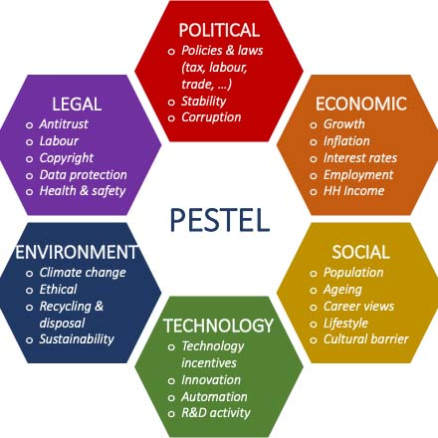

Slide 7
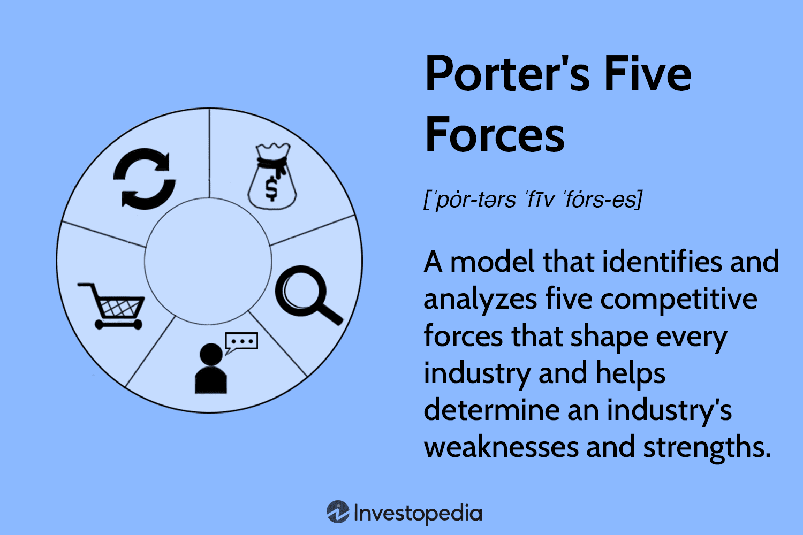

Slide 8
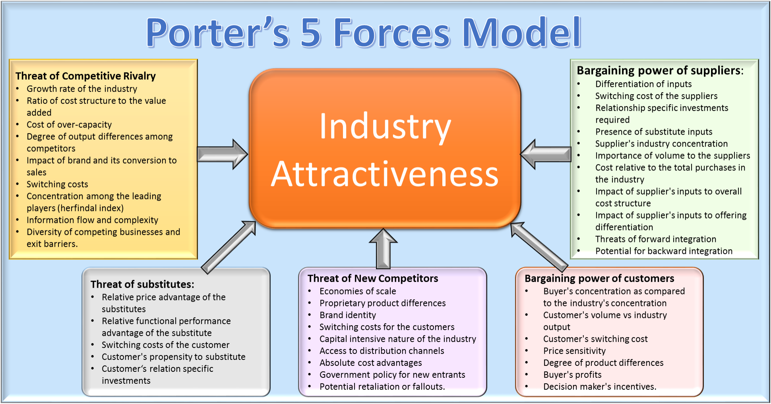

Slide 9
b. Strategic Analysis
The Strengths, Weaknesses, Opportunities and Threats (SWOT) analysis is a useful and powerful tool to analyse consequences of environmental change for the organisation. The role of SWOT analysis is to take the information from the environmental analysis and separate it into internal issues (strengths and weaknesses) and external issues (opportunities and threats).

Slide 10
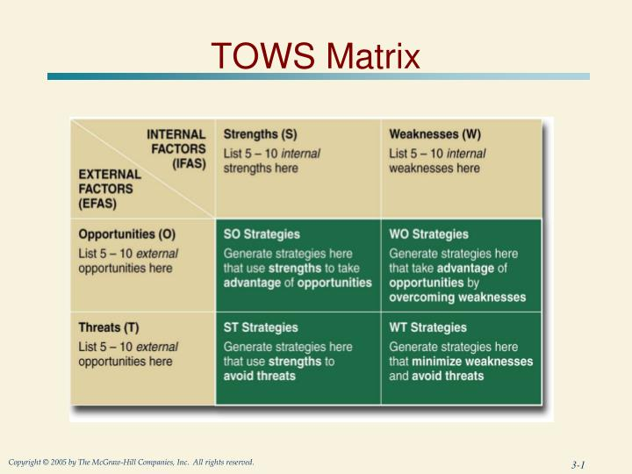

Slide 11
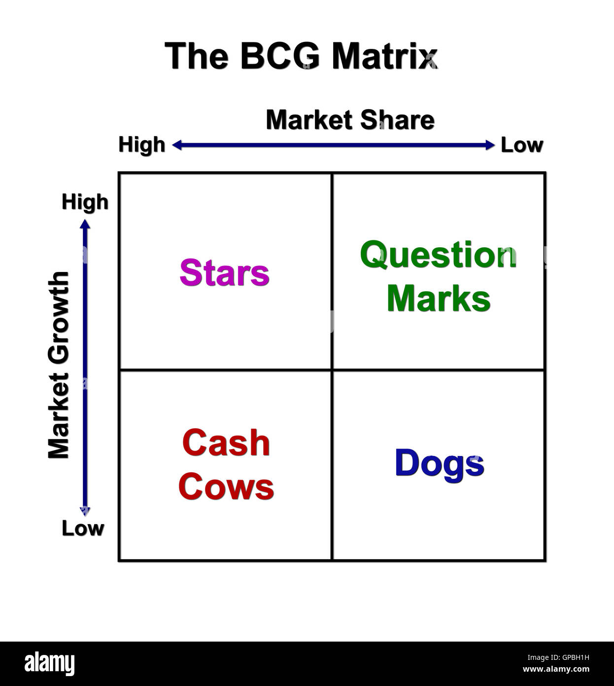

Slide 12
Strategic Assessment
c. Strategic Direction The information developed through techniques like SWOT is used to review the organisation's mission, set goals, develop strategic vision, and determine the most critical issues the organisation must address if it is going to achieve this vision. The objective of the strategic direction is to help ensure that the organisation's vision and goals:
are compatible with the organisation's capabilities and complement its culture,
foster commitment and cooperation among stakeholders; and
maximise the benefits inherent in environmental opportunities and minimise the risks inherent in environmental threats.

Slide 13
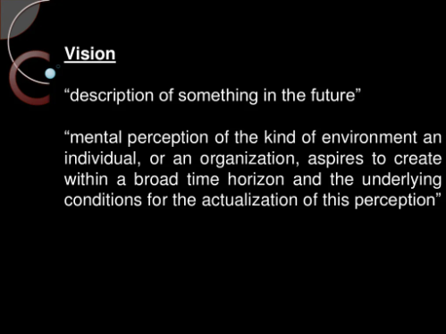

Slide 14
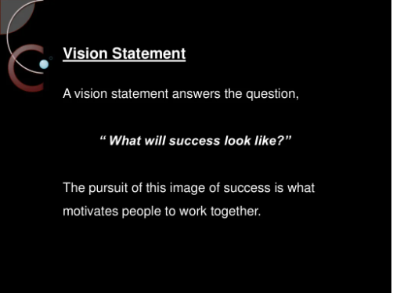

Slide 15
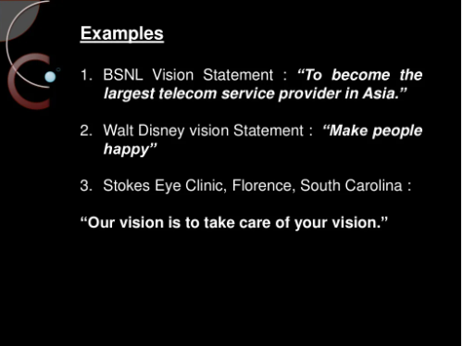

Slide 16
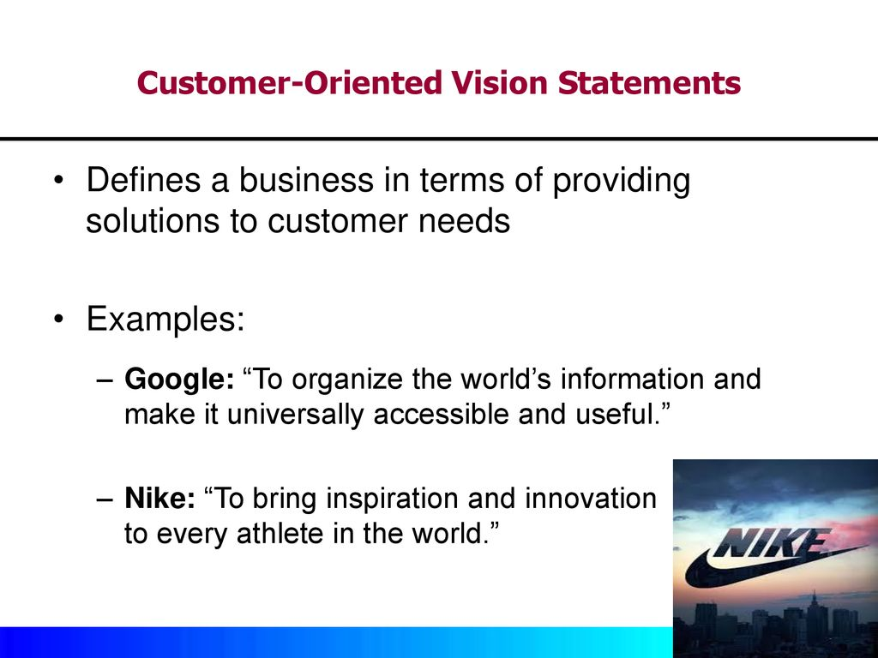

Slide 17
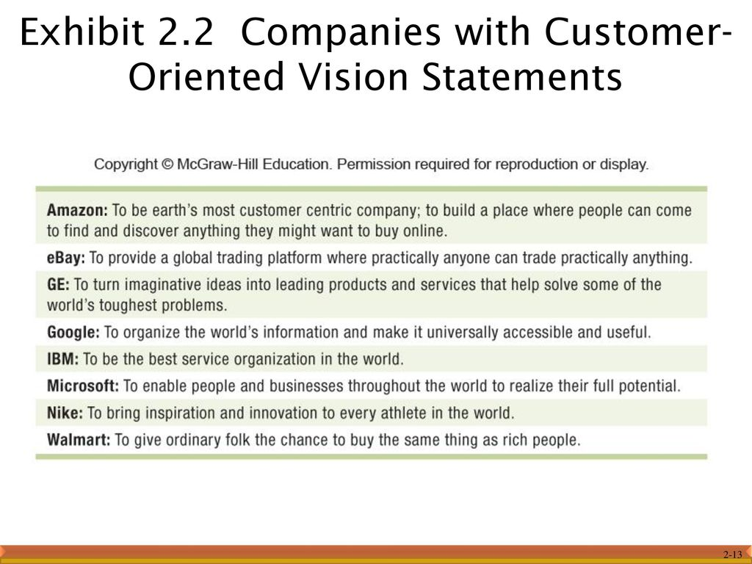

Slide 18
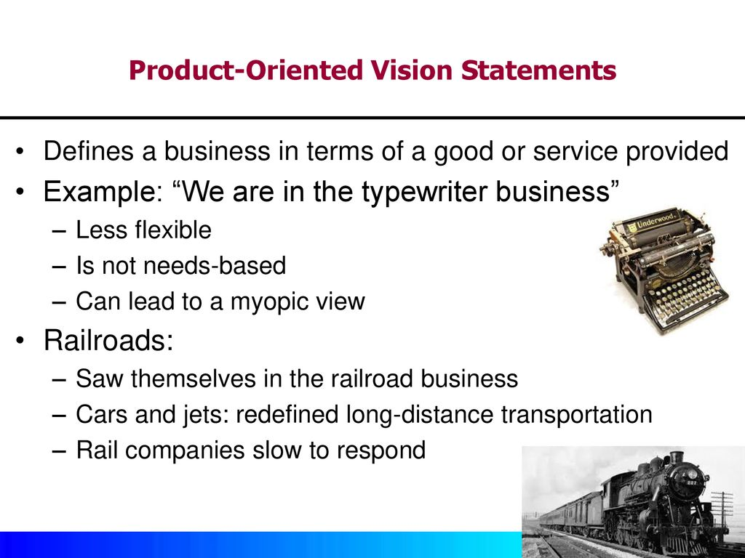

Slide 19
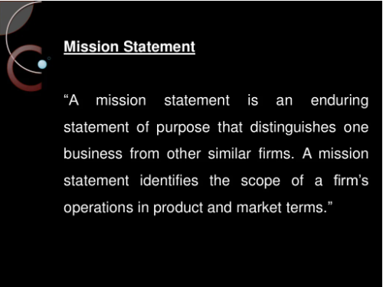

Slide 20
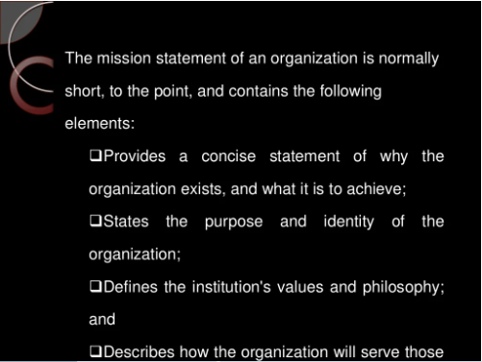

Slide 21
Mission Statement
The organization's objectives are identified and articulated in a mission statement.
The mission statement should be such that it clarifies:
the nature of the organization,
in what business the organization is,
what the long term and short term objectives
the methods to be adopted for achieving these objectives.
A mission statement is relevant for big as well as small organizations and for both profit making as well as non profit making organizations.

Slide 22
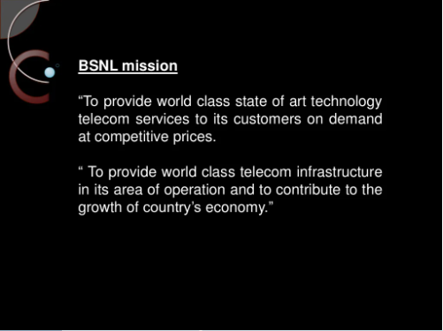

Slide 23
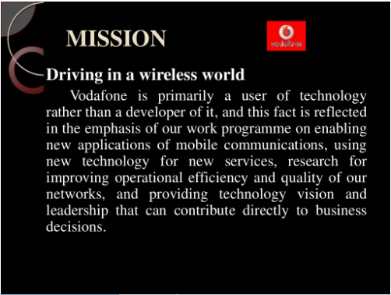

Slide 24
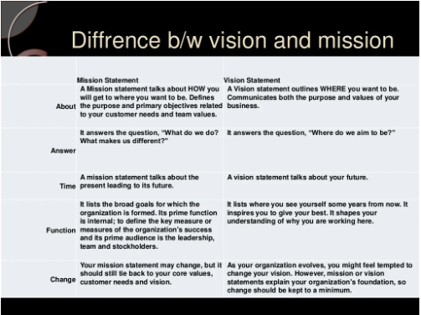

Slide 25
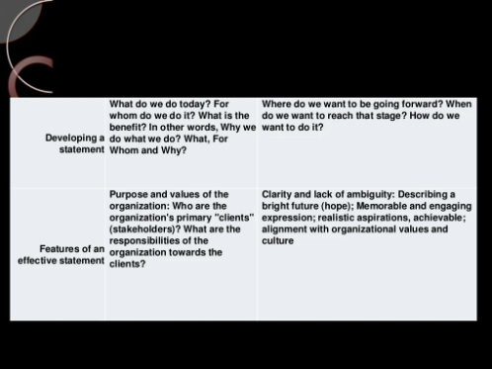
Differences between vision and mission

Slide 26
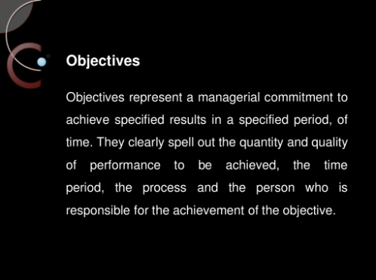

Slide 27
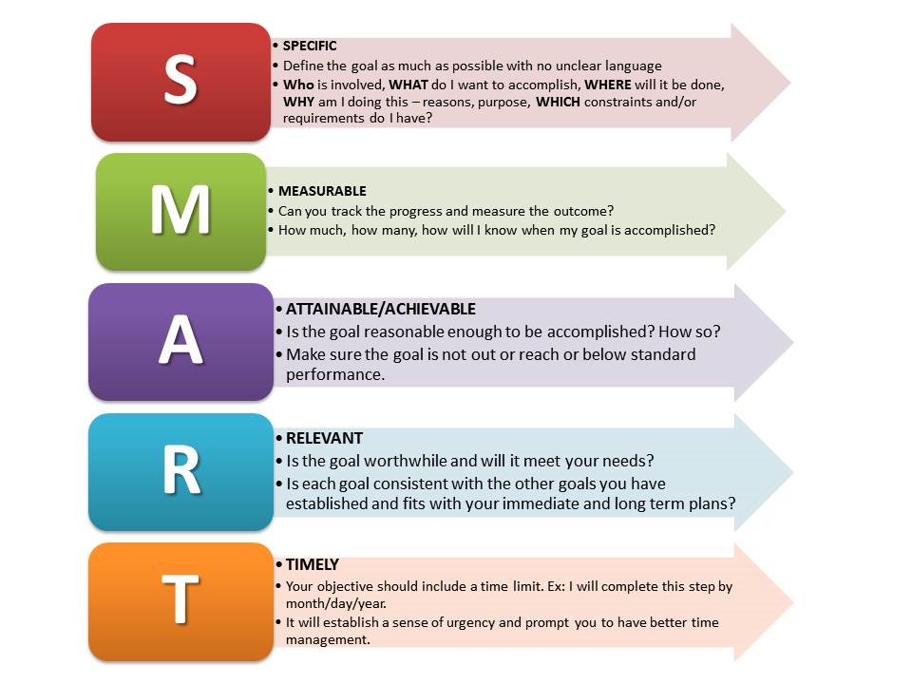
Characteristics of Objectives

Slide 28
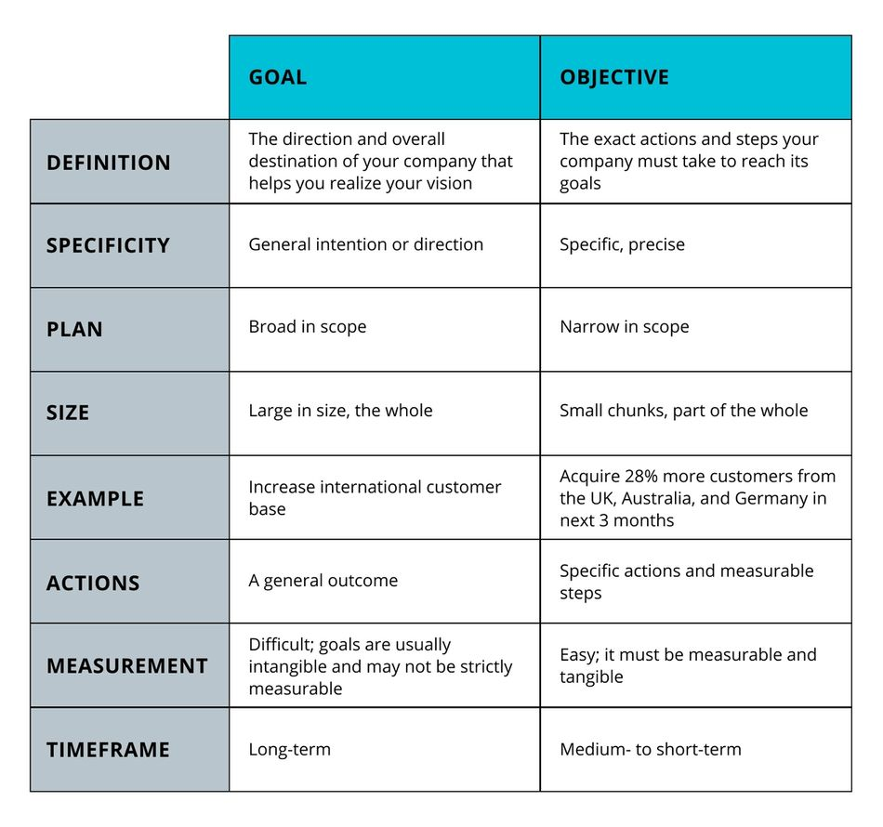
Differences between goals and objectives

Slide 29
Strategic Planning
It deals with creating range of scenarios to cover different situations in terms of favourability – an optimistic scenario, a pessimistic one and one in between these two. Probabilities of occurrence are assigned to each of them.
Contingency planning is another technique, which in a way supplements the scenario planning. It requires plans to be made for possible damaging combinations of events. For example, construction of nuclear power centres in seismic zones may require contingency plans to be included in case of a disaster.

Slide 30
Strategic Implementation
This involves executing the chosen strategy effectively and efficiently. It encompasses:
Allocation of sufficient resources- financial, personnel, infrastructure
Establishing a chain of command or structure to carry out tasks efficiently.
Assigning responsibility for specific tasks or processes to specific individuals or groups.
Managing the process, which includes monitoring results, comparing them with benchmarks and best practices, evaluating the efficacy and efficiency of the process, controlling for variances, and making adjustments to the process as necessary.

Slide 31
Performance Evaluation
Strategy formation and implementation is an on-going, never-ending, integrated process requiring continuous reassessment and reformation. Performance evaluation system compares actual results and desired results. This subsequently enables the strategists in modifying or introducing corrections in the plan, strategies, resources, and timing, as circumstances warrant.
A system is established to monitor use of resources by the organisation and its efficacy. The monitoring and reporting system is continuous, with periodic output reviewed by teams. However, major evaluations may be conducted on a rather long term basis.

Slide 32
