Slide 1


Management
Dr. Koninika Mukherjee

Slide 2
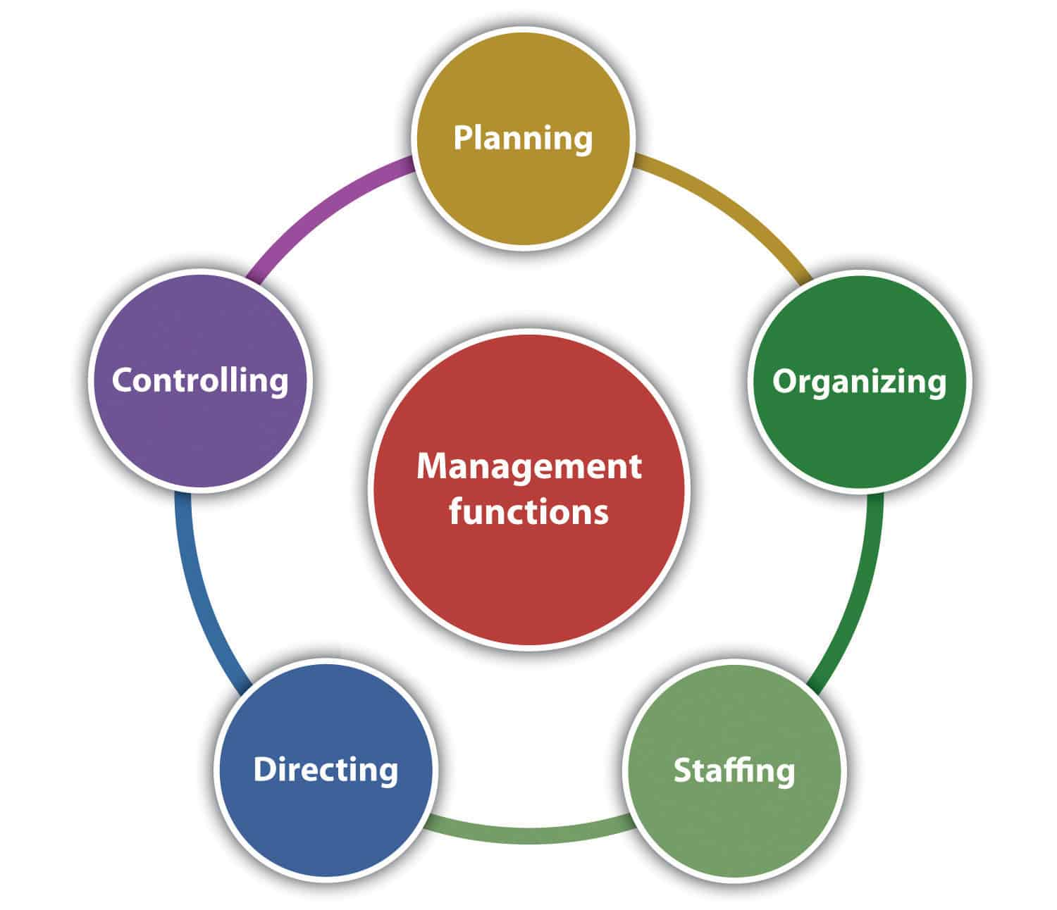

Slide 3
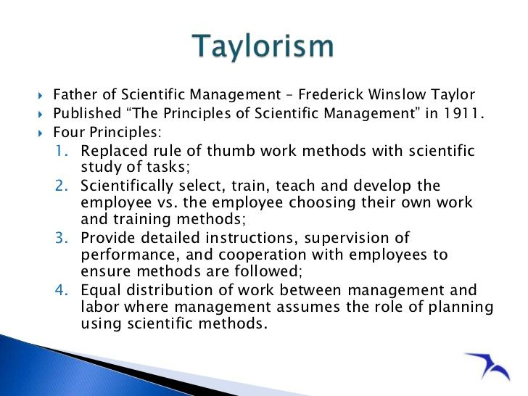

Slide 4
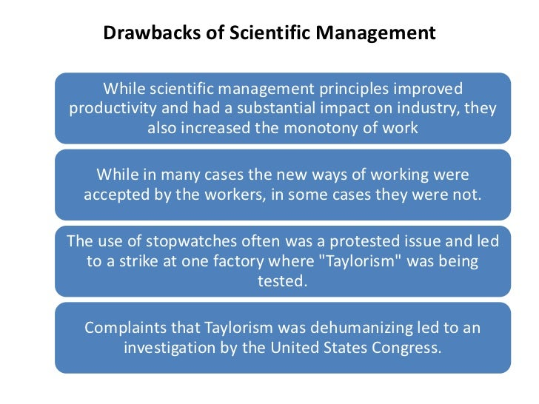

Slide 5
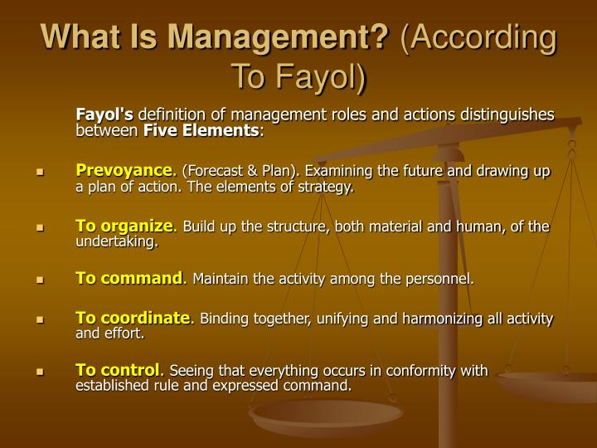

Slide 6
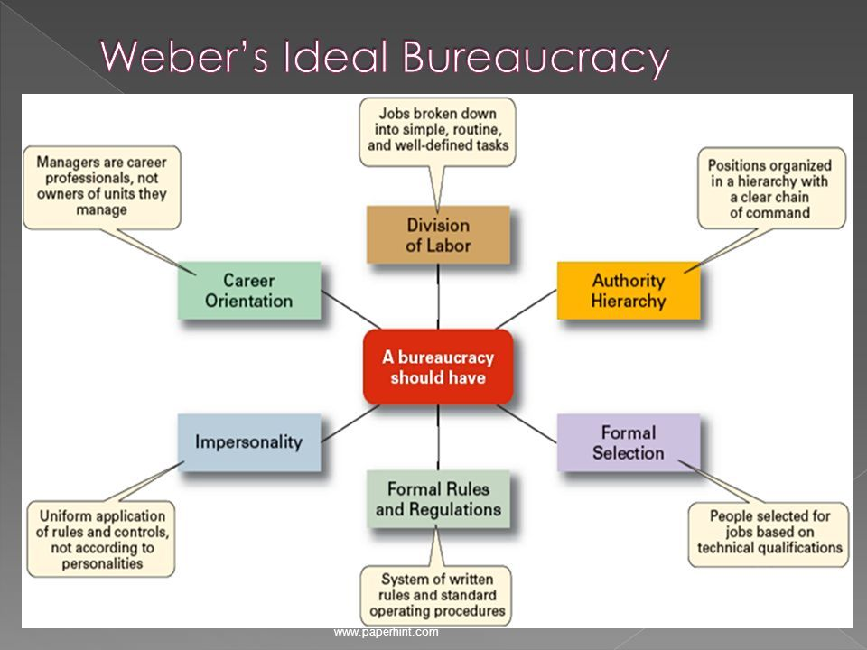

Slide 7
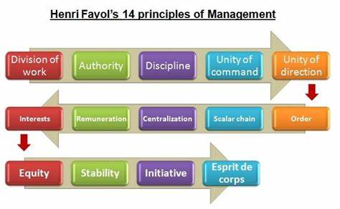

Slide 8
Principles of Management
Division of work : In any organised situation, work should be divided into compact jobs to be assigned to individuals. Division of labour facilitates specialisation and improves efficiency, if, it is done within reasonable limits.
Authority and responsibility : The authority of a manager should go hand in hand with the responsibility for effective results. In other words, there should be a parity or balance between authority and responsibility vested in a managerial position.
Discipline : Discipline defined as observance of diligence and respect, should be enforced throughout the organisation by managers as leaders of their work groups. Fayol declares that discipline requires good superiors at all levels. Fayol emphasised the need for discipline among the personnel for the smooth running of organisations and advocated penalties to prevent its violation.
Unity of command : This principle specifies that a subordinate in an organisation should be under the direct supervision of a single superior from whom he gets instructions and to whom he is accountable. In other words, every employee should have only one boss, otherwise, conflict and confusion in authority and instructions would result.

Slide 9
Principles of Management
Unity of direction : According to this principle, a set of activities having the same objective should be under the direction of a single manager. Similarly, there should t be only one plan of action for such a set of activities since the objective is the same.
Subordination of individual interest to central interest : The collective good and common interests of the organisation should prevail over the narrow sectional and self interest of its members.
Remuneration: Remuneration and the methods of payment in an organisation should be fair.
Centralisation : It refers to relative concentration of much authority in a manager at any managerial level but especially at the top managerial level. Decentralisation of authority refers to relative dispersal or devolution of authority among the various managerial levels and especially among the lower managerial levels to facilitate operational decision -making. There should be a proper combination and balance between centralisation and decentralisation in an organisation based on consideration of several internal and external factors.

Slide 10
Principles of Management
Hierarchy or scalar chain of command : Scalar chain implies authority relationships from the top to the lowest echelons of organisation. Authority relationships said to be scalar when subordinates report to their immediate superiors and when their superiors report directly, as subordinates, to their superiors (i.e. in 'scales').
Order : Order refers to a systematic arrangement of materials and placement of people in the organisation. In 'material order' everything should be in its proper place and there should be a place for everything. For 'social order' there should be a place assigned to each employee, and each employee should be in the place assigned.
Equity : Equity in this context refers to fair treatment to all workers in an organisation so that it promotes a friendly atmosphere between superiors and subordinates.
Stability of tenure of personnel : Organisations should make efforts to achieve relative stability and continuity of tenure of their personnel. This could be achieved by attractive remuneration and honourable treatment of personnel.
Initiative : An organisation should encourage desire initiative among its managers and employees by extending opportunities and freedom to contribute their best.
Esprit de corps : This is the principle that 'in union there is a strength', or 'team spirit'. The principle stresses the need for team spirit, cordial relations and a cooperation among the personnel.

Slide 11


Slide 12


Slide 13
