Slide 1
SongAtlas
By Christopher Clark & Christopher Manning

Slide 2
About the Project
Our project that we are calling SongAtlas is a platform for integrating multiple different music outlets (Spotify, SoundCloud, Last.fm, etc.) and combining them into a single central location for users to look up and find their favorite songs and the location there are in.
Our back-end is in SQL while our front-end is a combination of HTML and CSS. To connect the database to our front-end site, we are using client and server-side JavaScript with HTTP requests.

Slide 3
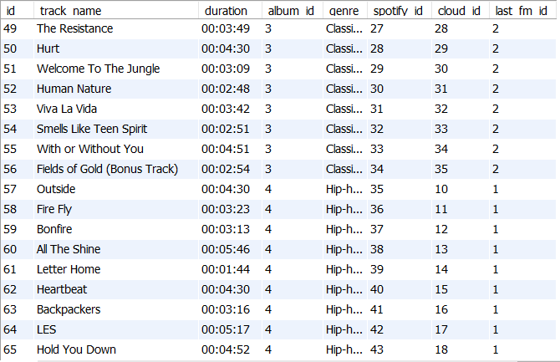
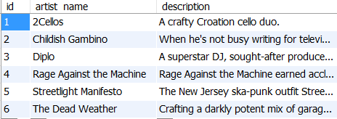
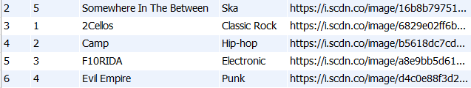
Data Tables
The tables we are using are: Tracks, Albums, Artists, and then tables for each music source, which currently is just Spotify, SoundCloud, and Last.fm
We also are including a separate table for User Submitted music. The purpose of this is to allow content to be added from sources that we currently using.

Slide 4
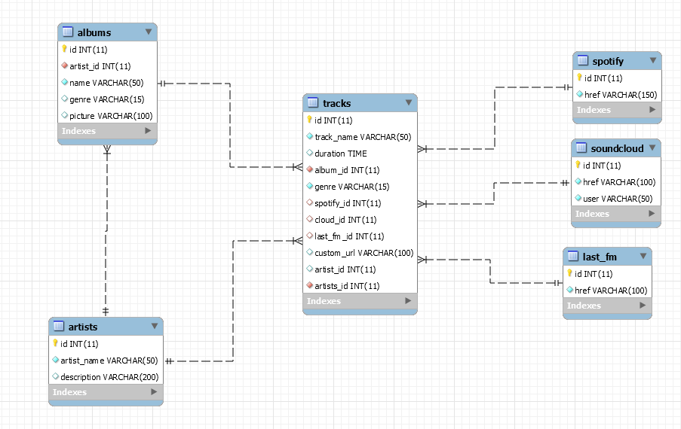
Database Architecture/EER Model

Slide 5
Short Demonstration
Thanks!

