Slide 1
SongAtlas
By Christopher Clark & Christopher Manning

Slide 2
About the Project
Our project that we are calling SongAtlas is a platform for integrating multiple different music outlets (Spotify, SoundCloud, Last.fm, etc.) and combining them into a single central location for users to look up and find their favorite songs and the location there are in.
Our back-end is in SQL while our front-end is a combination of HTML and CSS. To connect the database to our front-end site, we are using PHP.

Slide 3
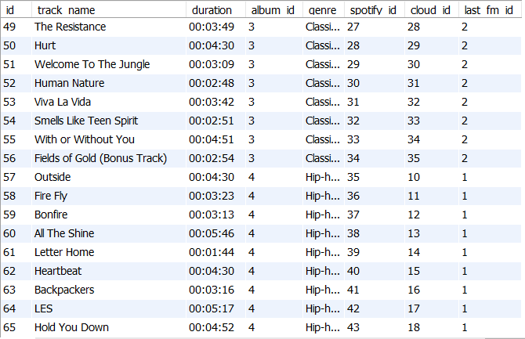
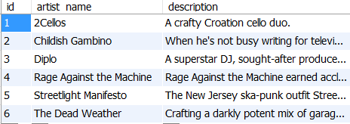
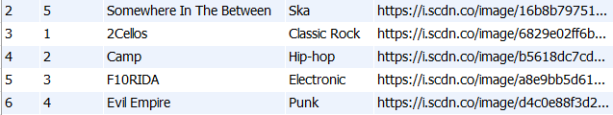
Data Tables
The tables we are using are: Tracks, Albums, Artists, and then tables for each music source, which currently is just Spotify, SoundCloud, and Last.fm.
For editing the data, it’s required through an admin page in order to make sure no extraneous data is created or deleted.

Slide 4
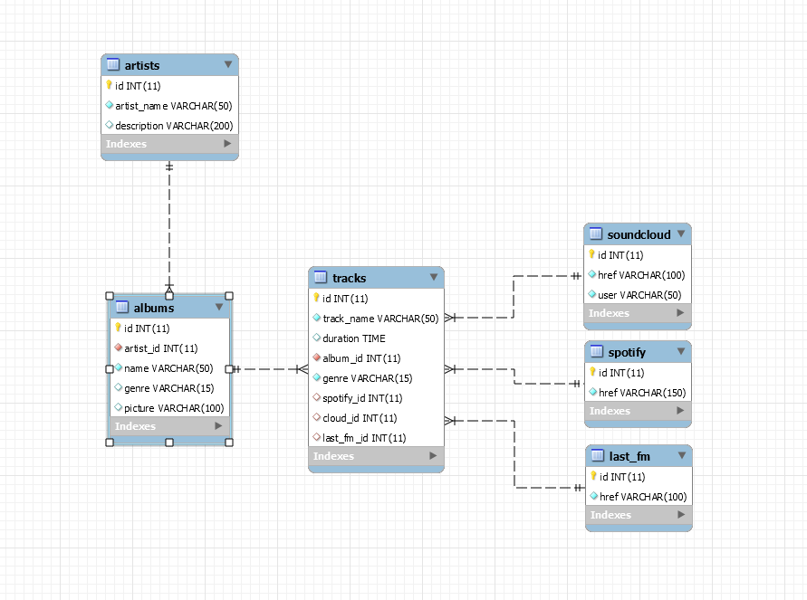
Database Architecture/EER Diagram

Slide 5
Short Demonstration
Thank you!

