Slide 1
Brew Buddy
Group 2:
Madison Gage
Andrew Howard
James Revette

Slide 2
What’s the issue?
Most consumer grade coffee heaters aren’t reliable and have:
Inconsistent Temperature Control
Limited Customization
Energy Wastage
Safety Risks

Slide 3
What is BrewBuddy?
The BrewBuddy is an advanced smart coffee heater designed to provide:
Precise Temperature Control
Customizable Settings
Real-Time Temperature Monitoring
Safety Features

Slide 4
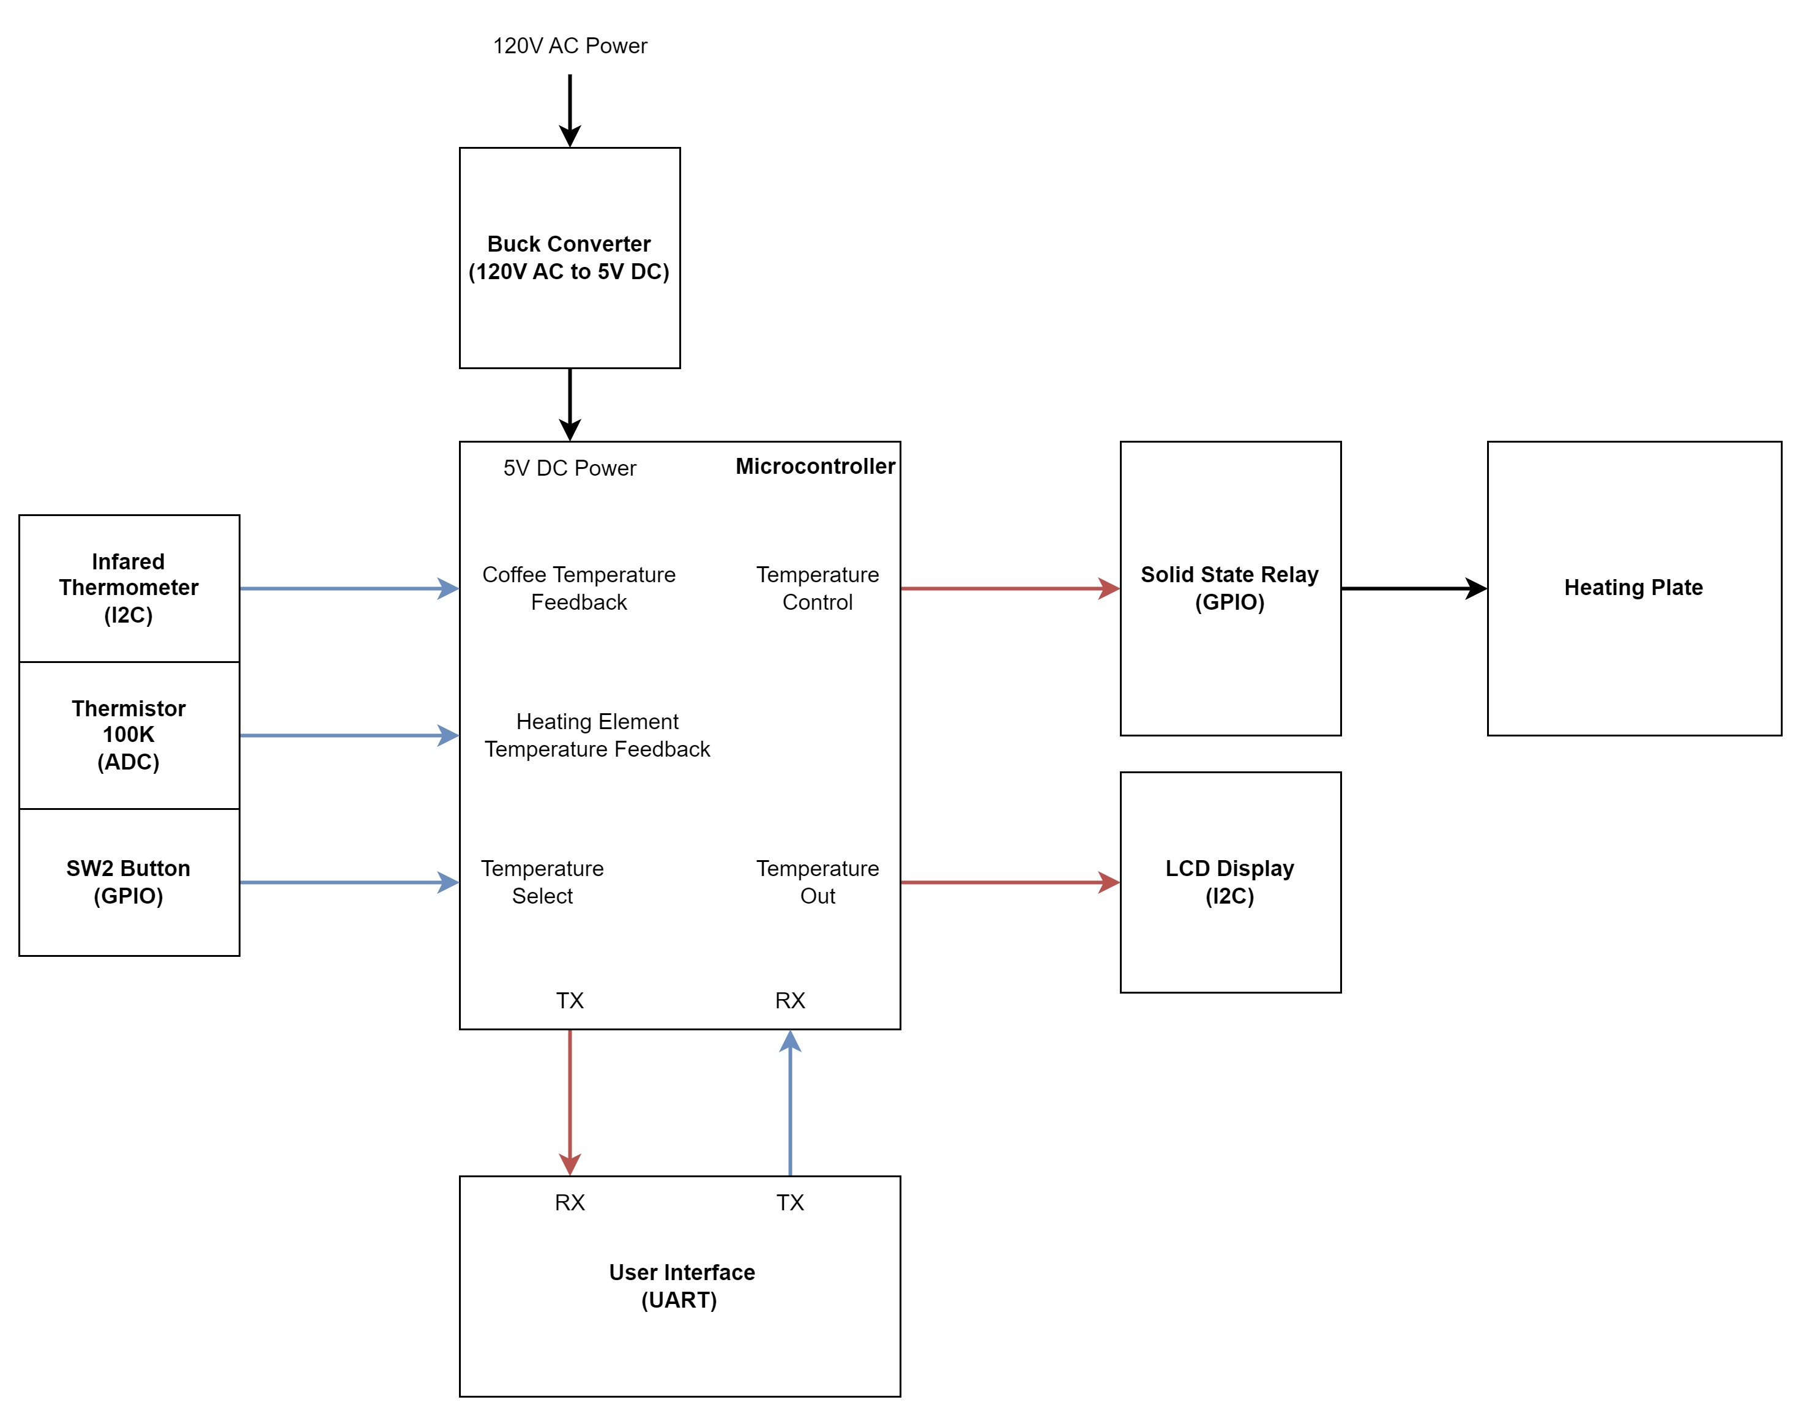

Slide 5
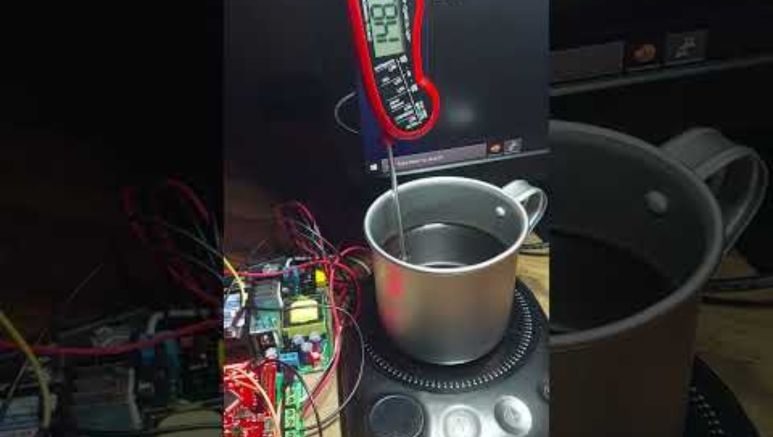

Slide 6
Questions?

Slide 7
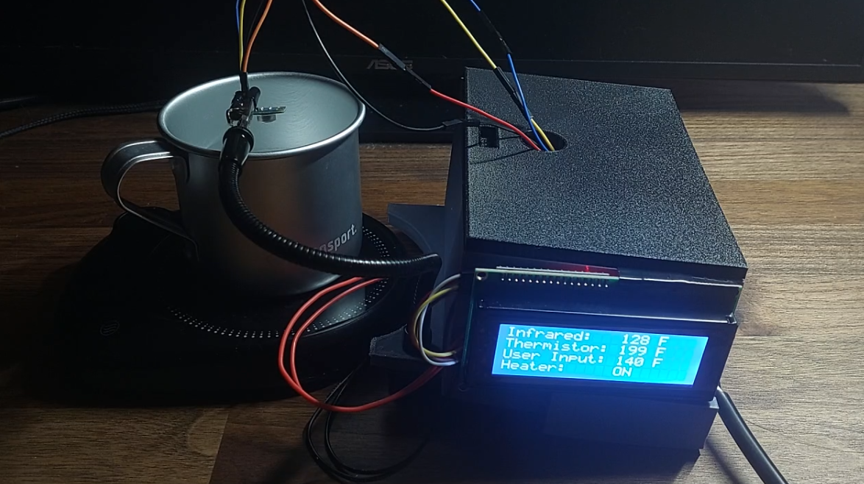

Slide 8
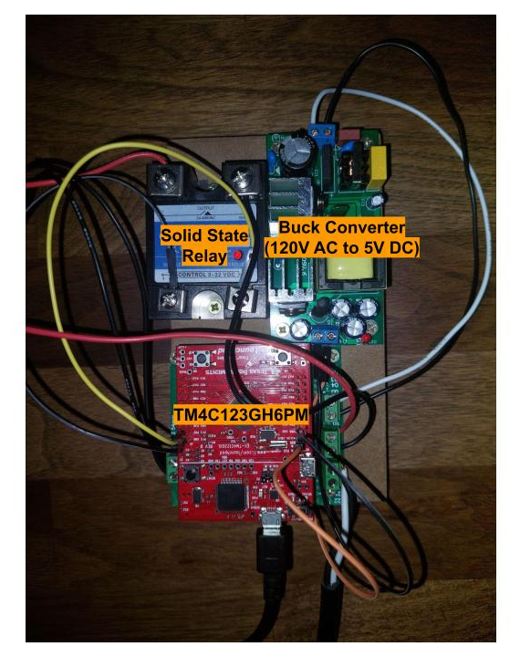

Slide 10
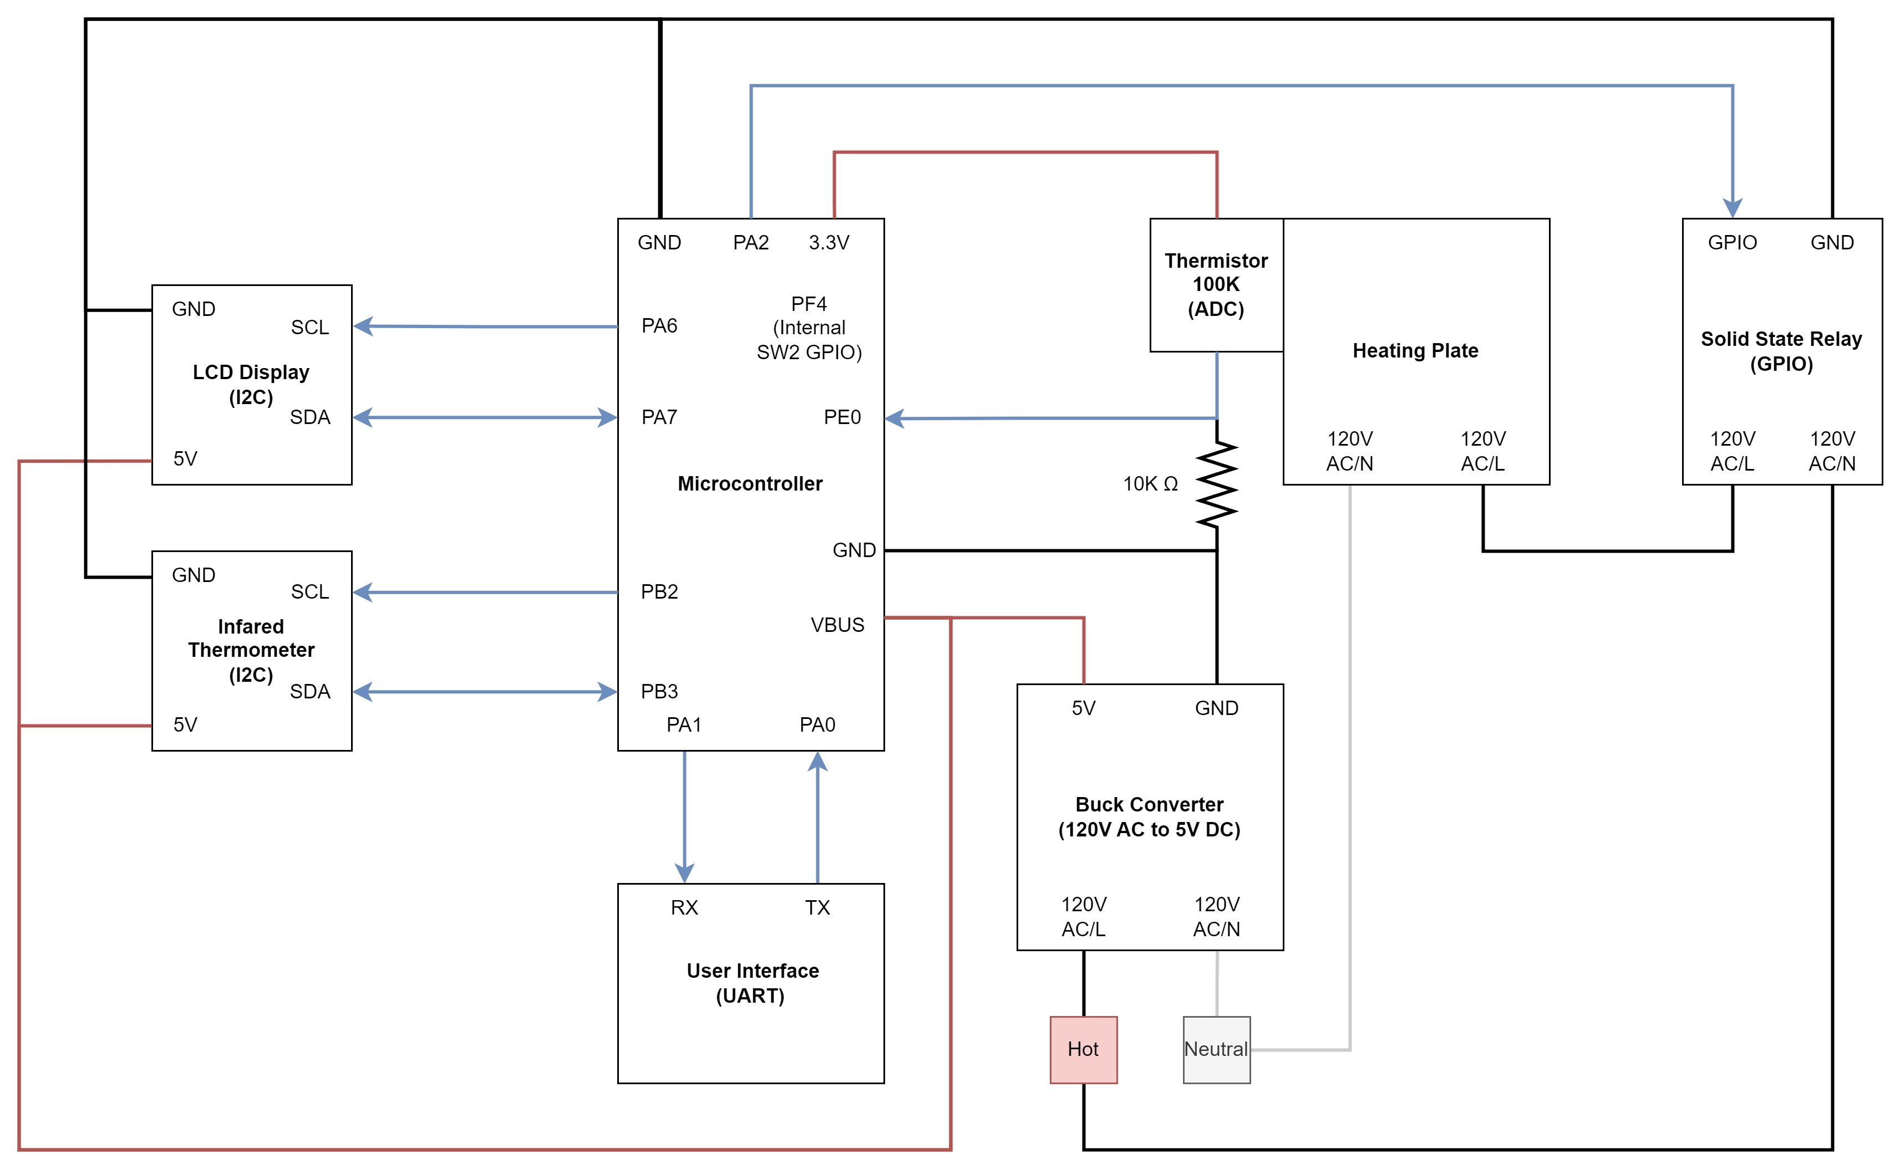

Slide 11
