Slide 1
Brew Buddy
Group 2:
Madison Gage
Andrew Howard
James Revette

Slide 2
What’s the issue?
Most consumer grade coffee heaters aren’t reliable and have:
Inconsistent Temperature Control
Limited Customization
Energy Wastage
Safety Risks

Slide 3
What is BrewBuddy?
The BrewBuddy is an advanced smart coffee heater designed to provide:
Precise Temperature Control
Customizable Settings
Real-Time Temperature Monitoring
Safety Features

Slide 4
System Design and Architecture
System Functionality
Measure the coffee’s temperature using an infared thermometer.
Display the temperature of the coffee with an LCD display.
Heat the coffee to a user-specified temperature via a heating plate controlled by a solid state relay.
Key Features
User Configurability: Temperature can be set in increments of 10 by holding a push button or precise increments over UART.
Safety Mechanism: A thermistor-based temperature monitor ensures that the heating plate doesn’t exceed safe operating limits, triggering a safety shutdown if necessary.
Energy Efficiency: The heater only activates when coffee is detected and the temperature is below the desired threshold, minimizing power usage.

Slide 5
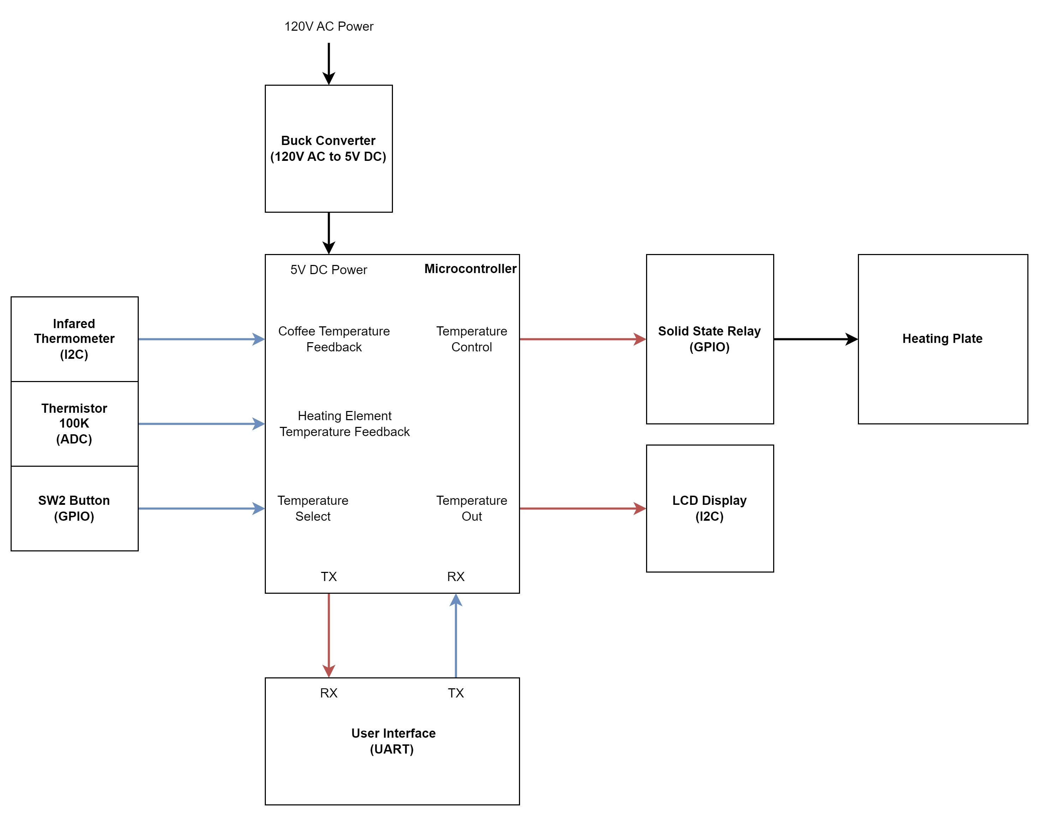

Slide 6
Implementation
Temperature Monitoring Subsystem: An infrared thermometer measures the coffee’s surface temperature and communicates readings to the microcontroller via the I2C interface. A 100K thermistor, integrated into a voltage divider circuit, monitors the heating plate’s temperature for safety.
Heating Subsystem: A solid-state relay (SSR) connects the microcontroller to the 120V AC heating plate. The SSR ensures safe and efficient switching of high voltage, controlled via GPIO signals.
User Interface Subsystem: An I2C-connected LCD displays real-time temperature readings and system status. A GPIO button allows users to configure desired temperature settings.
Power Supply Subsystem: A 120V to 5V DC buck converter powers the microcontroller and peripherals. This ensures stable operation across all components.

Slide 7
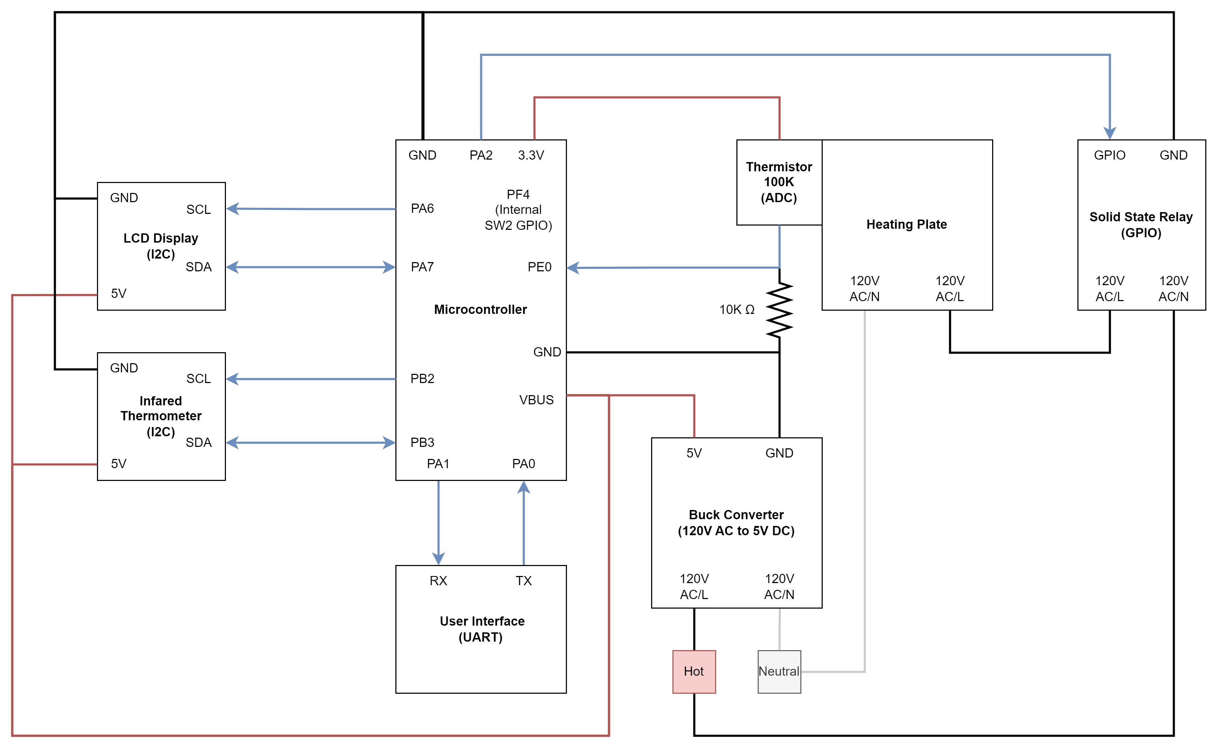

Slide 8
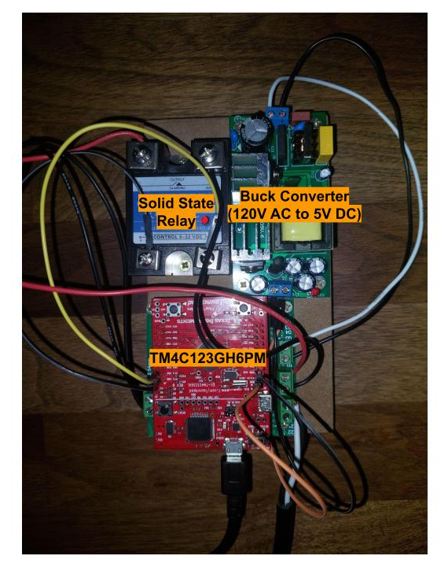

Slide 9
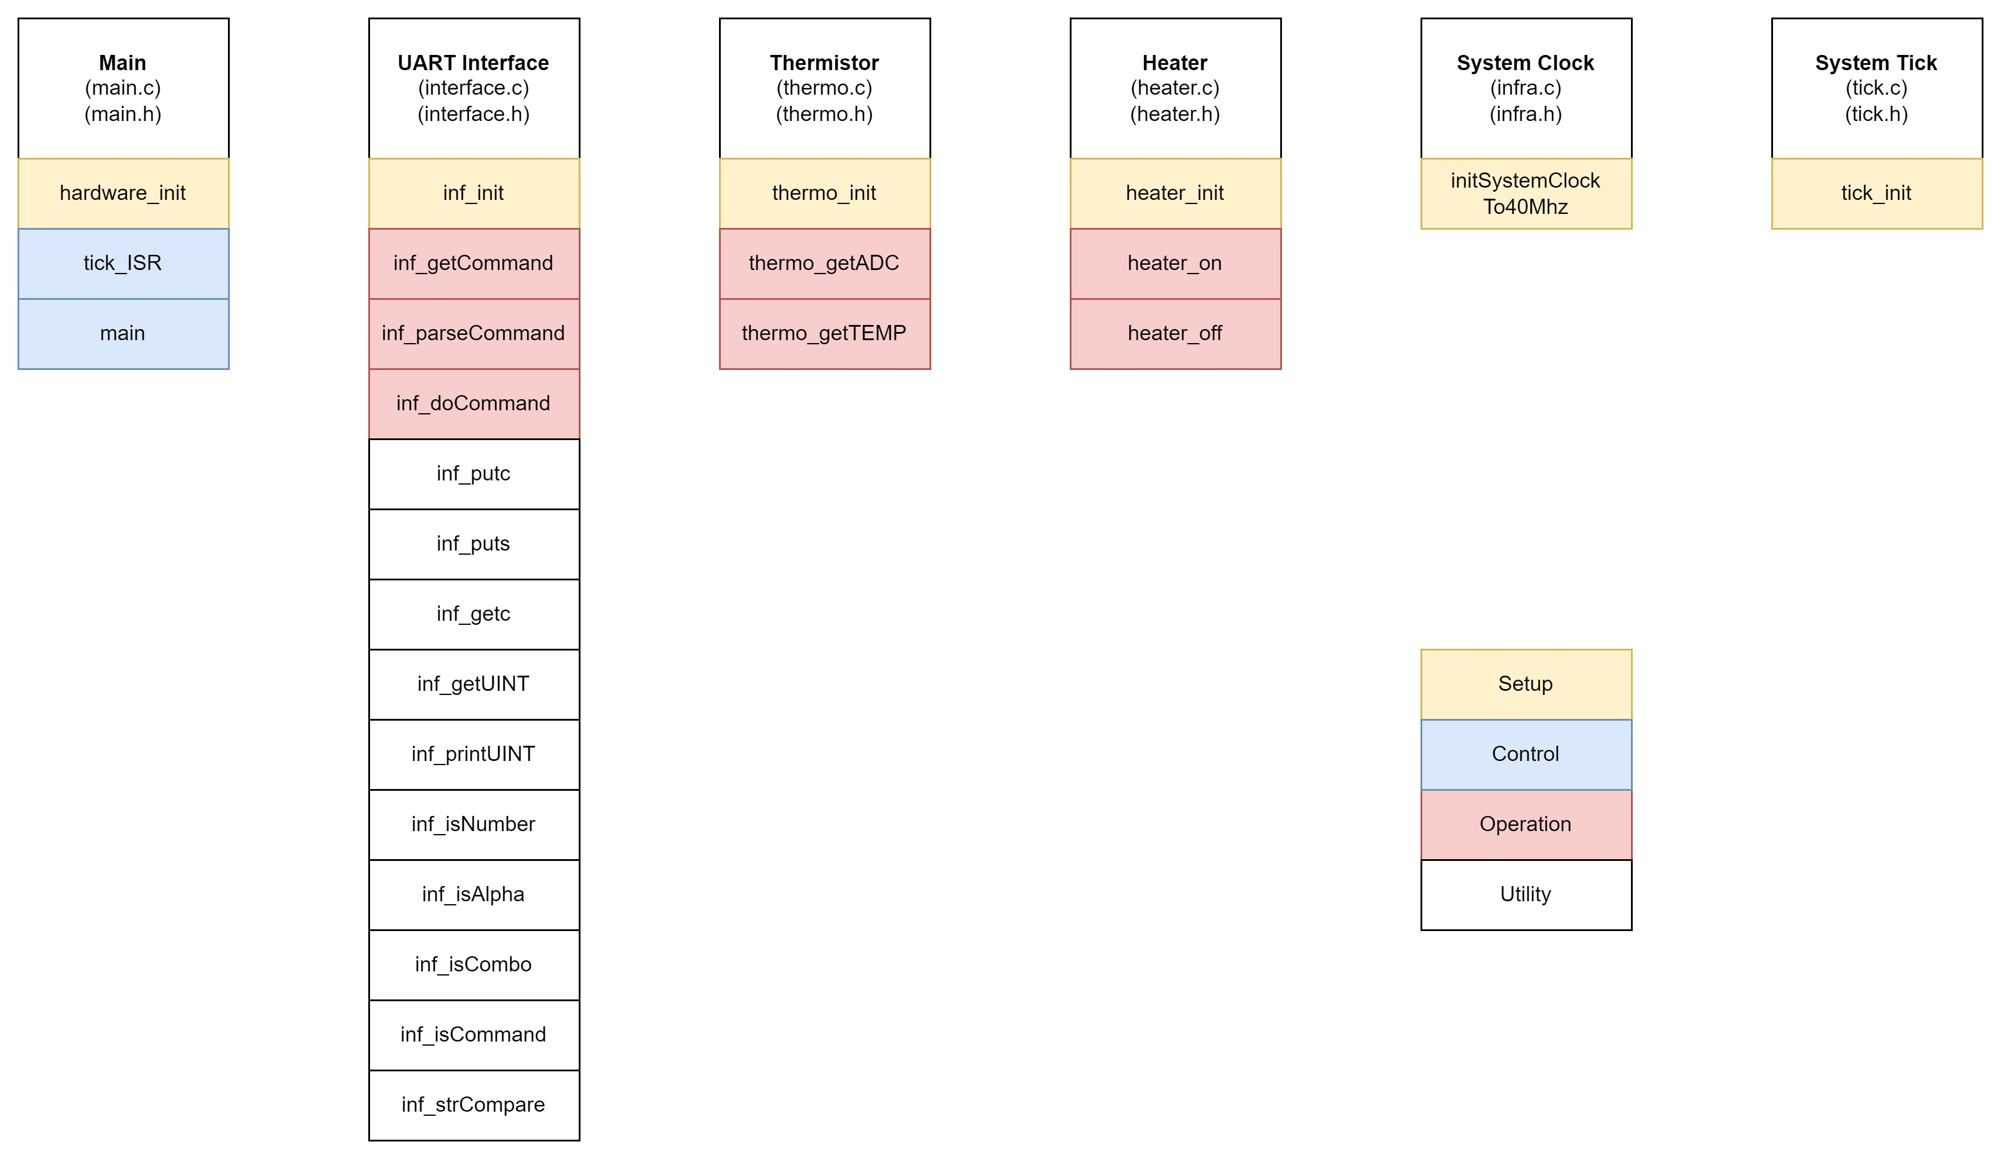

Slide 10
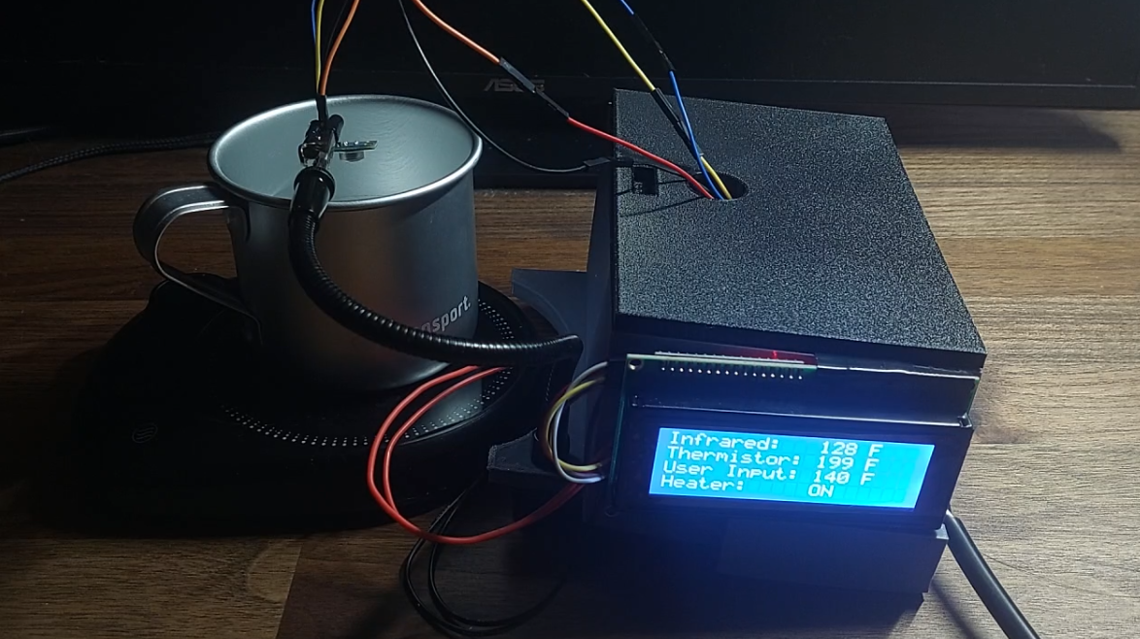

Slide 11
Questions?

