Slide 1
Brew Buddy Week 1
Madison Gage
Andrew Howard
James Revette

Slide 2
Main Objectives
Setup Program Class Hierarchy
Implement UART
Start Circuit Design
Research PTC Heating Switch Solutions

Slide 3
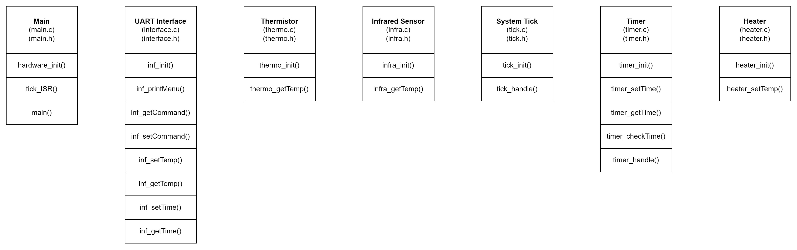
Setup Program Class Hierarchy

Slide 4
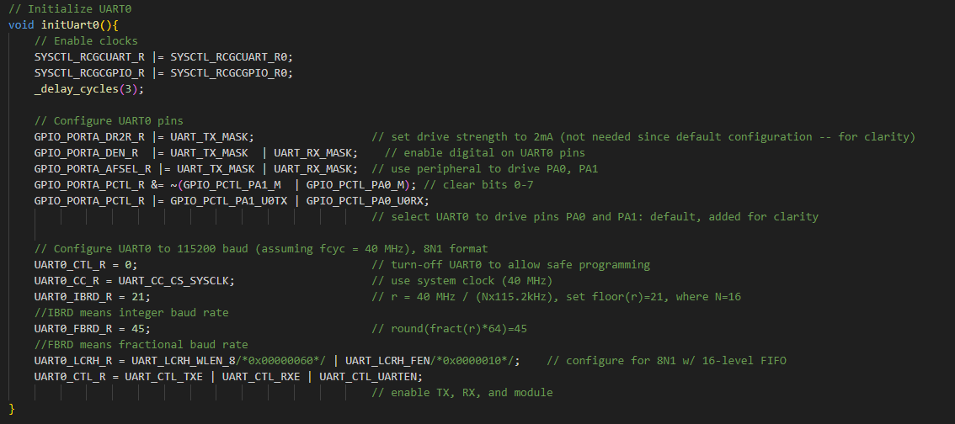
Implement UART

Slide 5
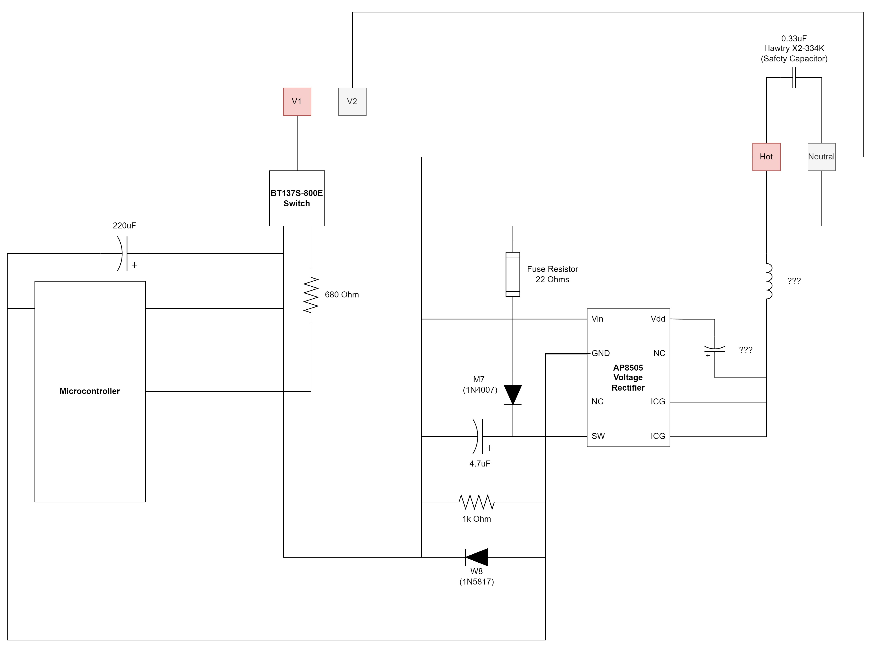
Start Circuit Design

Slide 6
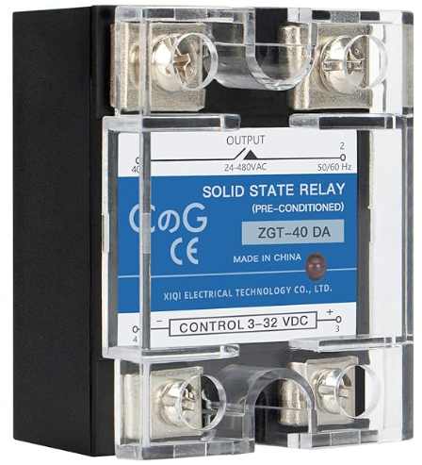
Research PTC Heating Switch Solutions

