Slide 1

Customer Shopping Behavior Analysis
Retail Customer Insights using Python, SQL & Power BI
DATA SOURCE: CUSTOMER_SHOPPING_BEHAVIOR.CSV · 3,900 RECORDS · 18 ATTRIBUTES

Slide 2
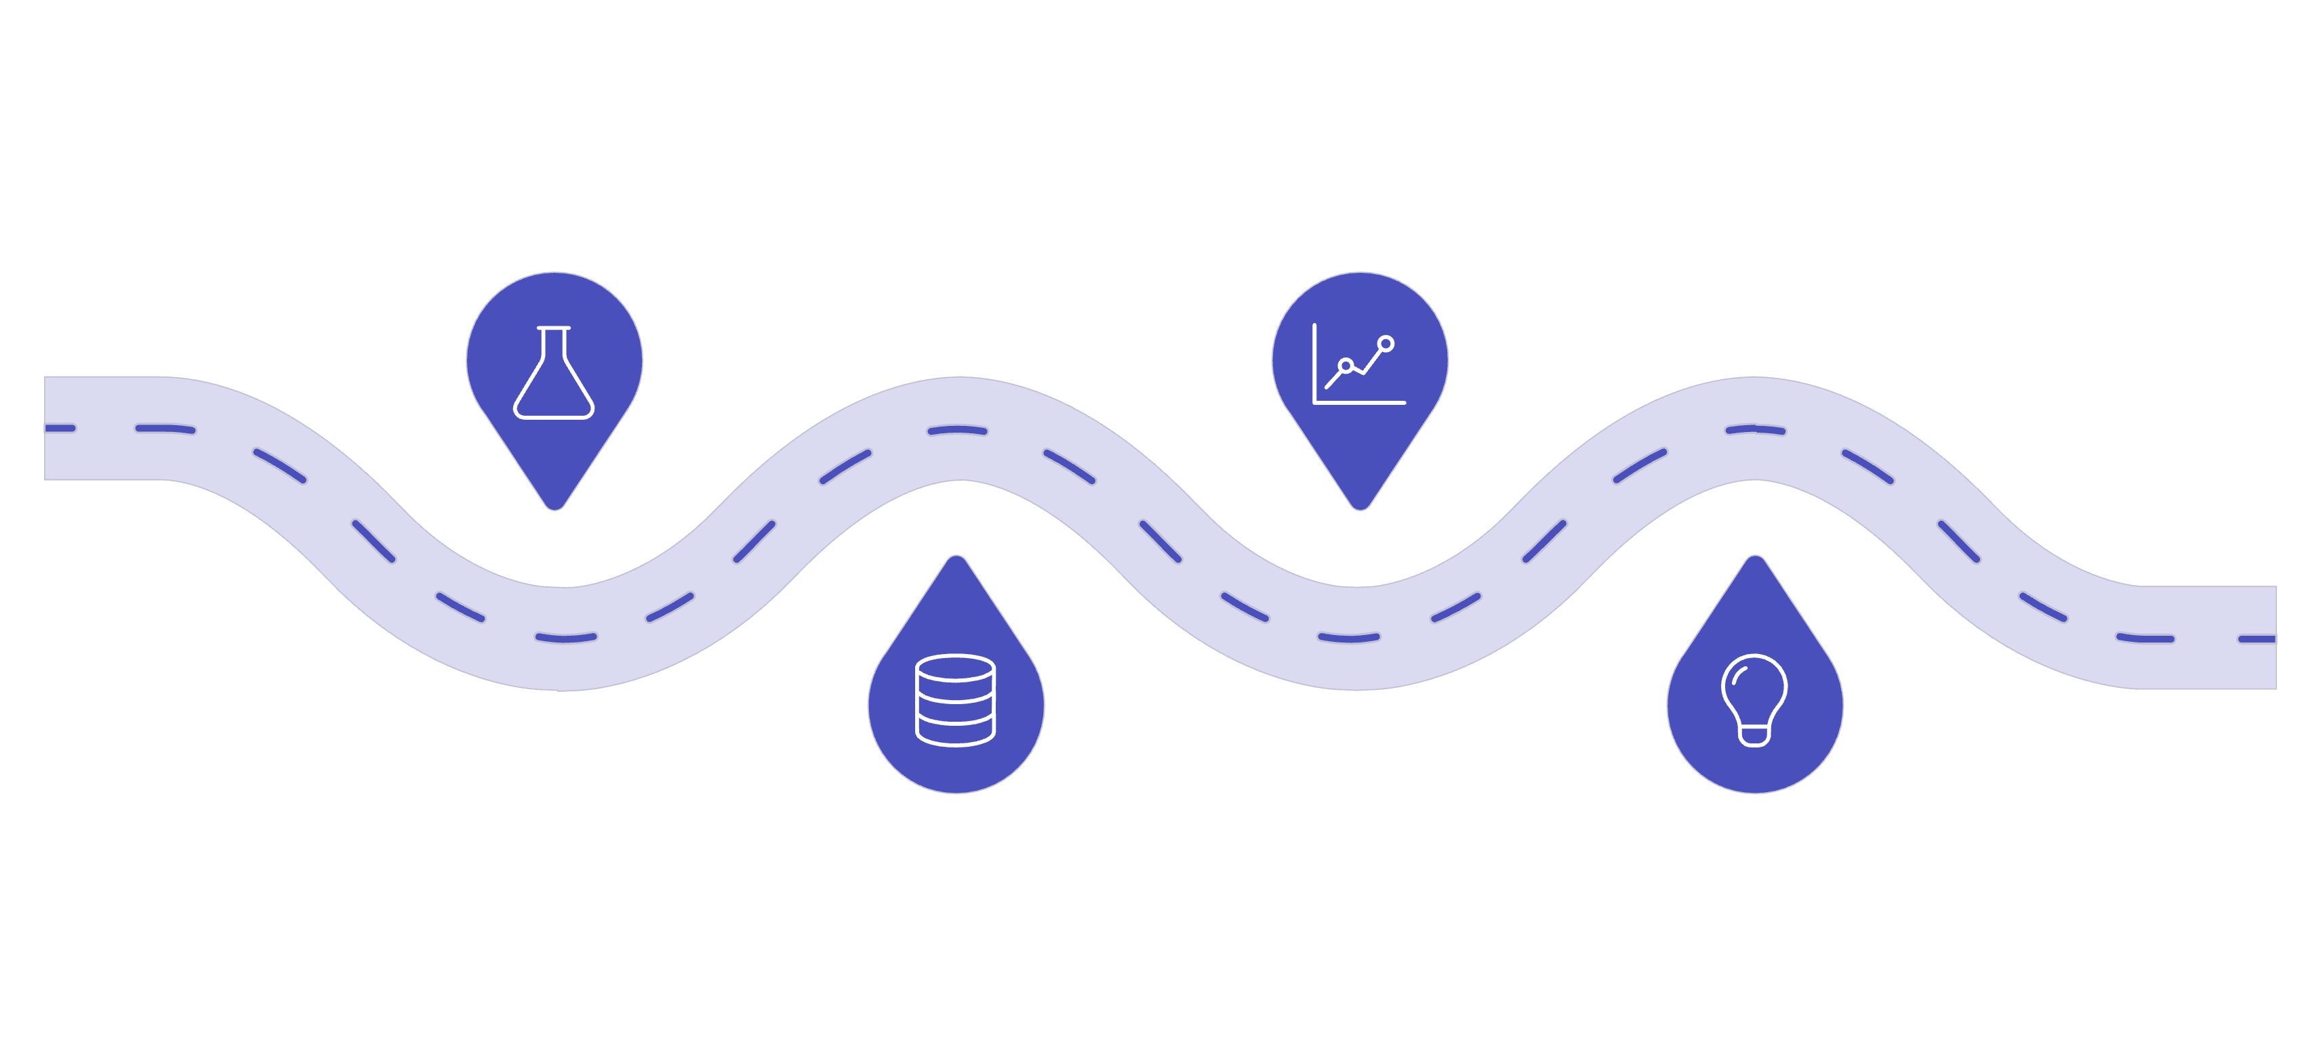
Turning 3,900 Transactions into Actionable Retail Insights
$233K
$59.76
Total Revenue
Avg Order Value
Across all 3,900 transactions
Per transaction average
3.75
3.9K
Avg Rating
Transactions
Out of 5 stars
Full dataset analyzed
Python
Power BI
Cleaning & EDA of raw transactions
Interactive dashboards
Recommendations
PostgreSQL
Analysis and aggregations
Actionable business insights
An end-to-end analysis connecting raw transactional data to retention, pricing, and merchandising decisions.

Slide 3
The Core Business Question
"How do customer demographics, shopping preferences, and engagement behaviors influence purchase value and retention — and where should marketing focus its budget?"
01
02
03
Clean & Standardize
Engineer Behavioral Features
Answer 10 Business Questions
Prepare raw data for reliable analysis
Create age groups, loyalty tiers, and frequency metrics
SQL queries with CTEs and window functions
04
05
Build Power BI Dashboard
Translate to Action
Interactive, stakeholder-facing insights
Concrete recommendations for retention and pricing

Slide 4
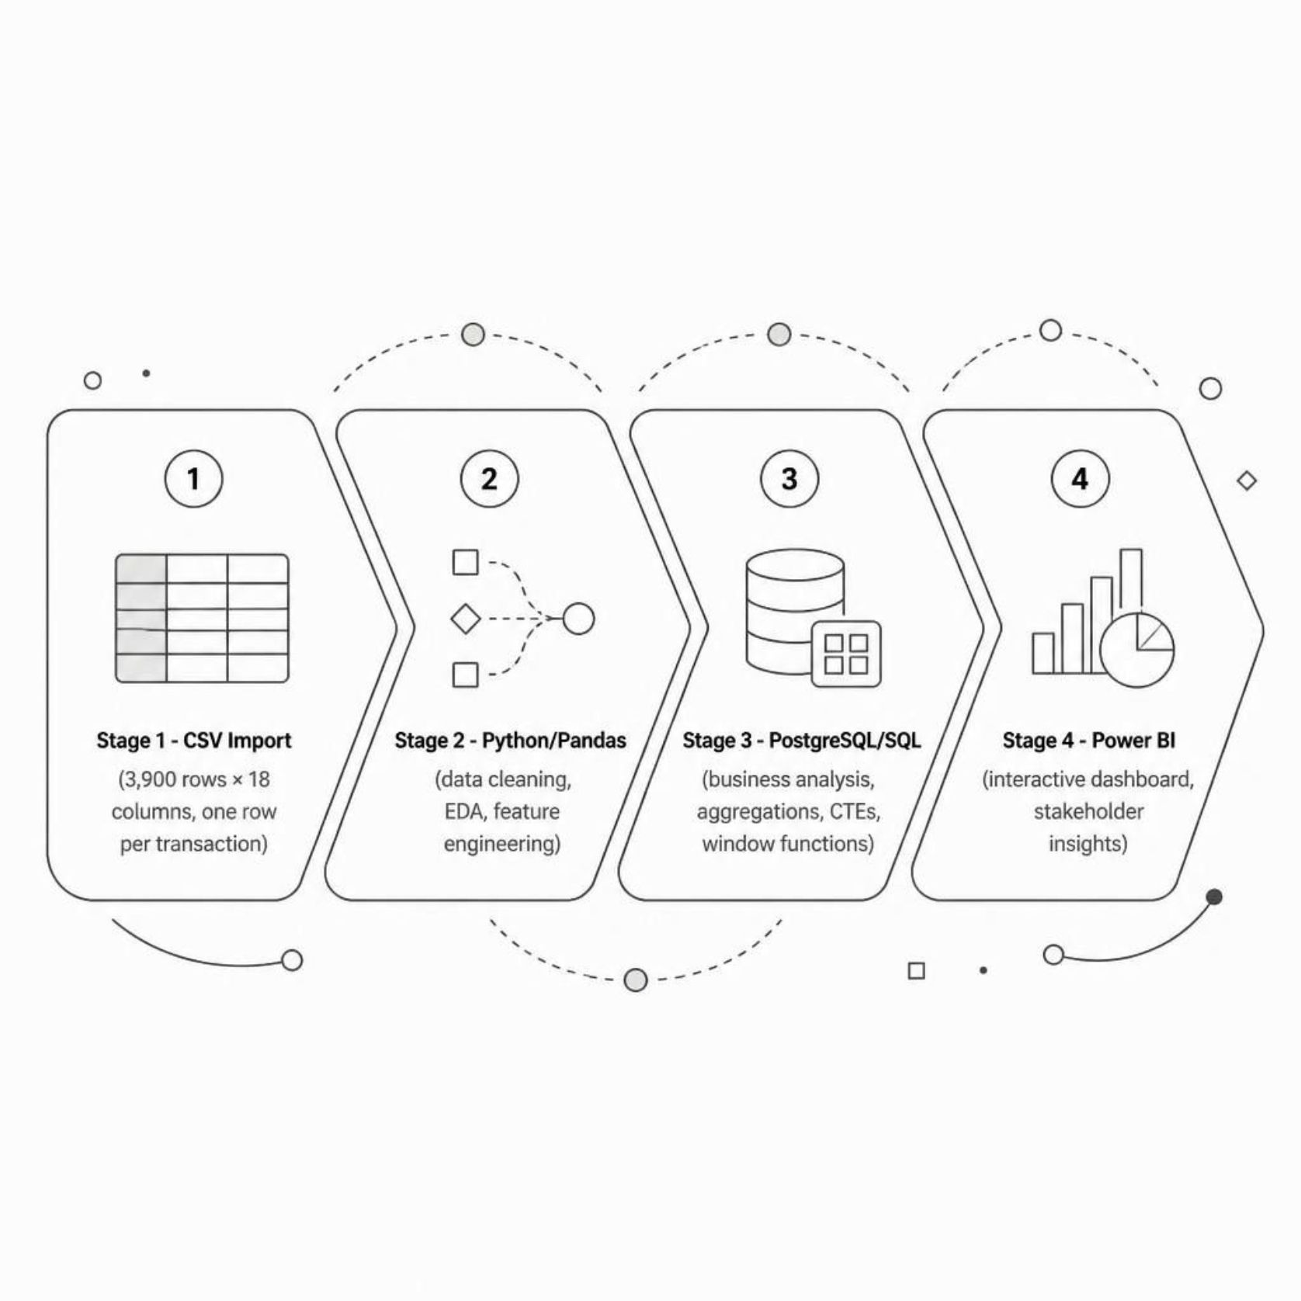

Data & Analytics Workflow
Dataset at a Glance
3,900 rows × 18 columns — one row per transaction
Demographics, product category, purchase amount, shipping, discounts, subscription, review rating, purchase history
Data quality: 37 missing values (0.9%), all in Review Rating
Each stage was chosen to preserve business meaning — not just remove missing data.

Slide 5



From Raw Data to Analysis-Ready Data
PYTHON PREPARATION
Cleaning Steps
Imputed 37 ratings using category-level median
Standardized column names for consistency
Removed duplicate discount column
Loaded cleaned data into PostgreSQL
FEATURE ENGINEERING
New Behavioral Features
Age Groups: Young Adult, Adult, Middle-aged, Senior
Purchase Frequency: Text → numeric days
Loyalty Tiers: New, Returning, Loyal

Slide 6
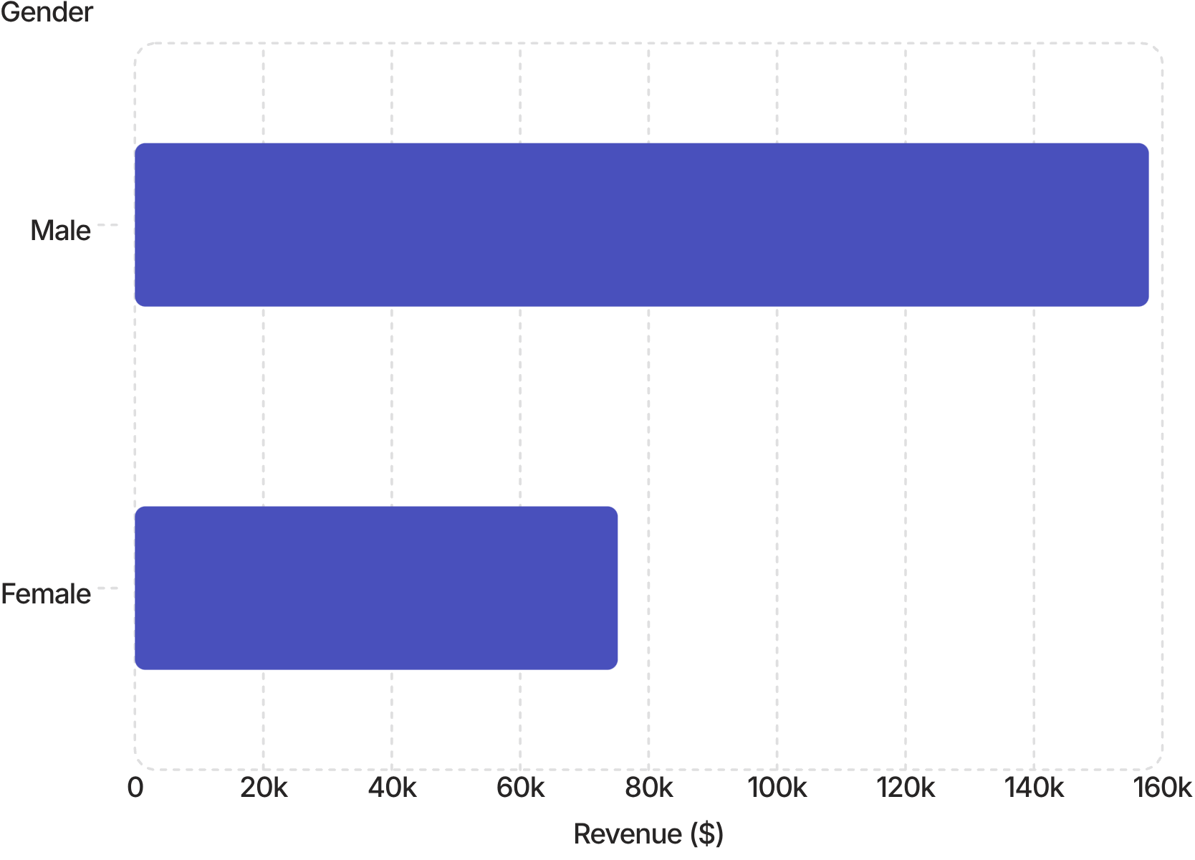

What Does the Transaction Data Tell Us?
Revenue by Gender
Male customers generated $157,890 — more than double female revenue of $75,191.
Discount Users
Shipping Speed
Subscription
839 customers with above-average spend despite discounts
Standard AOV: $58.46 · Express AOV: $60.48
Subscribers: $59.49 · Non-subscribers: $59.87
So What? Discounts, shipping speed, and subscription status show surprisingly weak differences in spending.

Slide 7
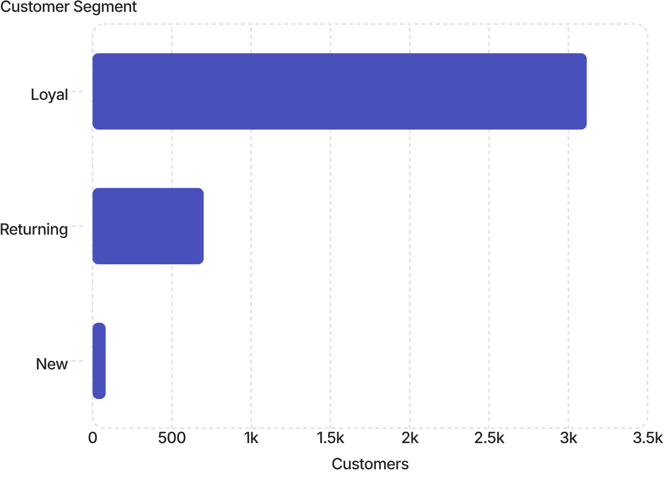
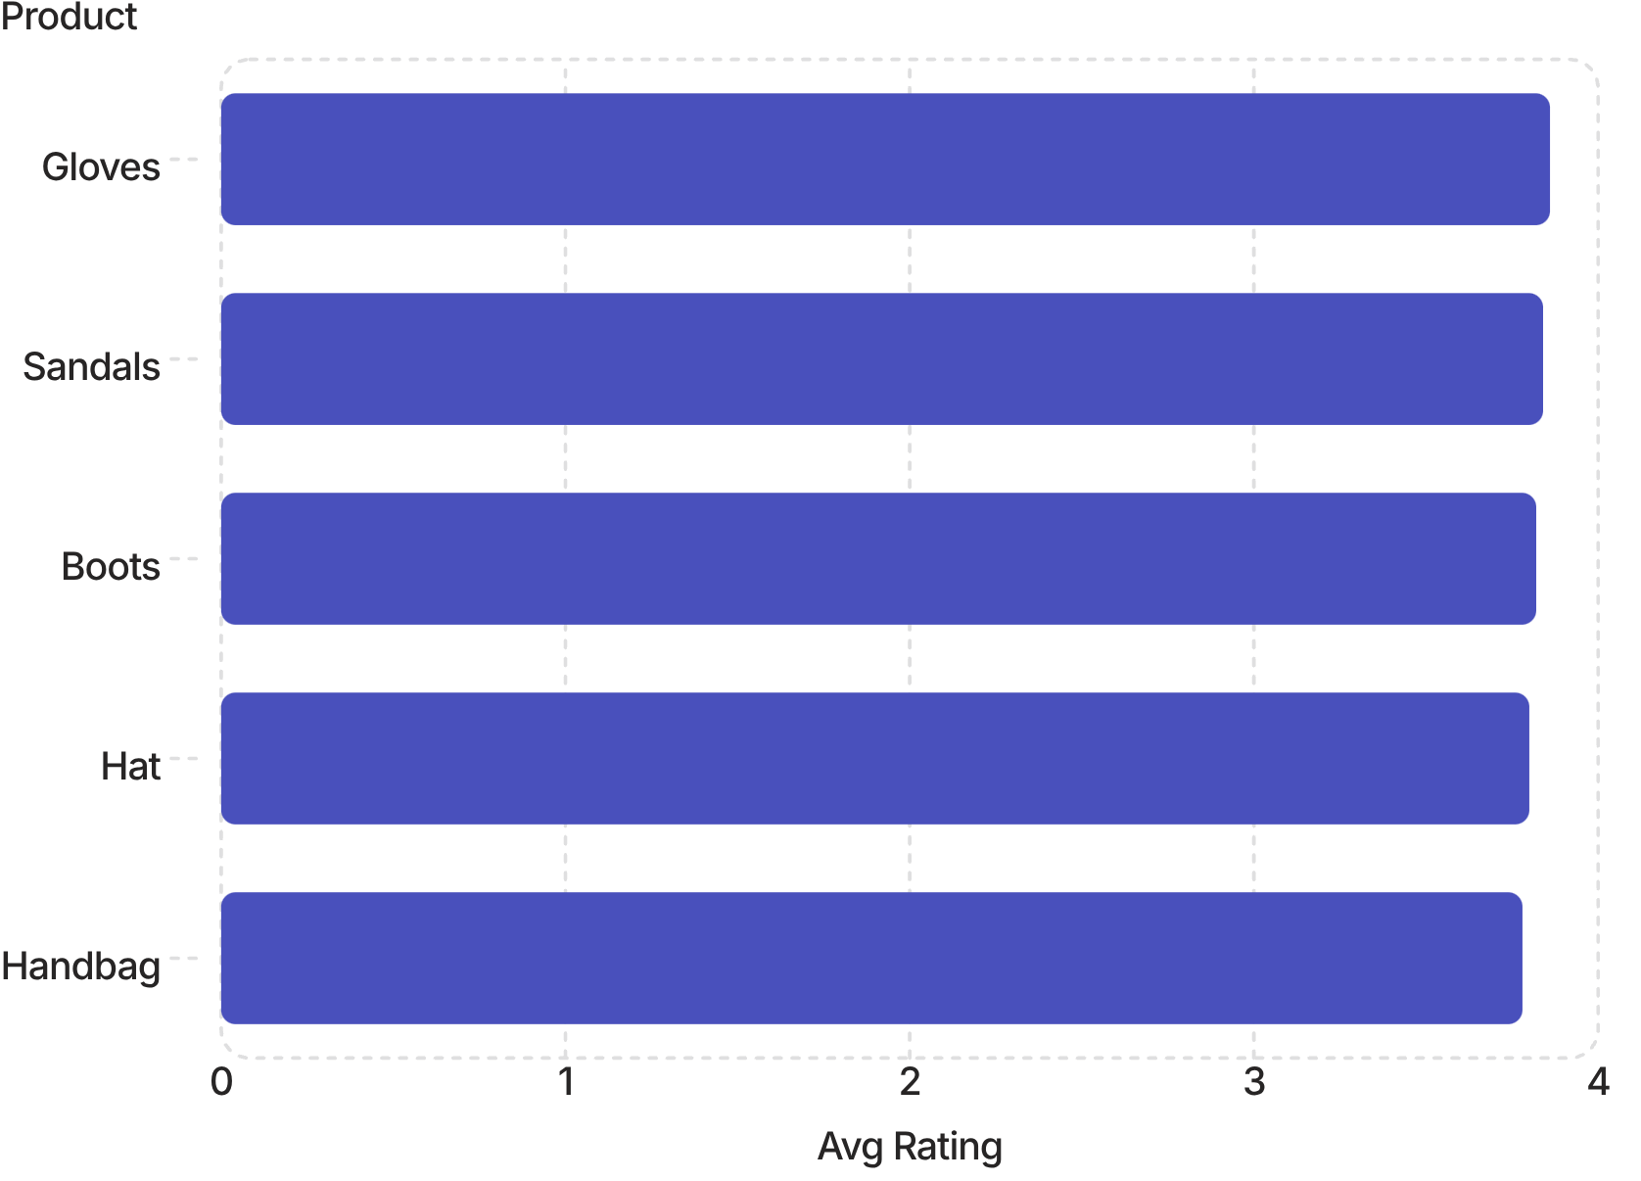
Behavioral Patterns Matter More Than Demographics
Customer Loyalty Distribution
94% of customers are in the Loyal segment — a retention-driven base. New customers represent just 2.1%, signaling an acquisition gap.
Product Ratings vs. Discount Depth
Highest-discounted products (Hat 50%, Sneakers 49.7%, Coat 49.1%) are not the highest-rated — discount strategy may not align with customer satisfaction.
So What? Age-group revenue is flat (~$56K–$62K per group). Behavioral signals outperform demographics for segmentation.

Slide 8
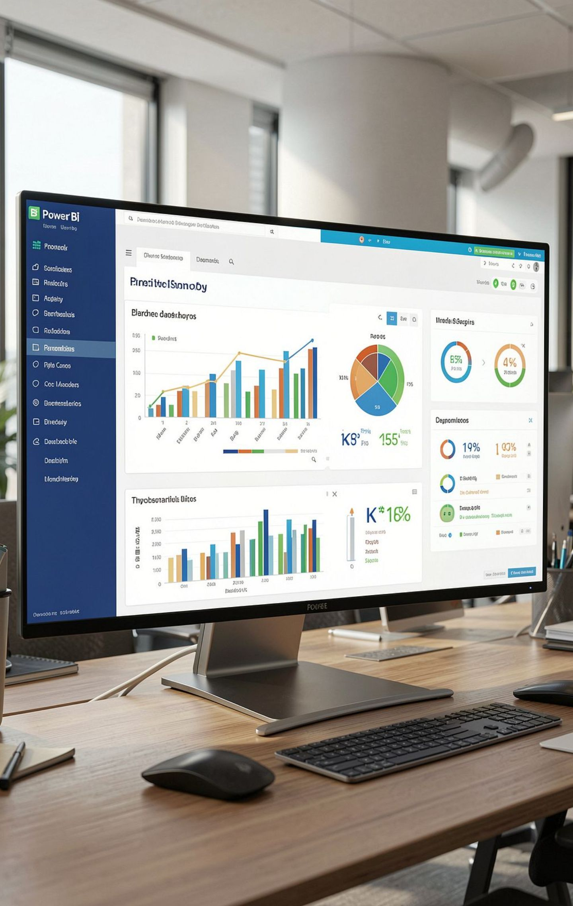




From SQL Analysis to Interactive Decision-Making
$233K Revenue
Total across all transactions
$59.76 AOV
Average order value
3,900 Customers
Unique transactions
3.75 Avg Rating
Out of 5 stars
Revenue Views
By Gender · Category · Age Group
Impact Analysis
Discount · Subscription · Shipping
Product & Segmentation
Performance by product · Customer tiers
Interactive Slicers
Category · Gender · Season · Shipping Type
Power BI transforms the SQL analysis into an interactive stakeholder-facing experience.

Slide 9

What Should the Business Do Next?
Key Insights
Strategic Recommendations
Discount users still spend above average
Subscription barely changes average spend
Express shipping adds minimal spend lift
94% of customers are Loyal — acquisition is thin
Revenue is flat across age groups
Highest-discounted products aren't highest-rated
Re-evaluate blanket discounting — target high-intent shoppers
Incentivize loyal non-subscribers with personalized offers
Invest in new-customer acquisition to reduce concentration risk
Use ratings to guide inventory — stock higher-rated products
Shift segmentation to behavioral data — not demographics
So What? Focus marketing investment on customer behavior, not broad demographic assumptions.

Slide 10
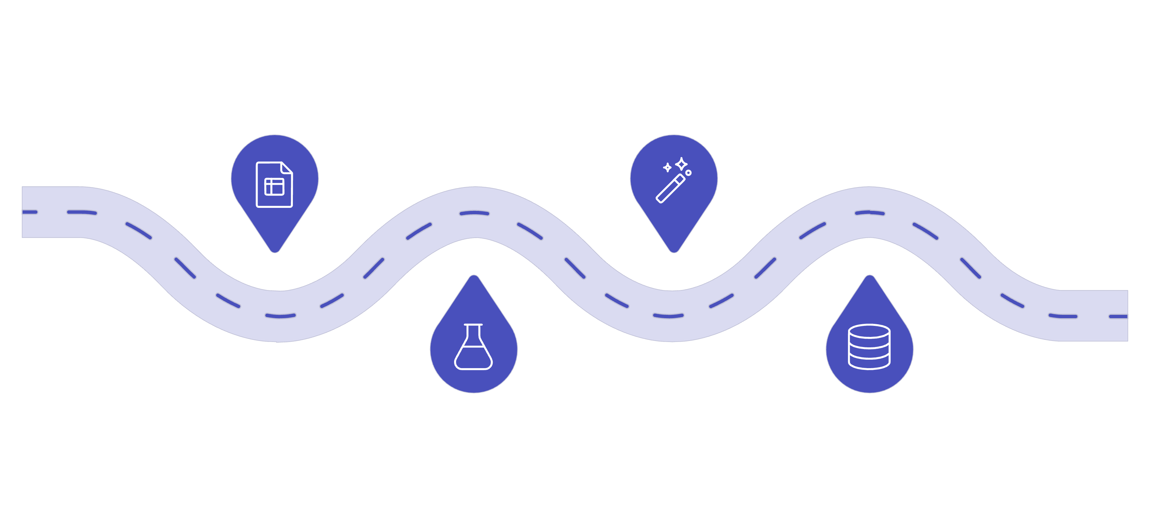
From 3,900 Transactions to Business Strategy
Feature Engineering
Raw CSV
Load 3,900 transaction records
Create retention and pricing features
Python Cleaning
SQL Analysis
Clean, dedupe, and normalize data
Store in PostgreSQL and query insights
"Turning 3,900 raw transactions into a data-backed retention and pricing strategy."
Project Portfolio
What This Project Demonstrates
🔗 GitHub: github.com/mannujr/customerBehaviour_dataAnalysis
Full code, SQL queries, and Power BI report available for review.
End-to-end analytics execution
Python data preparation & feature engineering
SQL business analysis with CTEs & window functions
Power BI dashboard design for stakeholders
Translating data findings into business actions

