Slide 1

Unleashing the Potential of NLP: Exploring the Impacts of AI on Jobs and Tasks
MSCA 32018 IP01 (Spring 2023) Natural Language Processing and Cognitive Computing
By
Kishor Kumar Reddy Mannur

Slide 2
Executive Summary with Meaningful Insights
A refined dataset of about ~130k news articles was obtained from rigorous cleaning, preprocessing, and tokenizing of a massive dataset of ~200k news articles
For a better understanding of the sentiment in the news articles’ text, sentiment analysis was conducted to classify the articles into positives and negatives.
To draw insights into the predicted sentiment texts, we apply LDA and BERT topic modeling techniques which helped us identify that the majority of the positive sentiments comprised of health, energy, efficiency, market, etc., as keywords within them hinting at a rise in the jobs and projects in these domains, for instance, healthcare, energy management, and others.

Slide 3
Executive Summary with Meaningful Insights
However, the scenario on the other end of the spectrum is contrasting as we observed that the top failures and reasons for negative sentiments are market, impact, ai, technology, jobs, and industry.
Overall, our study bridges the gap between complex AI research and practical knowledge, offering meaningful contributions to the advancement of the AI industry. By understanding the industry's growth trajectory and areas that require attention, we pave the way for informed decision-making, strategic planning, and the responsible utilization of this transformative technology

Slide 4

Actionable Recommendations
Some actionable insights that can be derived:
Capitalize on the Rising Trend of ChatGPT and OpenAI: Given the surge in popularity and continued news coverage of ChatGPT and OpenAI, it is essential to explore opportunities in this domain.
Monitor Negative Sentiments for Risk Assessment: The presence of negative sentiments surrounding topics like AI, technology, and jobs indicates potential risks and challenges.
Leverage Positive Sentiments in Health and Energy Domains: The positive sentiments associated with keywords like health, energy, efficiency, and market indicate promising opportunities in these sectors.
Emphasize Human-AI Collaboration and Job Retention: With the surge in AI capabilities, there is a concern about job displacement. Organizations should focus on promoting human-AI collaboration, reskilling initiatives, and creating new roles that leverage AI technology.
Foster Responsible AI Utilization: As AI technology advances, it is crucial to emphasize responsible and ethical AI practices. strategies based on evolving industry dynamics.

Slide 5
Actionable Recommendations ( in Project Working)
Enhance data cleaning and preprocessing techniques to ensure dataset quality and consistency.
Explore advanced sentiment analysis approaches for a more nuanced understanding of sentiment.
Experiment with different topic modeling techniques to uncover additional latent topics.
Validate results with domain experts to gain practical insights and interpretations.
Implement interactive visualization tools for user-friendly exploration and presentation of results.
Conduct longitudinal analysis to track sentiment trends and topic evolution over time.
Publish and share findings to contribute to the knowledge base and foster collaboration.

Slide 6



Article Clean-up and Filtering
The news articles datasets fetched using the starter notebook contain ~200,000 records.
After using the filtration and cleaning techniques ~134,000 records
Removed digits, non-word and non-space characters, newline, and tab characters
Limited the word length for the article sentences &character length for the words inside the sentences
Used closely related words along with the mentioned keywords to leave out unnecessary noise.
Methodology
Original dataset with ~200k news articles
Preprocessing
Keyword Filtering
Filtered news articles ~130k
Sentiment Analysis
Positive news articles ~72k
BERT & NER
to identify major topics, sentiments, and the entities related to them
Negative news articles ~69k

Slide 7
Topic Detection & Sentiment Analysis Methodology
With the clean and filtered data at my disposal, the next aim is to:
Perform sentiment analysis to identify the positively and negatively impacting news articles
Using a SVM classifier, by training a custom Yelp model, I obtained the negative and positive sentiments
Further, identifying the sentiment changing over time and what is causing that. (topic modeling for positive and negative news articles)
By applying BERTopic on both the categories of sentiment-analyzed news articles, tuning the parameters like the number of topics, etc. I found the major topics causing the sentiment.
Although LDA is good for visualizations, BERT takes it up a notch by giving the top words in the topic making it more interpretable and user-friendly which can help in conjunction with NER
Eventually, I would apply NER to these sentiment-classified articles to obtain information on who is responsible for the trends and where exactly are they happening

Slide 8
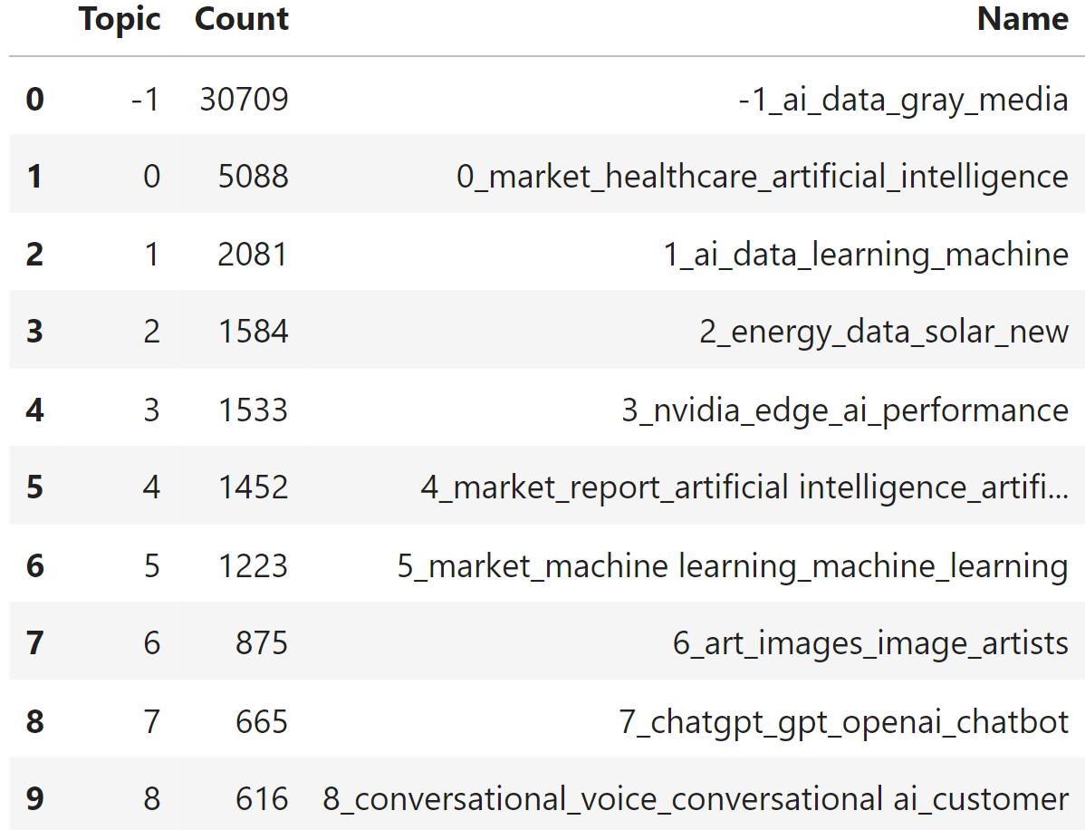
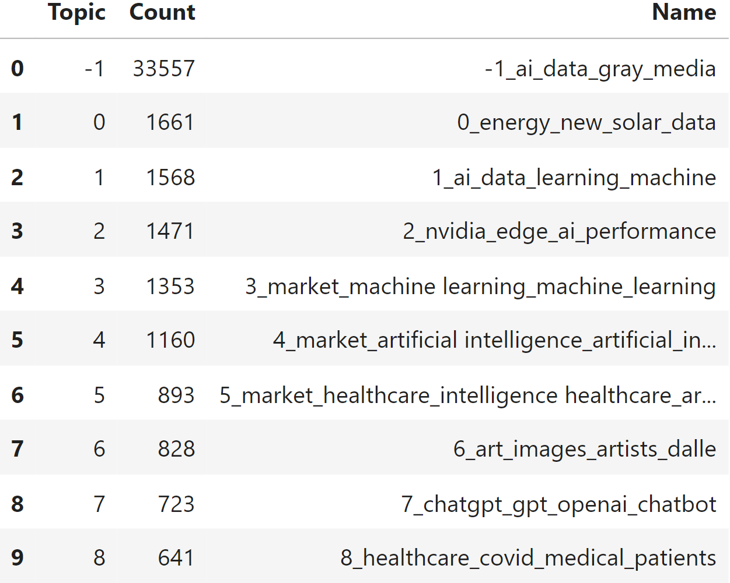
Topic Modeling
BERTopic applied to positive and negative sentiment articles gives us a better understanding of the trends.
Removed stopwords
Lowered the case of the text
Starting with n=100 topics and moving it down all the way to n=10 to obtain precise results.
Positive Sentiment Articles Topics
Negative Sentiment Articles Topics

Slide 9
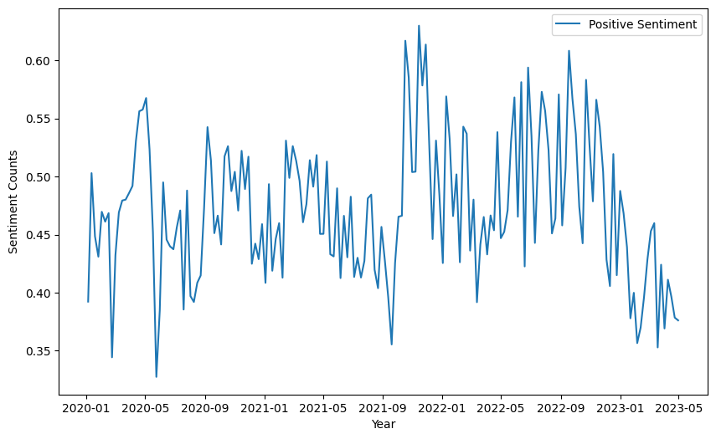
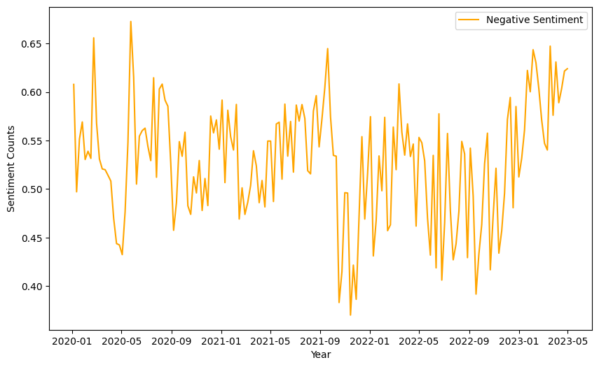
Sentiment Analysis Overall
Avg Positive Sentiment Score vs Time
Avg Negative Sentiment Score vs Time
Sentiment Scores (Positive & Negative) over Time

Slide 10
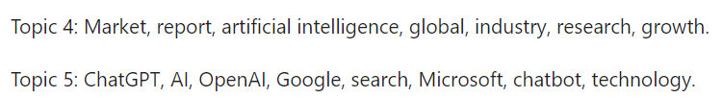
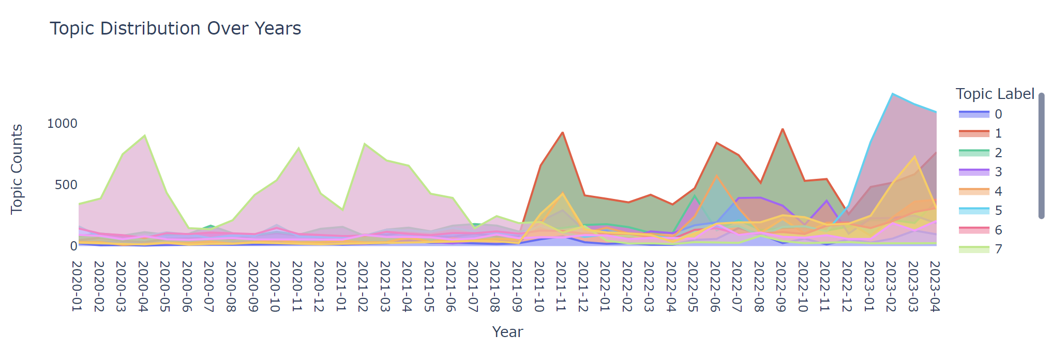
Sentiment Analysis (Positive)
We can see the progression of the top topics over the years
The topic_label=5 has surged since late 2022 and still making news, interesting, right? It’s about ChatGPT & OpenAI showing the LLM introduction and uptrend, especially in the early 2023s with GPT 3.5 out.
We can also see the topic stays in trend for about a year showing the race of AI in the year 2022
Rising competition in the AI race between top companies releasing new models
topic_label=1

Slide 11
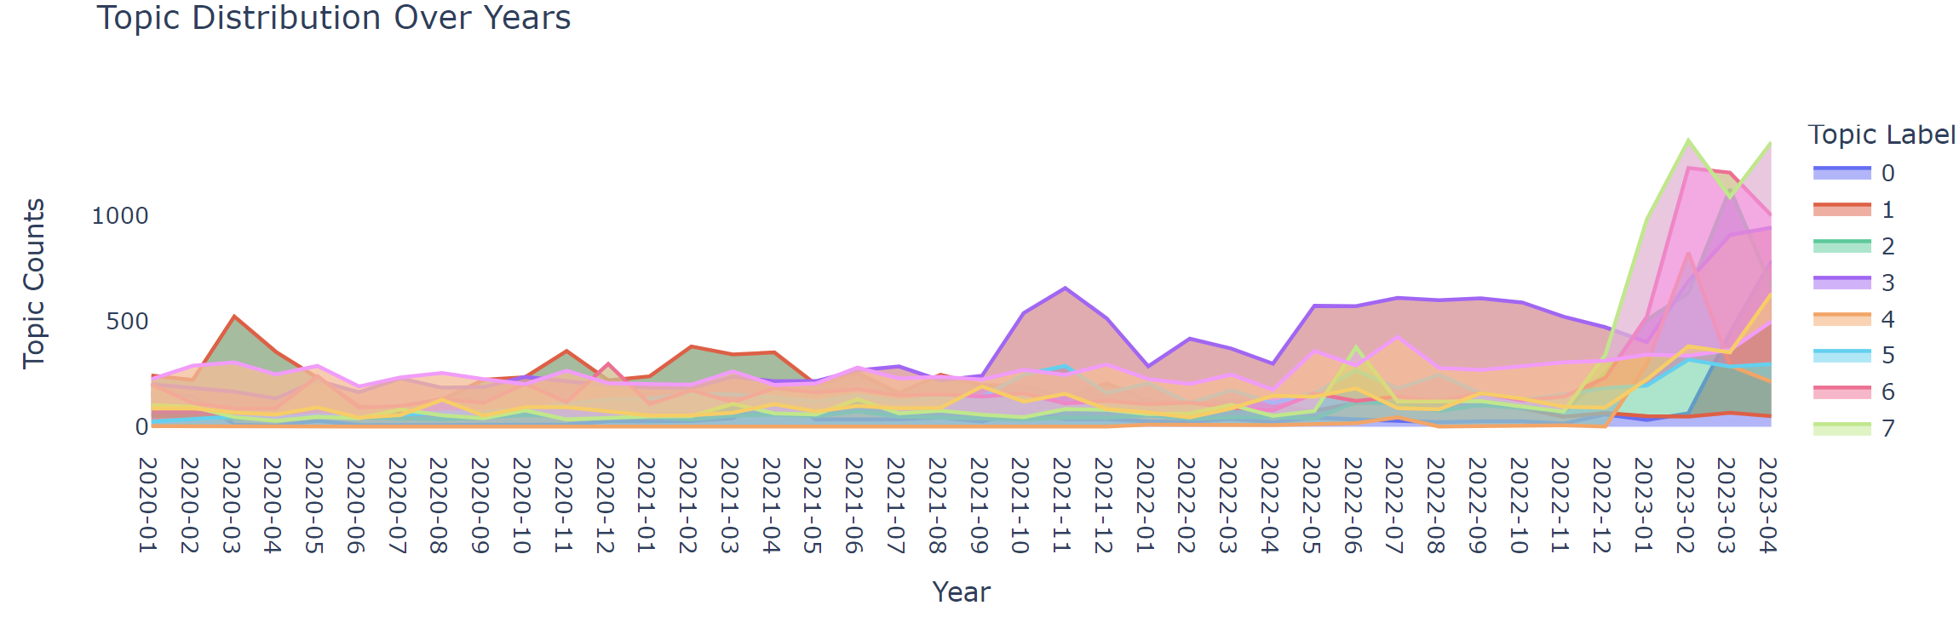

Sentiment Analysis (Negative)
It is interesting to see that negative sentiment isn’t particularly low and can help identify infamous topics/ trends.
topic_label=7 rose in mid-2022 and gained momentum towards the end of 2022 which shows how the stock prices of AI companies dropped, however, it suggests that due to Google’s loss of $100B in shares, thanks to Bard’s introduction video blunder, making it a trend.
topic_label=6 discusses AI models and systems, their capabilities, the role of human interaction, and the impact of AI technology on various domains in 2023. With the surge in AI and its capabilities, humans are at risk of losing their jobs.
AI companies stock prices trend
News on Jobs at risk due to AI

Slide 12
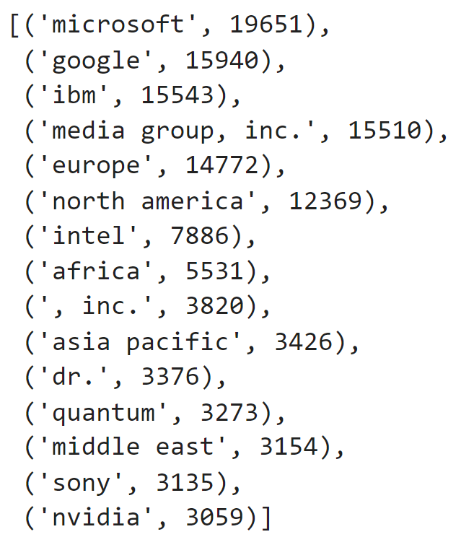
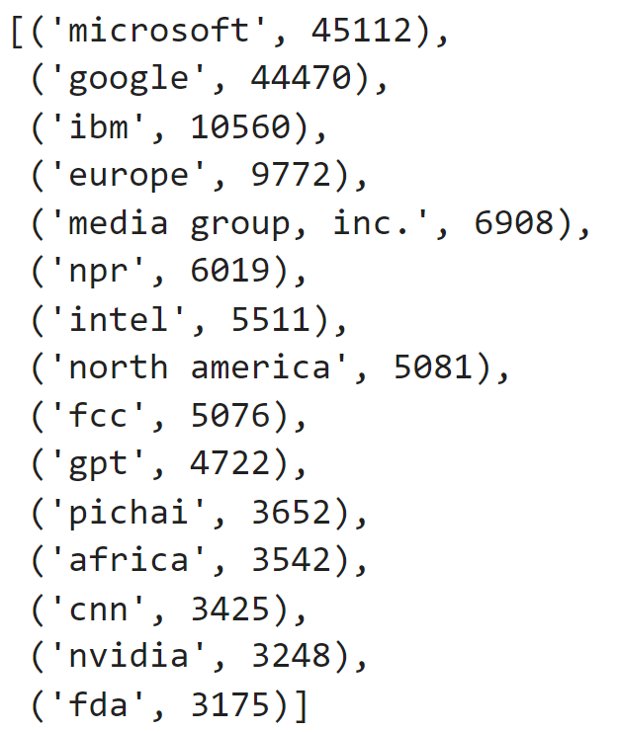
Entity Identification
It is important to extract the named entities from the news articles which can lead to actionable insights. Using NER with Spacy, we extract the entities like Person, Organization, and Location among others.
We obtain the following entities from both positive and negative news articles respectively as follows:
By leveraging the topic modeling, sentiment analysis from earlier and using the NER results, we can perform a targeted sentiment analysis and gain information and insights
Positive Sentiment Entities
Negative Sentiment Entities

Slide 13
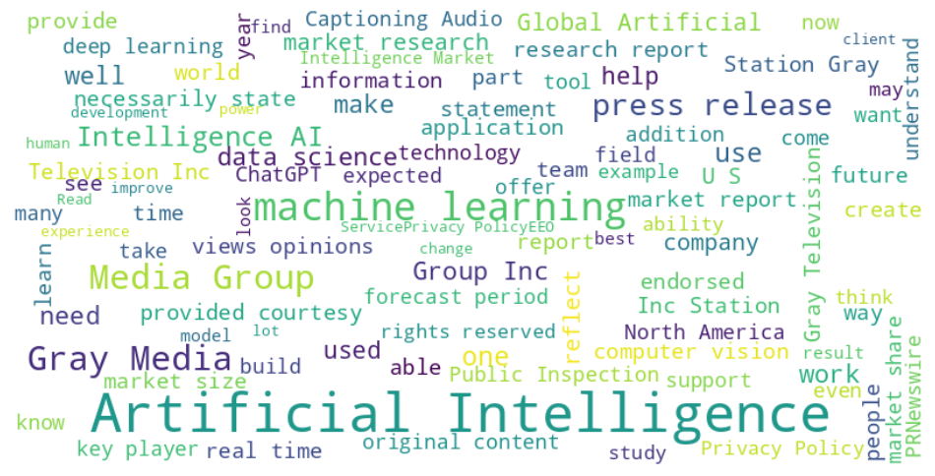
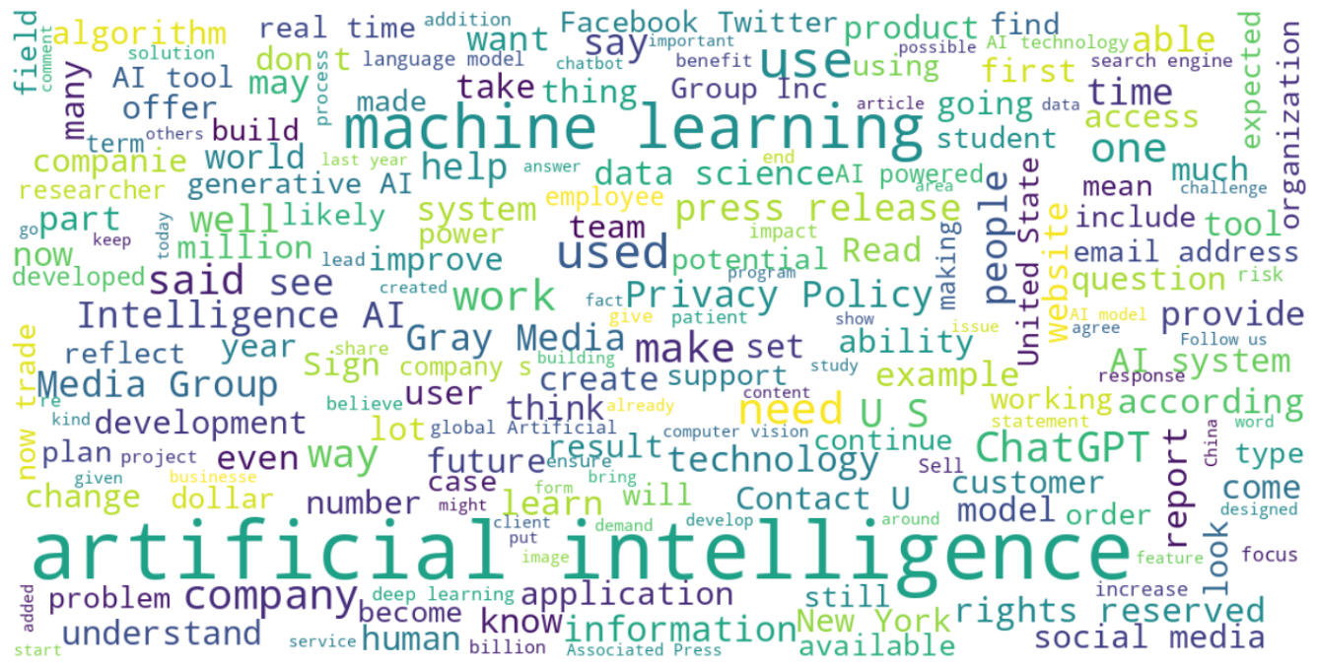
Entity Identification Word Clouds
From the extracted positive word cloud, it is suggestive of the topics in press, release, information, original content, improve, etc.
The further targeted sentiment can be observed that there was an overall rise in sentiment from mid ‘2022 signaling at the release and news surrounding ChatGPT
On the other hand, the negative word cloud shows terms like people, privacy, policy, customer, rights, problem, etc., which show the privacy concerns revolving around the advancements in the field of AI and machine learning. Microsoft sentiment both positive and negative rose in late ‘22.

Slide 14
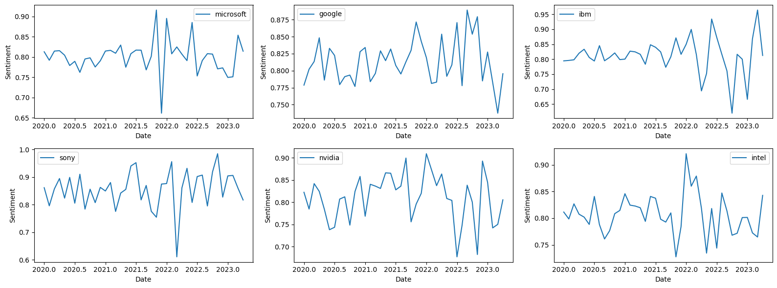
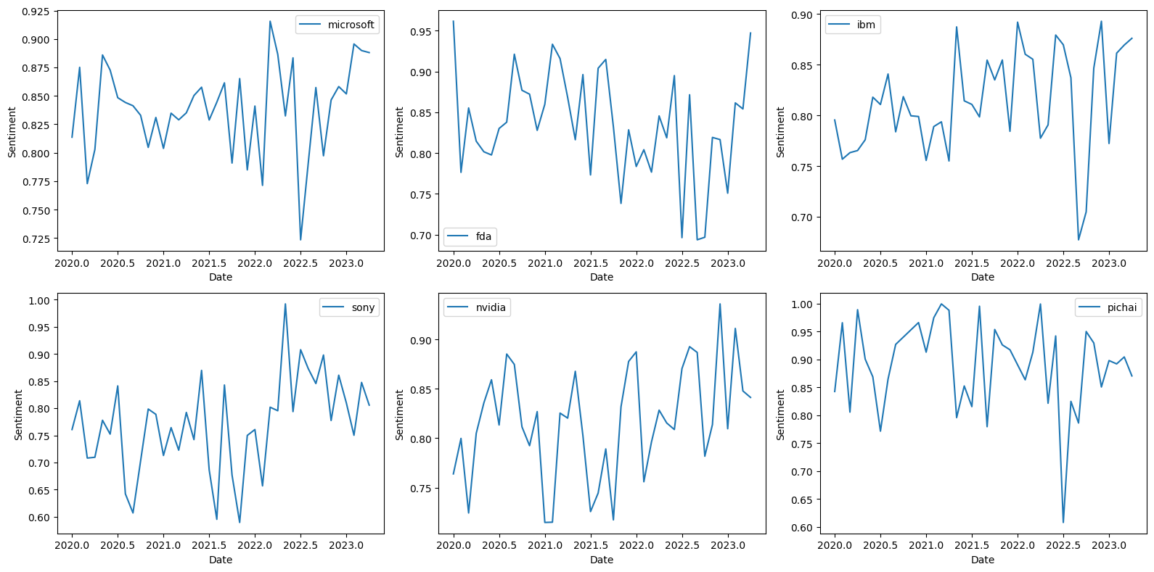
Entity Identification Targeted Sentiment
Targeted Sentiment Analysis on the Positive NER obtained
Targeted Sentiment Analysis on the Negative NER obtained

Slide 15
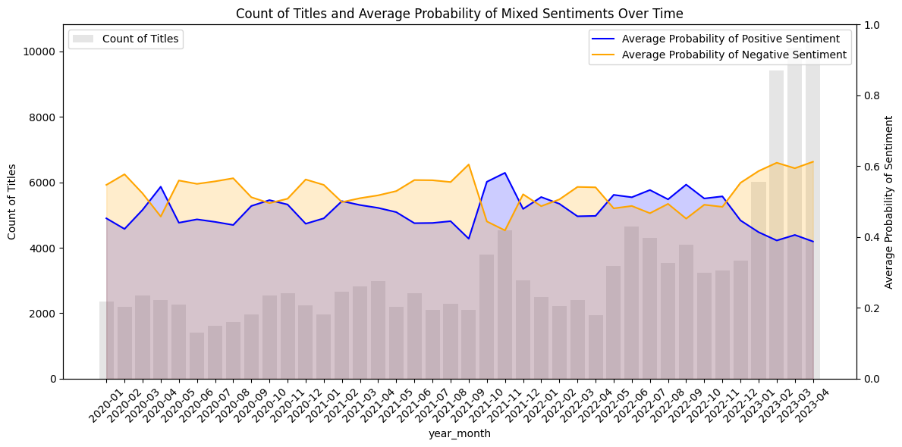
Appendix
This graph shows us the general mixed sentiment against the count of articles
ChatGPT and OpenAI find themselves having the most positive sentiment and trending upwards
Humans are at risk of losing their jobs.
Unstable stock prices in the AI arena.
Sentiment Analysis showing mixed opinions over time

Slide 16
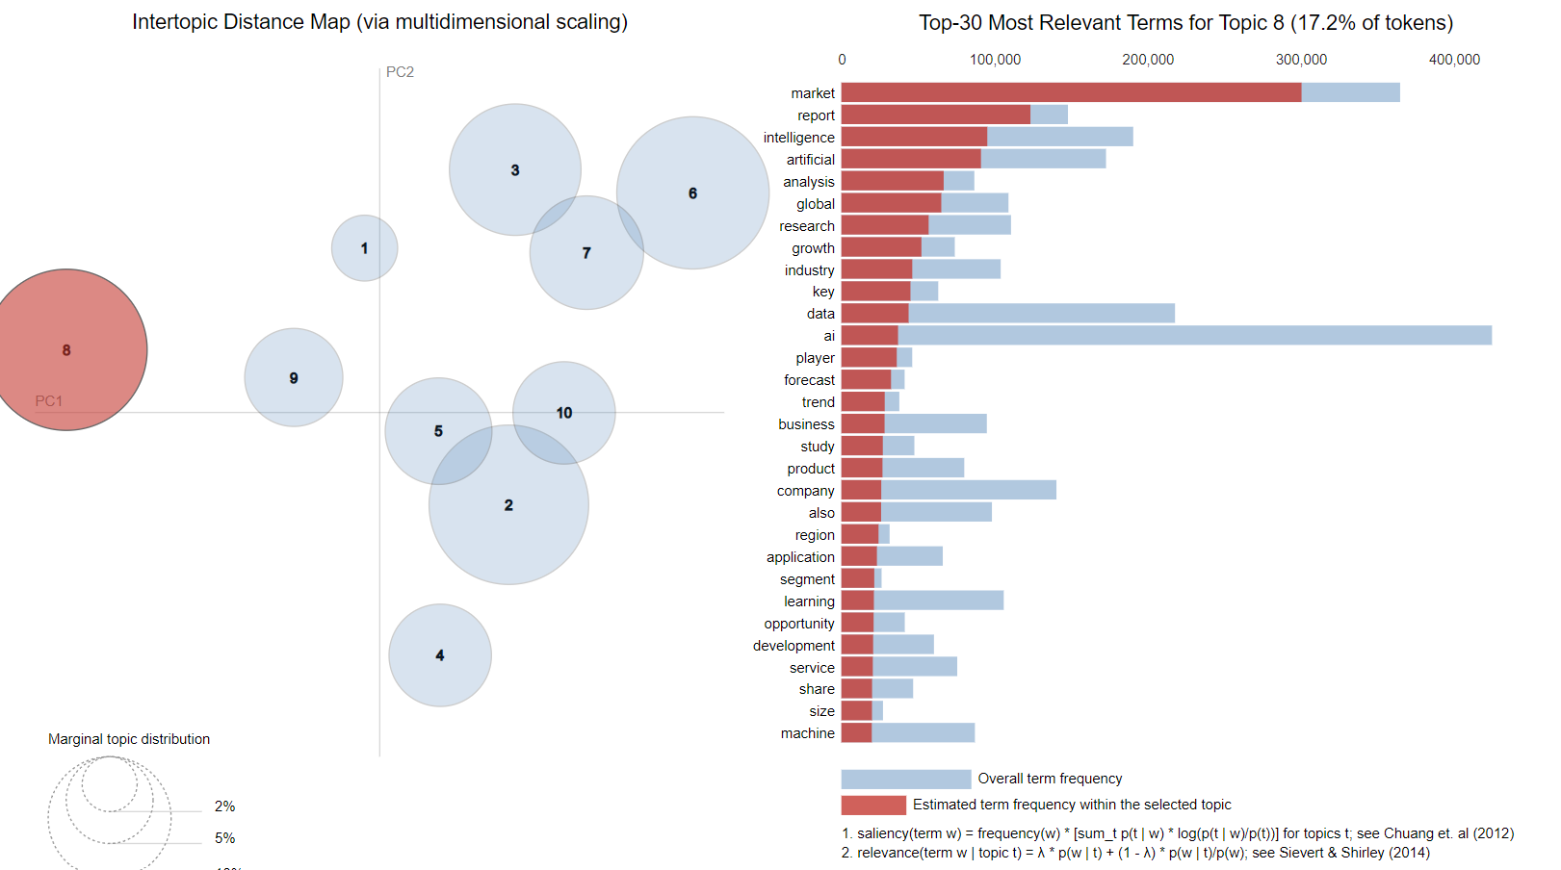
Appendix
Positive Sentiment pyLDAViz for Topic Modelling

Slide 17
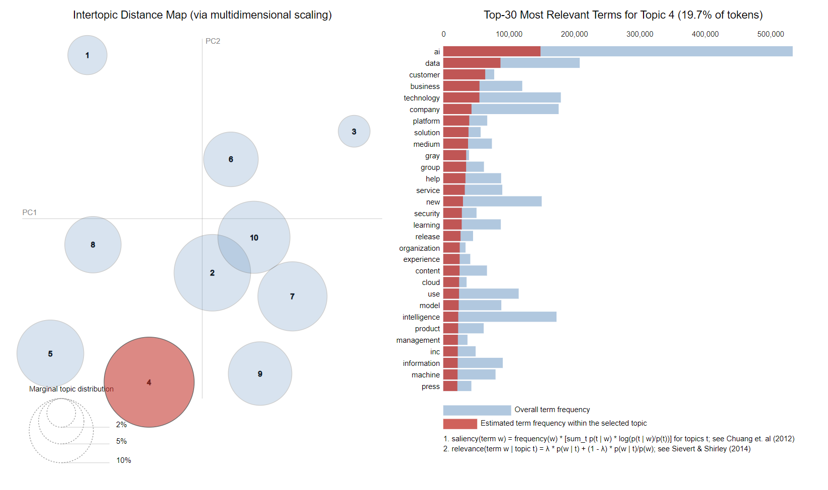
Appendix
Negative Sentiment pyLDAViz for Topic Modelling

Slide 18
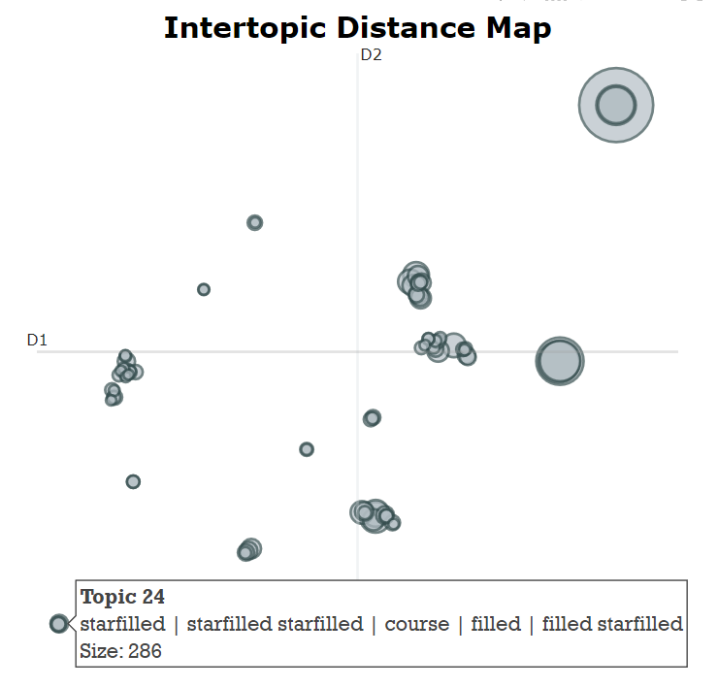
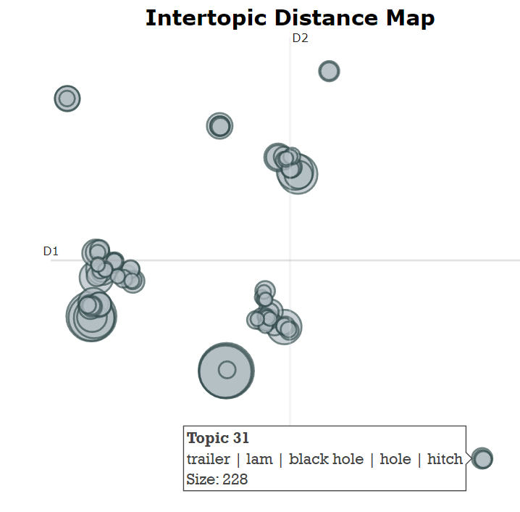
Appendix
Positive and Negative Sentiment BERT Topics Visualizations

