Slide 1

Down for the Count: Getting Reference Counting Back in the Ring
Rifat Shahriyar, Stephen M Blackburn, Daniel Frampton
The Australian National University

Slide 2
52 years ago …

Slide 3
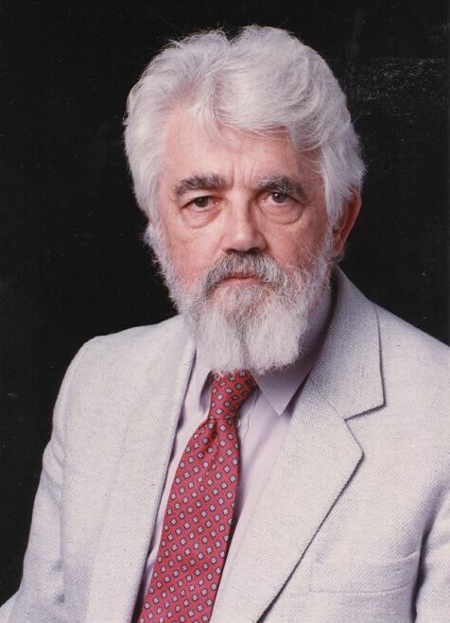
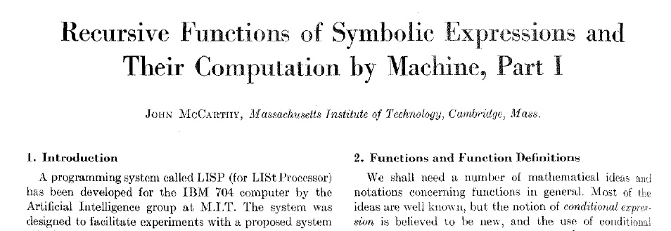

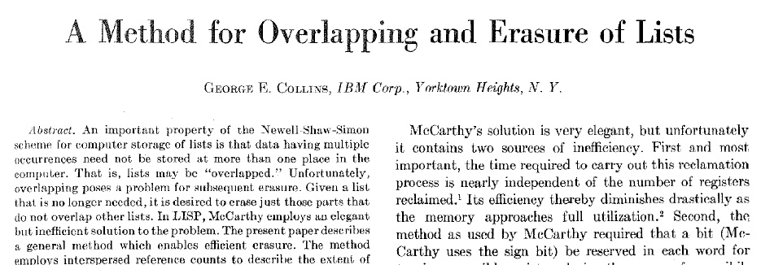
Notes:
Garbage collection was born 52 years ago.
Tracing by McCarthy – Communications of the ACM, April 1960
Reference Counting by Collins – Communications of the ACM, December 1960

Slide 4
Today …

Slide 5
Garbage collection is ubiquitous
Background
Two ideas underpin large literature:
Tracing [McCarthy60]
Reference Counting [Collins60]
However
Tracing used in all high performance GCs
Reference counting only in non-performance critical settings
Why?
Notes:
Reference counting is used in non-performance critical systems like PHP, Perl and Python

Slide 6
Tracing [McCarthy1960]
Background
A
B
D
C
✗
✗
E
F

Slide 7
Reference Counting [Collins 1960]
Background
1
1
✗
1
2
1
0
1
2
1

Slide 8
Reference Counting vs. Tracing
Background
Advantages
Immediate
Incremental Reclaim as-you-go
Object-local
Overhead distributed
Very simple Trivial implementation for naïve RC
Disadvantages
Maintain count Time and space overheads
Cycles Can’t be collected
Complex High performance implementation about as complex as tracing

Slide 9
The Challenge
One of the two fundamental GC algorithms
Many advantages
Neglected by all performance-conscious VMs
So how much slower is it?
Can we get RC back in the ring?
30%

Slide 10
Contributions
Background
In-depth analysis of key design choices for RC implementations
Optimizations that completely eliminate the performance overhead
Detailed performance study with other high performance collectors

Slide 11
Understanding Reference Counting

Slide 12
Design Space
Understanding Reference Counting
Storing the count
A word per object
Some available bits
Maintaining the count
Naive
Deferred
Coalescing
Generational and Age-Oriented
Cycles
Backup tracing
Trial deletion
Notes:
Cycle collection is not the main focus of this work

Slide 13
1. Storing the Count
Understanding Reference Counting
Space
Dedicated word (32 bits) per object
Steal bits from each object’s header
How many bits we actually need?
Notes:
One extra word in header incurs 2.5% overhead in Jikes RVM production collector

Slide 14
Maximum Reference Count Distribution
Understanding Reference Counting
Vast majority of objects have max counts of 7 or less

Slide 15
Overflow
Understanding Reference Counting
4 bits: 0.11% overflow
. But these attract 18% of incs and decs!
Notes:
3 bits, 0.65% overflow, attract 23% of incs and decs
4 bits, 0.11% overflow, attract 18% of incs and decs
5 bits, 0.06% overflow, attract 14% of incs and decs

Slide 16
2. Maintaining the Count
Understanding Reference Counting
Naive RC requires inc and dec on every pointer mutation
Easy to implement only write barriers, no GC maps
Deferred RC ignores changes to stacks and register
Temporary increment used to fake liveness of roots
Normal incs and decs deferred until collection time
Much faster than naive but requires GC maps
Coalescing RC ignores many changes to heap
Coalesce pointer mutations record just first and last in chain of changes

Slide 17
Sources of Incs and Decs
Understanding Reference Counting
New objects
Mutations to:
non-new scalar objects
non-new array objects
Temporary operations due to root reachability
Cycle collection-generated decrements

Slide 18
Understanding Reference Counting
Increments due to young objects
71% increments for newly allocated objects
Notes:
Collection is artificially triggered after 16MB of allocation

Slide 19
Understanding Reference Counting
Decrements due to young objects
71% decrements for newly allocated objects
Notes:
Collection is artificially triggered after 16MB of allocation

Slide 20
Understanding Reference Counting
Survival ratio
Only about 10% survive
Notes:
Collection is artificially triggered after 16MB of allocation

Slide 21
Improving Reference Counting

Slide 22
1. Storing the Count
Improving Reference Counting
Findings:
Max count < 8 in most cases
Very few overflows The percentage of stuck objects is very low
Design: Handling stuck objects
Auxiliary data structure to store count of the overflowed objects
Ignore them let backup tracing collect stuck objects
Restore them let backup tracing restore stuck counts

Slide 23
Improving Reference Counting
Limited bit strategies
heap size = 2x the minimum heap size
5% faster
Notes:
StuckIgnoreRC is 4% faster
StuckRestoreRC is 5% faster
HashTableRC is 1% slower

Slide 24
2. Maintaining the Count
Improving Reference Counting
Findings:
New objects are the source of most incs and decs
Survival ratio is low
New objects a fruitful focus
[Azatchi & Petrank’03]
[Blackburn & McKinley’03]

Slide 25
Existing Handling of New Objects
Improving Reference Counting
Implicitly dirty
Marked as dirty and enqueued
Inc applied to each referent at next collection
Implicitly live
Initial count of one
Dec enqueued, processed at next collection
Notes:
Implicitly dirty – enqueued to mod-buffer
Implicitly live – enqueued to dec-buffer

Slide 26
New: Handling of New Objects
Improving Reference Counting
Implicitly clean
Lazily dirty at collection time only if (transitively) inc’d by old object or roots
Non-surviving objects never processed
Implicitly dead
Lazily increment at collection time only if (transitively) inc’d by old object or roots
Available to free list unless they are incremented
Minor change to existing RC, not hybrid of two collectors
Notes:
Implicitly clean – transitive and retains all reachable objects
Implicitly dead – work in infrequent case of being live rather than frequent case of being dead

Slide 27
Improving Reference Counting
Implicitly Clean & Implicitly Dead
heap size = 2x the minimum heap size
16% &19% faster respectively
Notes:
16% and 19% faster

Slide 28
Improving Reference Counting
Standard vs. Improved RC
heap size = 2x the minimum heap size
24% faster (i.e. standard is 30% slower)
Notes:
24% faster (was 30% slower)

Slide 29
Back in the Ring

Slide 30
Back in the Ring
RC vs. MS
heap size = 2x the minimum heap size
Notes:
Why RC vs. MS?
Both systems use the same very well tuned free list implementation
Same heap but different GCs

Slide 31
Back in the Ring
RC vs. MS
heap size = 2x the minimum heap size
New RC ≈ MS
Notes:
New RC = MS

Slide 32
Back in the Ring
RC vs. URC vs. Immix
heap size = 2x the minimum heap size
2% slower than URC, 3% slower than Immix
Notes:
2% slower than URC, 3% slower than Immix

Slide 33
Back in the Ring
RC vs. Sticky Collectors
heap size = 2x the minimum heap size
Same as StickyMS and 10% slower than StickyImmix
Notes:
Same as StickyMS, 10% slower than StickyImmix

Slide 34
Summary and Conclusion
RC is neglected despite many advantages
RC 30% slower than tracing when using the same allocator
Three optimizations
4 bit count
Implicitly clean
Implicitly dead
Eliminate overhead entirely
RC is back in the ring!

Slide 35
Questions?

