Slide 1

Taking Off The Gloves With Reference Counting Immix
Rifat Shahriyar
Xi Yang
Stephen M. Blackburn
Australian National University
Kathryn S. McKinley
Microsoft Research
Notes:
Hello Everybody, I am Rifat Shahriyar from Australian National University.
I am here to present our paper ‘Taking off the gloves with reference counting immix’.
This is a joint work with Steve, Xi and Kathryn.

Slide 2
53 Years Ago…
Notes:
What happened 53 years ago?

Slide 3
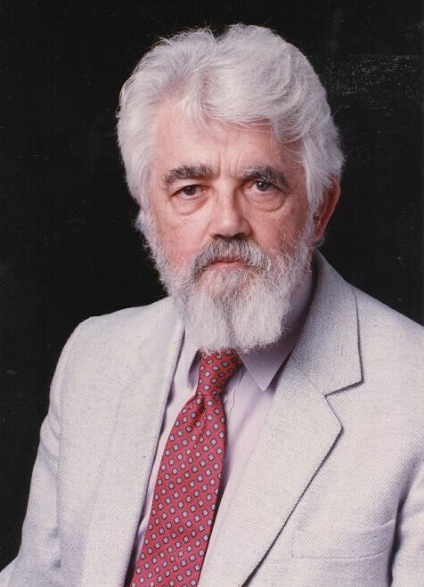
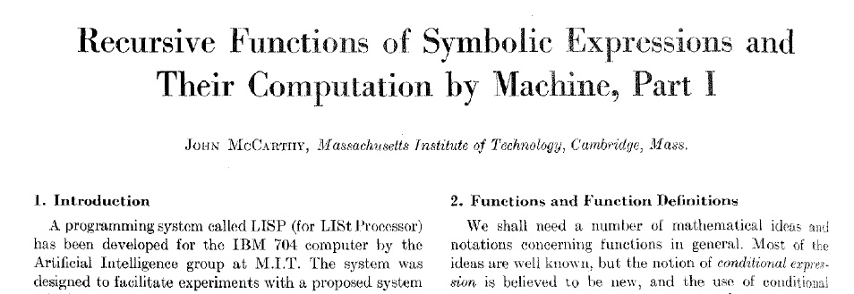
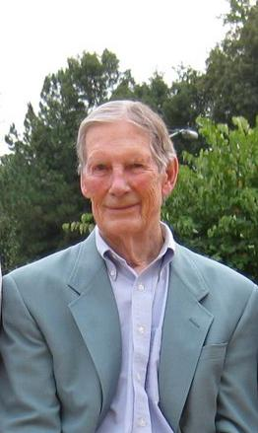
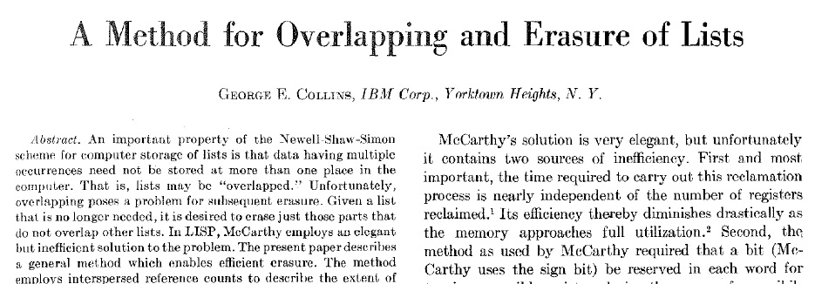
The Birth of GC
Notes:
2 fundamental branches to GC
GC was born in 1960.
At the top, first paper on tracing by McCarthy.
At the bottom, first paper on RC by Collins.

Slide 4
Today…
Notes:
Why I am here giving a talk in OOPSLA about RC?
Didn’t tracing already win the race?
All high performance VM uses tracing.

Slide 5
Why Reference Counting?
Advantages
Reclaim as-you-go
Object-local
Basic RC is easy
Disadvantages
Cycles
Performance
Our
Goal
Backup tracing
<2013
2013
Notes:
Reference counting has some interesting advantages.
Our goal is to make it faster than the production.
Zoom in on the result

Slide 6
Why So Slow?
GC
Total
Mutator
Notes:
Not only improving GC time
GC effects the application – mutator
9% total overhead, 9% mutator overhead
Infact 3% speed up in GC
But the fraction of time spend on GC is very low
So the GC improvement doesn’t effect total time

Slide 7
Looking a Little Deeper…
Instructions Retired
L1 D Cache Misses
Time
Notes:
Start with RC, then MS, then SS
then Immix (non generational baseline of the production)
Immix and SS matches production, sometimes better
But what about RC and MS?

Slide 8
Free List vs. Bump Pointer
Free List
Bump Pointer
Notes:
Define zeroing
Free list
Divides memory into different sized free list
Allocate objects where the size matches
Bump pointer
Increment a pointer by the size of the object
Problem of Free List
Poor cache locality – contemporaneously allocated objects often on different cache lines
Internal Fragmentation – size of the object doesn’t match the size of the class
External Fragmentation – memory available overall, but a specific size class not available
Zeroing – cell by cell zeroing
Advantage of Free List
Separate meta data for free and uses memory
Easily return memory occupied by dead objects
East to sweep object by object which is needed for RC
Advantage of Bump pointer
Good cache locality – contemporaneously allocated objects often on same cache lines
Zeroing – bulk zeroing

Slide 9
Looking a Little Deeper…
Free List
Instructions Retired
L1 D Cache Misses
Time
Bump Pointer
Notes:
Lets see which GC uses which allocator
RC and MS – Free List
SS and Immix – Bump pointer

Slide 10
Reference Counting
Notes:
Lets have a look how RC works

Slide 11
Basic Reference Counting [Collins 1960]
1
1
0
1
1
2
3
2
A
B
C
D
E
1
1
E
F
Notes:
A set of objects and references. Objects with their reference count.
Reference update – inc of new and dec of old
Reference delete – dec of old and if zero then collect
Reference delete – dec of old, two objects only pointing to each other, circular references

Slide 12
How RC works Fundamental optimizations
Backup tracing [Weizenbaum 1969]
Reclaim cyclic garbage
Deferral [Deutsch and Bobrow 1976]
Note changes to stacks & registers occasionally
Coalescing [Levanoni and Petrank 2001]
Note only initial and final state of references
Notes:
Deferral
Instead of catching every changes from stack and registers with barrier, it note changes occasionally
Coalescing
No explain

Slide 13
Deferral [Deutsch and Bobrow 1976, Bacon et al. 2001]
Stacks & Registers
1
2
1
1
0
1
1
2
2
1
B
C
D
E
2
A
F
++
--
--'
GC: move deferred decs
GC: apply decrements
GC: apply increments
mutator activity
GC: scan roots
D++
A--
F--
A--
F--
GC: collect
A--
A++
F++
B--
Notes:
Bottom of left hand side
IncBuffer
DecBuffer

Slide 14
Coalescing [Levanoni and Patrank 2001]
C++
D++
E++
F++
B--
C--
D--
E--
A
B
C
D
E
F
Remember A
Ignore intermediate
mutations
Compare A, A_{old}
B--, F++
Notes:
When it is first changed remember

Slide 15
How RC works Recent Optimizations
Limited bit count [Shahriyar et al. 2012]
Use just few bits, fix o/f with backup tracing
Elision of new object counts [Shahriyar et al. 2012]
Only do RC work if object survives to first GC
Allocate as dead [Shahriyar et al. 2012]
Avoid free-list work for short lived objects

Slide 16
How Immix works
object mark
recyclable lines
line mark
block
0
line
Contiguous allocation into regions
256B lines and 32KB blocks
Objects span lines but not blocks
Simple mark phase
Mark objects and containing regions
Free unmarked regions
Recycled allocation and defragmentation

Slide 17
Goal, Challenges, Contributions

Slide 18
Goal & Challenges
Goal
Object-local pay-as-you-go collection
Excellent mutator locality
Copying to eliminate fragmentation
Immix provides opportunistic copying
Same mutator locality as contiguous allocator
However, RC is inherently local
References to an object generally unknown…
…but copying must redirect all references
Notes:
Contiguous allocation with copying collection, must update all references to each moved object
Combining copying and RC is novel and surprising

Slide 19
Contributions
Identify heap layout as bottleneck for RC
Introduce copying RC (RC Immix)
Exploit Immix’s opportunistic copy
Observe new objects can be copied by first GC
Observe old objects can be copied by backup GC
Line/block reclamation, header bits
Deliver great performance

Slide 20
Design of RC Immix

Slide 21
Reference Counting in RC Immix
1
0
1
3
2
1
0
2
2
0
1
3
0
1
2
Reference count for object
Live object count for line
Lines ‘born dead’ (zero live object count)
Inc when any object gets first RC increment
Dec when any object is dead
Collect lines with zero live object count

Slide 22
Cycle Collection in RC Immix
0
2
0
1
3
2
4
0
0
0
2
1
2
Live object counts zeroed
Trace marks live objects and lines
Corrects incorrect counts (due to cycles)
Sweep
Collects unmarked lines
Sweeps dead lines, not dead objects
Notes:
Says Occasional

Slide 23
Defragmentation In RC Immix
RC is object-local, inhibiting copying
But, RC Immix seizes two opportunities
All references to new objects known at first GC
Backup tracing performs a global trace
Use opportunistic copying in both cases
Mix copying with in-place RC and marking
Stop copying when available space exhausted

Slide 24
Proactive Defragmentation
0
1
1
2
0
3
1
2
2
1
3
4
5
Copy surviving new objects (with bounded reserve)
Optimization, not for correctness
Reserve sized for performance unlike semi-space
Use past survival rate to predict the future

Slide 25
Reactive Defragmentation
Backup tracing performs a global trace
Piggyback on this, copy live objects
Use available memory threshold
If below threshold, do defrag at next cycle GC

Slide 26
Methodology
Notes:
Evaluation methodology

Slide 27
Hardware, Software & Benchmarks
21 benchmarks
DaCapo, SPECjvm98 and pjbb2005
20 invocations for each benchmark
Jikes RVM and MMTk
All garbage collectors are parallel
Intel Core i7 2600K, 4GB
Ubuntu 10.04.1 LTS
Notes:
Details in paper

Slide 28
Results

Slide 29
Bottom Line Geomean of all benchmarks, versus production
Total Time
Mutator Time
GC Time
heap size = 2x the minimum heap size
3% improvement over production on geomean

Slide 30
Total Time By Benchmark
jess
db
javac
mtrt
jack
bloat
chart
fop
pmd
xalan
compress
avrora
eclipse
hsqldb
jython
luindex
sunflow
pjbb2005
lusearchfix
heap size = 2x the minimum heap size
+5% worst case, -25% best case

Slide 31
Mutator Time By Benchmark
jess
db
javac
mtrt
jack
bloat
chart
fop
pmd
xalan
compress
avrora
eclipse
hsqldb
jython
luindex
sunflow
pjbb2005
lusearchfix
heap size = 2x the minimum heap size
+4% worst case, -10% best case

Slide 32
GC Time By Benchmark
jess
db
javac
mtrt
jack
bloat
chart
fop
pmd
xalan
compress
avrora
eclipse
hsqldb
jython
luindex
sunflow
pjbb2005
lusearchfix
heap size = 2x the minimum heap size
+5% worst case, -25% best case

Slide 33
Total Time v Heap Size
RCImmix matches GenImmix at 1.3x and outperforms from 1.4x

Slide 34
Summary and Conclusion
RC Immix
Combines RC and Immix
Great performance
Outperforms fastest production
Transforms RC
-3%
RC 2013
Questions?
RC Immix
Available at: http://jira.codehaus.org/browse/RVM-1061

Slide 35
Extra Slides

Slide 36
Contiguous Allocator
Increment a bump pointer by the size of the object
Better cache locality
Contemporaneously allocated objects on same/nearby cache lines
Touches memory sequentially priming the prefetcher
Fewer instruction per allocation
Efficient bulk zeroing to pre-initialize objects

Slide 37
Free list Allocator
Organize memory into k size free lists
Allocate into a free cell in the smallest size class that fits
Suffers from fragmentation
Internal (objects not matched to size of their cell)
External (free cells of particular size exists but requires different size)
Poor cache locality
Contemporaneously allocated objects often on different cache lines
Higher instruction per allocation
Object by object zeroing to pre-initialize objects

Slide 38
Header Bits in RCImmix
LG
LG
N
M
RC
RC
RC
RC
LG
LG
N
M
S
RC
RC
RC
(a) RC
(c) RC Immix during mutation
& reference counting
4 bits 0.11% - 3 bits 0.65%
F
F
M
S
F
F
N
M
S
RC
RC
RC
(b) Immix
(c) RC Immix during tracing
LG: Logged M: Marked
N: New object RC: Reference Count
F: Forwarded S: Spans line(s)

Slide 39
GC Fraction
heap size = 2x the minimum heap size
5.5% time spend in GC for GenImmix, 4.1% for RCImmix

Slide 40
Mutator Time
RCImmix matches GenImmix which uses a dedicated nursery space

Slide 41
GC Time
RCImmix outperforms GenImmix

Slide 42
Optimized Root Scanning
RC treat boot image as part of root set
Enumerate each reference at each collection
Significant bottleneck in small heaps
RCImmix treat as non collected part of the heap
Significant performance boost in small heaps

Slide 43
Cycle Collection in RC Immix
0
2
0
3
4
0
2
Trace marks live objects and lines
Sweep
Corrects incorrect line counts (due to cycles)
Collects unmarked lines
Sweeps dead lines, not dead objects

Slide 44
Future Opportunities
Root Coalescing
Motivation
If roots are not changed, then unnecessary inc/dec
Statics and Stack coalescing
99% of the statics are unchanged
Monitor the stack slots for changed content
Conservative Stack Scan
Motivation
Stack maps are hard to implement, forces to use naïve RC (PHP)
Conservative scanning
No stack maps, enable to use high performance RC without them

Slide 45
GC Fundamentals Algorithmic Components
Allocation
Identification
Reclamation
`
Sweep-to-Free
Tracing
(implicit)
Free List
Compact
Reference Counting
(explicit)
Bump Allocation
Evacuate
3
1
Notes:
A GC algorithm can be broken down into of three algorithmic components. How objects are allocated, how garbage is identified, and how space is reclaimed.

Slide 46
GC Fundamentals Canonical Garbage Collectors
Mark-Sweep [McCarthy 1960]
Free-list + trace + sweep-to-free
`
Sweep-to-Free
Mark-Compact [Styger 1967]
Bump allocation + trace + compact
Compact
Evacuate
Semi-Space [Cheney 1970]
Bump allocation + trace + evacuate

