Slide 1
Introduction to Garbage Collection

Slide 2
GC Fundamentals Algorithmic Components
Allocation
Identification
Reclamation
`
Sweep-to-Free
Tracing
(implicit)
Free List
Compact
Reference Counting
(explicit)
Bump Allocation
Evacuate
3
1
Notes:
A GC algorithm can be broken down into of three algorithmic components. How objects are allocated, how garbage is identified, and how space is reclaimed.

Slide 3
GC Fundamentals Canonical Garbage Collectors
Mark-Sweep [McCarthy 1960]
Free-list + trace + sweep-to-free
`
Sweep-to-Free
Mark-Compact [Styger 1967]
Bump allocation + trace + compact
Compact
Evacuate
Semi-Space [Cheney 1970]
Bump allocation + trace + evacuate

Slide 4
GC Fundamentals The Time–Space Tradeoff

Slide 5
Mark-Sweep (Free List Allocation + Trace + Sweep-to-Free)
Space efficient
✓
Poor locality
✓
Simple, very fast collection
Notes:
On this and the following slides, we contrast the three fundamental collectors, starting with mark-sweep. We do this by presenting four perspectives on collector performance: mutator, collector, minimum heap size, and total performance. Garbage collection people see the application as an adversary, hence the term “mutator” is used in the literature to characterize the application (in exclusion to the collector). It is often underappreciated that collection policies can affect mutator performance. The poor locality of the free list allocator gives mark-sweep poor mutator locality. However mark-sweep collection is fast and simple, and it is space efficient.

Slide 6
Mark-Compact (Bump Allocation + Trace + Compact)
Good
locality
Space efficient
✓
✓
Expensive multi-pass collection

Slide 7
Semi-Space (Bump Allocation + Trace + Evacuate)
Good locality
Space inefficient
✓
Space inefficient
Notes:
So each of the three fundamental algorithms has an Achilles heel. To achieve a better time-space performance curve, most production collectors sidestep these problems by composing the three reclamation strategies, often combining them with generational collection.
Since we first looked at their performance in detail in a SIGMETRICS paper four years ago, we have been looking for another way, an alternative strategy which avoids the shortcomings of the existing approaches while matching their best performance.

Slide 8
Sweep-To-Region and Mark-Region
Reclamation
Mark-Sweep
Free-list + trace + sweep-to-free
Sweep-to-Free
`
Compact
Mark-Compact
Bump allocation + trace + compact
Evacuate
Semi-Space
Bump allocation + trace + evacuate
Mark-Region
Bump alloc + trace + sweep-to-region
Sweep-to-Region
Notes:
We do this by identifying a fourth reclamation strategy, sweep-to-region. It works by dividing the space into regions, and freeing any region with no live objects in it. Regions can then be used for contiguous bump allocation. Mark-region is a canonical collector combining contiguous bump allocation with tracing and sweep-to-region reclamation. Before we look more closely at mark-region let me give you a sneak preview of how it performs.

Slide 9
Mark-Region (Bump Allocation + Trace + Sweep-to-Region)
Good locality
Space efficient
✓
✓
Excellent
performance
✓
Simple, very fast collection
✓

Slide 10
Naïve Mark-Region
0
Contiguous allocation into regions
Excellent locality
For simplicity, objects cannot span regions
Simple mark phase (like mark-sweep)
Mark objects and their containing region
Unmarked regions can be freed

Slide 11
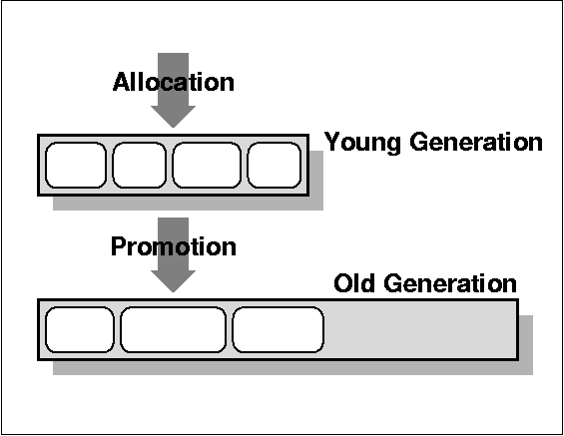
Generational [Ungar 1984]
Most objects die young
Nursery space
Mature space

Slide 12
Immix [Blackburn and McKinley 2008]
object mark
recyclable lines
line mark
block
0
line
Contiguous allocation into regions
256B lines and 32KB blocks
Objects span lines but not blocks
Simple mark phase
Mark objects and containing regions
Free unmarked regions
Recycled allocation and defragmentation

