Slide 1
Housing Cost Prediction for King County (Washington) Micro-Project #1 https://github.com/mannyjrod/housing_cost_prediction_King_County
Emmanuel Rodriguez
29 September 2022

Slide 2
Problem Statement
Problem Statement & Hypothesis Formulation
Background: A housing dataset of King County (county seat to Seattle, Washington) will be used to analyze which features (or factors) have the largest effect on the value of homes. Additionally, a machine learning regression model will be called to predict the future value of homes.
Objective(s):
What are the factors that have the largest effect on housing cost in King County, WA. I.e.,
Which features (factors) are having the greatest effect on the price of the home?
Which are the least expensive zip codes?
Given the dataset for homes sold in the years 2014 – 2015, does a machine learning model predict future prices (say, 5 years into the future) with ‘reasonable’ accuracy?
This will require comparison of the ML model prediction results with actual home price trends since 2016, and in turn a refreshed dataset.
Notes:
In order to intelligently purchase a home at “fair market value” – it is important that due-diligence be performed

Slide 3
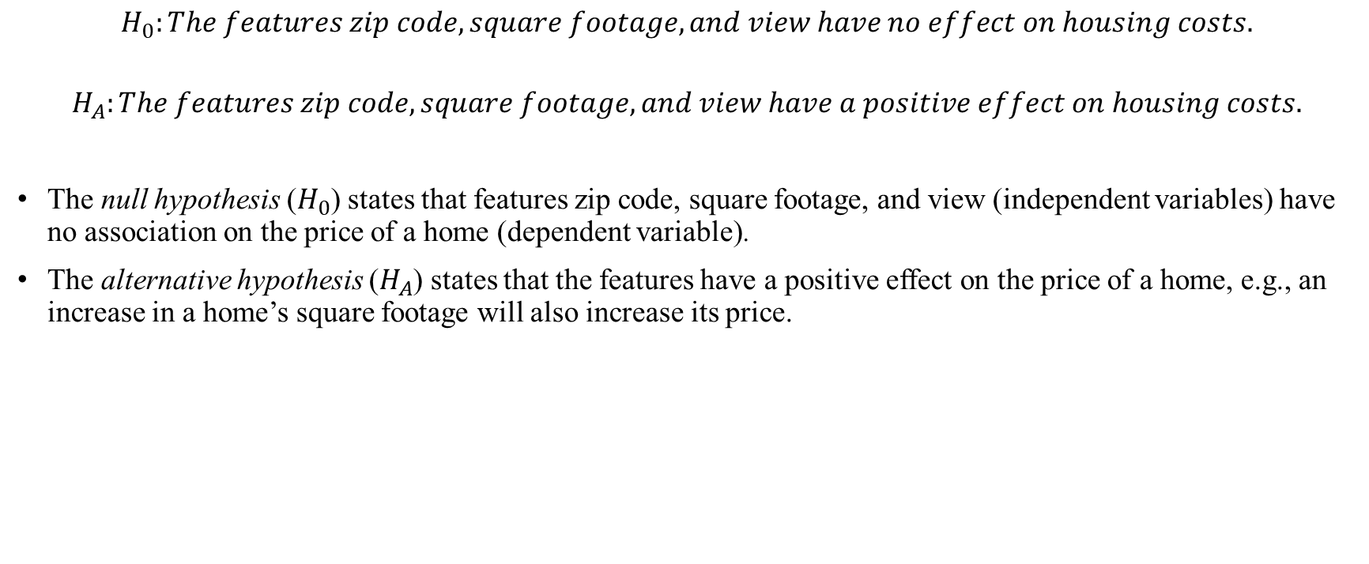
Hypothesis Formulation
Problem Statement & Hypothesis Formulation
$$H_{0}:The features zip code, square footage, and view have no effect on housing costs.$$
$$H_{A}:The features zip code, square footage, and view have a positive effect on housing costs.$$
The null hypothesis ($H_{0}$) states that features zip code, square footage, and view (independent variables) have no association on the price of a home (dependent variable).
The alternative hypothesis ($H_{A}$) states that the features have a positive effect on the price of a home, e.g., an increase in a home’s square footage will also increase its price.
Notes:
Writing a null hypothesis –
The null hypothesis is the default position that there is no association between the variables in the model.
The alternative hypothesis is the opposite, where there does exist an association between variables in the model.

Slide 4
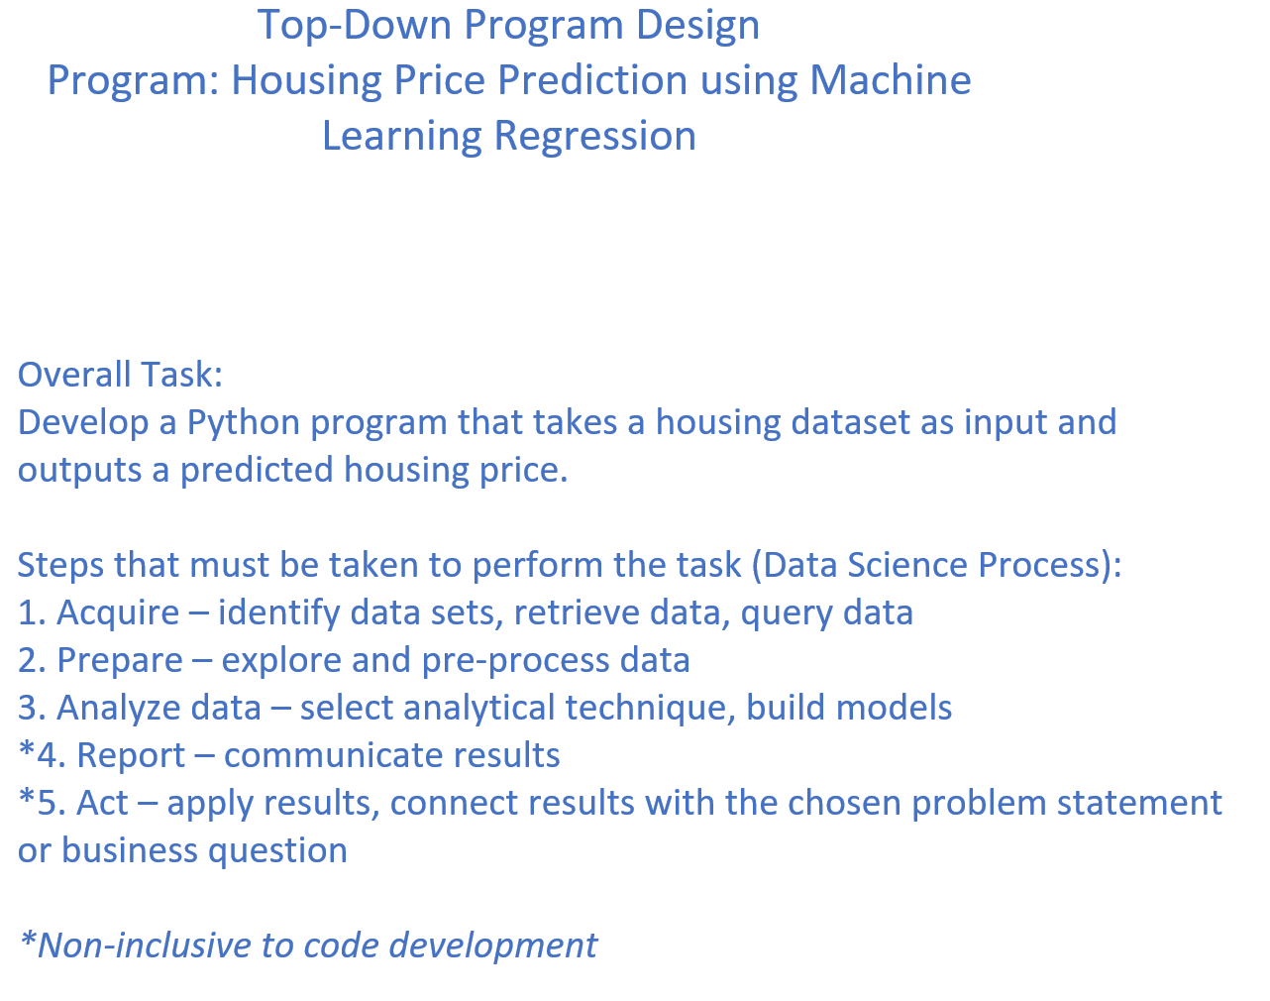
Top-Down Program Design
Program Design

Slide 5
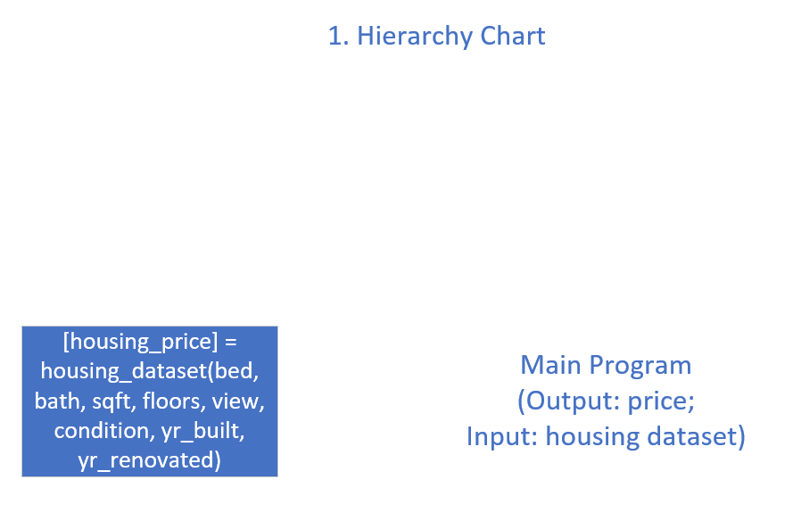
Hierarchy Chart
Program Design

Slide 6
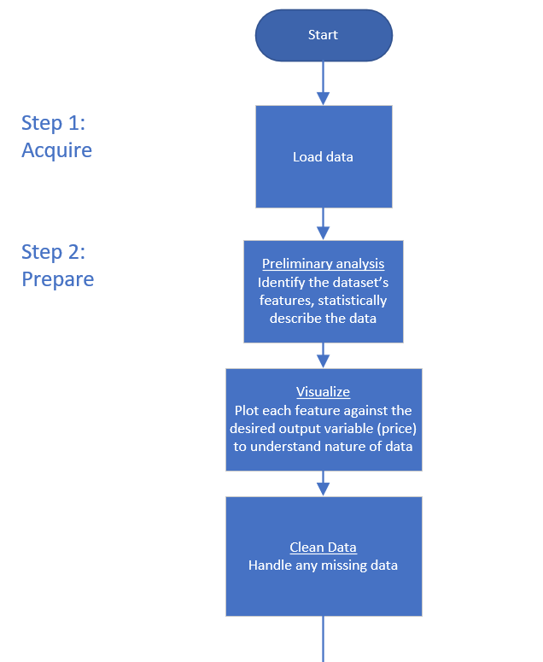
Flowchart
Program Design

Slide 7
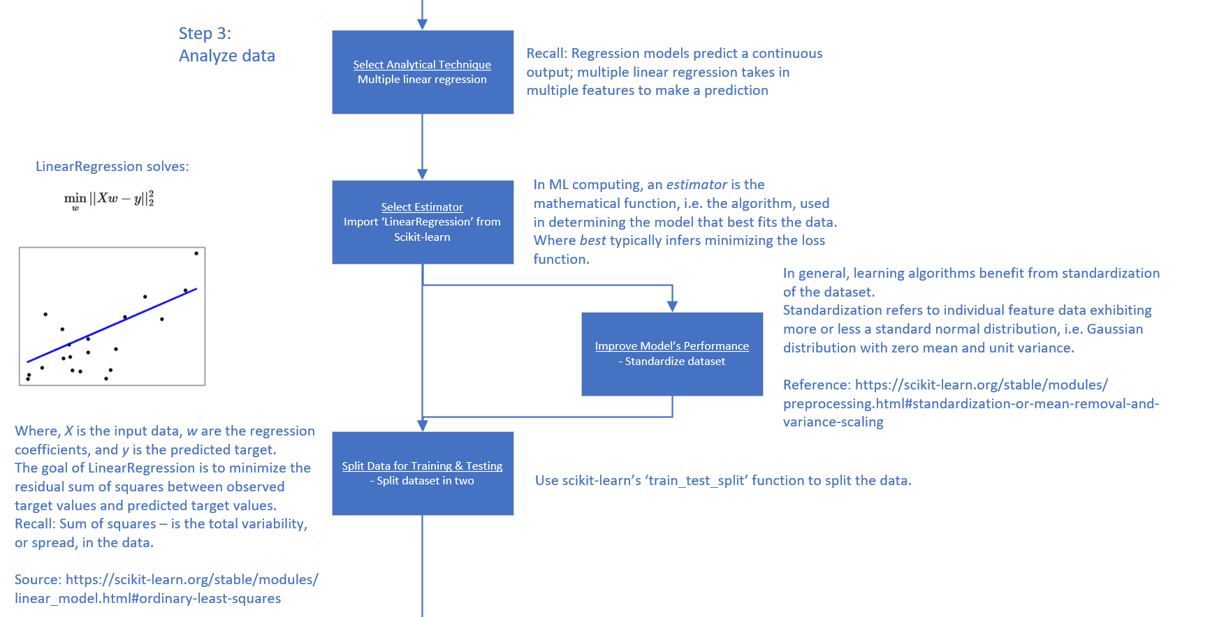
Flowchart, cont.
Program Design

Slide 8
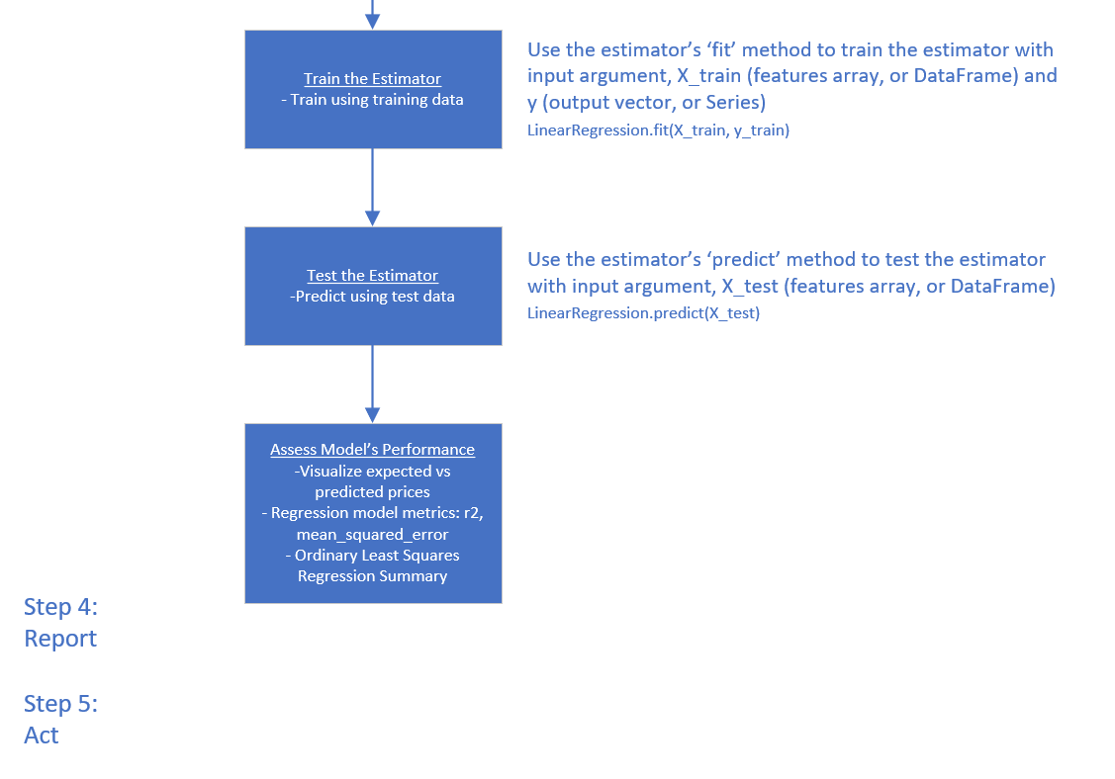
Flowchart, cont.
Program Design

Slide 9
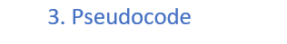
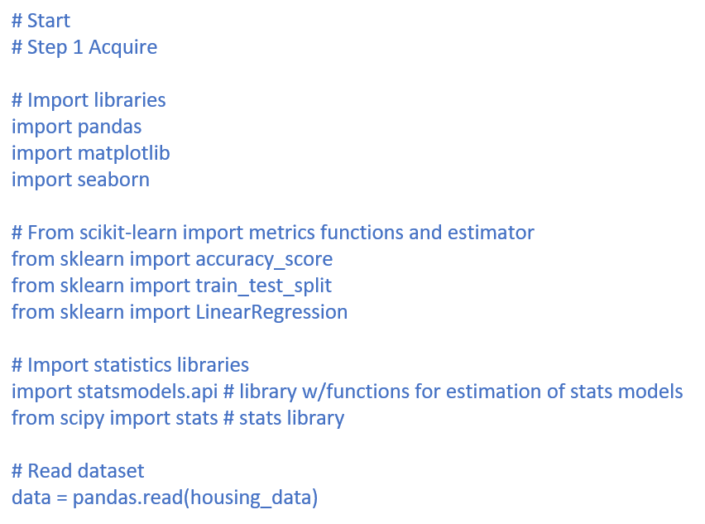
Pseudocode
Program Design

Slide 10
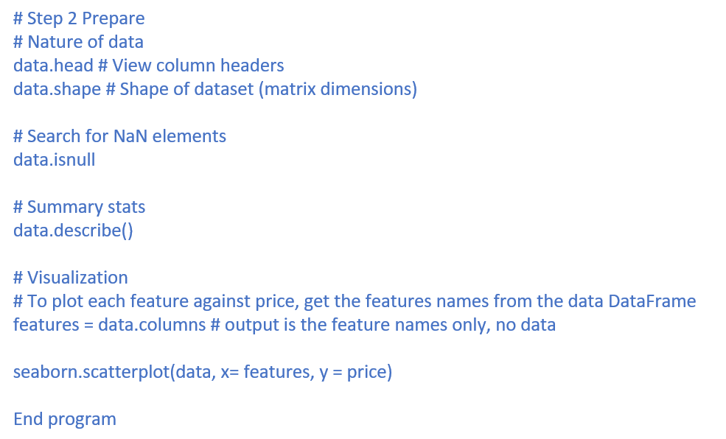
Pseudocode, cont.
Program Design

Slide 11
Acquire
The Data Science Process (1/5)
Housing sales data was acquired through Kaggle.com, which is a popular place for data scientists, machine learning practitioners, engineers, and data scientists to post projects, participate in data science competitions and acquire open-source datasets.
Data source: https://www.kaggle.com/datasets/vallabhadattap/kingcountyhousing?select=KC_housing_data.csv
Other potential data sources:
U.S. Department of Housing and Urban Development
https://www.hud.gov/
US Census Bureau
New Residential Sales: https://www.census.gov/construction/nrs/index.html

Slide 12
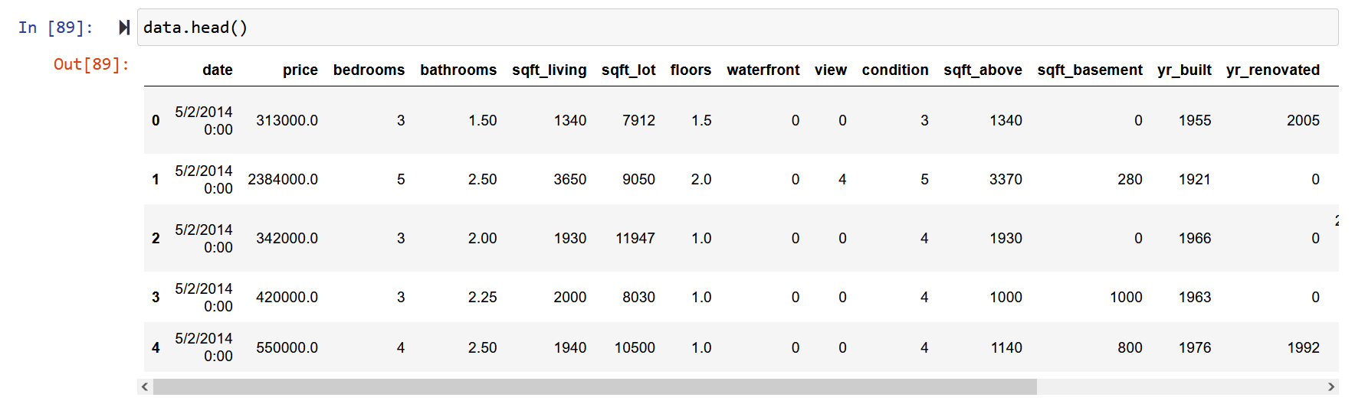
Prepare
The Data Science Process (2/5)
‘data.head()’ function outputs the column headers and the first five rows of the dataset

Slide 13
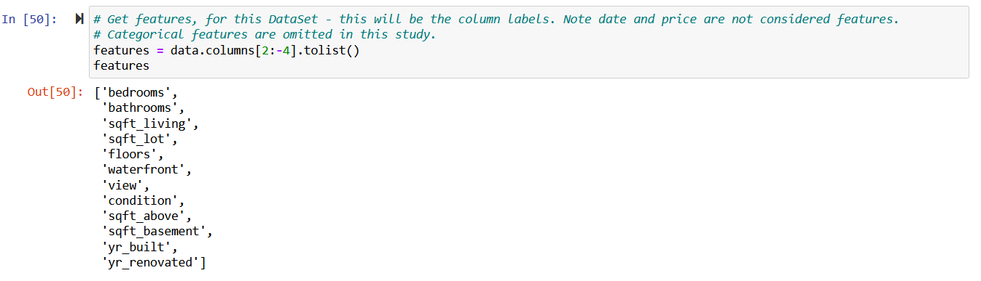
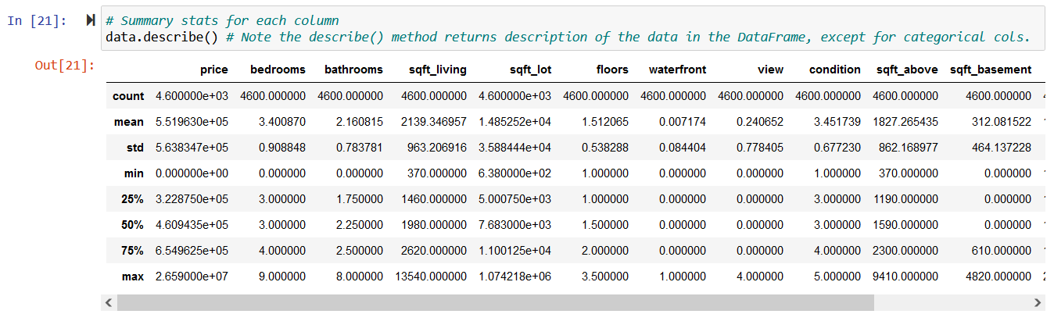
Prepare, cont.
The Data Science Process (2/5)
Features:
Summary stats:

Slide 14
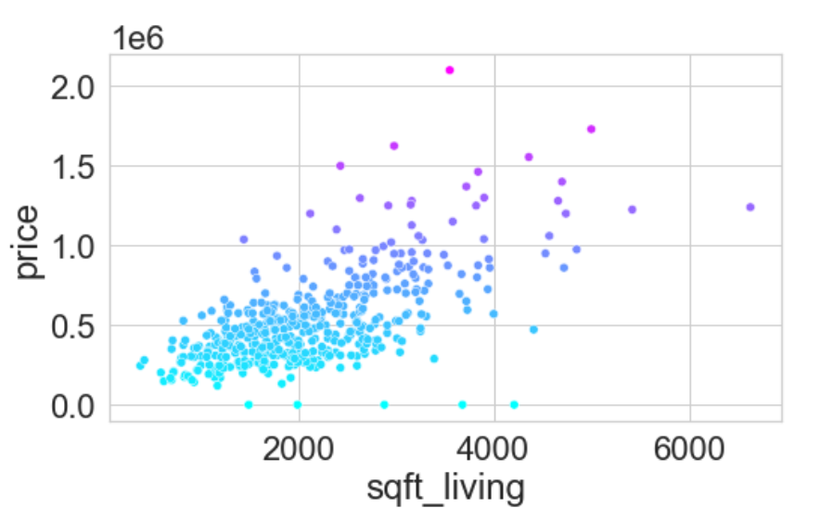
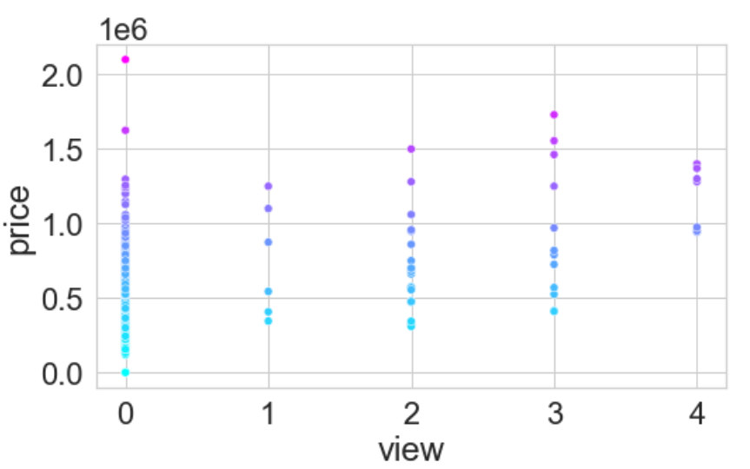
Prepare, cont.
The Data Science Process (2/5)
Visualization of how median home value relates to features

Slide 15
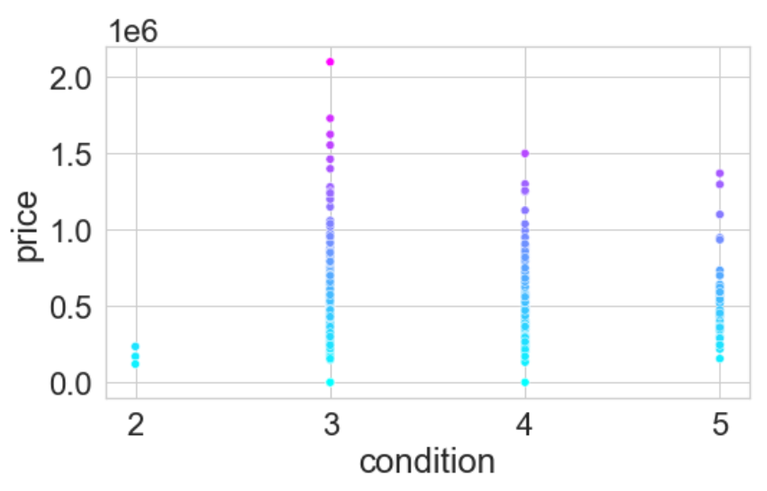
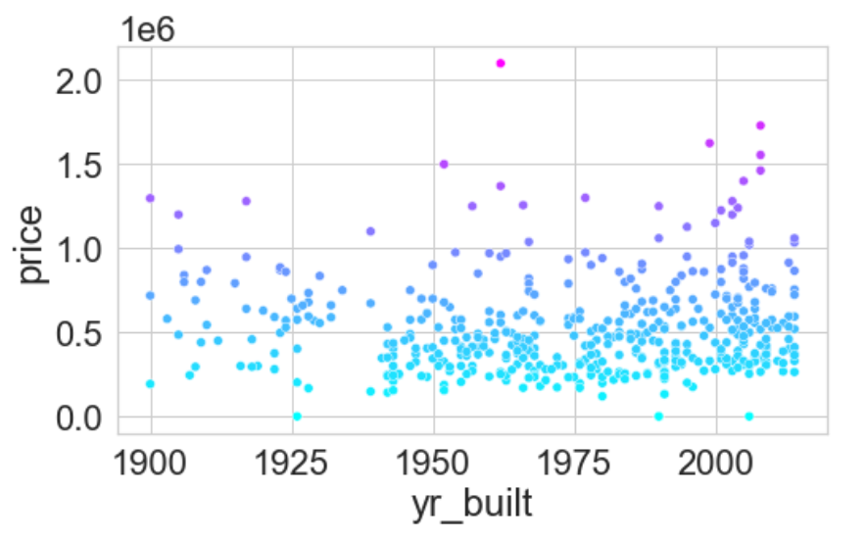
Prepare, cont.
The Data Science Process (2/5)
Visualization of how median home value relates to features

Slide 16
Analyze data
The Data Science Process (3/5)
<select analytical technique, build models>
This is a regression task, and it is of supervised type of ML (i.e., the training data being fed into the model is labeled).

Slide 17
Report
The Data Science Process (4/5)
<communicate results>

Slide 18
Act
The Data Science Process (5/5)
<apply results, connect results with the chosen problem statement or business question>

