Slide 1

DRUGDASH
Brad Barrett
Manny Ramos
Samantha Devlin
Tim Tallent

Slide 2
DrugDash – Functional Proposal
An interactive Dashboard that explores US States for the following data:
Drug Overdose Deaths, % to total Deaths and Drug type over a 12-month period over the years 2015 to 2018.
Exploring drug overdose by state the interactive dashboard will also compare state unemployment rates over the same time period.
Mental health survey by state that ask survey participants the following questions. What stresses you out,
What are you most likely to do when you are stressed,
The purpose of this dashboard is to allow the user to select a State then understand the stress factors, unemployment rates and drug use habits of the state residents.

Slide 3
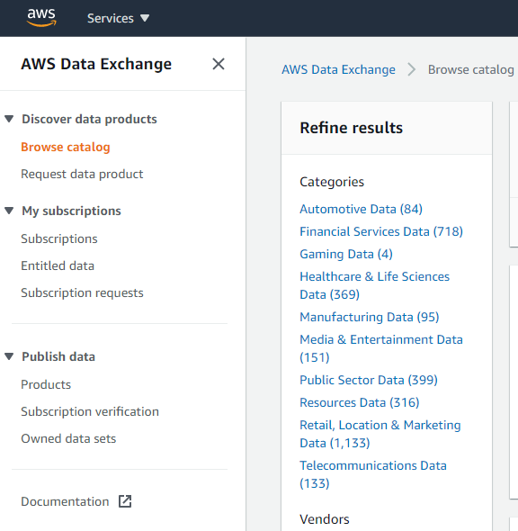
Source Data
Data source from AWS Data Exchange: Original format CSV.
Drug Overdose by type, state and year.
Unemployment Rate by state and year.
Drug overdoses compared to % total deaths in the state.
Mental Health Survey by all 50 states asking residence how they deal with stress factors.

Slide 4





ETL Process:
Loaded CSVs in Jupyter labs using Pandas to transform and combined data.
Then passed dataframes to SQLAlchemy to create a multiple usable database resources.
Using Python we developed a flask app in JSON format as a functioning API through Heroku.
See deployed API links below for access.
https://calm-fortress-78674.herokuapp.com/api/v1.0/drugdata
https://calm-fortress-78674.herokuapp.com/api/v1.0/drugvunemployment
Create HTML & JavaScript based interactive dashboard that will allow users to interface by selecting a state to change visualization and details.

Slide 5
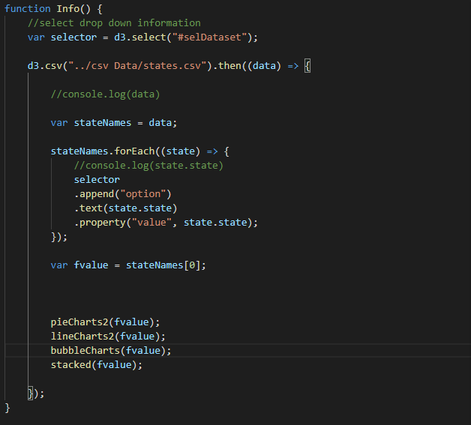
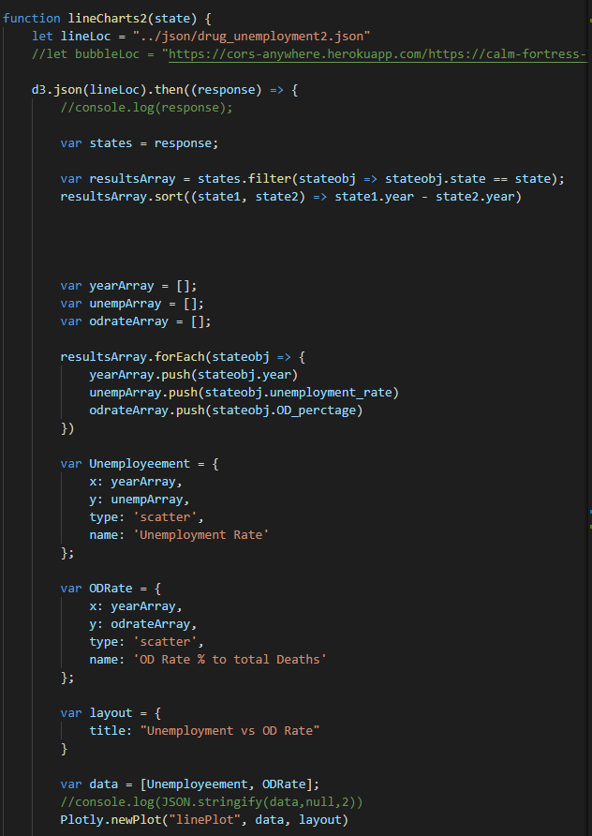
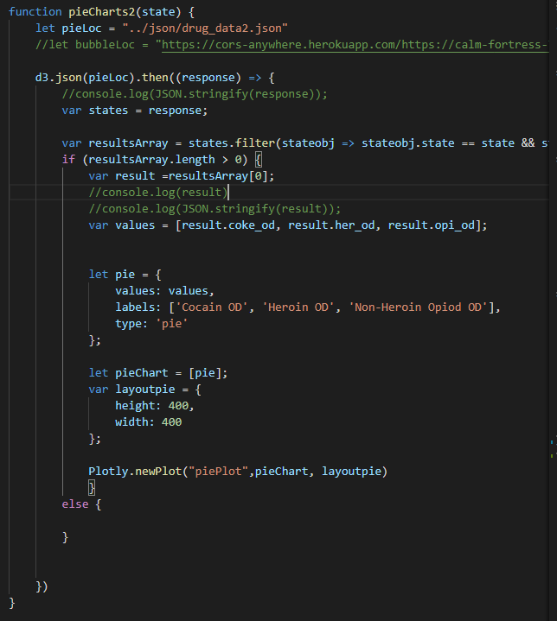
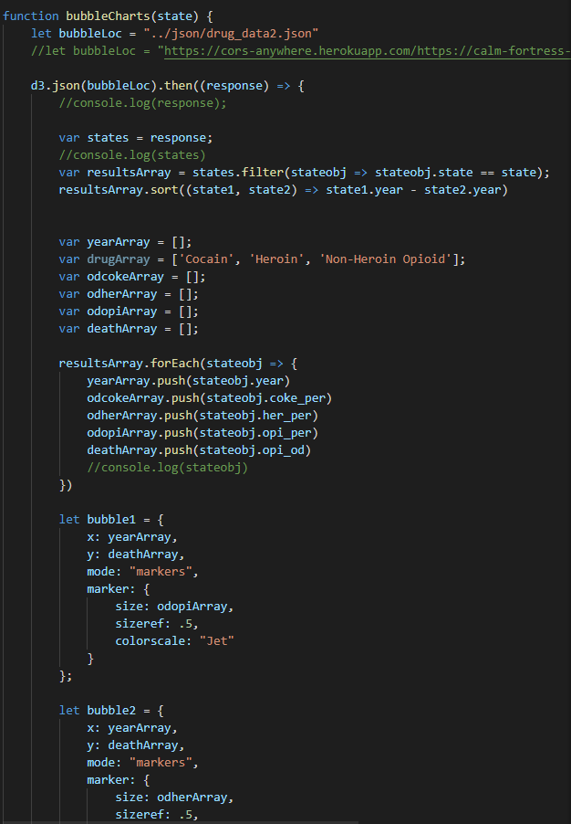
Java Script Code Process
Info Function: Initializes Chart functions with starting value populated through states.
Chart Functions pass with state object to filter API/JSON data and catch records to populate Chart data.
On-Change function allows users to select new states and repass record data back to charts to update.

Slide 6
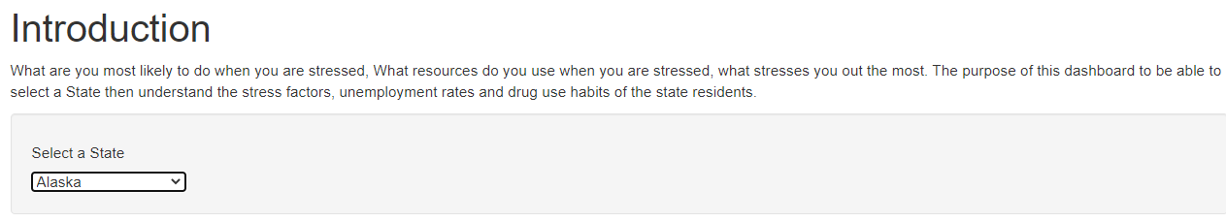
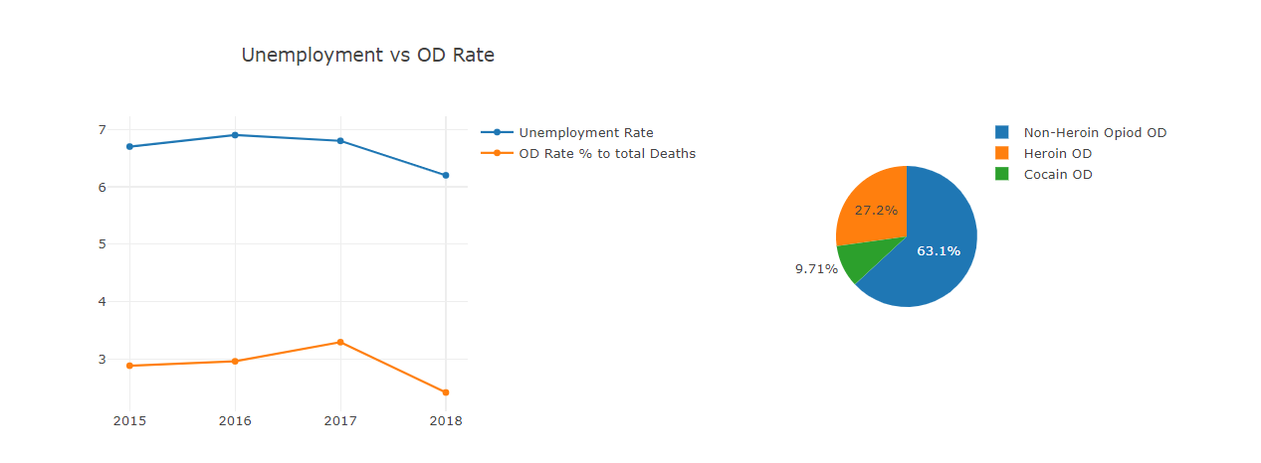
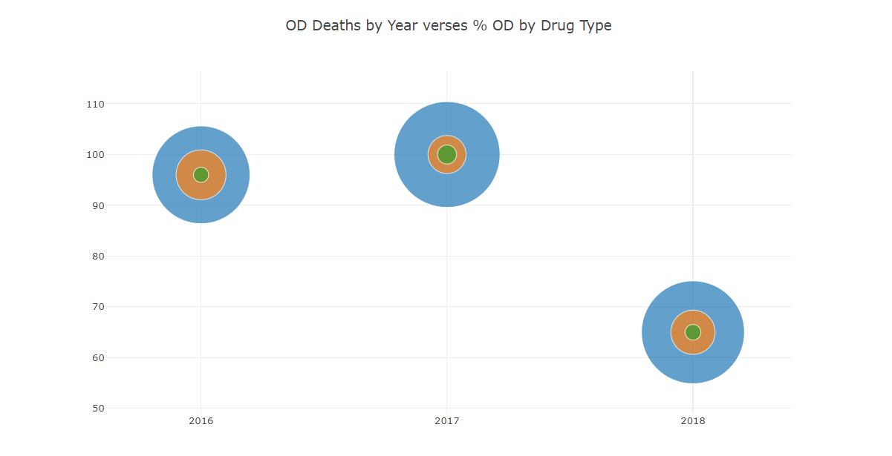
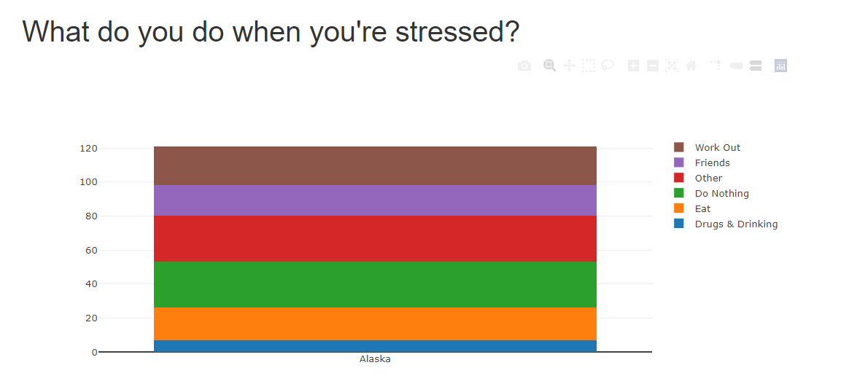
Java Script Process
Interactive drop down to select state.
Once the state is selected the javascript functions populate the following charts.
Line Chart: Unemployment vs OD Rate
Pie Chart: % Breakdown of OD Type.
Bubble Chart: Comparing total OD Deaths by Chart.
Stacked Bar Chart: Displaying how people in that state cope with stress by category.

Slide 7
Conclusions & Observations
Majority of States showed declines in OD Rates when Unemployment rates decreased.
Majority of OD occurred were Non-Heroin based Opioids including synthetics.
Majority of States showed decreased in OD Death Rates while some states maintained OD Rates without death. Although we cannot prove this we believe the more wide spread use of products like Narcan may have helped save OD patients in some states.
Majority of people surveyed did not list drugs or drinking as their primary response to stress factors.
Issues:
State data for OD Rates is spotty with some records by states not recording for some or all years.
Now on to a live demo of the DrugDash

Slide 8
Questions
And
live share

