Slide 1
Groovy Distributed Task Management System
COSC 880
Towson University
Department of Computer and Information Sciences
Advisor: Dr. Josh Dehlinger
Emanuel Rivera
https://github.com/mannyrivera2010/barium

Slide 2
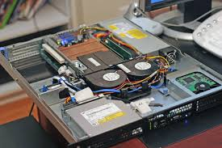
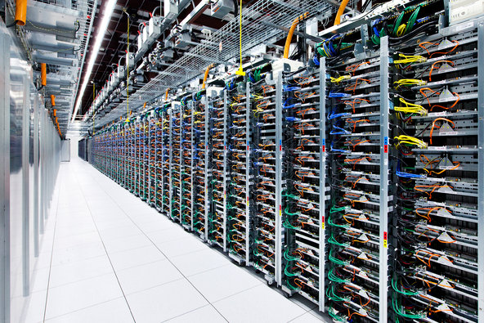
Motivation/Purpose
Motivation- Figure out a way to deal with processing growing data sets and processing graph data in less time in a distributed way
The purpose of this project was to create a framework based on dividing a job into many tasks to use the computational power of many machines

Slide 3
Terminology
Owner/Worker Framework- an asynchronous distributed task management system framework that allows developers to have a generic way to execute code on multiple machines. Also known as Barium
Queues/Publish Subscribe- communication models in which the framework uses to communicate between worker nodes
BariumUI- a front-end which consume barium’s RESTful API powered by an AngularJS web application framework.

Slide 4
Terminology (Cont.)
Owner- the owner is responsible for generating, monitoring, and putting tasks into the queue for workers to be executed in a distributed way
Worker- the worker is responsible for executing a task a task from the queue and publishing all results to the pub/sub topic that the owner listens to
Task- a task is a unit of work that is executed on the worker

Slide 5
System
REST Client
WS Client
WS Client
FIFO Queue
Pub/Sub
REST
WS
Pub/Sub
Pub/Sub
Pub/Sub
Owner1
Worker1
Worker2
Pub/Sub
Tracking Table

Slide 6
Technologies
Backend Technologies
Netty
HazelCast
Groovy/Java
Gradle
Node.js
Frontend Technologies
AngularJS
Grunt

Slide 7
Demonstration
Processing many PubMed Central® (PMC) XMLs for conversion into a Single Line-delimited JSON file for analytics
PMC - is a free full-text archive in xml format of biomedical and life sciences journal literature at the U.S. National Institutes of Health's National Library of Medicine (NIH/NLM).
Demo
There is a slide in the end of presentation called “Demonstration Procedure” with more information

Slide 8
Improvements
Owner/Worker Framework Frontend (BariumUI)
Owner/Worker Framework Backend (Barium)
Better Software Testing
Major Code Refactor
Fully Feature Website
Multi-Broker Support

Slide 9
Lesson Learned
A lot of different technologies
Software Design
Distributed Computing
Gain the skill to use different resources to solve computing problems

Slide 10

Discussion/Thank You

Slide 11
Sources
https://hazelcast.com/
https://angularjs.org/
http://yeoman.io/codelab/setup.html
https://git-scm.com/
https://www.github.com
http://www.csun.edu/~shan/comp696-698/Resources/Thesis-Outline-Guide-rev1.pdf
http://www.easterbrook.ca/steve/2010/01/how-to-write-a-scientific-abstract-in-six-easy-steps/
http://oanasagile.blogspot.com/2012/11/test-driven-business-featuring-lean.html
http://netty.io/
http://sd.jtimothyking.com/2006/07/11/twelve-benefits-of-writing-unit-tests-first/
http://blog.codinghorror.com/code-smells/
http://www.allthingsdistributed.com/files/amazon-dynamo-sosp2007.pdf
http://www.cs.washington.edu/events/colloquia/search/details?id=437
http://kafka.apache.org/
http://gruntjs.com/
https://nodejs.org/en/
http://theleanstartup.com/principles
https://commons.wikimedia.org/wiki/File:Inside_and_Rear_of_Webserver.jpg
http://www.engadget.com/2015/08/20/google-reveals-server-info/

Slide 12
Presentation Demonstration Procedure
This is the procedure used for the demonstration on how to use the Owner/Worker framework for the presentation portion of the project. The goal of the demo was to convert PubMed Central Open Access Subset XML’s files into single JSON line-delimited file in a scalable way and using the processing power of many machines. Once all PMC’s xml has been converted into JSON format, there are tools which can be used to analyze the data which is used for data mining. It will allow you to ask questions that provided value from the data. The dataset contains all of the articles in the PMC open access subset. PubMed Central has a public ftp server that allows you to download subset.
Procedure
Visit http://www.ncbi.nlm.nih.gov/pmc/tools/ftp/ and download the datasets archive files
Un-compress the archive and put the files into the file server powered by Node.js
Start Owner and Worker nodes on each machine
Owner- read directory from Webserver and make queue for each folder that exist in the top directory. There will be one Task for each folder that exist.
Worker- get file from webserver, convert XML to JSON , send results to the owner to Flat File of JSON lines for analyzing.
After the job has finished, analyze the file with a tool

