Slide 1


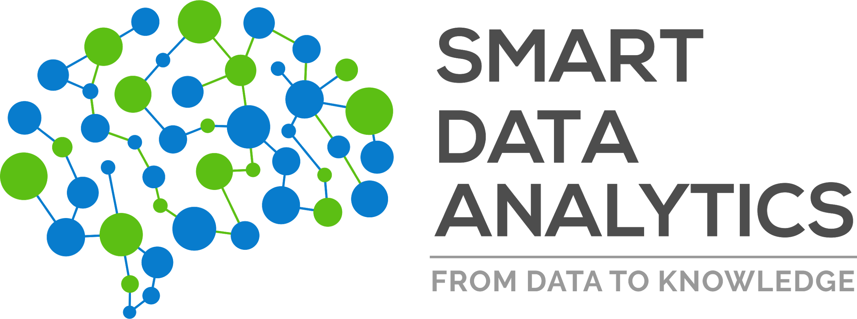

SPARQL and Gremlin Interoperation
Harsh Thakkar harsh9t@gmail.com
Smart Data Analytics Lab, University of Bonn

Slide 2






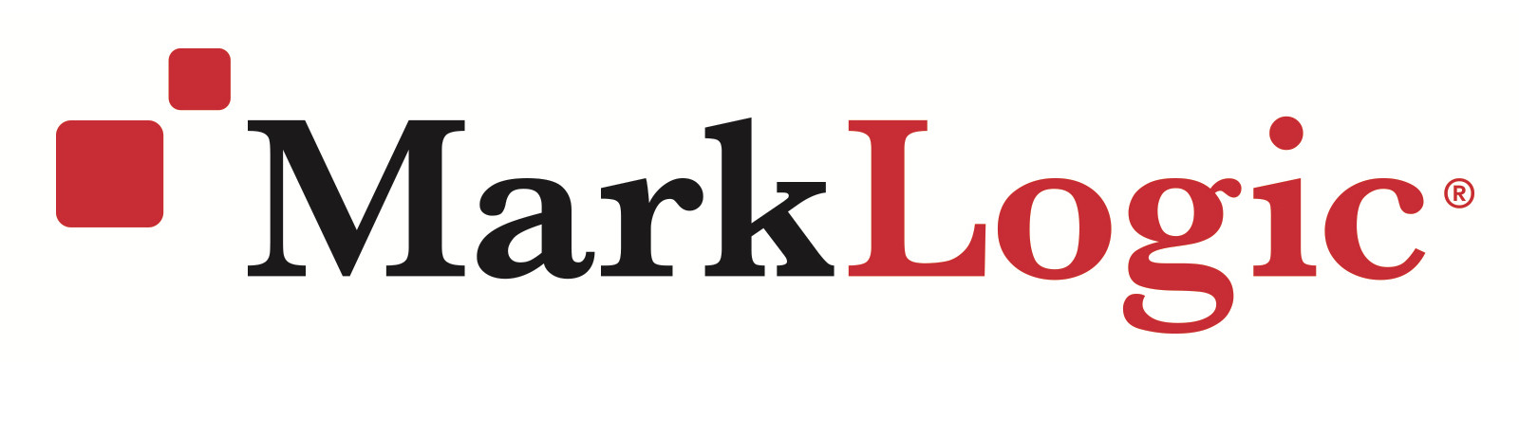
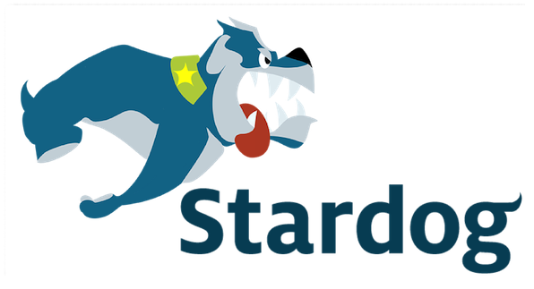
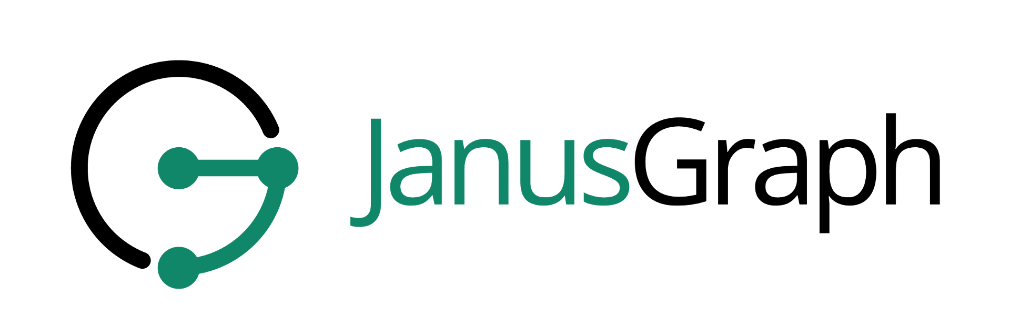




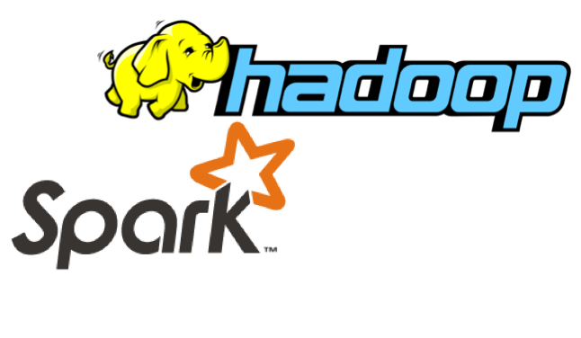
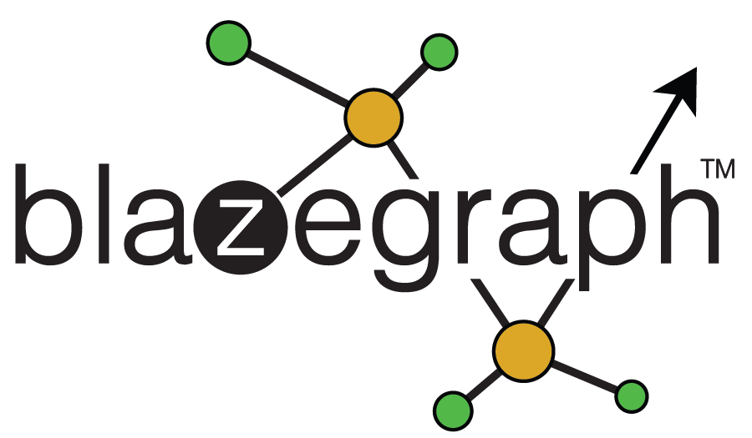
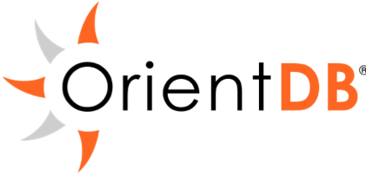
SPARQL Declarative query language
Gremlin Imperative/declarative query language
And more...
And more...

Slide 3
SPARQL Declarative query language
Gremlin Imperative/declarative query language
SPARQL-Gremlin
And more...
And more...

Slide 4


Gremlin
SPARQL
Cypher Declarative query language
SPARQL-Gremlin
Cypher for Gremlin
And more...

Slide 5
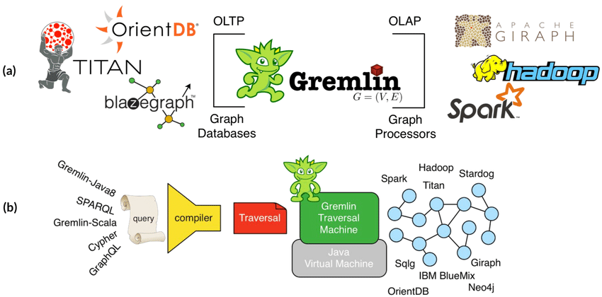
SPARQL for Gremlin
Run SPARQL on TinkerPop-enabled database ecosystem (both OLTP databases and OLAP processors) [docs, github]
Allow SPARQL with Gremlin steps (composite traversals)
Call Gremlin from SPARQL?

Slide 6
1. Run SPARQL on TINKERPOP-enabled databases
SPARQL
SELECT ?a ?b ?c WHERE
{
?a v:label "person" .
?a e:knows ?b .
?a e:created ?c .
?b e:created ?c .
?a v:age ?d . FILTER (?d <= 30)
}
g.V().match(
.as(‘a’).hasLabel(‘person’),
.as(‘a’).out(‘knows’).as(‘b’),
.as(‘a’).out(‘created’).as(‘c’),
.as(‘b’).out(‘created’).as(‘c’),
.as(‘a’).values(‘age’).as(‘d’).where('d',lte(30))).select(‘a’,’b’,’c’)
Gremlin provides GPM construct using match()-step

Slide 7
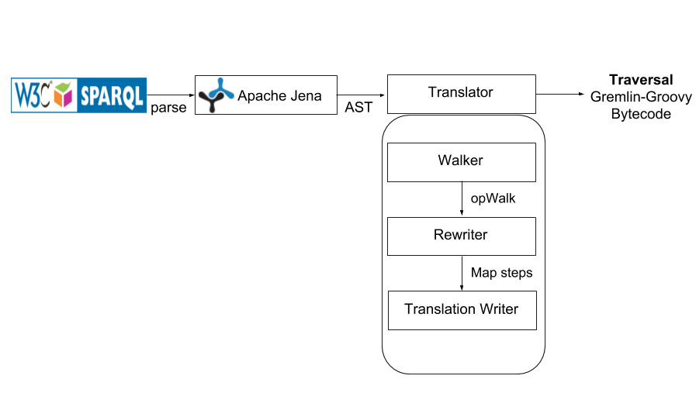
SPARQL to Gremlin conceptual flow

Slide 8
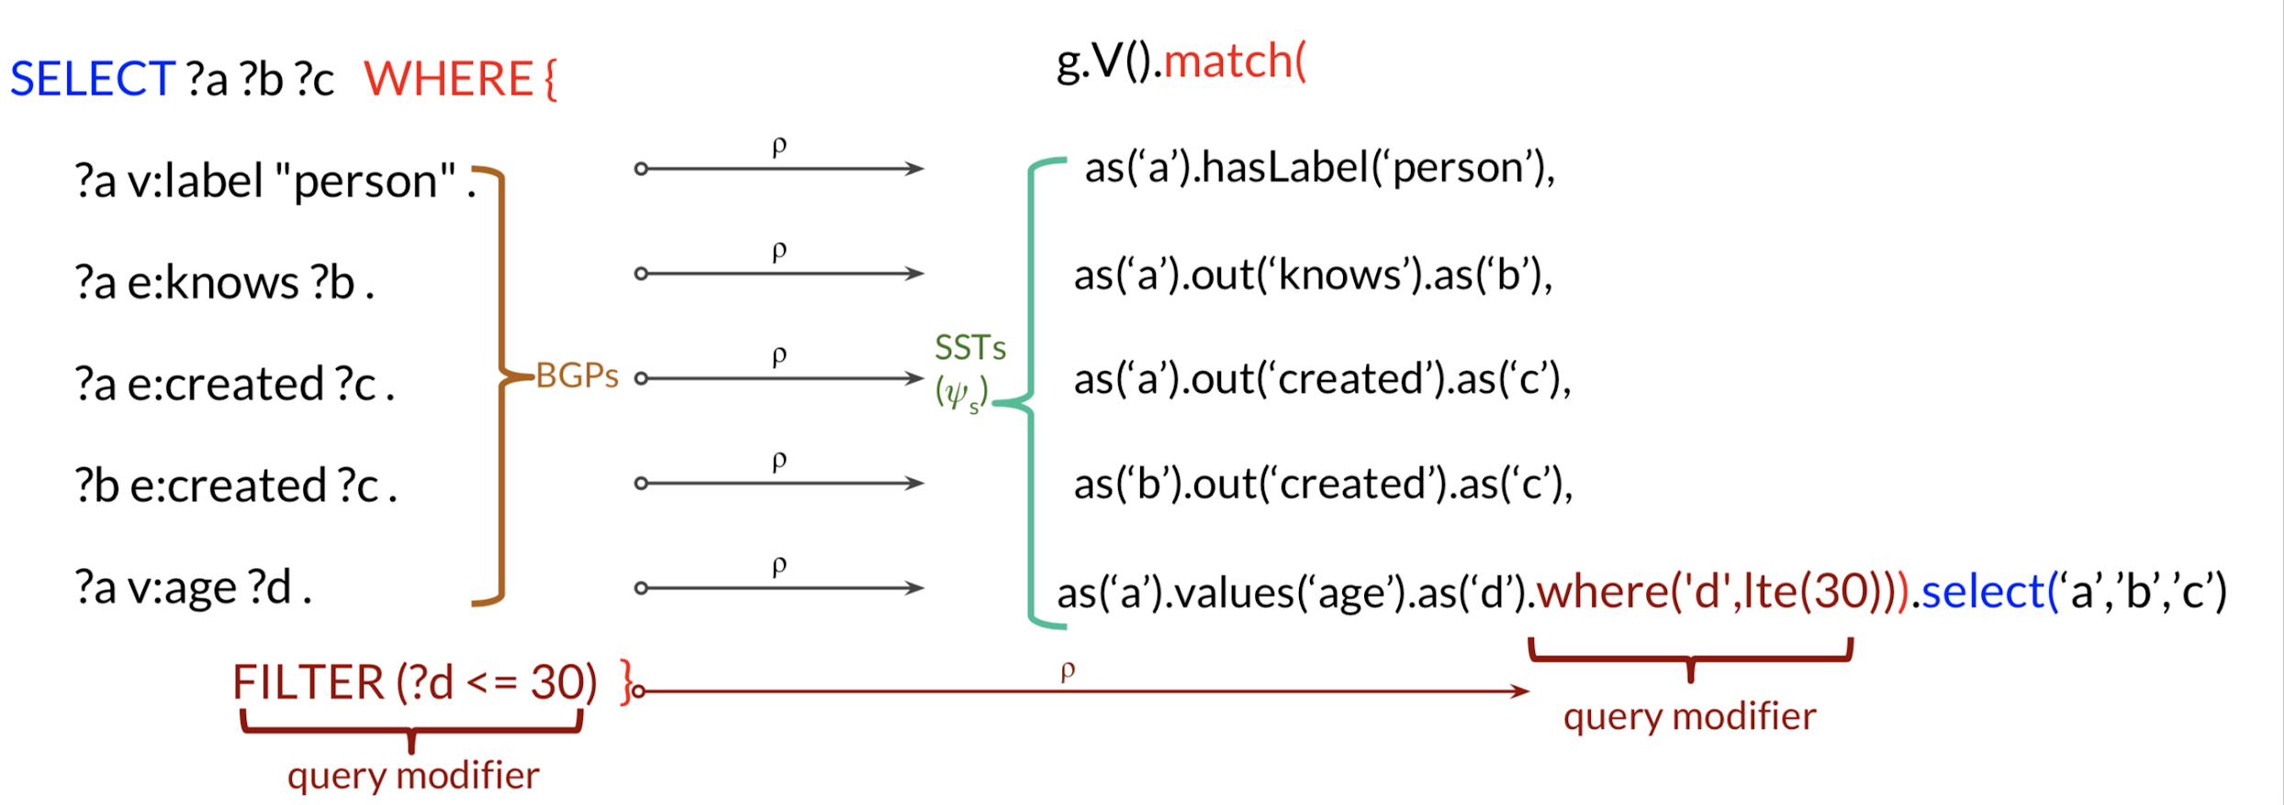
1. Run SPARQL on TINKERPOP-enabled databases
SPARQL

Slide 9
1. Run SPARQL on TINKERPOP-enabled databases
SparqlTraversalSource
Can be used with RemoteStrategy from 3.4.1 (commit)
gremlin> graph = TinkerFactory.createModern()
==>tinkergraph[vertices:6 edges:6]
gremlin> g = graph.traversal(SparqlTraversalSource)
==>sparqltraversalsource[tinkergraph[vertices:6 edges:6], standard]
gremlin> g.sparql("""SELECT ?name ?age
WHERE { ?person v:name ?name . ?person v:age ?age }
ORDER BY ASC(?age)""")
==>[name:vadas,age:27]
==>[name:marko,age:29]
==>[name:josh,age:32]
==>[name:peter,age:35]

Slide 10
2. SPARQL w/ Gremlin steps (composite traversal)
Feature planned for release in TinkerPop 3.4.1
Github PR #2171
Traversal can continue with a combination of diverse gremlin steps
g.sparql("SELECT * WHERE { }").out().label().dedup()
==>person
==>software
CYPHER for Gremlin
gremlin> g.cypher("MATCH (n) RETURN n").select("n").outE().label().dedup()
==>created
==>knows

Slide 11
3. Query SPARQL from Gremlin
Open question
Vendor-specific implementation
E.g.
SELECT ?a WHERE
{ ?a v:label "person" .
{
GREMLIN(select(“a”).values(“name”))
}
}

Slide 12
Coverage and Limitations
Supports SPARQL “SELECT” queries
Covers SPARQL 1.0 and basic aggregators from SPARQL 1.1 (read more)
Limitations
Variables as predicates
Read more

Slide 13


Links
TinkerPop plugin: https://github.com/apache/tinkerpop/tree/master/sparql-gremlin
Reference documentation: http://tinkerpop.apache.org/docs/current/reference/#sparql-gremlin
CYPHER for Gremlin: https://github.com/opencypher/cypher-for-gremlin
Contact Me: harsh9t@gmail.com | harsh9t
SPARQL
SPARQL-Gremlin
Gremlin
Cypher Declarative query language
Cypher for Gremlin

Slide 14
References
Thakkar, Harsh, Dharmen Punjani, Jens Lehmann, and Sören Auer. "Two for one: querying property graph databases using SPARQL via gremlinator." In Proceedings of the 1st ACM SIGMOD Joint International Workshop on Graph Data Management Experiences & Systems (GRADES) and Network Data Analytics (NDA), p. 12. ACM, 2018. (https://dl.acm.org/citation.cfm?id=3210271) [demo paper]
Thakkar, Harsh, Dharmen Punjani, Yashwant Keswani, Jens Lehmann, and Sören Auer. "A Stitch in Time Saves Nine--SPARQL querying of Property Graphs using Gremlin Traversals." arXiv preprint arXiv:1801.02911 (2018). (https://arxiv.org/pdf/1801.02911.pdf) [full paper]

