Slide 1

Enterprise Grade Deployment
Martin Novák I Product Architect
Barcamp, UHK, 12.10.2019

Slide 2
Agenda
Deployment transformation
1
Kubernetes & OpenShift
2
Demo
3
Kubernetes operators
4
Summary
5

Slide 3
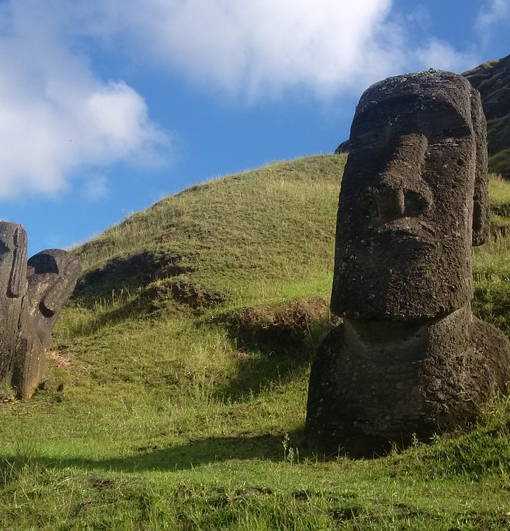
Monolithic Architecture

Slide 4
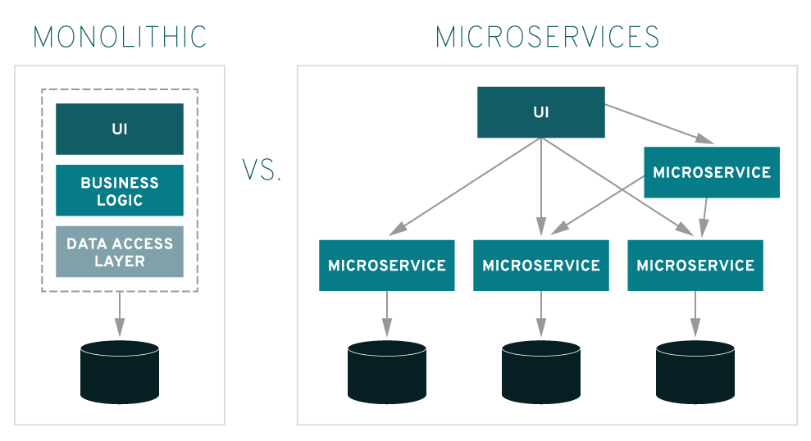
Monolithic architecture
One big code base
Hard maintenance
One process
Single point of failure
Shared memory advantage
Usually one platform supported

Slide 5
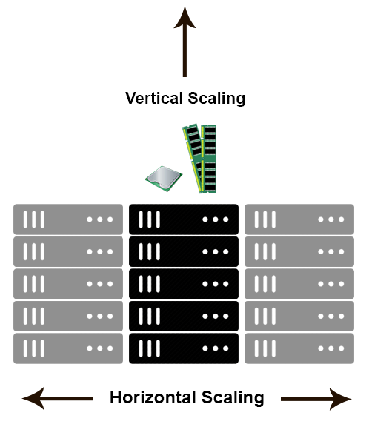
Monolithic architecture - Scaling
Required horizontal and vertical scaling
Complex custom load balancer configuration
Installer wizard
Separate application

Slide 6

Docker

Slide 7
Docker
Containers
Isolation/Security
Same kernel as host system
Faster than VMs
Image contains everything for run
Useful for run of multiple applications simultaneously

Slide 8
Microservices

Slide 9
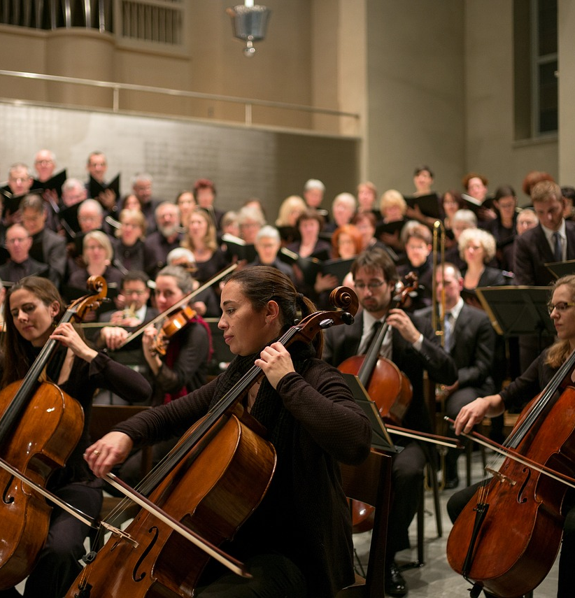
Container Orchestration

Slide 10
Container orchestration
Run and control more containers simultaneously
Maintenance of application cluster state
Examples
Docker Compose
Docker Swarm
Kubernetes/OpenShift

Slide 11
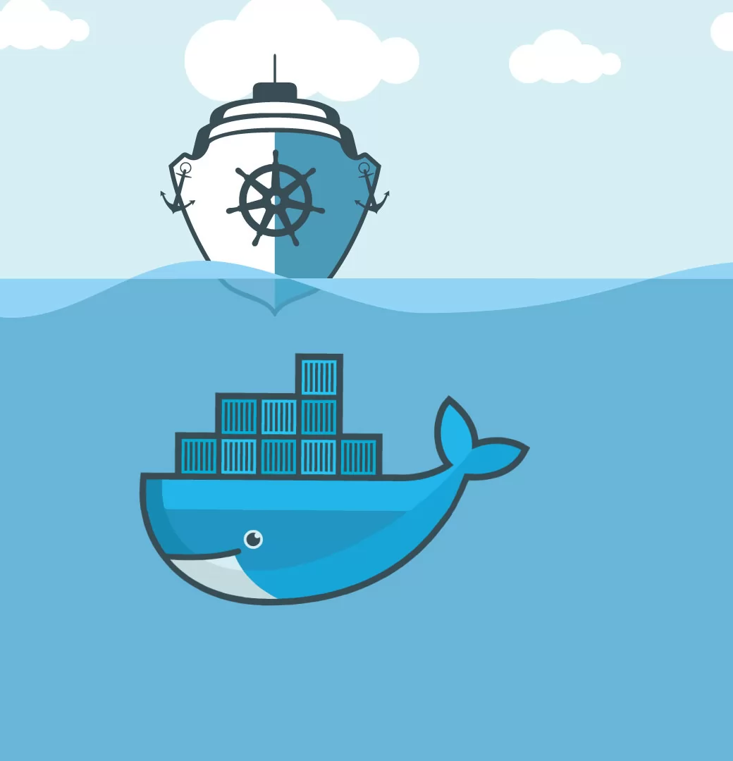

Kubernetes (K8s)

Slide 12
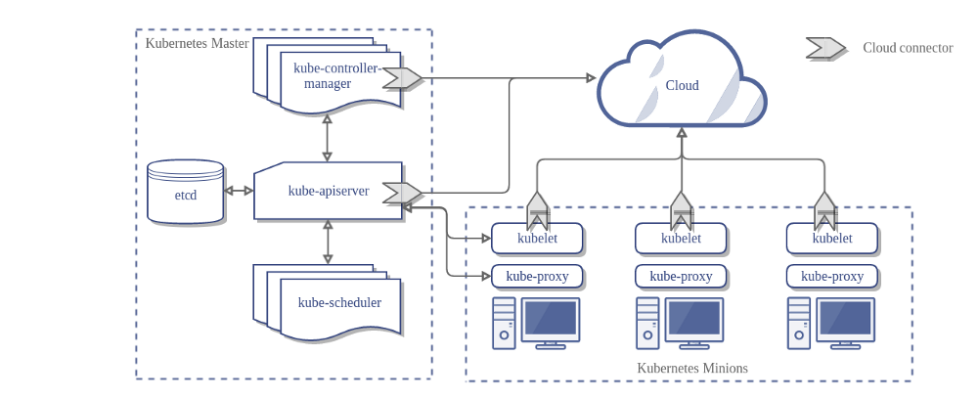
Kubernetes cluster

Slide 13
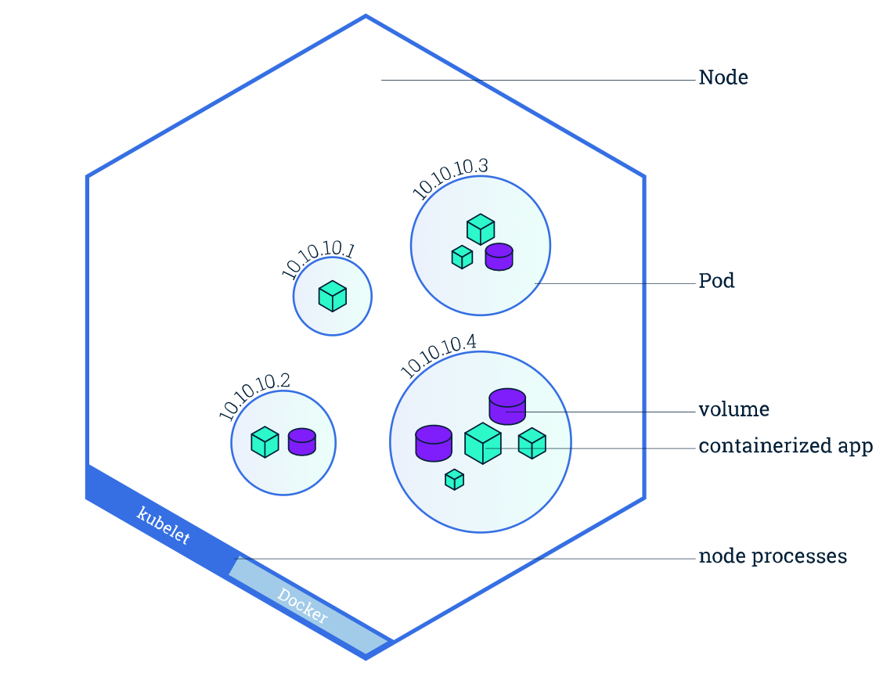
Kubernetes node

Slide 14
Kubernetes installation
Local machine
Minikube
https://github.com/kubernetes/minikube
Cloud
Terraform/Ansible scripts
Azure Kubernetes Service (AKS)
Elastic Kubernetes Service (EKS)

Slide 15
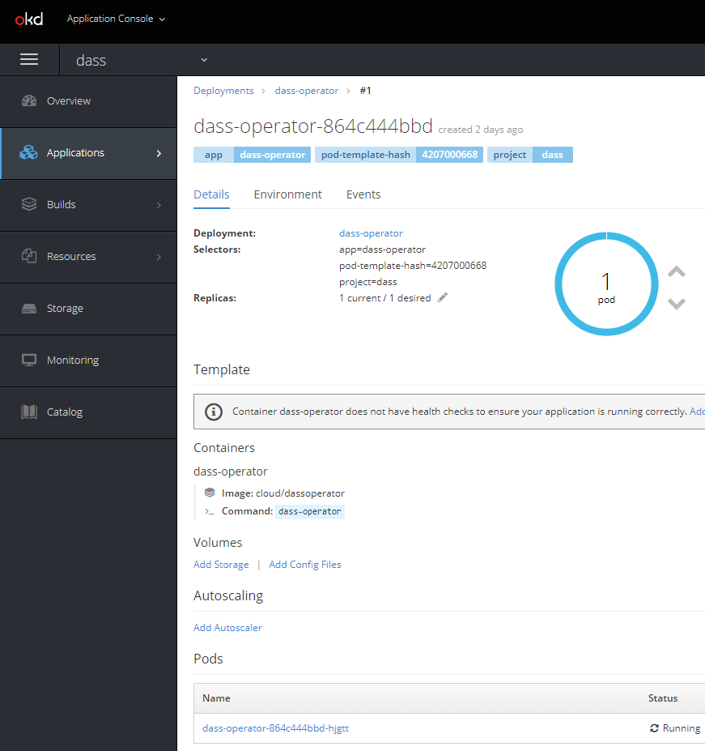

OpenShift

Slide 16
OpenShift
Enterprise Kubernetes
Mainly security oriented
Can be demanded by customers as the required application deployment
Layer over k8s
Templates almost the same as in k8s
GUI

Slide 17
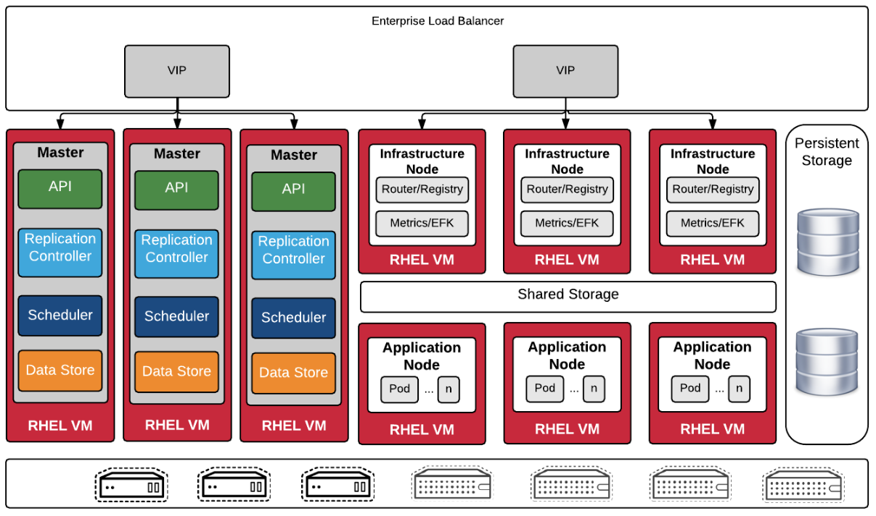
OpenShift cluster

Slide 18
OpenShift installation
Local machine
Minishift
https://www.okd.io/minishift/
Community version
https://www.okd.io
Azure templates 3.9/3.11 fork
Paid versions on RedHat/Azure/Amazon servers

Slide 19

Demo

Slide 20

Kubernetes Operators

Slide 21
Kubernetes operators
Extensions of k8s/OpenShift API
Operator framework
https://github.com/operator-framework/operator-sdk
Go language
Testing
Autopilot of application
Installation, upgrades, restore, backups, auto scaling, self repair…

Slide 22
Operators
CustomResource of OpenShift
Control loop
Watch on objects
OnChange: analyze difference between actual and desired state
Act on changes
Example
https://github.com/operator-framework/operator-sdk-samples/tree/master/memcached-operator

Slide 23
Summary
Complex systems moves from monoliths to microservices
Docker becomes software standard
Kubernetes or OpenShif as an containers orchestrator
Complex orchestrating logic via Kubernetes operators

Slide 24
Thank you!
Martin Novák,
m.nov4k@gmail.com

Slide 25
Resources
https://kubernetes.io/
https://medium.com/@adilsonbna/installing-a-highly-available-openshift-origin-cluster-f3493cbdb644
https://pixabay.com/photos/moai-quarry-easter-island-history-3525785/
https://pixabay.com/photos/container-port-loading-stacked-3118783/
https://pixabay.com/photos/classical-music-orchestra-choir-2199085/
https://pixabay.com/illustrations/call-centre-help-desk-communication-4246688/
https://pixabay.com/photos/hands-clay-potter-pottery-1139098/
https://www.redhat.com/en/topics/microservices/what-are-microservices
https://github.com/vaquarkhan/vaquarkhan/wiki/Difference-between-scaling-horizontally-and-vertically
https://svitla.com/blog/kubernetes-vs-docker

