Slide 1

Enterprise Grade Deployment
Martin Novák I Product Architect
Barcamp, UHK, 12.10.2019

Slide 2
Agenda
Deployment transformation
1
Kubernetes & OpenShift
2
Demo
3
Kubernetes operators
4
Summary
5

Slide 3
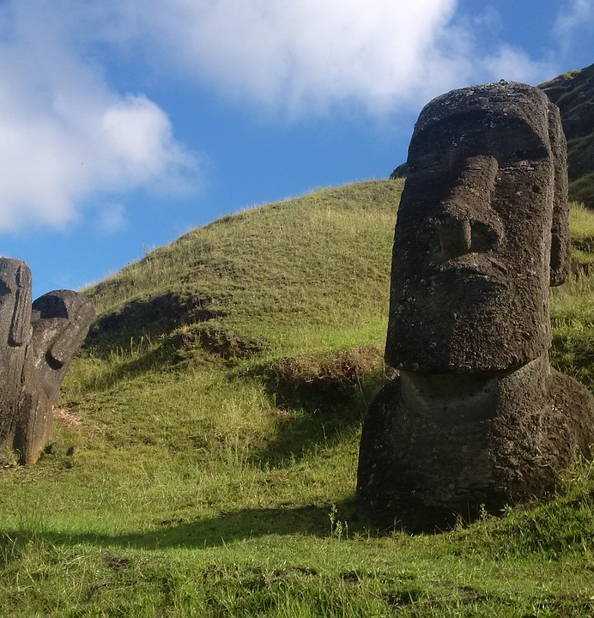
Monolithic Architecture

Slide 4
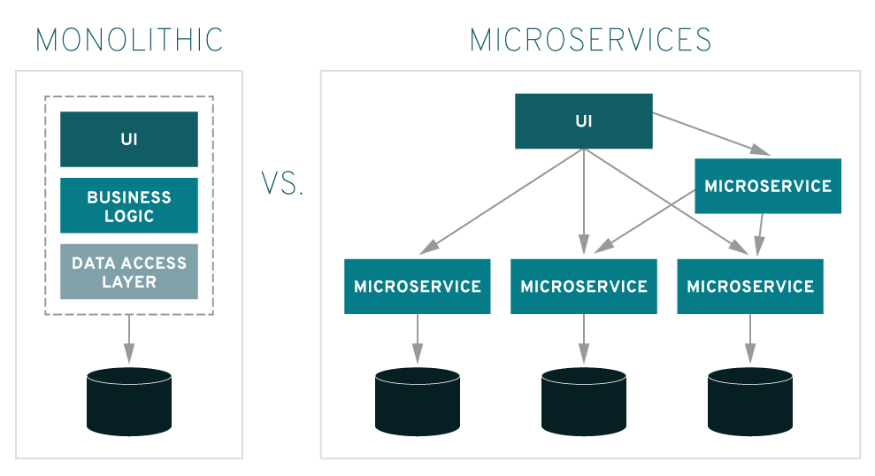
Monolithic architecture
One big code base
Hard maintenance
One process
Single point of failure
Shared memory advantage
Usually one platform supported

Slide 5
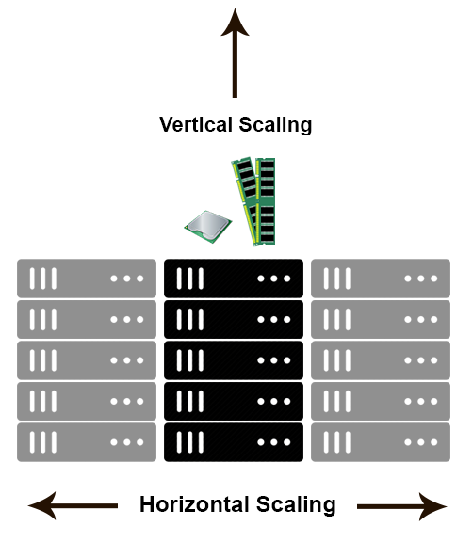
Monolithic architecture - Scaling
Required horizontal and vertical scaling
Complex custom load balancer configuration
Installer wizard
Separate application

Slide 6

Docker

Slide 7
Docker
Containers
Isolation/Security
Same kernel as host system
Faster than VMs
Image contains everything for run

Slide 8
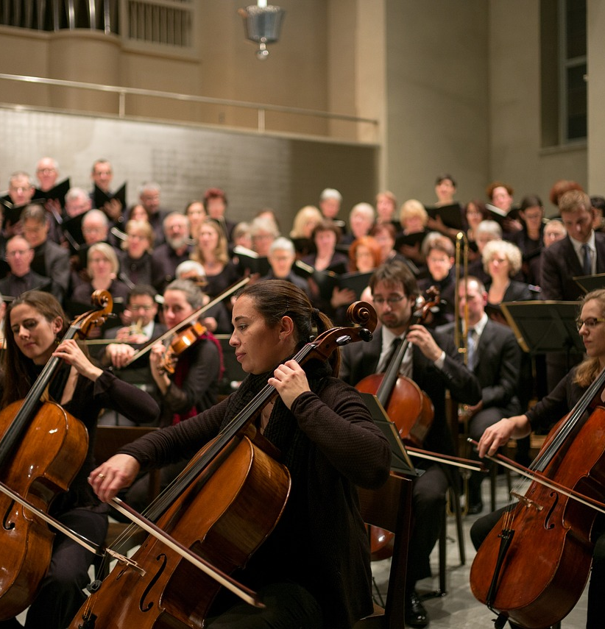
Container Orchestration

Slide 9
Container orchestration
Run and control more containers simultaneously
Maintenance of application cluster state
Examples
Docker Compose
Docker Swarm
Kubernetes/OpenShift

Slide 10
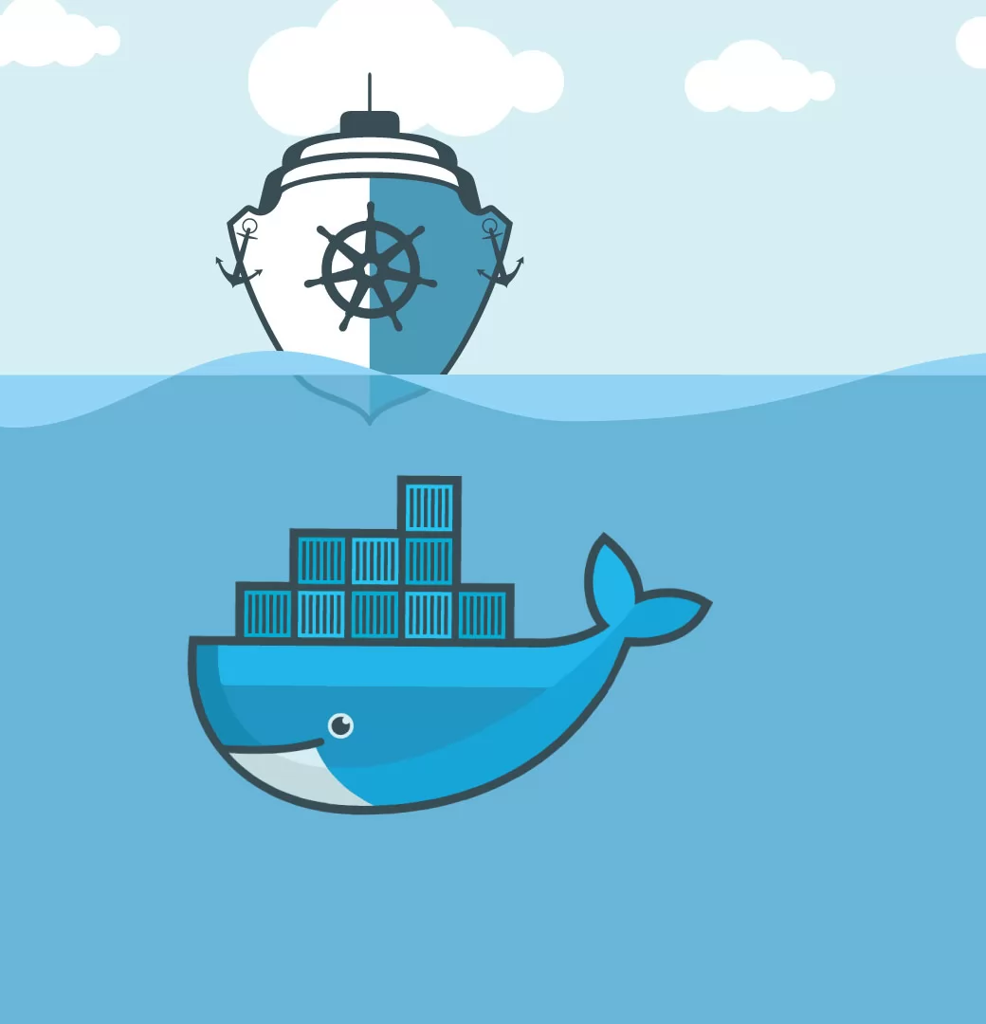

Kubernetes (K8s)

Slide 11
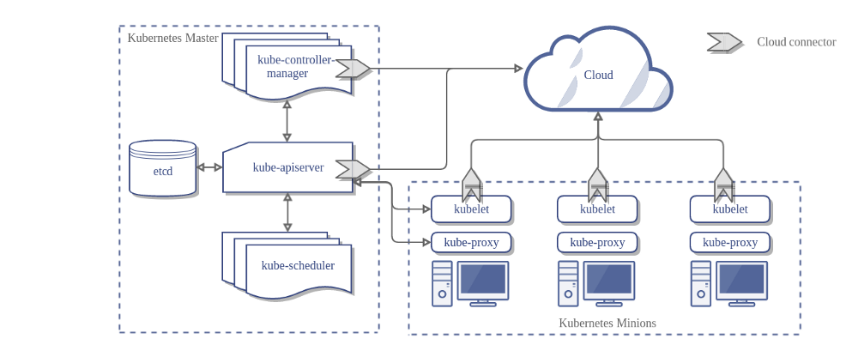
Kubernetes cluster

Slide 12
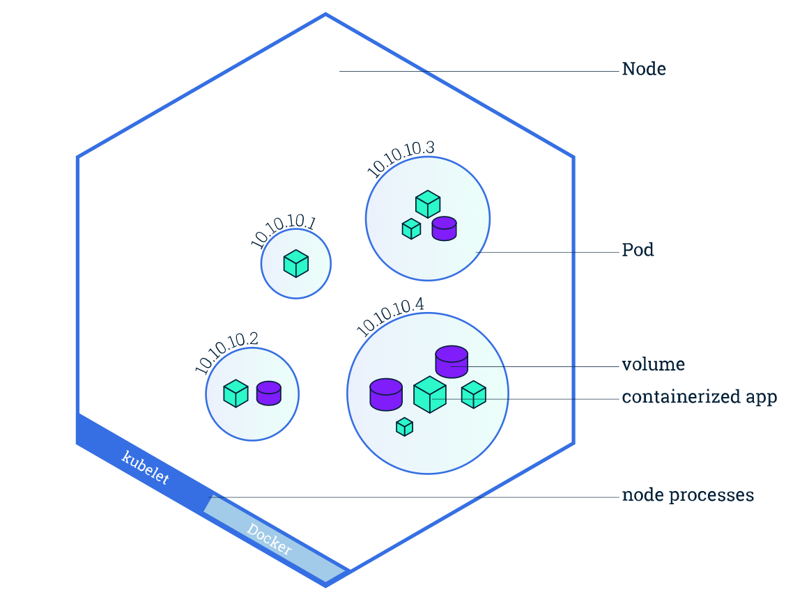
Kubernetes node

Slide 13
Kubernetes installation
Local machine
Minikube
https://github.com/kubernetes/minikube
Cloud
Terraform/Ansible scripts
Azure Kubernetes Service (AKS)
Elastic Kubernetes Service (EKS)

Slide 14
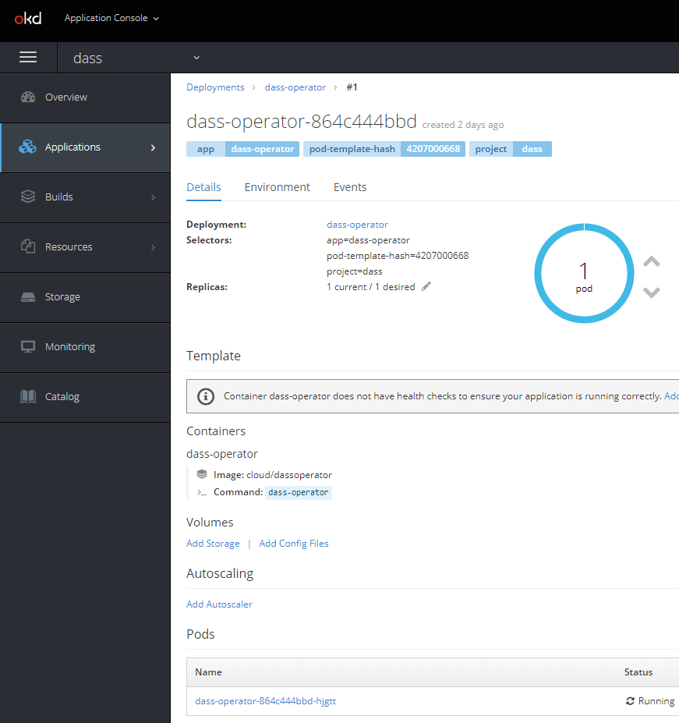

OpenShift

Slide 15
OpenShift
Enterprise Kubernetes
Mainly security oriented
Can be demanded by customers as the required application deployment
Layer over k8s
Templates almost the same as in k8s
GUI

Slide 16
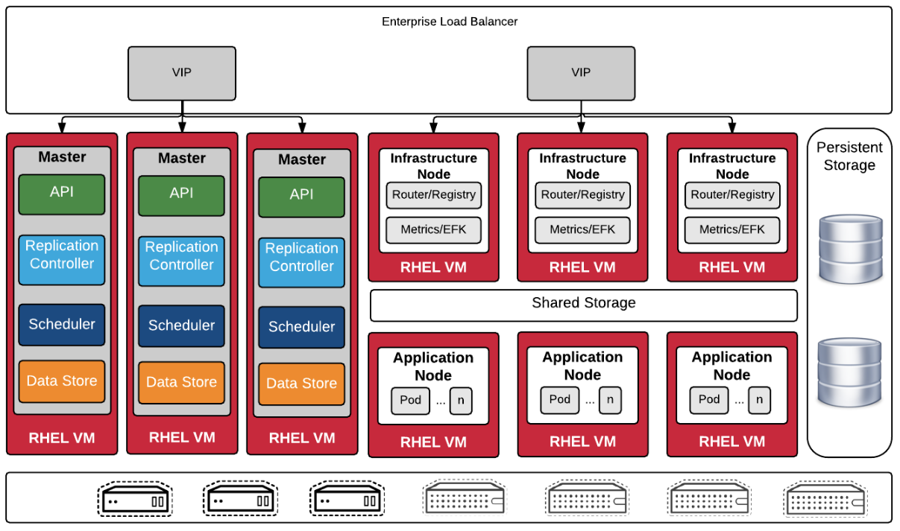
OpenShift cluster

Slide 17
OpenShift installation
Local machine
Minishift
https://www.okd.io/minishift/
Community version
https://www.okd.io
Azure templates 3.9/3.11 fork
Paid versions on RedHat/Azure/Amazon servers

Slide 18

Demo

Slide 19

Kubernetes Operators

Slide 20
Kubernetes operators
Extensions of k8s/OpenShift API
Operator framework
https://github.com/operator-framework/operator-sdk
Go language
Testing
Autopilot of application
Installation, upgrades, restore, backups, auto scaling, self repair…

Slide 21
Operators
CustomResource of OpenShift
Control loop
Watch on objects
OnChange: analyze difference between actual and desired state
Act on changes
Example
https://github.com/operator-framework/operator-sdk-samples/tree/master/memcached-operator

Slide 22
Summary
Complex systems moves from monoliths to microservices
Docker becomes software standard
Kubernetes or OpenShift as an containers orchestrator
Complex orchestrating logic via Kubernetes operators

Slide 23
Thank you!
Martin Novák,
m.nov4k@gmail.com

Slide 24
Resources
https://kubernetes.io/
https://medium.com/@adilsonbna/installing-a-highly-available-openshift-origin-cluster-f3493cbdb644
https://pixabay.com/photos/moai-quarry-easter-island-history-3525785/
https://pixabay.com/photos/container-port-loading-stacked-3118783/
https://pixabay.com/photos/classical-music-orchestra-choir-2199085/
https://pixabay.com/illustrations/call-centre-help-desk-communication-4246688/
https://pixabay.com/photos/hands-clay-potter-pottery-1139098/
https://www.redhat.com/en/topics/microservices/what-are-microservices
https://github.com/vaquarkhan/vaquarkhan/wiki/Difference-between-scaling-horizontally-and-vertically
https://svitla.com/blog/kubernetes-vs-docker

