Slide 1
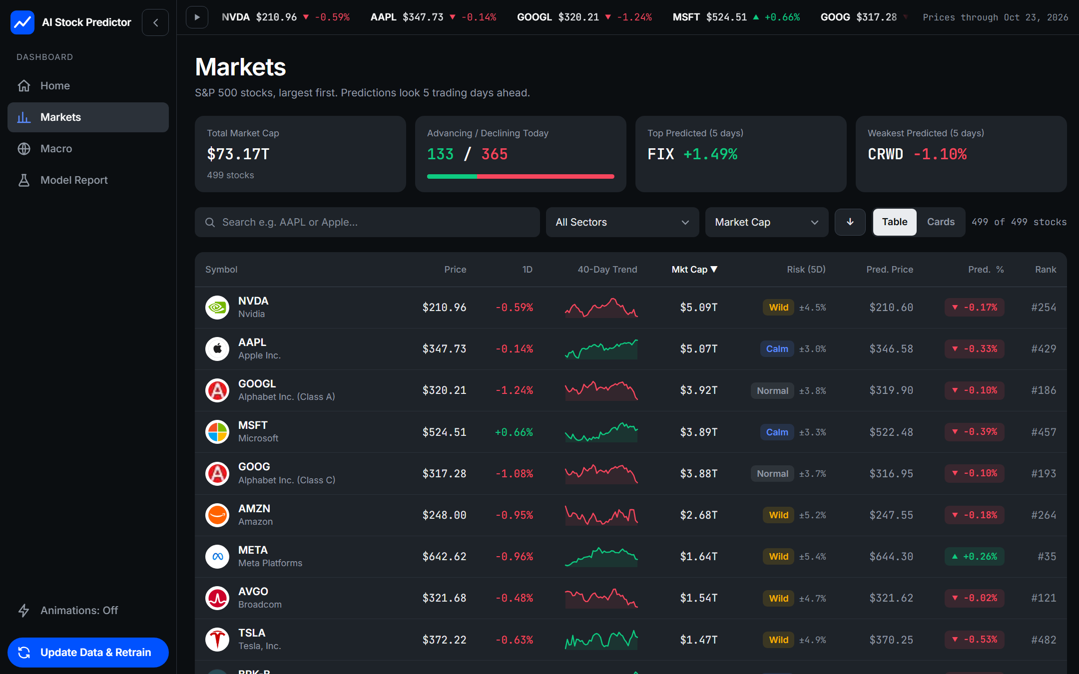
AI Stock
Predictor
Ranks the S&P 500, forecasts risk, and grades its own predictions.
By Manomay Kini · Aahil Abdul Latheef
Aditya Prabhu · Arnav Gupta
Experimental · Not financial advice
Notes:
AI Stock Predictor: a local web app that ranks S&P 500 stocks, forecasts how wild each one will be, and reports honestly how well its models did on data they never saw.

Slide 2
What it does
Three things, each scored on data the models never saw
499
23.2%
No edge
stocks ranked
of next-week volatility explained
on predicting returns
Every S&P 500 company, largest first, with logo, 40-day trend and a predicted 5-day return.
A Risk Forecast rates each stock Calm, Normal or Wild. The simple 'same as lately' baseline explains 18.5%.
Direction accuracy 52.4% against 52.3% for always guessing up. The app shows this plainly.
AI Stock Predictor · Experimental, not financial advice
2
Notes:
Return forecasts have no reliable skill. Volatility is the part of the model with real, measurable skill.

Slide 3
How it works
A Python pipeline on your own computer, from raw prices to a ranked signal
1
2
3
4
5
Ingestion
Features
Models
Server
Interface
yfinance · FRED · Wikipedia
pandas · NumPy
scikit-learn
FastAPI · Uvicorn
HTML · CSS · JavaScript
10 years of daily prices, share counts, macro series and the index list, saved as local files.
Bad rows dropped, odd data flagged, then 20 scale-free inputs per stock per day.
Ridge regressions: one for the next 5-day return, one for next-week volatility.
Turns files and models into JSON on 127.0.0.1. Updates run as a background job.
Watchlist, canvas charts, macro page and a model report card in the browser.
After the first download everything runs offline. Nothing is sent anywhere, and no paid service or API key is needed.
AI Stock Predictor · Experimental, not financial advice
3
Notes:
Walk through the five steps left to right. The point to land: it all runs locally, and the data sources are free.

Slide 4
What changed since version 1
A desktop price guesser became a local web app that checks itself
VERSION 1
NOW
Interface
Desktop app (CustomTkinter)
Web app: FastAPI server + browser
Coverage
50 stocks
499 S&P 500 stocks
Models
50 Random Forests, one per stock
2 pooled Ridge models (return and risk)
Prediction
Next-day price level
5-day return, plus a volatility forecast
Data
yfinance prices
yfinance + FRED macro + share counts + logos
Honesty
No scoring against a baseline
Scored on 2 unseen years against simple baselines
AI Stock Predictor · Experimental, not financial advice
4
Notes:
Version 1 predicted price levels with a random forest per stock and never checked itself. The new version predicts returns and risk, and reports its own score.

Slide 5
Technology stack
Open tools only. Items marked NEW are additions since version 1
Data
Python & ML
Server
Interface
yfinance
Python 3.11
FastAPI
NEW
HTML · CSS · JS
NEW
prices, share counts
language
web framework
no framework
FRED
NEW
pandas · NumPy
Uvicorn
NEW
Canvas + SVG
NEW
rates and credit series
data and features
ASGI server
charts, sparklines
Wikipedia
scikit-learn
gzip
NEW
Inter fonts
NEW
S&P 500 list, sectors
Ridge regression
compressed responses
Inter, JetBrains Mono
requests · lxml
joblib
127.0.0.1 only
NEW
Intl API
NEW
downloads, parsing
saves trained models
never exposed
numbers, dates
Retired: Random Forest · CustomTkinter · mplfinance · Matplotlib · Pillow
AI Stock Predictor · Experimental, not financial advice
5
Notes:
Everything here is free and open source. The biggest changes are the FastAPI server and the browser interface.

Slide 6
Dashboard overview
Largest first
The watchlist opens sorted by market cap. Click any column header to re-sort.
Risk tag
Calm, Normal or Wild with the typical 5-day swing, forecast by the volatility model.
Prediction
Predicted price, predicted change and rank. Treat the rank as a hint, not a signal.
AI Stock Predictor · Experimental, not financial advice
6
Notes:
Point out the ticker, the market-cap ordering, and the Risk column. Logos are cached locally and fall back to an initials tile.

Slide 7
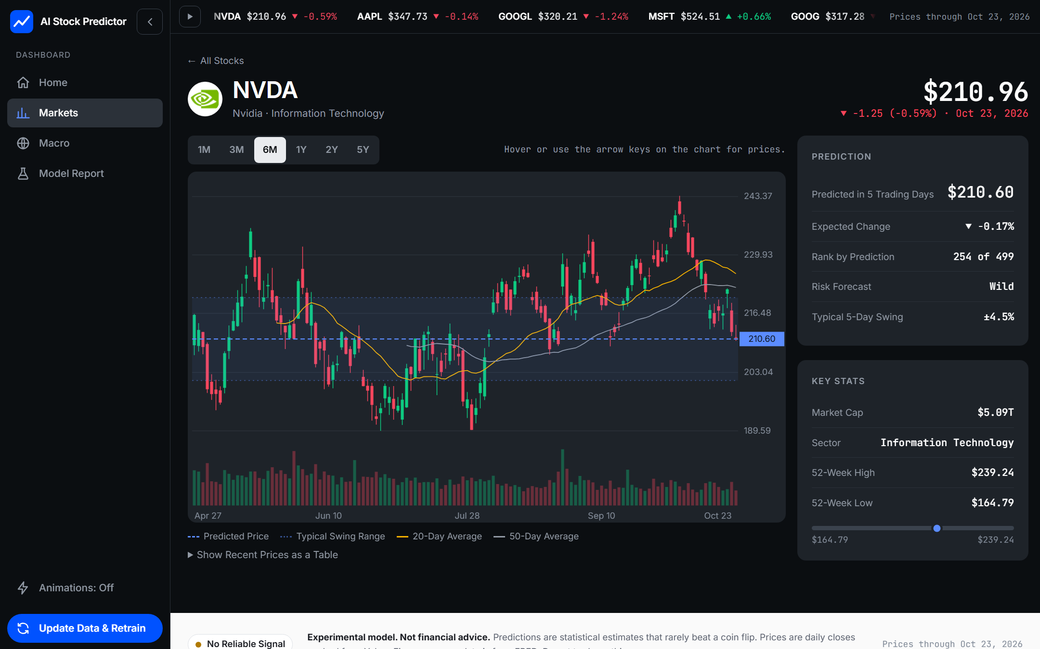
Stock page
Honest uncertainty
The shaded band is the typical 5-day swing. The predicted price sits well inside it.
Chart
Candlesticks, volume and two moving averages. Hover or use the arrow keys for prices.
Key stats
Market cap, sector and the 52-week range with a position marker.
AI Stock Predictor · Experimental, not financial advice
7
Notes:
The band makes the key point visually: a predicted move of a fraction of a percent is tiny compared with the normal swing.

Slide 8
Results, reported honestly
Scored on 101 weeks and 250,356 predictions the models never trained on
RETURN FORECAST
RISK FORECAST
No reliable signal
Real, measurable skill
52.4% vs 52.3%
Direction right, against always guessing up
t = 0.01
Best fifth minus worst fifth each week. Needs above 2
50.6%
Top-ranked fifth beating the median stock. Chance is 50%
Explains 23.2% of next-week volatility vs 18.5% for 'same as lately'. Most of this is volatility persisting; the model adds a measurable gain.
AI Stock Predictor · Experimental, not financial advice
8
Notes:
The return model does not beat chance. The risk model does beat its baseline, modestly. Both facts are shown in the app's Model Report page.

Slide 9
Limits and responsible use
Not financial advice
Returns are mostly noise
Risk is not direction
Educational tool. It does not place trades and should never be the basis for an investment decision.
A 5-day return forecast cannot beat guessing here, so read the rank as a ranking, not a prediction.
A Wild rating means big moves either way. It says nothing about up or down.
Free data has limits
What it ignores
Next steps
Prices come from Yahoo Finance and macro data from FRED. They can be delayed, revised or wrong.
News, earnings, fundamentals, sentiment, trading costs and liquidity are not in the models.
Test earnings and fundamentals data, add news sentiment, and measure results after costs.
AI Stock Predictor · Experimental, not financial advice
9
Notes:
Be explicit with the audience: this is a learning project about building an honest forecasting pipeline.

Slide 10
How to run
1
Install
$ pip install -r requirements.txt
$ python server.py
# open http://127.0.0.1:8000
pip install -r requirements.txt
2
Start the server
python server.py
3
Open the app
Pages
http://127.0.0.1:8000 opens automatically
Home loading screen and landing page
Markets watchlist and stock pages
Macro rates and credit conditions
Model Report the honest scorecard
4
Update once
Select Update Data & Retrain. It needs internet, takes a couple of minutes, then works offline
AI Stock Predictor · Experimental, not financial advice
10
Notes:
Run the update once; later launches are fast because predictions are cached on disk.

Slide 11
Conclusion
What we achieved
What we learned
A complete local web app covering 499 S&P 500 stocks.
A risk forecast with measurable skill, scored against a baseline.
A model report that says plainly when there is no edge.
Free data only, and no paid services or API keys.
Daily stock returns are close to unpredictable with price data alone.
Volatility is forecastable, mostly because it persists.
Honest scoring against simple baselines is what makes a model trustworthy.
The most useful feature is the one that tells you when not to trust the model.
AI Stock Predictor · Experimental, not financial advice
11
Notes:
Close on the honesty point: the scorecard is the product as much as the predictions are.

