Slide 1
Detecting Fake News On Social Media
Team Members:
Vamsi Krishna Muppala
Edwin Sahil Samuel Kathi
Jayakumar Kukkathotti
Yashwanth Kumar Chaganti
Rahul Bantu
Manoj Reddy
Spoorthy Gope Gowda
Thivatharan Jeganathan

Slide 2




Introduction:
Social media is the most cost-efficient way of communication among people Analyzing people's reactions to popular news posts while eliminating false information online is intriguing
Designing a news monitor system that concentrates on the news content can alert the public about fake news
The prevalence of social media as a primary source of news and information
The potential impact of fake news on individuals, society, and even nations
The need for reliable and efficient methods of detecting and combating the spread of fake news on social media

Slide 3
Previous work
Work Done in Paper:
Deployed various algorithms and models such as SVM,Logistic Regression with Binary Feature selection to detect fake news.
Work done apart from paper:
Feature Selection:
#Binary feature selection
TFIDF feature selection
Count Vectorizer feature selection
Algorithms and Models used to perform the feature selection:
#Logistic Regression
XG Boost
#SVM(Support Vector Machine)
Used evaluation metrics on computing each model with every feature selection to get the best model.

Slide 4
Previous work cont..
Evaluation Metrics used to select best model based on performance.
Precision
Recall
F1 Score
AUC-ROC
We presented the performance of the SVM model using all three feature selection techniques, and found that it achieved the highest accuracy among them.

Slide 5
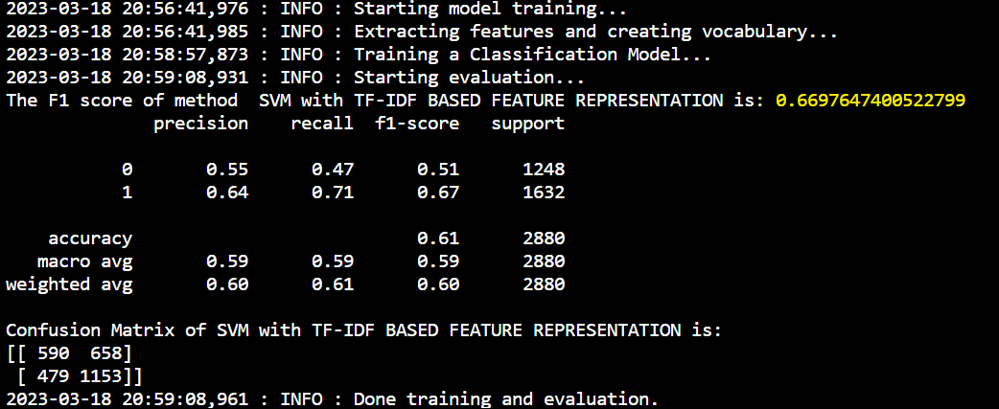
Previous Results:
Feature selection: TF-IDF (Models F1 score and confusion matrix):
SVM:

Slide 6
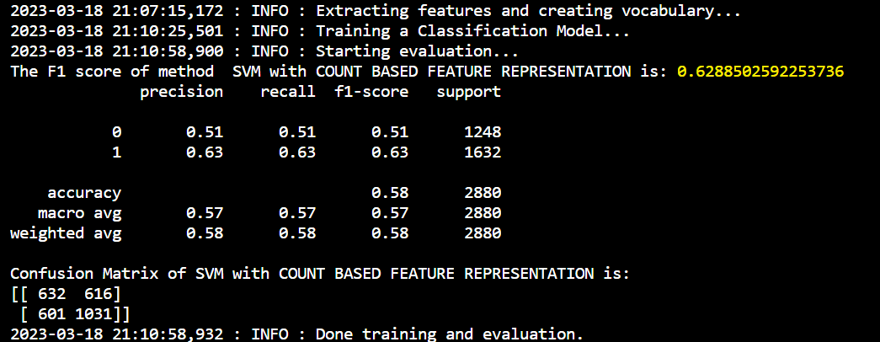
Feature selection: Counts (Models F1 score and confusion matrix):
SVM:

Slide 7
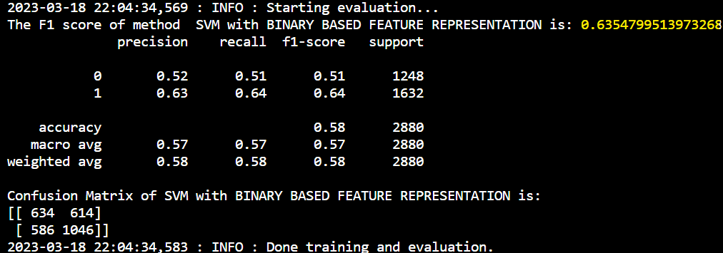
(iii)Feature selection: Binary (Models F1 score and confusion matrix)
SVM:

Slide 8
Proposed Solution:
BERT:
BERT is a state-of-the-art pertained language model developed by google.
It performs various natural language processing such as text classification, sentiment analysis, question answering and many more.
BERT's architecture is based on a Transformer neural network, which allows it to process long sequences of text efficiently by attending to relevant words and phrases.
BERT has been used in a variety of applications, including chatbots, search engines, and voice assistants. Its ability to understand the nuances of language has also led to advancements in fields such as healthcare and finance.

Slide 9
Implementation:
Once we cleaning the dataset have concatenated the test.csv and train.csv dataset and created a new dataset called as new_test.csv and split the dataset as x_train,x_test,y_train,y_test.
Then we tokenize x_train and x_test to convert a list of text documents (X) into tokenized sequences that can be used as input to a machine learning model.The tokenizer object is initialized with the 'Bert-base-uncased' model, which is a pre-trained version of the BERT model.
Then we creating a neural network model using two dense layer with relu and sigmoid as activation function and compiled the model using Adam optimizer and binary cross-entropy as loss function.As neural network models have shown superior performance on many NLP tasks such as BERT
Then we are loaded the BERT model.
Train the Keras model using the fit method, with early stopping as a callback.
Once the model is trained.We predict the model using testdataset, represented by the input data x_test_tokens.
Then we calculated the evaluation metrics ,classification reports.

Slide 10
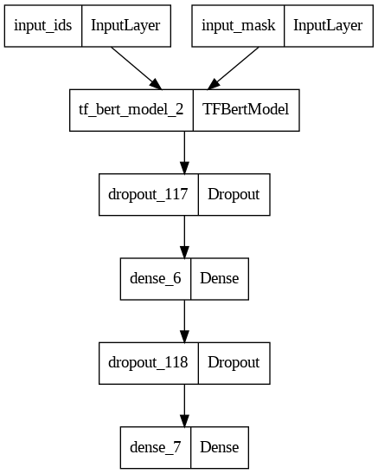
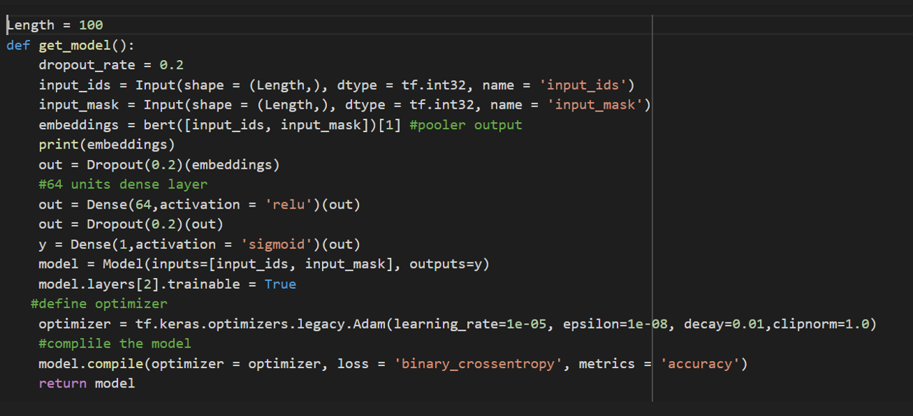
Model Architecture:

Slide 11
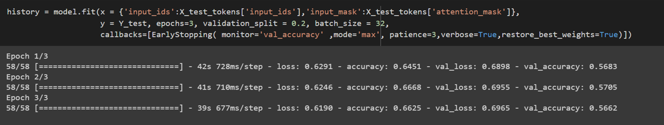
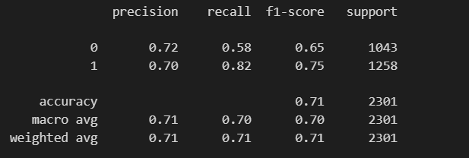
BERT learning model Result:

Slide 12
Comparison:
Previous algorithm: Best F1 score and accuracy for SVM - TF-IDF model and the values are 0.67 and 0.61 respectively.
Proposed algorithm: Best F1 score and accuracy for BERT respectively 0.71-0.72 is which is greater compared to SVM

Slide 13
Conclusion:
Using BERT algorithm, we can get better accuracy of 0.71 which is greater than accuracy with SVM.
BERT algorithm due to its sophisticated deep learning architecture and extensive pre-training on enormous amounts of data, BERT performs better than SVM in a variety of NLP tasks since it is better able to understand the context meaning of words in a sentence.

Slide 14
References:
[1]GitHub link : https://github.com/kiranrawat/Detecting-Fake-News-On-Social-Media
[2]Wang, William Yang. " liar, liar pants on fire": A new benchmark dataset for fake news detection." arXiv preprint arXiv:1705.00648 (2017).
[3]https://kavita-ganesan.com/news-classifier-with-logistic-regression-in-python/#.X7XeFBNKhQK.
[4]Xiang Zhang, Junbo Zhao, Yann LeCun, “Character-level Convolutional Networks for Text Classification,” IEEE Conference on Neural Information Processing Systems, pp. 649–657, 2015.
[5]Tom Young, Devamanyu Hazarika, Soujanya Poria, Erik Cambria, “Recent Trends in Deep Learning Based Natural Language Processing,” IEEE Computational Intelligence Magazine, vol. 13, pp. 55–75, 2018.
[6]Zhihui Zhu, Jianhua Huang, Yueming Hu, and Xingquan Zhu, "SVM-Based Feature Selection for Multi-Label Classification," IEEE Transactions on Knowledge and Data Engineering, vol. 25, pp. 1240-1252, 2013.
[7]Tianqi Chen and Carlos Guestrin, "XGBoost: A Scalable Tree Boosting System," Proceedings of the 22nd ACM SIGKDD International Conference on Knowledge Discovery and Data Mining, pp. 785-794, 2016.

Slide 15
Questions?

