Slide 1

Notes:
About 8 minutes total: 3 on the team and vision, 3 on the project page, 2 on the M1 board. Before starting, post the org home page URL and the M1 project URL in #final_projects.

Slide 2
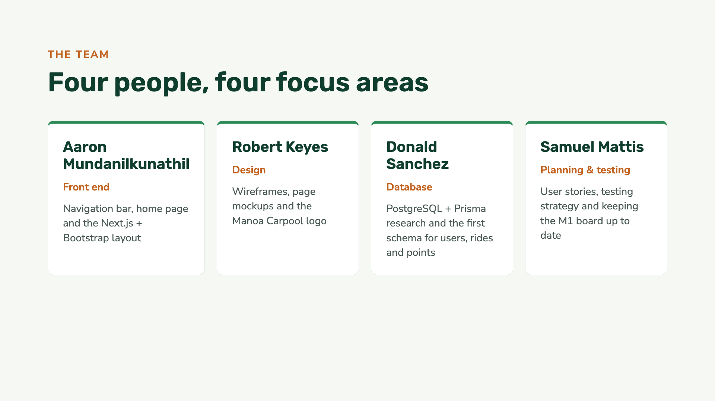
Notes:
Each person says their name, their focus area and one fun fact. The focus areas match the M1 issue groups on the board later.

Slide 3
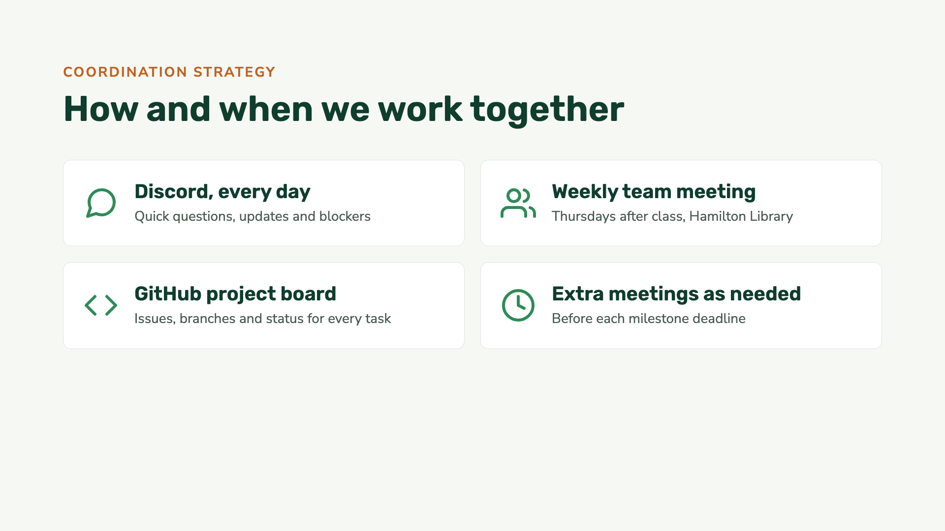
Notes:
We meet in person once a week after class, talk on Discord every day, and track all work as issues on the GitHub board. We add extra meetings in the days before each milestone.

Slide 4
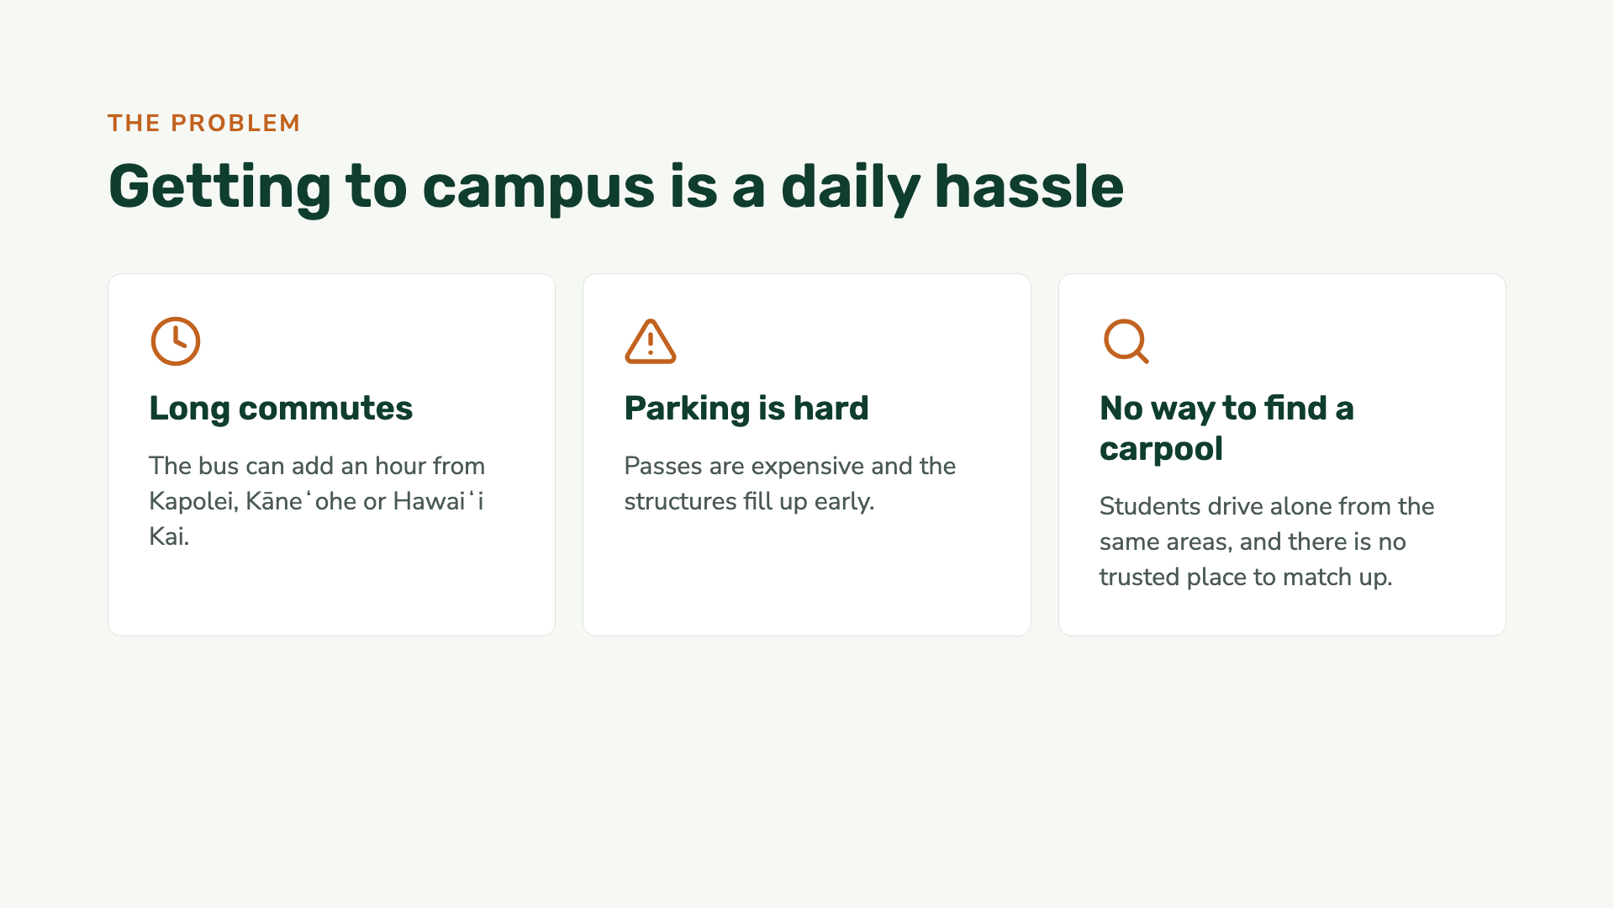

Slide 5
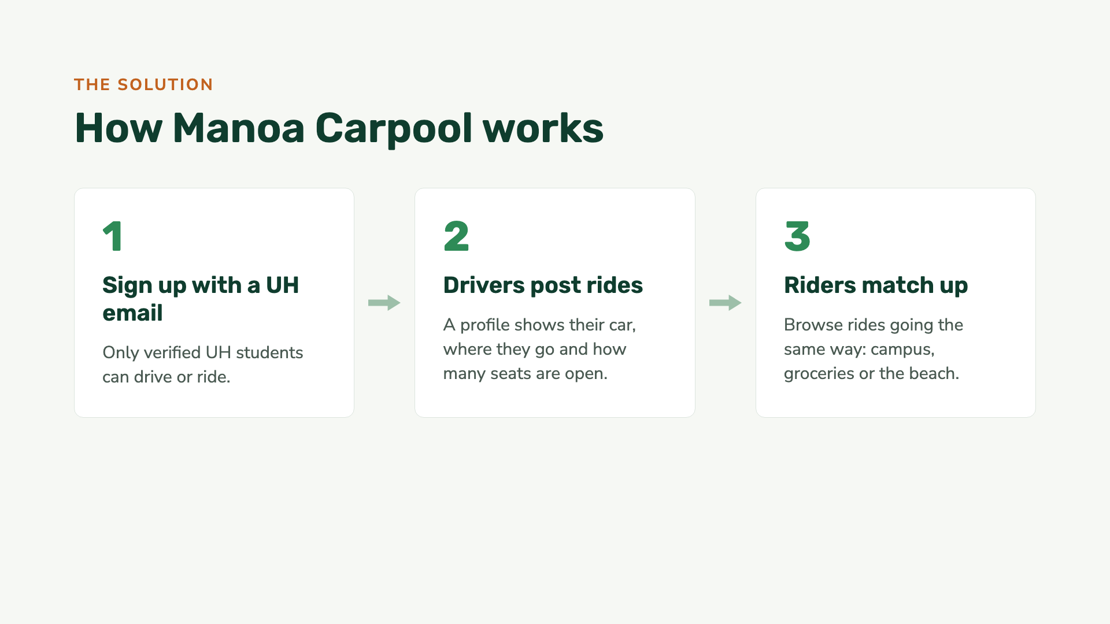

Slide 6
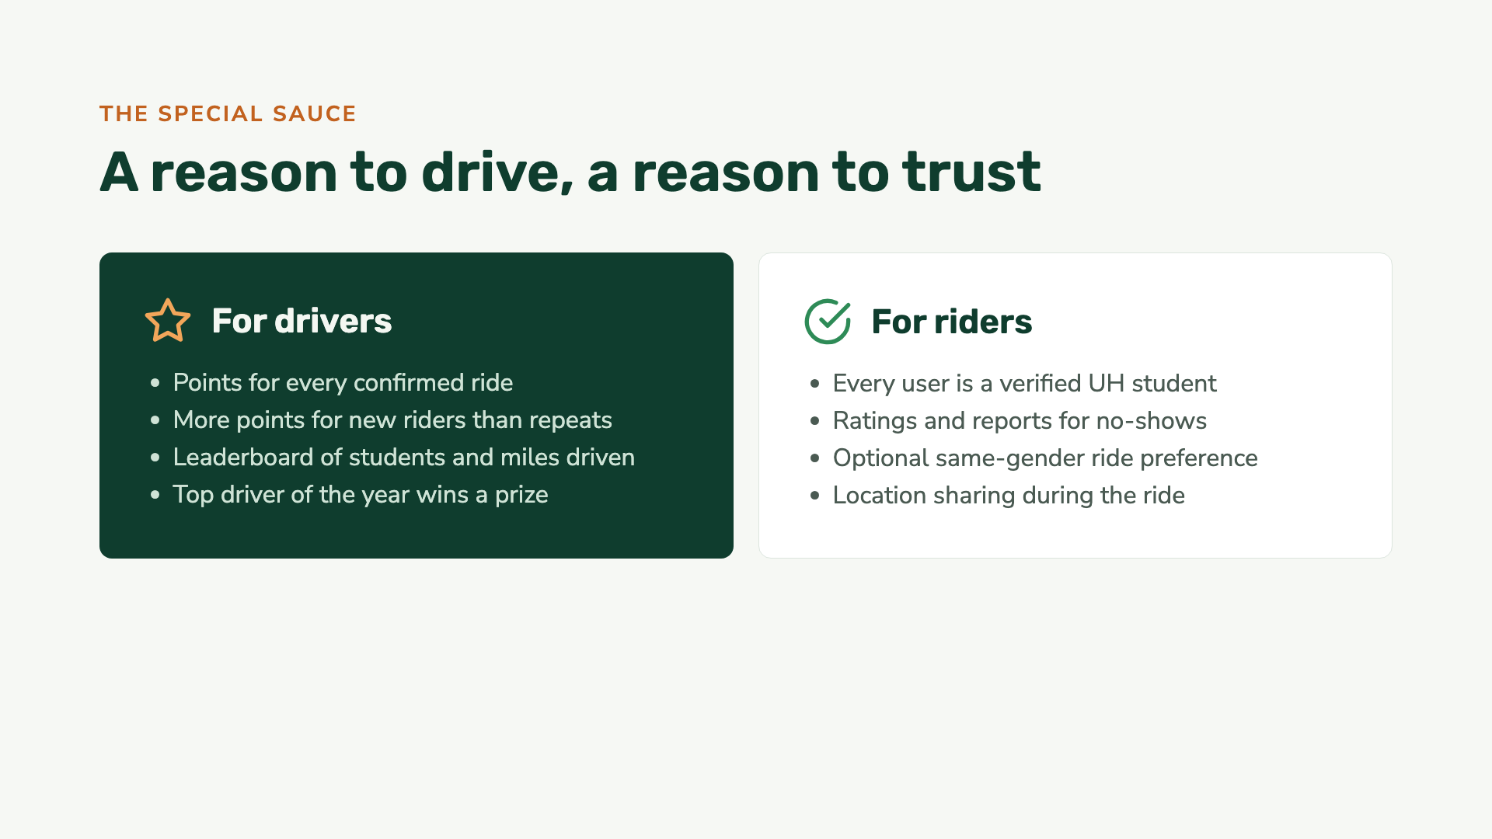
Notes:
This is the per-user state the assignment asks for: each user’s schedule, home area, points, rating and preferences change what they see.

Slide 7


Slide 8
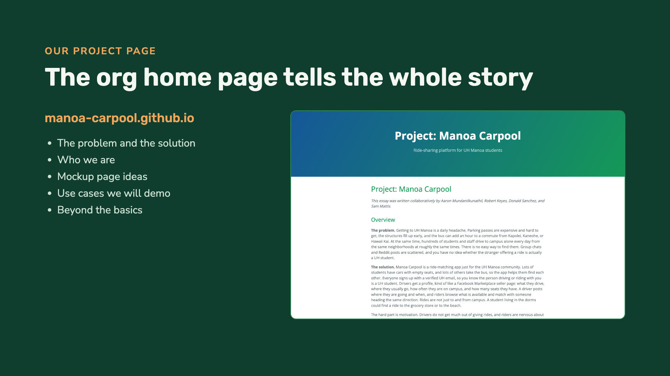
Notes:
About 3 minutes with the next slide. Open manoa-carpool.github.io live and scroll through the overview, team, mockup page ideas and use cases.

Slide 9
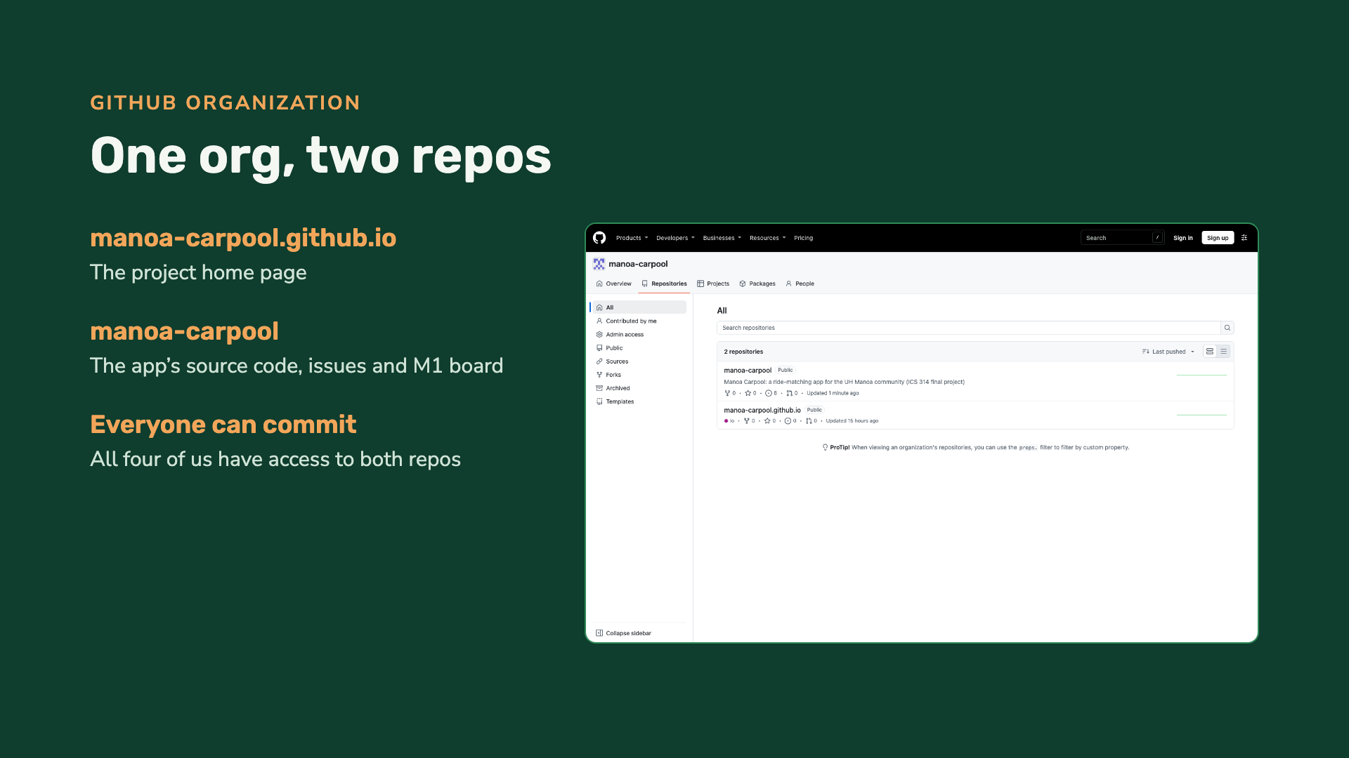
Notes:
Show github.com/manoa-carpool: the home page repo and the app repo.

Slide 10
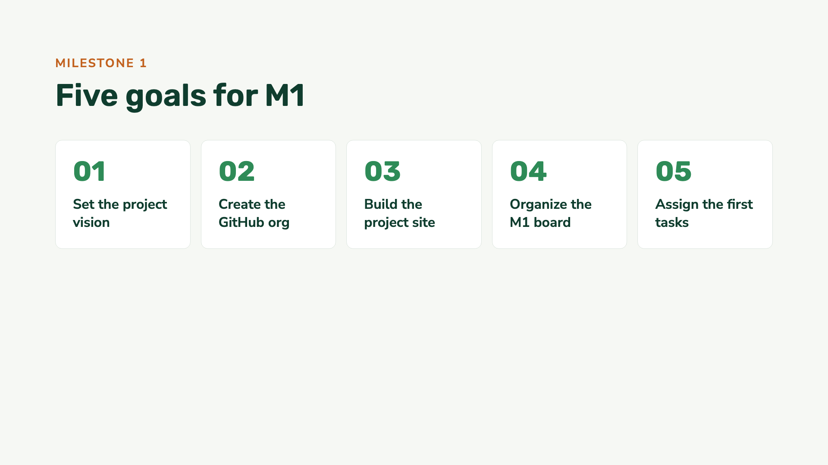

Slide 11
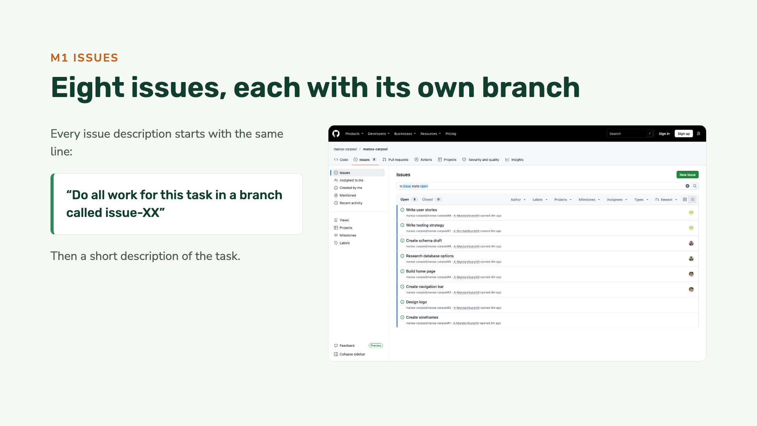
Notes:
Open one issue live, for example #3 Create navigation bar, to show the issue-3 branch line.

Slide 12
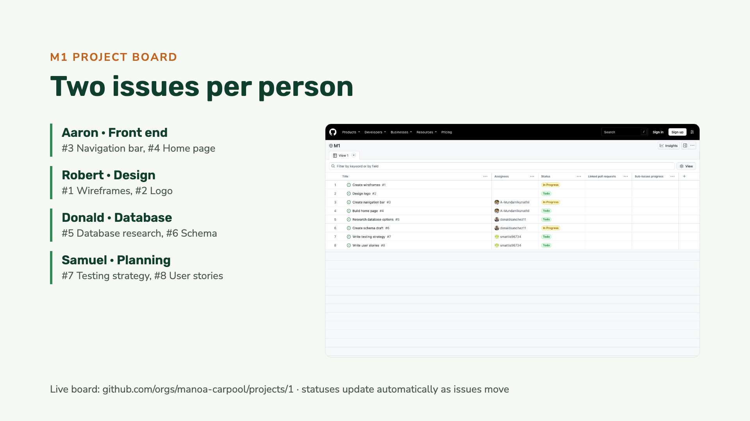
Notes:
About 2 minutes. Open github.com/orgs/manoa-carpool/projects/1 live. Show the Todo / In Progress status, the assignees, and open one issue to show the issue-XX branch line.

Slide 13


