Slide 1


Slide 2


Slide 3


Slide 4


Slide 5


Slide 6


Slide 7


Slide 8
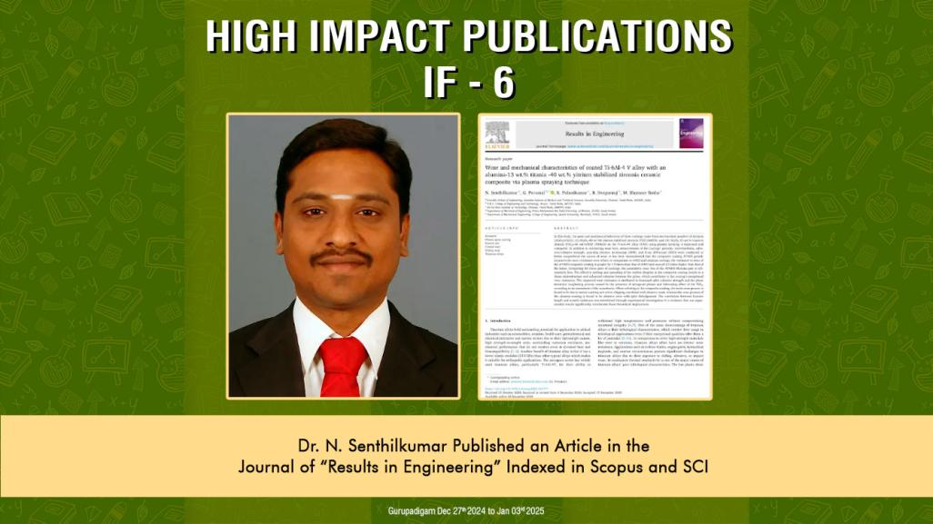

Slide 9


Slide 10


Slide 11


Slide 12
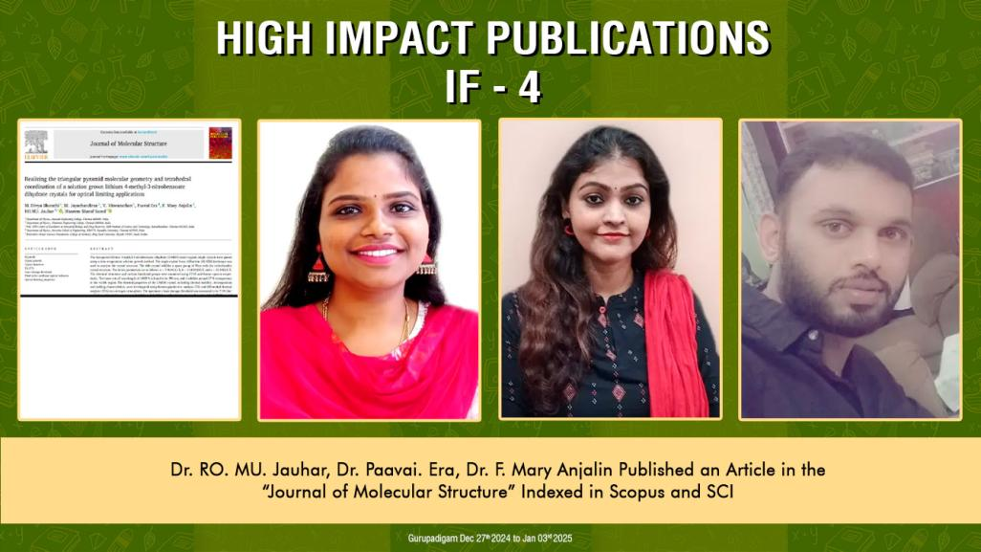

Slide 13


Slide 14


Slide 15
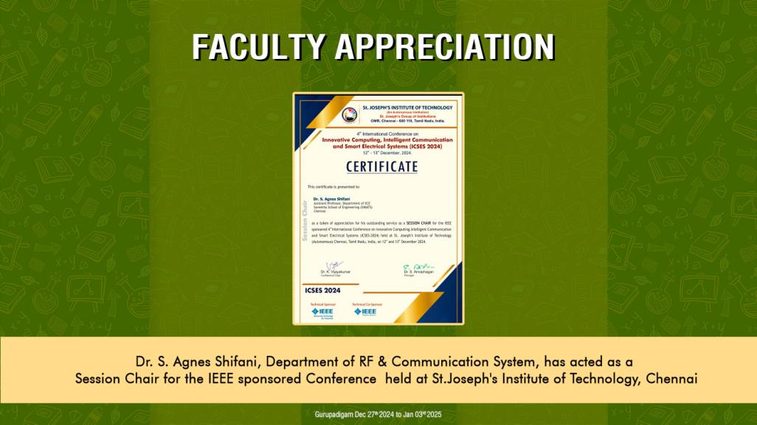

Slide 16


Slide 17
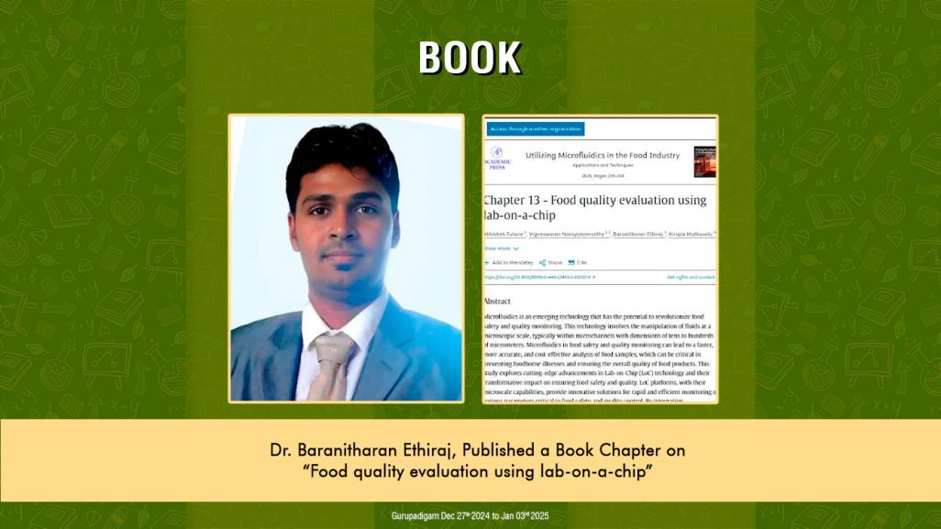

Slide 18
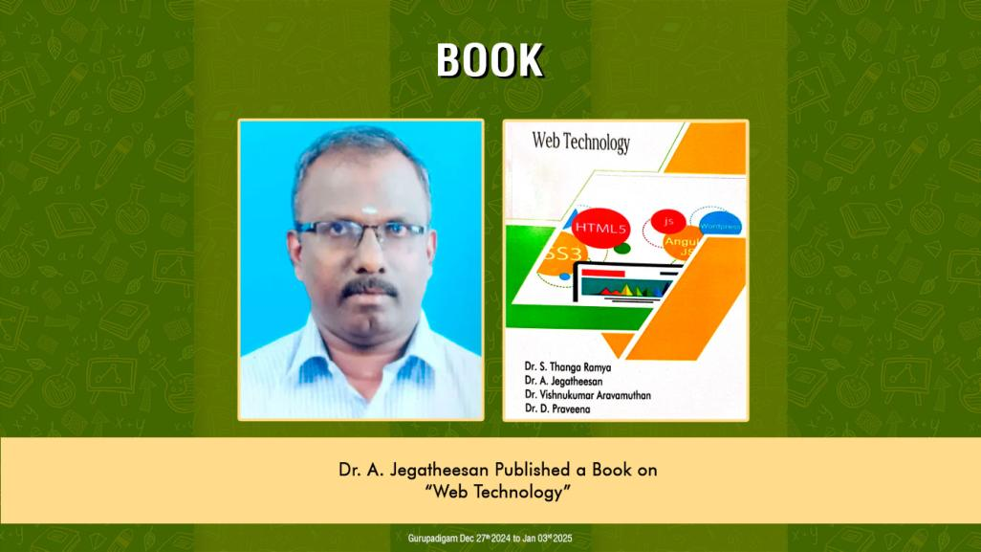

Slide 19
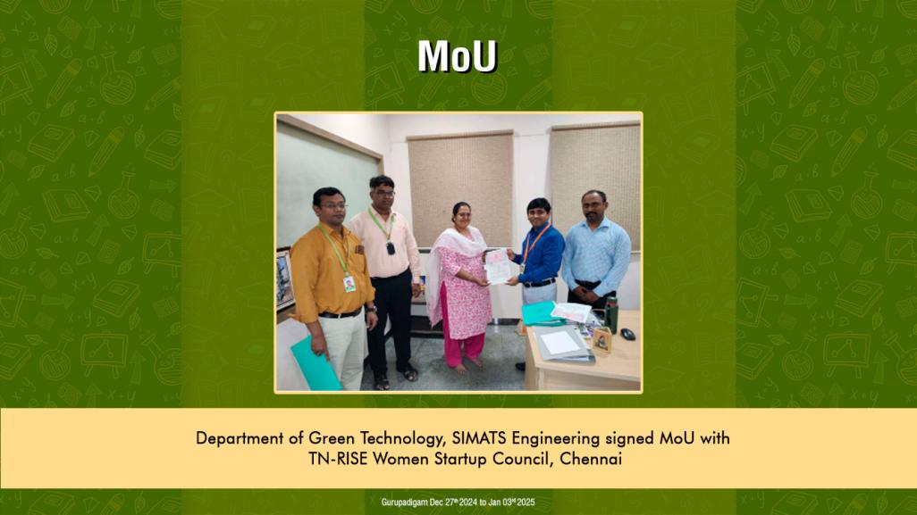

Slide 20
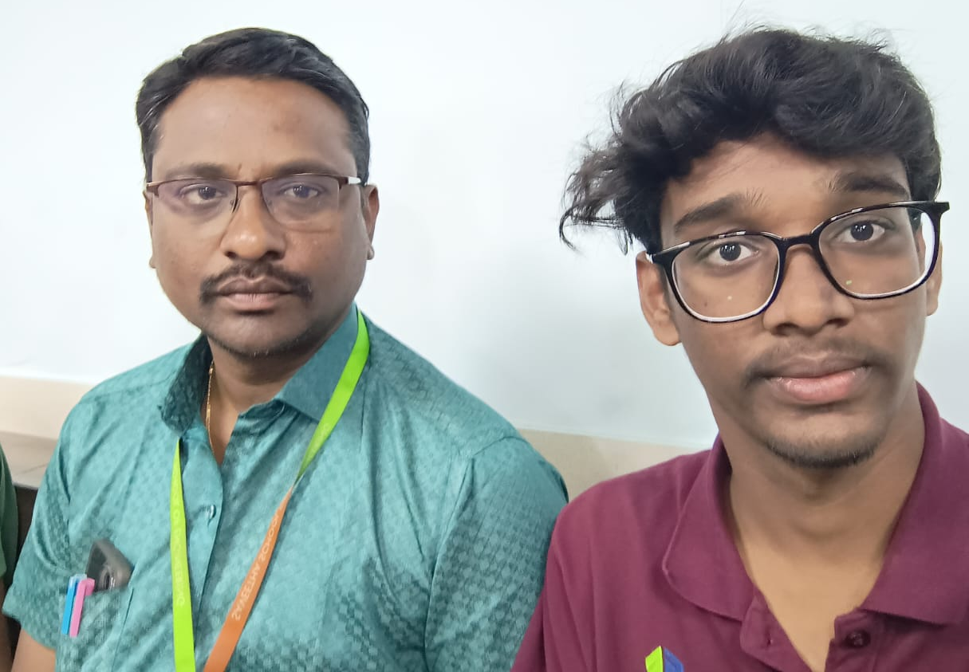
Name: Doradla Manobhiram
Register No: 192311260 / CSE-B
No. of Core Completed (out of 30): 9
No. of Elective Completed (out of 8): 0
No. of withheld Courses: 3
No. of Arrears: 2
Total Credits Earned: 36
CGPA: 7.71
Slot B | Total Marks | Marks Obtained | Class Average Mark
Model Exam A Slot | 100 | 60 | 72.8
Test 1 ( B Slot) | 100 | 65 | 71.4
Test 2 ( B Slot) | 100 | 70 | 74.5
Test 3 ( B Slot) | 100 | 75 | 70.7
Test 4 ( B Slot) | 100 | 60 | 71.4
Test 5 ( B Slot) | 100 | Univ Exam | -

Slide 21
Dear Parent,
Your Son, Mr. D. Manobhiram was instructed to participate in international/national workshops/conferences. He was also advised to register for any online certificate courses and NPTEL courses to enhance her skill sets. He is interested in developing mobile applications and to play online games.
His leetcode link is https://leetcode.com/user3081kW/. So far, he has completed 95 programs, and his present rank is 943030. He has to undergone internship to improve his industry experience with a minimum duration of 3 months, which is essential to complete his degree and to submit the Graduate Record Book (GRB). He was advised to take up English certificate courses.
Slot | Course Code | Course Name | Attendance %
A | CSA0443 | Operating System for CPU Scheduling | 82
B | CSA0956 | Programming in JAVA for Multithreading and Concurrency | 83

Slide 22

MENTEE RESPONSE
PARENT’S RESPONSE
text
text

