Slide 1
CoolTick Tool
Submitted to: Dr. Mark stamp
By
Manodivya Kathiravan
Prijila Nair

Slide 2
CoolTick Tool
Desktop stock ticker.
Allows you to keep track of your favorite stock symbols.
Trial Limitations: 30 day trial. Limited to two symbols.
How does it look?

Slide 3
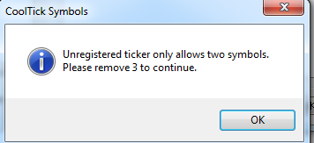
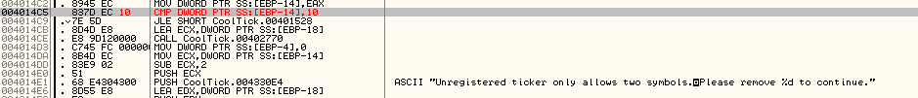
Feature 1 - Adding more symbols
Before:
After:

Slide 4
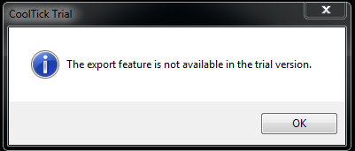

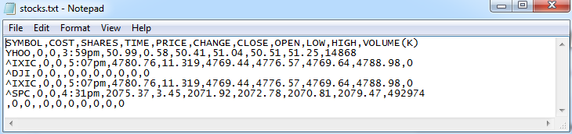
Feature 2 - Export Data
Before:
After:

Slide 5
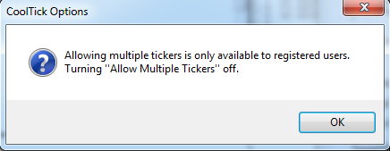
Feature 3 – Allow multiple tickers
Before:
After:

Slide 6
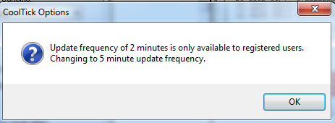
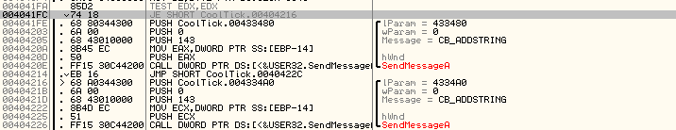
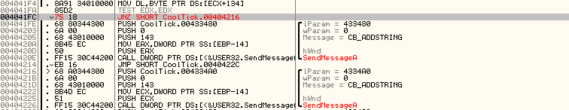

Feature 4 – Update frequency
Before:
After:

Slide 7
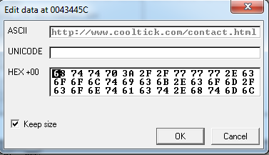
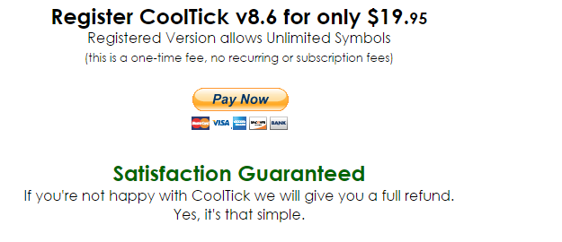
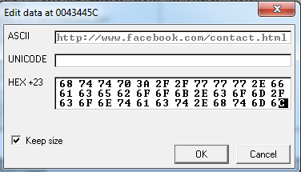
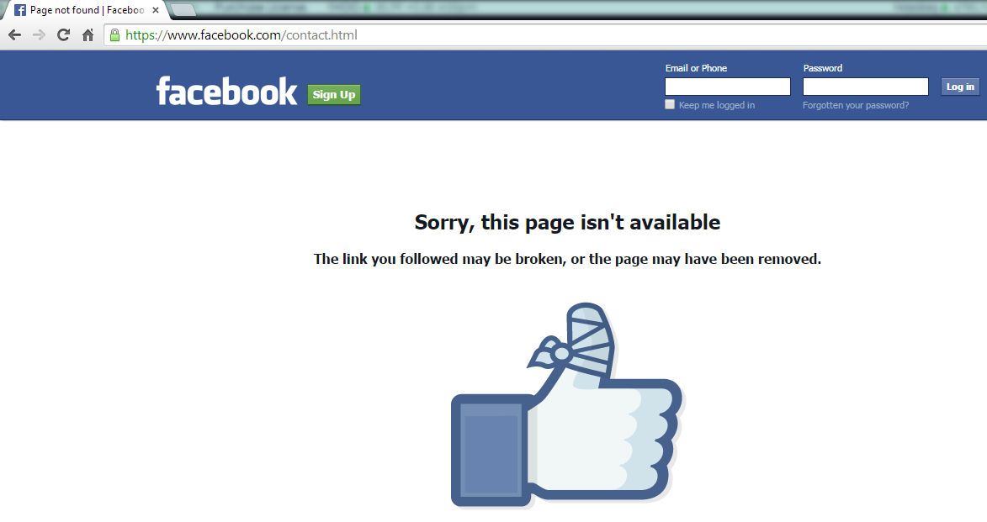

Feature 5 – Purchase license redirect
Before:
http://www.cooltick.com/contact.html
After:

Slide 8
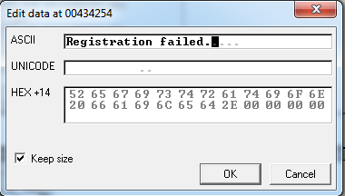
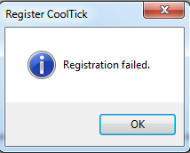

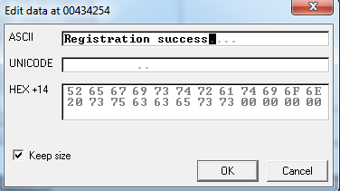

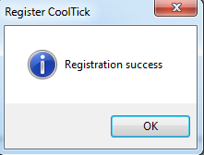
Feature 6 – Register Successful
Before:
After:

Slide 9
DEMO

Slide 10
How to prevent these attacks?
Check isDebuggerPresent ?
Force exit when detected
Code injection – calling dummy functions before/after the actual functional calls
Code obfuscation

Slide 11
Questions?

Slide 12
Thank You!

