Slide 1
Model Deployment in Production
With Python Flask at www.pythonanywhere.com/

Slide 2
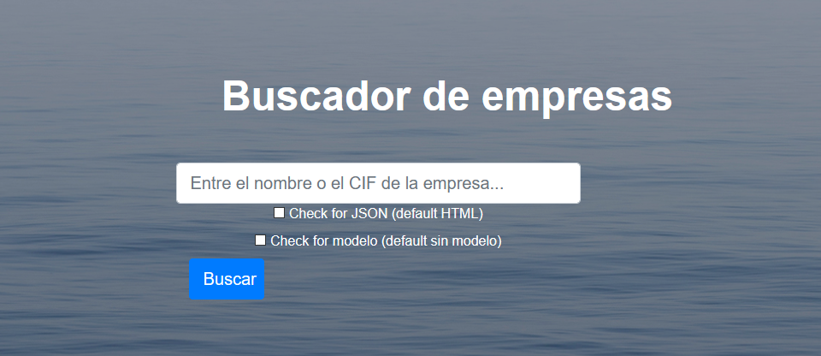
http://tobesure.pythonanywhere.com/

Slide 3
invoking_api_tobesure.py
from urllib.request import urlopen
sourceCode = urlopen("http://tobesure.pythonanywhere.com/buscador?nif=A28015865&JSON=yes&modelo=yes").read()
import json
empresas = json.loads(sourceCode)
print(empresas[0]['Nombre'])
print(empresas[0]['probabilidad_default'])

Slide 4

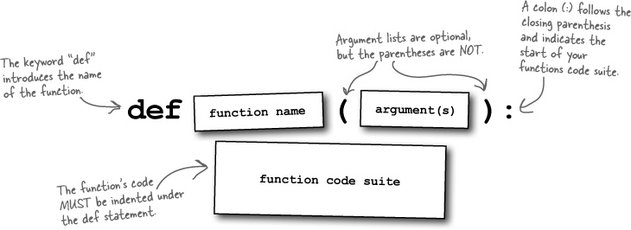
def index():
return "Hello World"

Slide 5



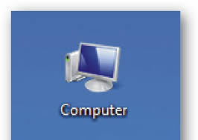


def index():
return "Hello World"
?
?
?
?

Slide 6



Matraz o Flask
# Using both methods of registering URLs here
# just to show that both work
def handle_route2():
return X().route2()
app.add_url_rule('/y/', view_func=handle_route2)
# the most common is using a decorator:
@app.route('/x/')
def handle_route1():
return X().route1()
def index():
return "Hello World"

Slide 7

Matraz o Flask
from flask import Flask
app = Flask(__name__)
@app.route('/')
def index():
return "Hello World"
@app.route('/miruta1')
def miruta1():
return "Mi ruta 1"
@app.route('/mivar/<mivar1>')
def mivar(mivar1):
return "mivar="+ mivar1
if __name__ == '__main__':
app.run(
port=int("5000")
)
def index():
return "Hello World"

Slide 8
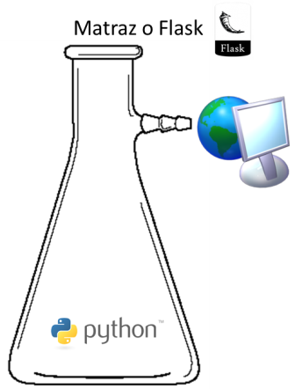
from flask import Flask
app = Flask(__name__)
@app.route('/')
def index():
return "Hello World"
@app.route('/miruta1')
def miruta1():
return "Mi ruta 1"
@app.route('/mivar/<mivar1>')
def mivar(mivar1):
return "mivar="+ mivar1
if __name__ == '__main__':
app.run(
port=int("5000")
)
http://localhost:5000/mivar/mystring1234
http – http means your data will be transfered using Hypertext Transfer Protocol, most commonly used over the internet
5000 - it means you will use the Flask default port (80 is the default internet port)
localhost resolves to 127.0.0.1
/mivar will call the python function “def mivar(mivar1)” with “mystring1234” as value, equivalent to in Python:
print mivar(“mystring1234”)

Slide 9


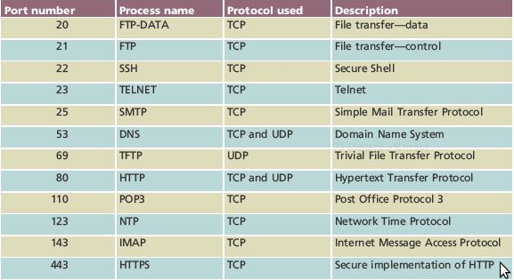
HTML / Javascript / Bootstrap
def index():
return "Hello World"
API / JSON / XML

Slide 10
HTML / Javascript / Bootstrap

Slide 11
API / JSON / XML

Slide 12
HTML / Javascript / Bootstrap
API / JSON / XML

Slide 13


Slide 14
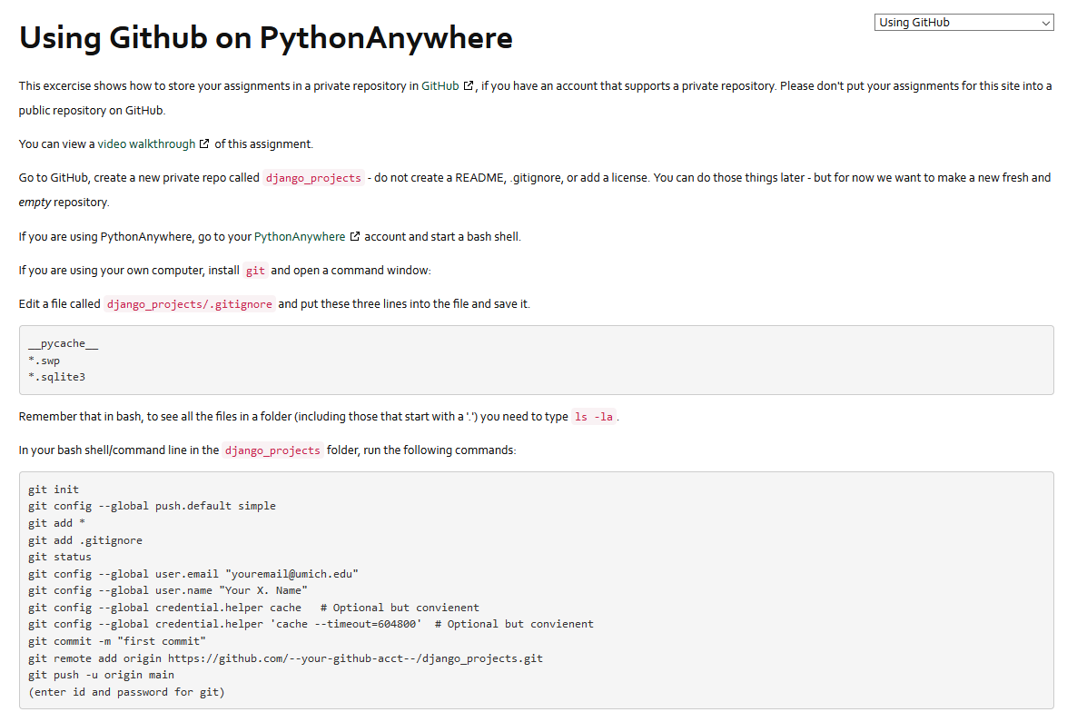
https://www.youtube.com/watch?v=9FJwue2Eqao
https://www.dj4e.com/assn/dj4e_github.md

Slide 15
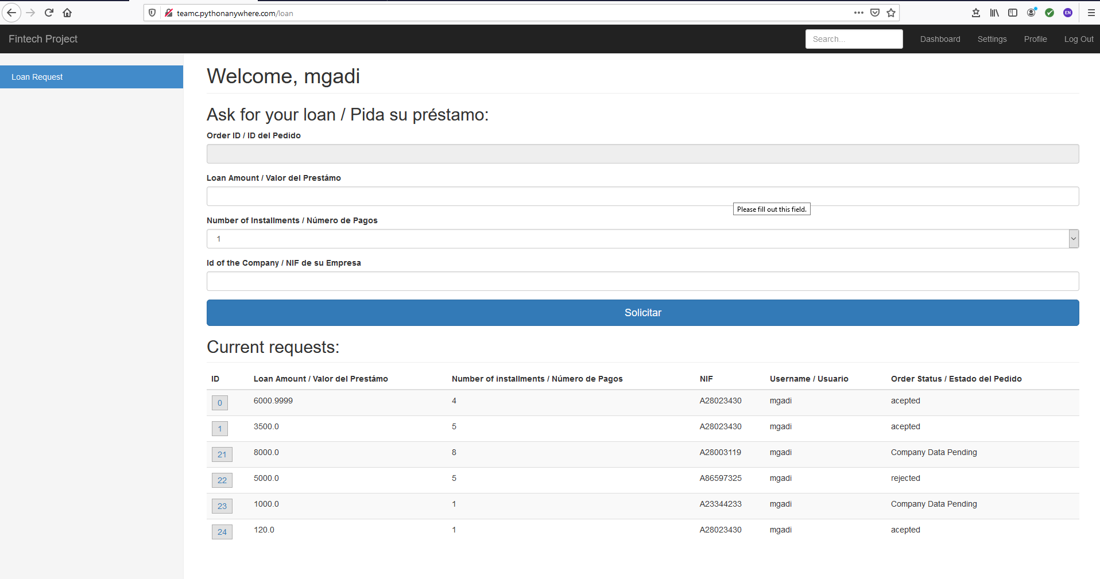
http://teamc.pythonanywhere.com/

