Slide 1

Sample of Low-Tech Demo
Put Your project Name Here
Put Your Team Names Here
Put the Date Here
Innovation Engineering

Slide 2
PROJECT NAME:
Team members and contact information:
Name: | Email:

Slide 3
Need
Approach
Benefit
Competition
Who needs it and why? (edit)
What approach will be used? (edit)
What is the benefit? (edit)
What is the next best alternative if this project was not done? (edit)
Why is this a good space?
How will you win:
How will others in the industry react? (edit) (optional – you can leave it blank)
Business and/or technical strategy (optional – you can leave it blank)

Slide 4

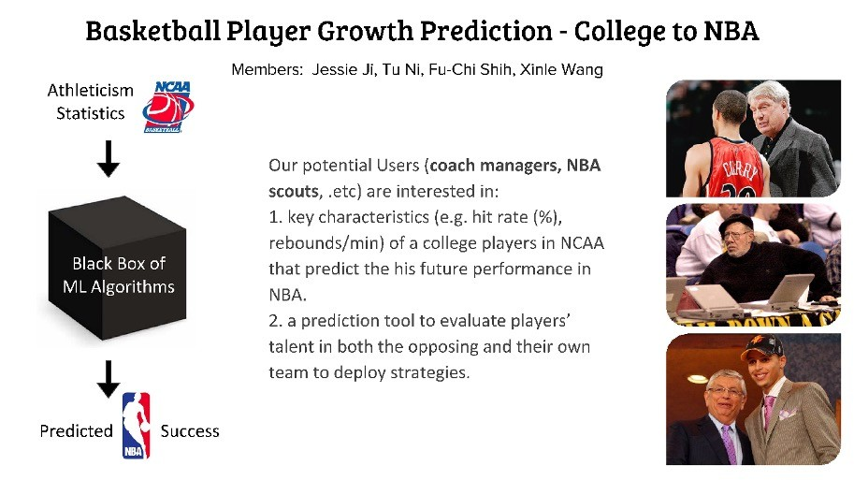

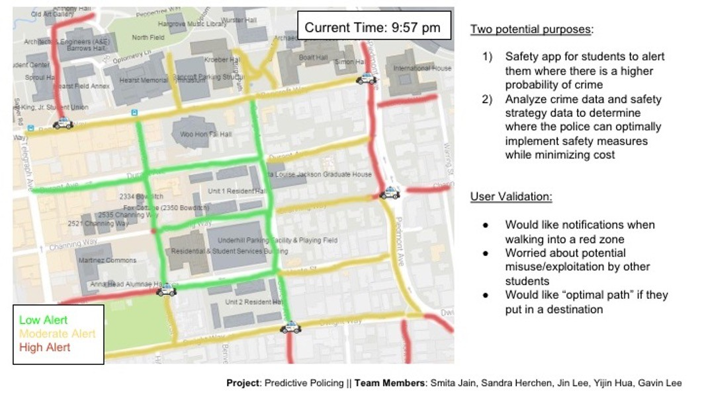
WHAT IS YOUR PROJECT?
High Level Description
Problem Solution
Any validation information
(did you talk with anyone who wants it)
This slide is about “why” and “what” You may use NABC
Need, Approach, Benefit, Competition You may divide this slide into 2-3 slides
Example: Sport Prediction
Example: Predictive Policing

Slide 5
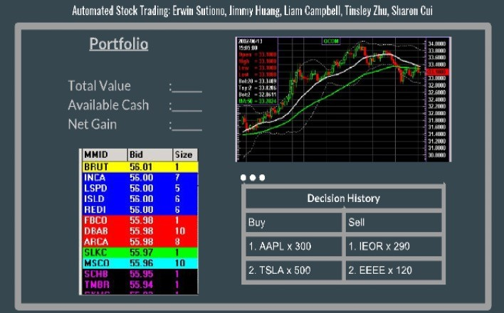
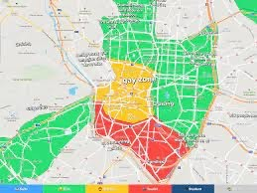
DESIGN THE USER PERSPECTIVE. ILLUSTRATE UI INPUT/OUTPUTOR
List Top 3 User Requirements (your best guess)
Example Intended Screenshot
Ease of Use ...? Performance/Speed...? Presentation...?
Accuracy…?
Illustrate:
Enter Address
Illustrate: Show Crime Statistics Show on Map |  |  |  | Illustrate:
Get feedback from the target user(s) if you can.
Make a Story Board for One Key Task in Your Application (Use Up to 5 Slides if Needed)

Slide 6
TECHNICAL COMPONENTS OF PROJECT
Top Components Required for the Project in Order of Importance
UI
Ability to send emails
Use of Neural Network Algorithms Where will we get the data
Color Code Orange or Red: Lines you need to learn to do Color Code Green: Lines which will be easy to develop

Slide 7
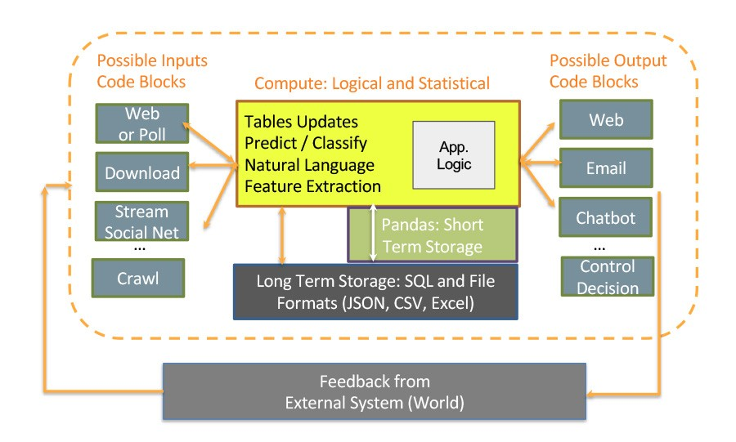
SAMPLE SYSTEM ARCHITECTURE
Replace the diagram below with your rough System Architecture and/or Data Models. (It is okay to use two or more slides in this section).

Slide 8
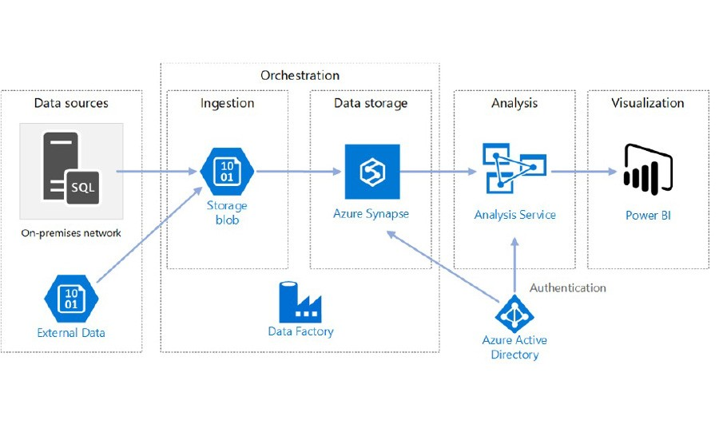
SAMPLE SYSTEM ARCHITECTURE
Replace the diagram below with your rough System Architecture and/or Data Models. (It is okay to use two or more slides in this section).

Slide 9
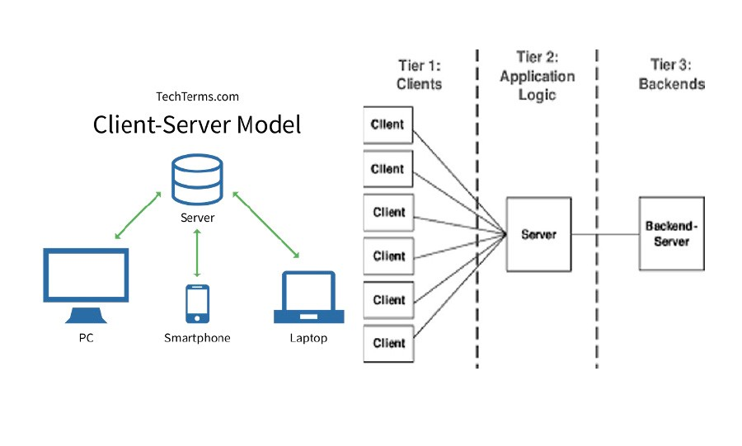
SAMPLE SYSTEM ARCHITECTURE
Replace the diagram below with your rough System Architecture and/or Data Models. (It is okay to use two or more slides in this section).

Slide 10
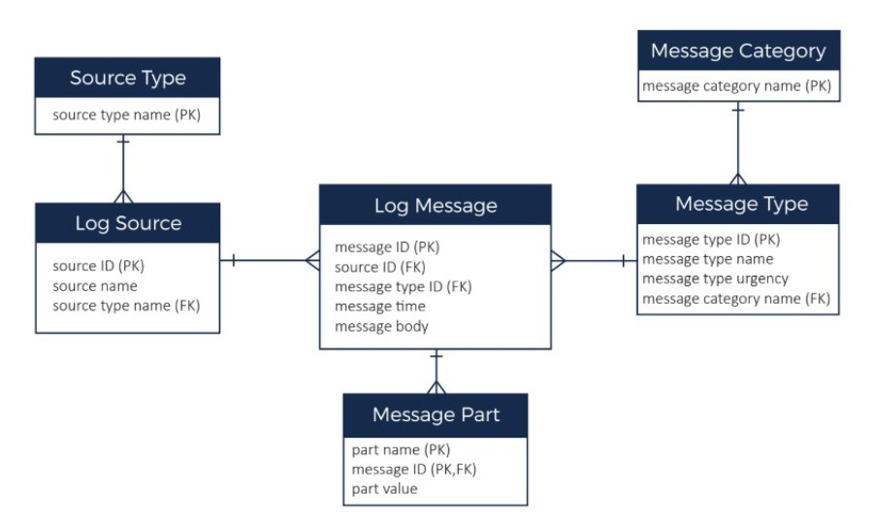
SAMPLE SYSTEM ARCHITECTURE
Replace the diagram below with your rough System Architecture and/or Data Models. (It is okay to use two or more slides in this section).

Slide 11
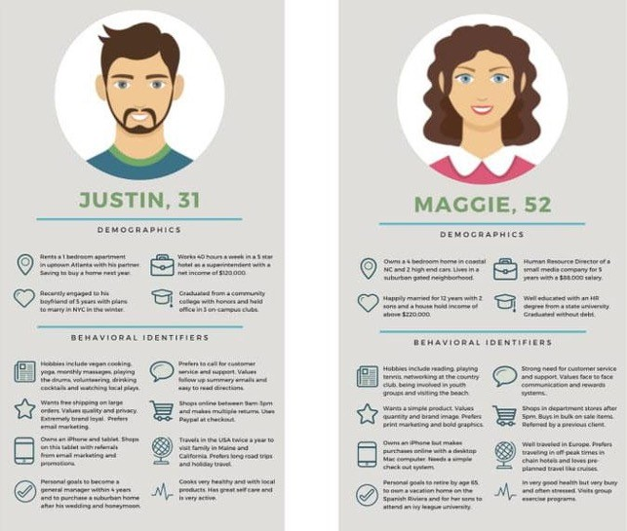
PERSONAS
Who is the user(s)?
Ease of Use ...? Performance/Speed...? Presentation...?
Accuracy…?

Slide 12
JUMP START
How will you get started quickly?
Given your persona of first customer, do you have access to them and who will be the first to give you feedback on your project?
They should be the first users of your MVP (Minimum Viable Product).
What is the minimum work needed to create value for the first user(s)?

