Slide 1

GENERALIZED LINEAR MODELS
GAMMA
DISTRIBUTION

Slide 2
TABLE OF
CONTENT
Target Variable Type 01
Assigned Model Type 02 Understanding Gamma 03 Comparison with Binomial 05 Six-Stage Approach 06

Slide 3
1 . Target Variable Type
Broad Category: Continuous Positive Variables
The Gamma Distribution is a type of distribution that works on supervised models. This means that the target variable is clearly defined and we want to find the relation between input variables and the target variable.
In the case of a Gamma Distribution, the focus is on positive continuous variables. Variables are commonly right-skewed and heteroscedastic.
Example: Insurance claims, transaction amounts (these cannot be negative), time events

Slide 4

2 . ASSIGNED MODEL
TYPE
Model Type: Generalized Linear Model (GLM)
Assigned Distribution: Gamma Distribution
Gamma distributions
work on models target variables. It
with also
continuous positive
gallows linear models to be extended by allowing non-normal distributions. Gamma distributions also handle right-skewed data and a non-constant (heteroscedastic) variance.

Slide 5
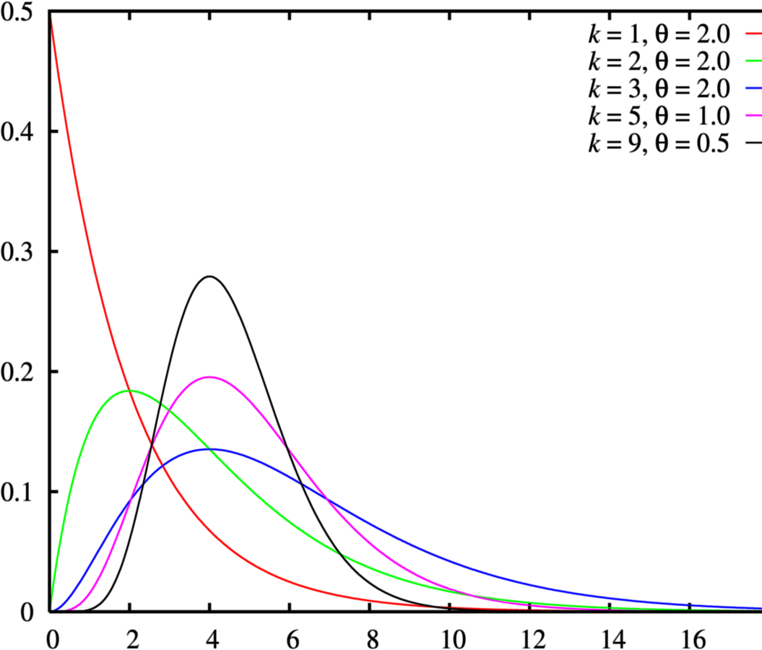
The gamma distribution for various parameters
https://brilliant.org/wiki/gamma-distribution/
Greater K moves to the right
Greater Theta taller distribution

Slide 6
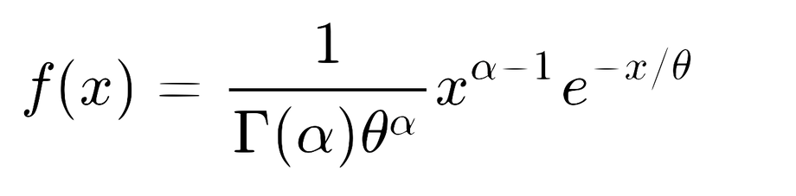
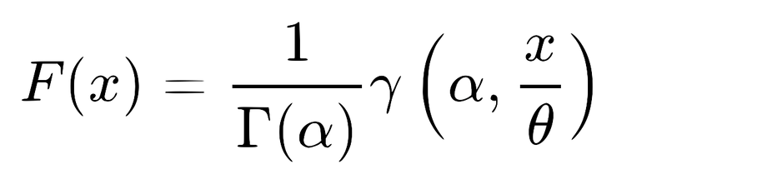
3 . UNDERSTANDING GAMMA
Core Principles: The distribution is defined for positive numbers and tends to be right- skewed and heteroscedastic. The mean is linked to predictors by using log and inverse variables. Has a shape parameter (α) and a scale parameter (θ).
PDF: CDF:

Slide 7
3 . UNDERSTANDING GAMMA
Assumptions:
Response variable is positive ⟶ y > 0 Observations are independent
Variance of the response variable increases with the scare of the mean ⟶ Heteroscedasticiy Relationship between y and predictor variables is linear
Use Cases:
Modeling measurements with positive skewness Modeling costs, waiting times, insurance

Slide 8



4 . COMPARISON WITH BINOMIAL
Feature
Target Variable Assumption Variance
Distribution Shape Use Cases
Gamma Distribution
Continuous, Positive
Right-Skewed, Heteroscedasticity, Independence Increases with square of mean
Continuous, Right-Skewed Costs, Time
Binomial Distribution
Categorical, Binomial (0,1)
Fixed number of trials, Binary, Independence Depends on mean
Discrete, Between 0 and 1 Yes/No
Gamma handles positive, skewed and continuous data while binomial is used when the outcomes are binomial (0/1, Yes/No, Success/Failure)

Slide 9
SIX-STAGE APPROACH TO MULTIVARIABLE MODEL BUILDING FOR LINEAR REGRESSION ANALYSIS

