Slide 1
Categorical Variable
df[var].value_counts(normalize=True)
Chi-Square Test
Exploratory Data Analysis
Unbiased variable with Normal Distribution
Any of this can prove normality: Shapiro, KS, Jarque-Bera and Histogram
Use mean (parametric test)
T-test
ANOVA test if 3+ groups
Numerical
Variable
df[var].describe()
Capped discrete, very skewed or with no Normal Distribution
Use median (non-parametric test)
Mann–Whitney test
Kruskal Wallis if 3+ groups and non-parametric

Slide 2
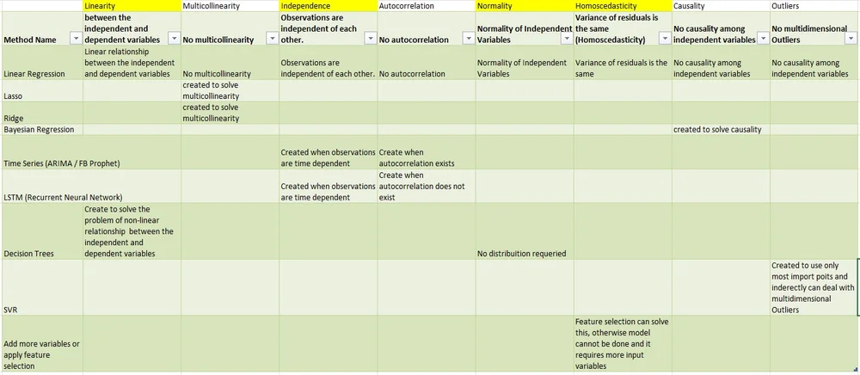
Why Principal Component Analysis?
PCA

Slide 3
Look the data
Not enough columns or rows
(univariate and bivariate analysis only)
Yes, enough columns or rows
(multivariate analysis, too much work to do it by hand)
Multivariate Methods
They will help us
No target variable (no label data) no column informing what needs to be predicted
Yes, target variable (labelled data) there is a column informing what needs to be predicted
Unsupervised
Supervised
#colums * 20 > # rows
Or Multicolinearity /Correlation/Causality
Target continuous
Target Binary / Categorical
#colums * 20 < # rows
EDA
PCA
Cluster
Regression
Classification
(-) Worse models/inference
(+) Better models/inference

Slide 4
When to use PCA?
Addressing Multicollinearity
Data Visualization (especially 2D)
Noise Reduction
Improved Model Performance
Feature Extraction* (Not really, better with SEM)
Dimensionality Reduction** (This is not the same as feature selection, this is for reducing the number of columns for visualization or secondary model)

