Slide 1


PYTHON BÁSICO – DÍA 5 - FINAL
Prof. Manoel Gadi
mfalonso@faculty.ie.edu

Slide 2
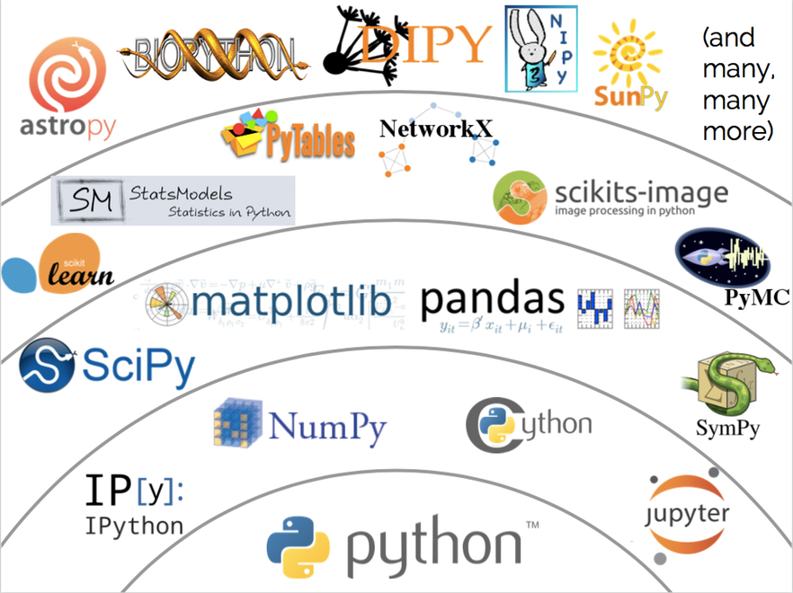

Slide 3
ESTRUCTURAS DE DATOS

Slide 4
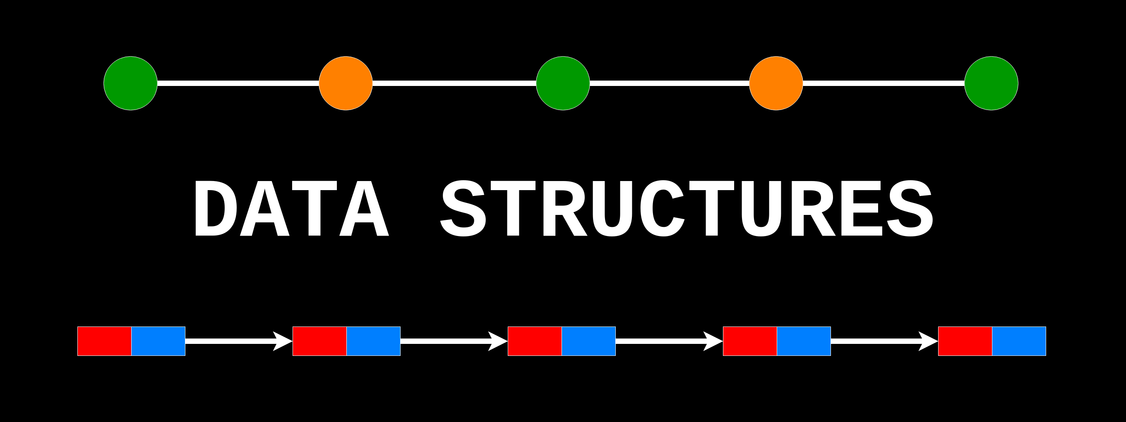

Slide 5

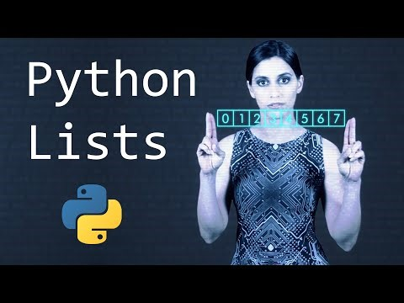

Slide 6
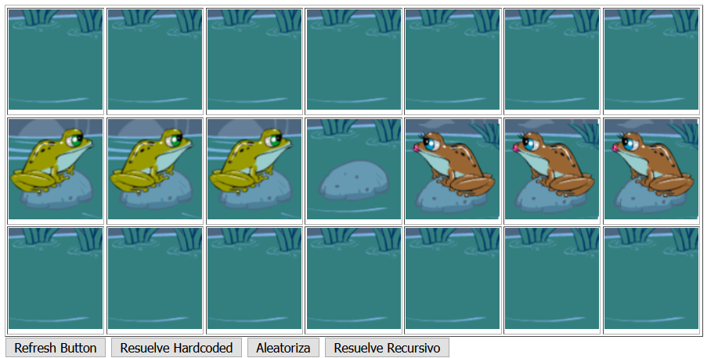
PARTE 2: RESOLVER LA RANA EN PYTHON
http://mfalonso.pythonanywhere.com/ranas
CREANDO UNA LISTA.

Slide 7
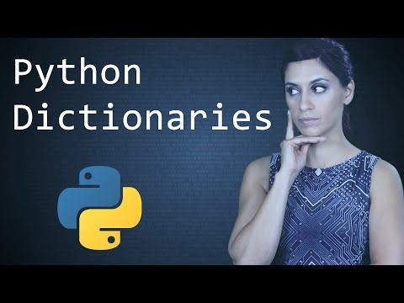

Slide 8
CPU
ROM
DATOS:
VELOCIDAD
VOLUMEN
VARIABILILDAD (estructuras)
HD
95% de los problemas
CÓDIGO:
ENTENDIBLE (documentación)
CORRECTO (testeo)
REUTILIZABLE (funciones, clases y paquetes)

Slide 9
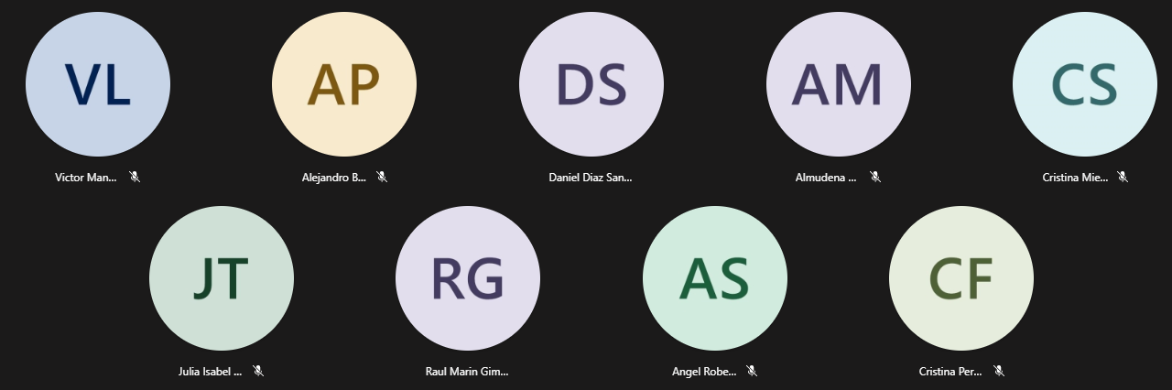

Slide 10
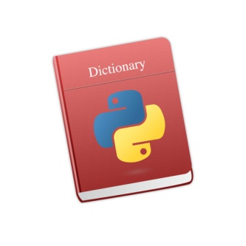
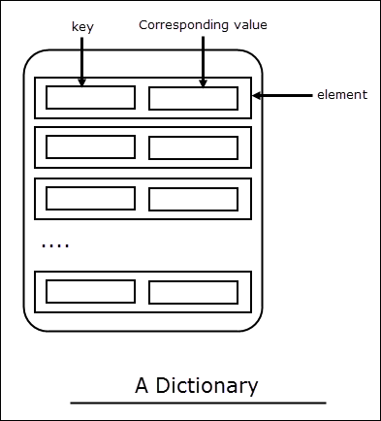
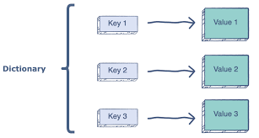

Python Dictionary:
Python 's dictionaries are hash table type. They work like associative arrays or hashes found in Perl and consist of key-value pairs.
Keys can be almost any Python type, but are usually numbers or strings. Values, on the other hand, can be any arbitrary Python object.
Dictionaries are enclosed by curly braces ( { } ) and values can be assigned and accessed using square braces ( [] ).

Slide 11

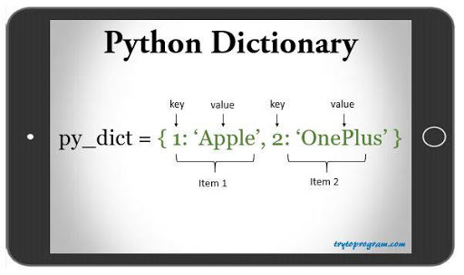
Python Dictionary - Syntax

Slide 12
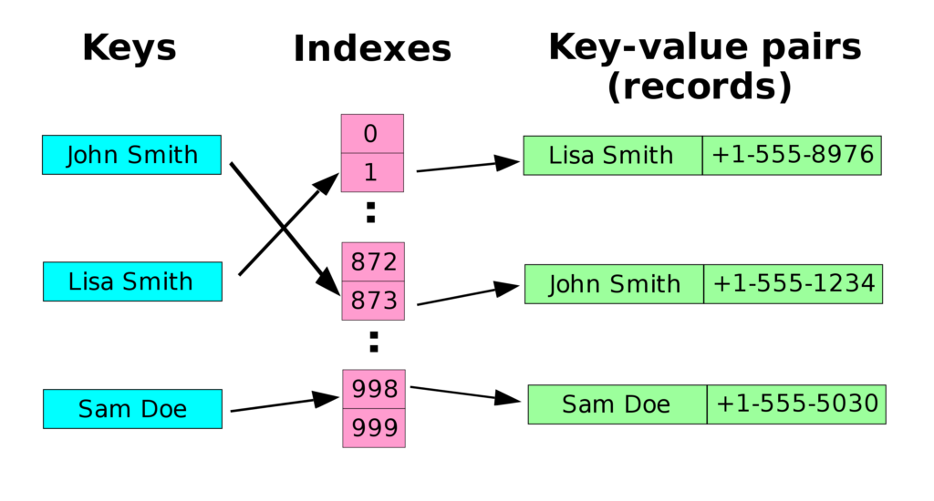
Python Dictionary – Is it efficient?
The fastest structure to find an element by key!

Slide 13

Which of the following statements are true?
a) Dictionaries do not have much value in Python b) Dictionaries are a fundamental part of Python c) Dictionaries are used extensively in applications d) Dictionaries are not at par with the tech innovation
Correct answer at 49:10
https://talkpython.fm/episodes/show/100/python-past-present-and-future-with-guido-van-rossum

Slide 14
Which of the following statements are true?
a) Dictionaries do not have much value in Python b) Dictionaries are a fundamental part of Python c) Dictionaries are used extensively in applications d) Dictionaries are not at par with the tech innovation
Correct answer: b and c at 49:10
https://talkpython.fm/episodes/show/100/python-past-present-and-future-with-guido-van-rossum

Slide 15
mydict = {}
mydict['one'] = "This is one"
mydict[2] = "This is two"
tinydict = {'name': 'john','code':6734, 'dept': 'sales'}
print(mydict['one']) # Prints value for 'one' key
print(mydict[2] ) # Prints value for 2 key
print(tinydict) # Prints complete dictionary
print(tinydict.keys() ) # Prints all the keys
print(tinydict.values() ) # Prints all the values
for item in tinydict.keys():
print("key={} / value={}".format(item,tinydict[item])) ) # Iterate over each key.
OUTPUT:
This is one
This is two
{'dept': 'sales', 'code': 6734, 'name': 'john'}
['dept', 'code', 'name']
['sales', 6734, 'john']
key=name / value=john
key=code / value=6734
key=dept / value=sales

Slide 16
Ejemplo API-JSON
invoking_callsign_api_json.py
from urllib.request import urlopen
import json
callsign = 'KK6JKQ'
sourceCode = urlopen("http://73s.com/qsos/%s.json" % callsign).read()
callsign_details = json.loads(sourceCode)
for key,value in callsign_details[0].items():
print('{}: {}'.format(key, value))
# Making call to many callsigns:
callsigns = ['KK6JKQ', 'UA1LO', 'N7ICE']
callsigns_json = {}
for callsign in callsigns:
try:
print(callsign)
sourceCode = urlopen("http://73s.com/qsos/%s.json" % callsign).read()
callsign_details = json.loads(sourceCode)
for key,value in callsign_details[0].items():
print('{}: {}'.format(key, value))
callsigns_json[callsign] = callsign_details
except:
print("{}<---ERROR".format(callsign))

Slide 17
Ejemplo API-JSON
invoking_callsign_api_json.py
# Saving a dictionary to a JSON file
import json
with open('callsigns_json.json', 'w') as f:
json.dump(callsigns_json, f)
# Reading from JSON file
with open('callsigns_json.json') as data_file:
data_loaded = json.load(data_file)
# Reading multiples callsigns from a file
f = open("callsigns.txt", "r")
for line in f.readlines():
print(line.strip())

Slide 18
Python Set:
Python's set is just a special case of dictionaries where values are not included only key. Sets are structures in math where elements are unique.
Sets can be almost any Python type, but are usually numbers or strings..
Sets are enclosed by curly braces ( { } ) without “:” .

Slide 19
50%
Good / Appropriate Algorithm
30%
Good / Appropriate Data Structure
20%
Faster / +Memory Computer
By Prof. Manoel Gadi
Like Constants!
list
tuple
dictionary
set
COMMON:
Collection of 0, 1 or many of any combination of types of Python scalars
Pure Python (comes within the language)
DIFFERENTIAL:
Mutable, Ordered [0,n-1]
Immutable, Ordered [0,n-1]
Key is Unique and Unordered (key immutable / Value= Mutable)
Unique, Unordered
CREATE EMPTY:
list1=list(); list2=[]
tuple1=tuple(); tuple2=()
dict1=dict(); dict2={}
set1 = set()
CREATE:
list1 = [3,6,7,3,7]
tupple1 = (3,3,6,7,7)
dict1 ={3:'str',6:False}
set1 = {3,6,7}
INSERT:
list1.append(8)
-
dict1['Juan'] = 'Casado'
set1.add(8)
INSERT IN POSITION:
list1.insert(3,'value')
-
-
-
list1.pop(1) / list1.remove(3)
REMOVE:
-
del dict1['Juan']
set1.remove(8)
Python Ecosystem (libraries)
Data frame (pandas)
Key-Value (pickledb)
HDFS (pytables)
SQL

Slide 20
PYTHON BÁSICO – DÍA 5 - FINAL
Prof. Manoel Gadi
mfalonso@faculty.ie.edu

Slide 21

https://www.youtube.com/watch?v=hgI0p1zf31k

