Slide 1
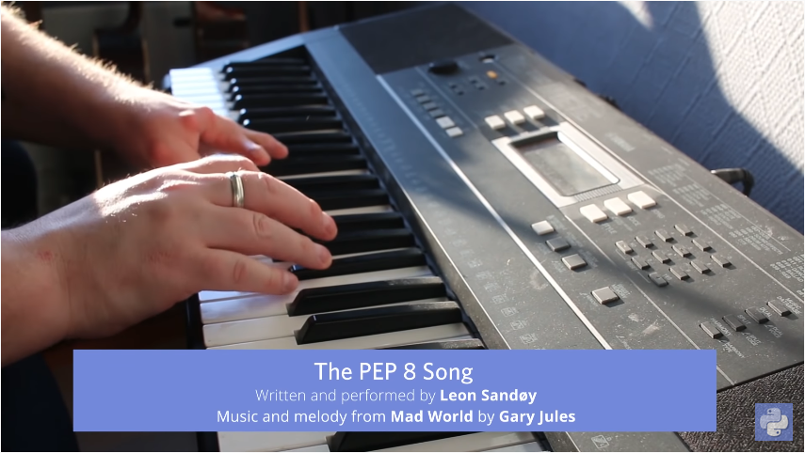
https://www.youtube.com/watch?v=hgI0p1zf31k

Slide 2


PYTHON BÁSICO – DIA 4
Prof. Manoel Gadi
mfalonso@faculty.ie.edu

Slide 3
ESTRUCTURAS DE DATOS

Slide 4
CPU
ROM
DATOS:
VELOCIDAD
VOLUMEN
VARIABILILDAD (estructuras)
HD
95% de los problemas
CÓDIGO:
ENTENDIBLE (documentación)
CORRECTO (testeo)
REUTILIZABLE (funciones, clases y paquetes)

Slide 5

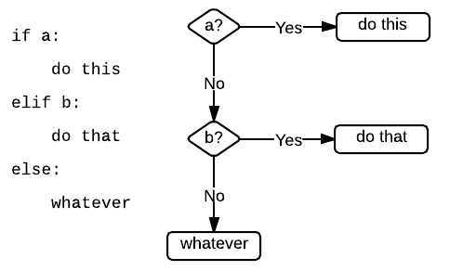
If – elif - else

Slide 6
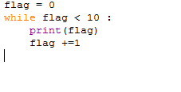
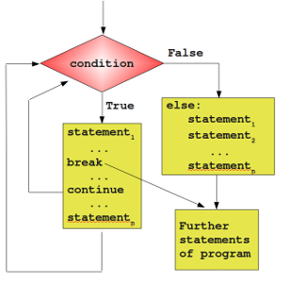
While Loop

Slide 7
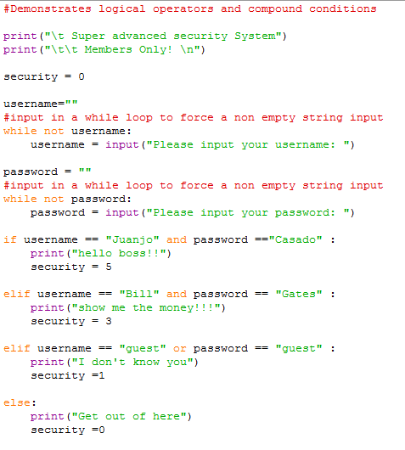
While and if

Slide 8
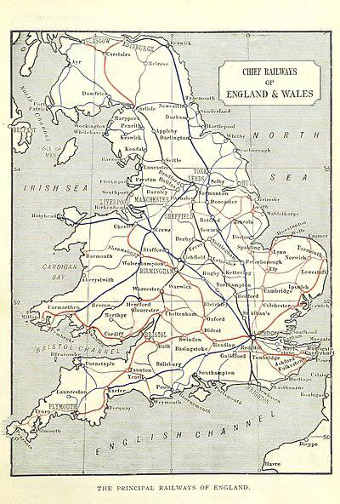

ONE SINGLE TRAIN (no parallelism) and while and if code

Slide 9
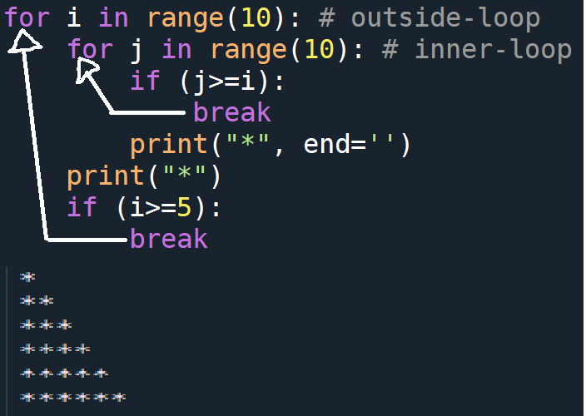
When we use 'break‘, does 'break' exit the immediate loop it is part of or does it exit the outermost loop?

Slide 10
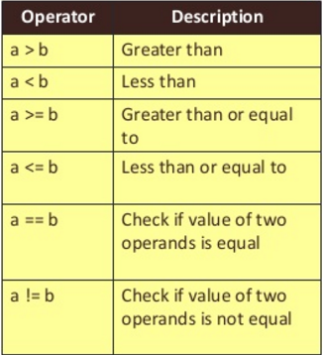
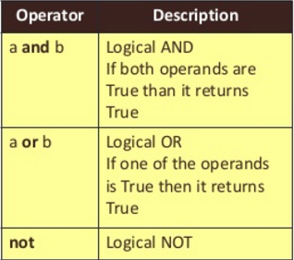
Logical operators

Slide 11
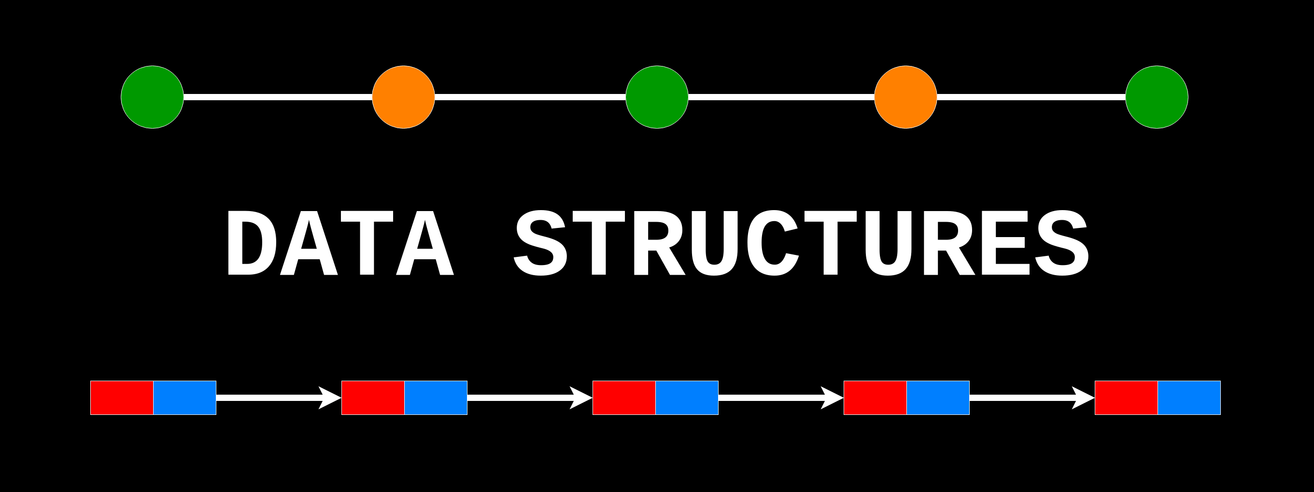

Slide 12

Lists, tuples and Dictionaries

Slide 13
Standard Data Types:
Python has 6 primitive (scalar) data types:
None
Boolean
Integer
Float
Complex
String
What is a structure?
A way of organizing one or more scalar types (none, boolean, integer, float, complex and string).

Slide 14
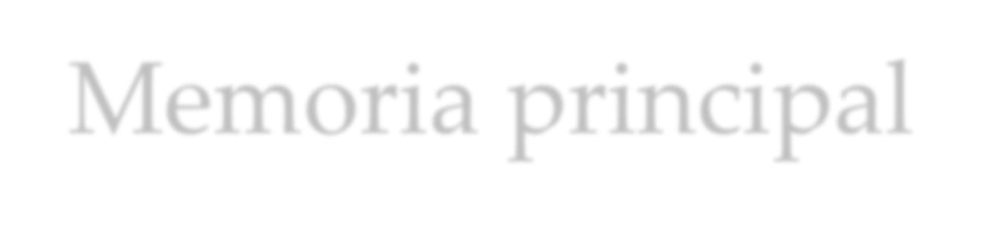

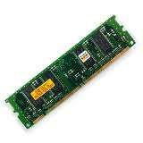
Memoria principal
Main memory en inglés.
Es donde se almacenas los programas mientras se están ejecutando.
También se almacenan los datos. (Von Newman)
RAM: Random Access Memory
o Memoria de acceso aleatorio
Se borra cuando se apaga el ordenador
Es muy rápida

Slide 15

Memoria principal
La memoria está dividida en pequeñas unidades llamadas bytes
Los bytes están formados por bits.
El bit podría definirse como la unidad mínima de
información.
A cada byte en la memoria se le asocia una dirección.

Slide 16
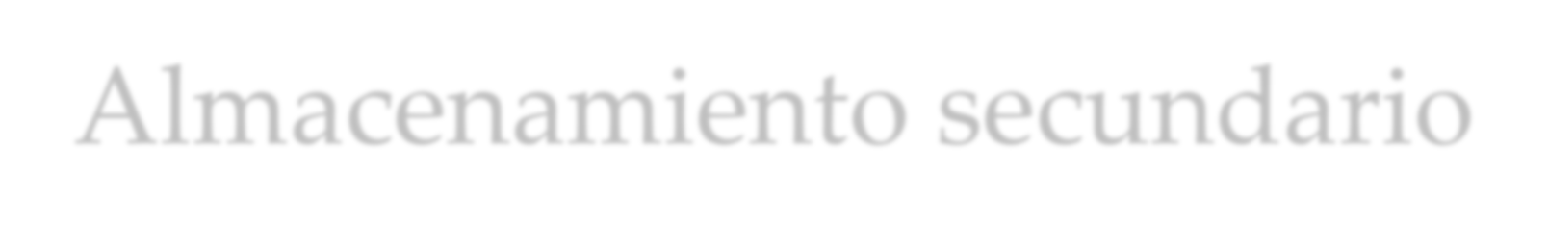
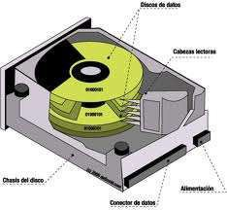
Almacenamiento secundario
Es un tipo de memoria que almacena datos durante mucho tiempo.
No se borran cuando se apaga el ordenador.
Es más lenta que la memoria principal
Frecuentemente, los programas son almacenados en la memoria secundaria y cargados en la memoria principal cuando es necesario.
Ej: Discos duros, SSD, etc.

Slide 17
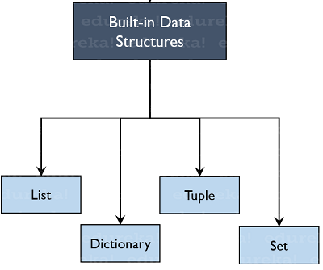
Built-in Data Structures:
Python has 4 standard data structures:
List
Tuple
Dictionary
Set
What is a structure?
A way of organizing one or more scalar types (none, boolean, integer, float, complex and string).

Slide 18
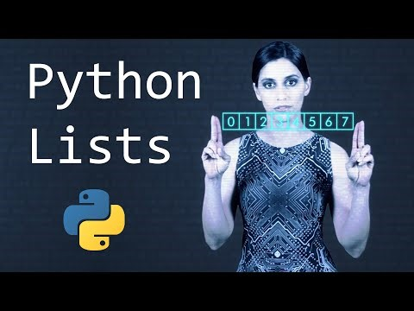

Slide 19
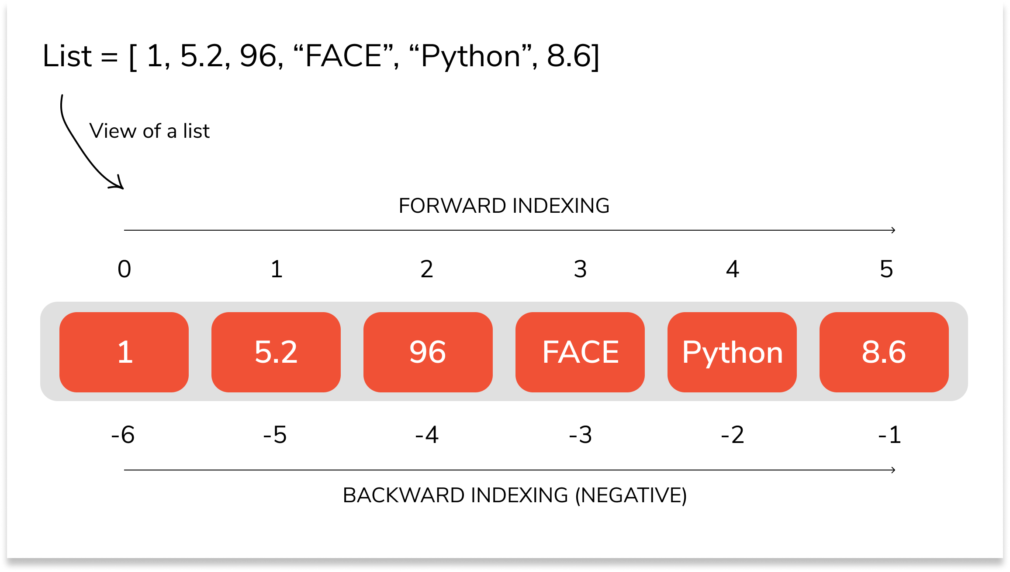
Python Lists:
Lists are the most versatile of Python's compound data types. A list contains items separated by commas and enclosed within square brackets ([]).
To some extent, lists are similar to lists in R. However lists are the default option in Python. All the items belonging to a list can be of different data type.
The values stored in a list can be accessed using the slice operator ( [ ] and [ : ] ) with indexes starting at 0 in the beginning of the list and working their way to end-1.
The plus ( + ) sign is the list concatenation operator, and the asterisk ( * ) is the repetition operator.

Slide 20
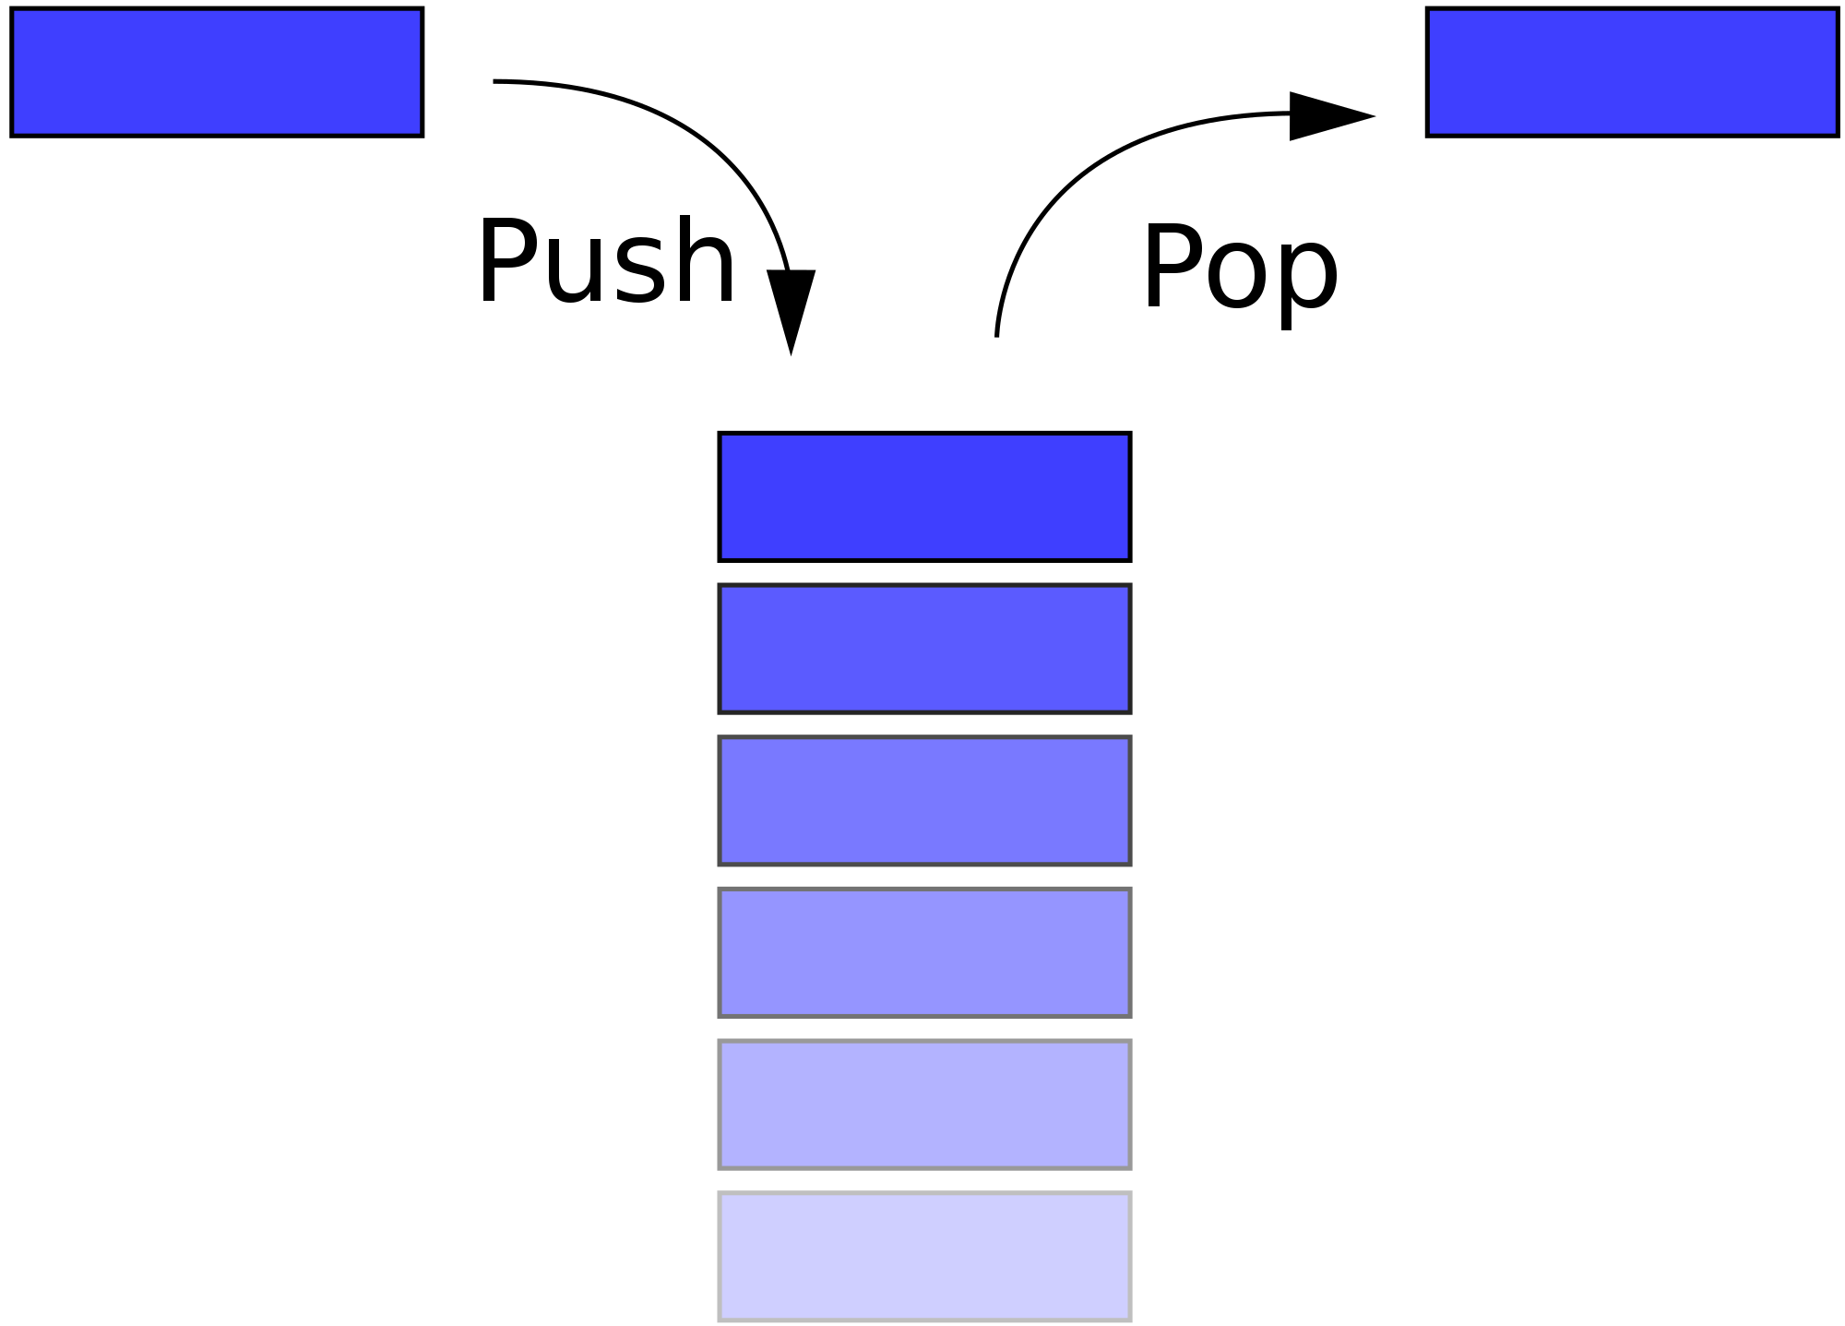
List as stack (Last In First Out)
append
pop
mylist = [ 'abcd', 786 , 2.23, 'john', 70.2 ]
mylist.append(10)
mylist.pop()

Slide 21
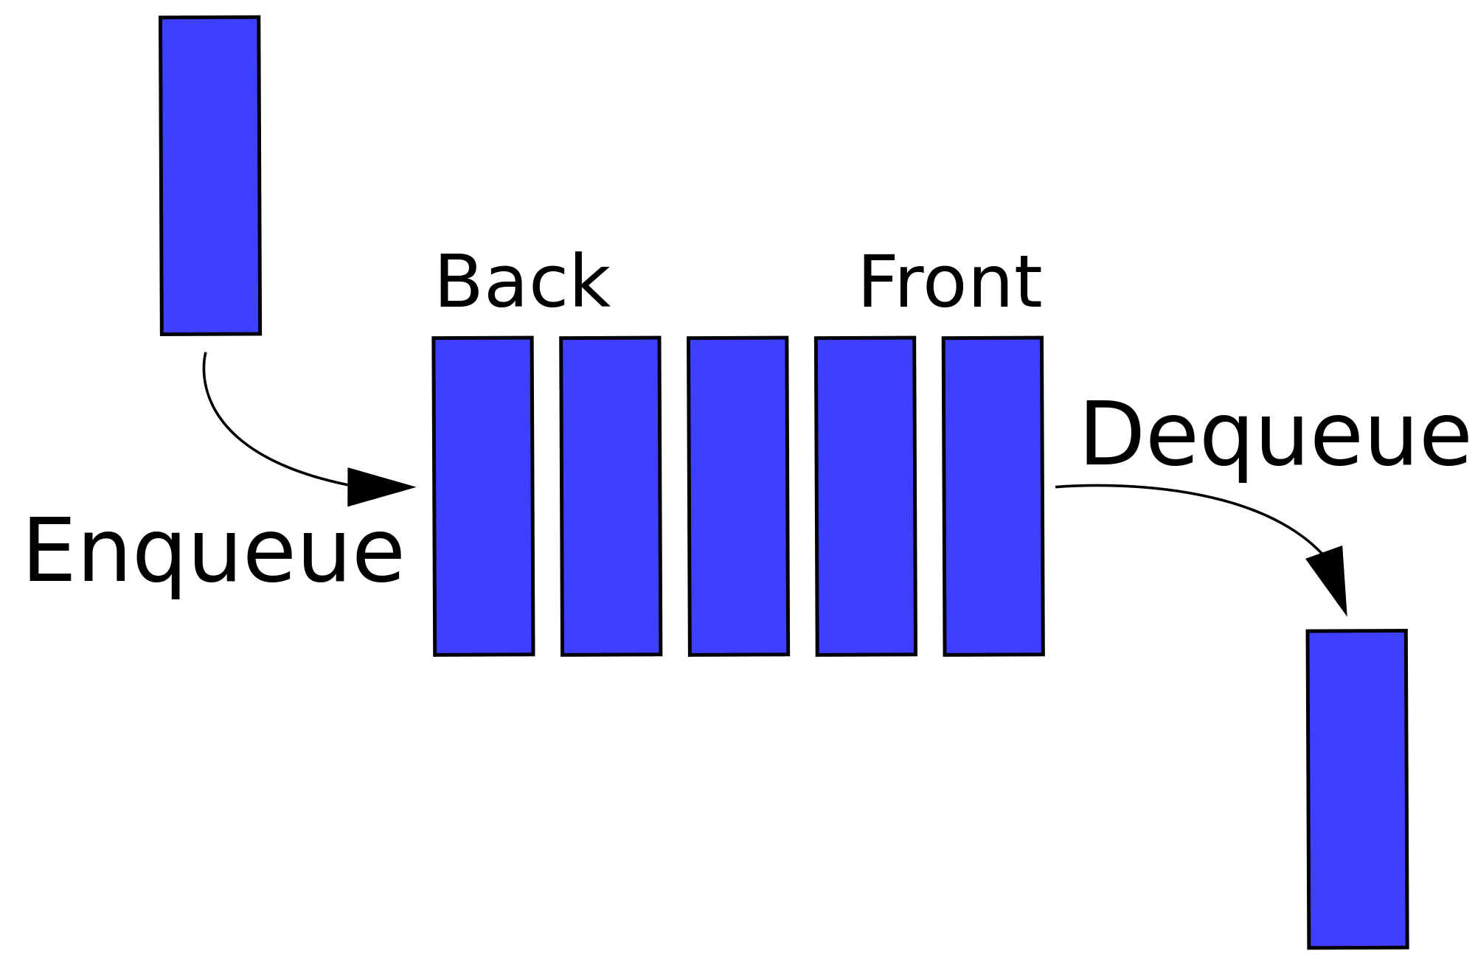
List as queue (First In First Out)
pop(0)
append
mylist = [ 'abcd', 786 , 2.23, 'john', 70.2 ]
mylist.append(10)
mylist.pop(0)

Slide 22
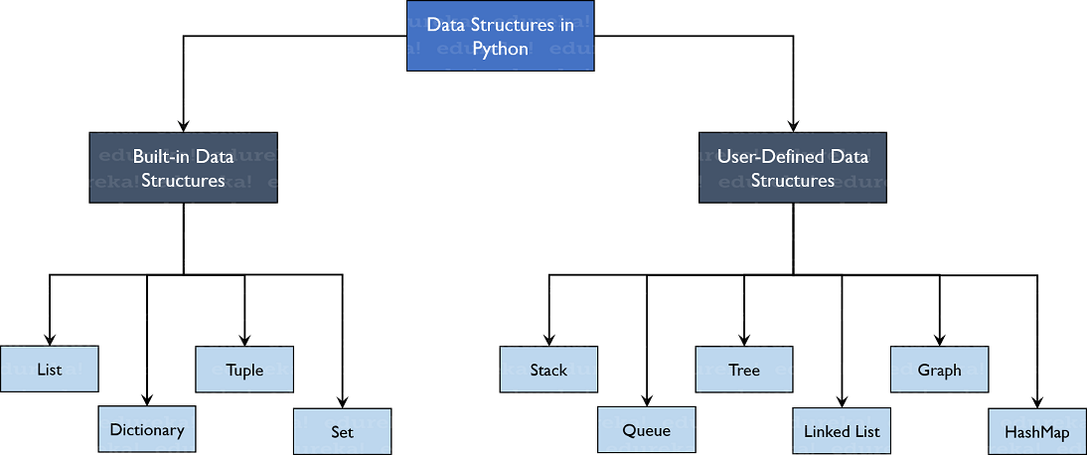

Slide 23
mylist = [ 'abcd', 786 , 2.23, 'john', 70.2 ]
tinylist = [123, 'john']
print(list) # Prints complete list
print(mylist[0] ) # Prints first element of the list
print(mylist[1:3]) # Prints elements starting from 2nd till 3rd
print(mylist[2:]) # Prints elements starting from 3rd element
print(tinylist * 2) # Prints list two times
Print(mylist + tinylist) # Prints concatenated lists
Output:
['abcd', 786, 2.23, 'john', 70.2]
abcd
[786, 2.23]
[2.23, 'john', 70.2]
[123, 'john', 123, 'john']
['abcd', 786, 2.23, 'john', 70.2, 123, 'john']

Slide 24
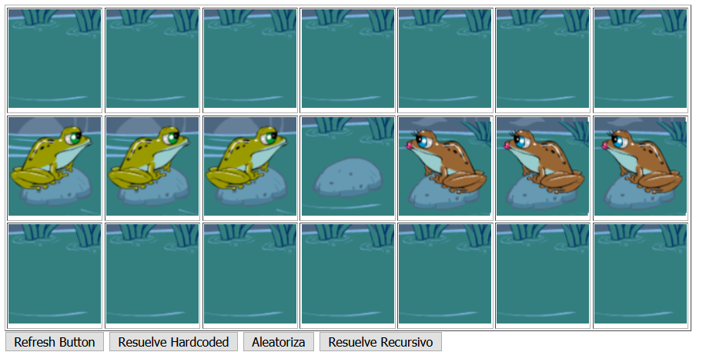
PARTE 2: RESOLVER LA RANA EN PYTHON
http://mfalonso.pythonanywhere.com/ranas
CREANDO UNA LISTA.

Slide 25
DESCANSO – NOS VEMOS A LAS 13:10

Slide 26
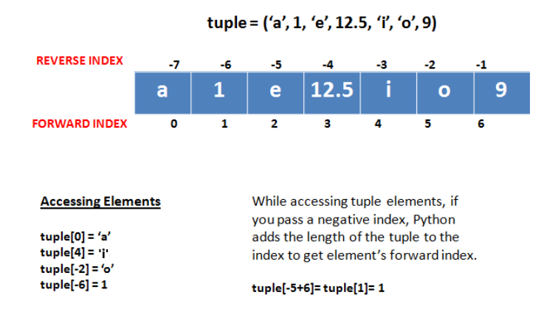
Python Tuples:
A tuple is another sequence data type that is similar to the list. A tuple consists of a number of values separated by commas. Unlike lists, however, tuples are enclosed within parentheses.
The main differences between lists and tuples are: Lists are enclosed in brackets ( [ ] ), and their elements and size can be changed, while tuples are enclosed in parentheses ( ( ) ) and cannot be updated. Tuples can be thought of as read-only lists.

Slide 27
mytuple = ( 'abcd', 786 , 2.23, 'john', 70.2 )
tinytuple = (123, 'john')
print(mytuple) # Prints complete list
print(mytuple[0]) # Prints first element of the list
print(mytuple[1:3]) # Prints elements starting from 2nd till 3rd
print(mytuple[2:] ) # Prints elements starting from 3rd element
print(mytinytuple * 2) # Prints list two times
print(mytuple + tinytuple) # Prints concatenated lists
OUTPUT:
('abcd', 786, 2.23, 'john', 70.2)
abcd
(786, 2.23)
(2.23, 'john', 70.2)
(123, 'john', 123, 'john')
('abcd', 786, 2.23, 'john', 70.2, 123, 'john')
The use of tuples will become
clearer when we learn functions

Slide 28
Python Basic Exercises 5 - Lists
(home work: will be solved next class)
Write a program which accepts a sequence of comma-separated numbers from console and generate a list and a tuple with the square of every number.
Suppose the following input is supplied to the program: 34,67,55,33,12,98
Then, the output should be:
[1156, 4489, 3025, 1089, 144, 9604]
(1156, 4489, 3025, 1089, 144, 9604)
Hint: In case of input data being supplied to the question, it should be assumed to be a console input. tuple() constructor method can convert list to tuple

Slide 29
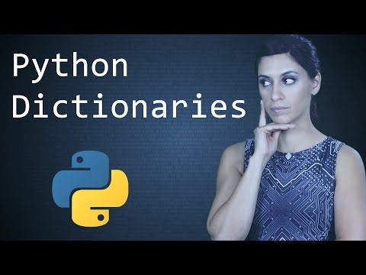

Slide 30
CPU
ROM
DATOS:
VELOCIDAD
VOLUMEN
VARIABILILDAD (estructuras)
HD
95% de los problemas
CÓDIGO:
ENTENDIBLE (documentación)
CORRECTO (testeo)
REUTILIZABLE (funciones, clases y paquetes)

Slide 31
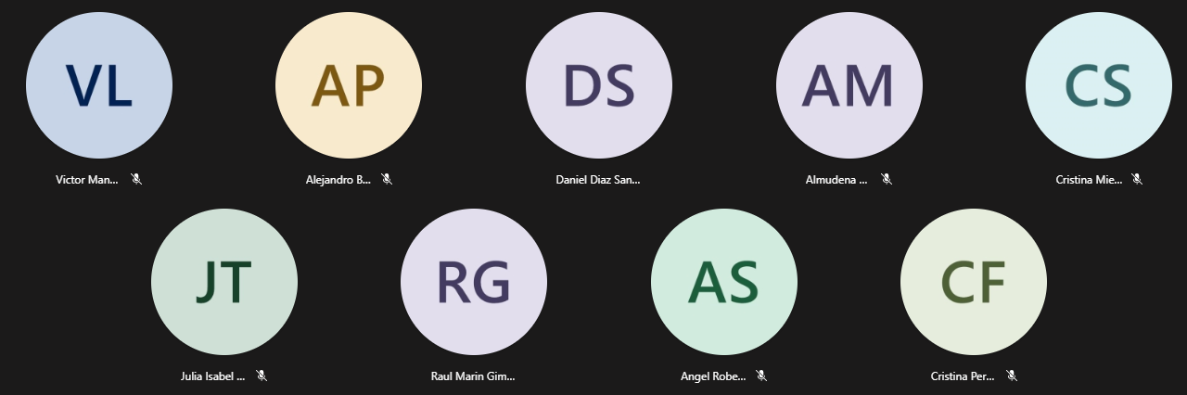

Slide 32
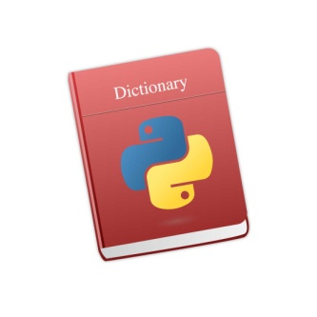
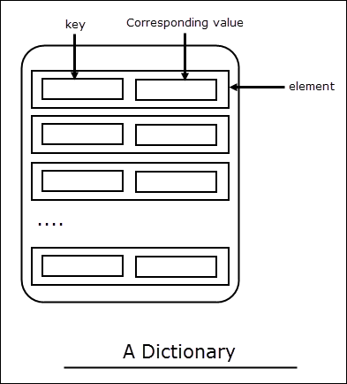
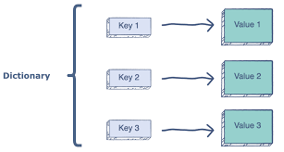

Python Dictionary:
Python 's dictionaries are hash table type. They work like associative arrays or hashes found in Perl and consist of key-value pairs.
Keys can be almost any Python type, but are usually numbers or strings. Values, on the other hand, can be any arbitrary Python object.
Dictionaries are enclosed by curly braces ( { } ) and values can be assigned and accessed using square braces ( [] ).

Slide 33

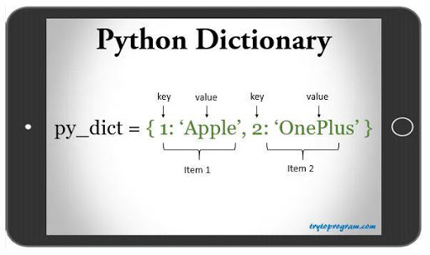
Python Dictionary - Syntax

Slide 34
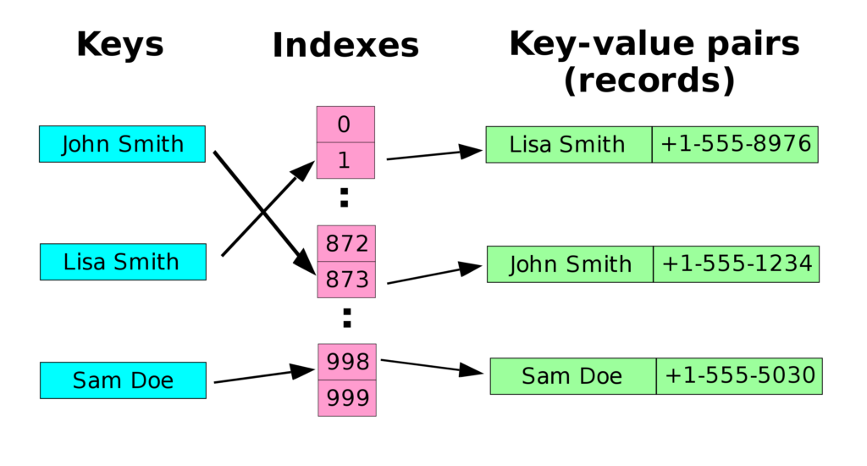
Python Dictionary – Is it efficient?
The fastest structure to find an element by key!

Slide 35

Which of the following statements are true?
a) Dictionaries do not have much value in Python b) Dictionaries are a fundamental part of Python c) Dictionaries are used extensively in applications d) Dictionaries are not at par with the tech innovation
Correct answer at 49:10
https://talkpython.fm/episodes/show/100/python-past-present-and-future-with-guido-van-rossum

Slide 36
Which of the following statements are true?
a) Dictionaries do not have much value in Python b) Dictionaries are a fundamental part of Python c) Dictionaries are used extensively in applications d) Dictionaries are not at par with the tech innovation
Correct answer: b and c at 49:10
https://talkpython.fm/episodes/show/100/python-past-present-and-future-with-guido-van-rossum

Slide 37
mydict = {}
mydict['one'] = "This is one"
mydict[2] = "This is two"
tinydict = {'name': 'john','code':6734, 'dept': 'sales'}
print(mydict['one']) # Prints value for 'one' key
print(mydict[2] ) # Prints value for 2 key
print(tinydict) # Prints complete dictionary
print(tinydict.keys() ) # Prints all the keys
print(tinydict.values() ) # Prints all the values
for item in tinydict.keys():
print("key={} / value={}".format(item,tinydict[item])) ) # Iterate over each key.
OUTPUT:
This is one
This is two
{'dept': 'sales', 'code': 6734, 'name': 'john'}
['dept', 'code', 'name']
['sales', 6734, 'john']
key=name / value=john
key=code / value=6734
key=dept / value=sales

Slide 38
Ejemplo API-JSON
invoking_callsign_api_json.py
from urllib.request import urlopen
import json
callsign = 'KK6JKQ'
sourceCode = urlopen("http://73s.com/qsos/%s.json" % callsign).read()
callsign_details = json.loads(sourceCode)
for key,value in callsign_details[0].items():
print('{}: {}'.format(key, value))
# Making call to many callsigns:
callsigns = ['KK6JKQ', 'UA1LO', 'N7ICE']
callsigns_json = {}
for callsign in callsigns:
try:
print(callsign)
sourceCode = urlopen("http://73s.com/qsos/%s.json" % callsign).read()
callsign_details = json.loads(sourceCode)
for key,value in callsign_details[0].items():
print('{}: {}'.format(key, value))
callsigns_json[callsign] = callsign_details
except:
print("{}<---ERROR".format(callsign))

Slide 39
Ejemplo API-JSON
invoking_callsign_api_json.py
# Saving a dictionary to a JSON file
import json
with open('callsigns_json.json', 'w') as f:
json.dump(callsigns_json, f)
# Reading from JSON file
with open('callsigns_json.json') as data_file:
data_loaded = json.load(data_file)
# Reading multiples callsigns from a file
f = open("callsigns.txt", "r")
for line in f.readlines():
print(line.strip())

Slide 40
Python Set:
Python's set is just a special case of dictionaries where values are not included only key. Sets are structures in math where elements are unique.
Sets can be almost any Python type, but are usually numbers or strings..
Sets are enclosed by curly braces ( { } ) without “:” .

Slide 41
50%
Good / Appropriate Algorithm
30%
Good / Appropriate Data Structure
20%
Faster / +Memory Computer
By Prof. Manoel Gadi
Like Constants!
list
tuple
dictionary
set
COMMON:
Collection of 0, 1 or many of any combination of types of Python scalars
Pure Python (comes within the language)
DIFFERENTIAL:
Mutable, Ordered [0,n-1]
Immutable, Ordered [0,n-1]
Key is Unique and Unordered (key immutable / Value= Mutable)
Unique, Unordered
CREATE EMPTY:
list1=list(); list2=[]
tuple1=tuple(); tuple2=()
dict1=dict(); dict2={}
set1 = set()
CREATE:
list1 = [3,6,7,3,7]
tupple1 = (3,3,6,7,7)
dict1 ={3:'str',6:False}
set1 = {3,6,7}
INSERT:
list1.append(8)
-
dict1['Juan'] = 'Casado'
set1.add(8)
INSERT IN POSITION:
list1.insert(3,'value')
-
-
-
list1.pop(1) / list1.remove(3)
REMOVE:
-
del dict1['Juan']
set1.remove(8)
Python Ecosystem (libraries)
Data frame (pandas)
Key-Value (pickledb)
HDFS (pytables)
SQL

Slide 42
Python Basic Exercises 6 - Dictionary
(home work: will be solved next class)
With a given integer number n, write a program to generate a dictionary that contains (i, i*i) such that is an integral number between 1 and n (both included). Finally, the program should print the dictionary.
Suppose the following input is supplied to the program: 8 Then, the output should be:
{1: 1, 2: 4, 3: 9, 4: 16, 5: 25, 6: 36, 7: 49, 8: 64}
Hint: In case of input data being supplied to the question, it should be assumed to be a console input. Consider using the constructor method dict()

Slide 43
Python Basic Exercises 6 - Dictionary
(home work: will be solved next class)
With a given integer number n, write a program to generate a dictionary that contains (i, i*i) such that is an integral number between 1 and n (both included). Finally, the program should print the dictionary.
SOLUTION:
n = int(input("Please enter a positive integer number: "))
n_dict = {}
for i in range(n):
n_dict[i] = i**2
print(n_dict)

