Slide 1
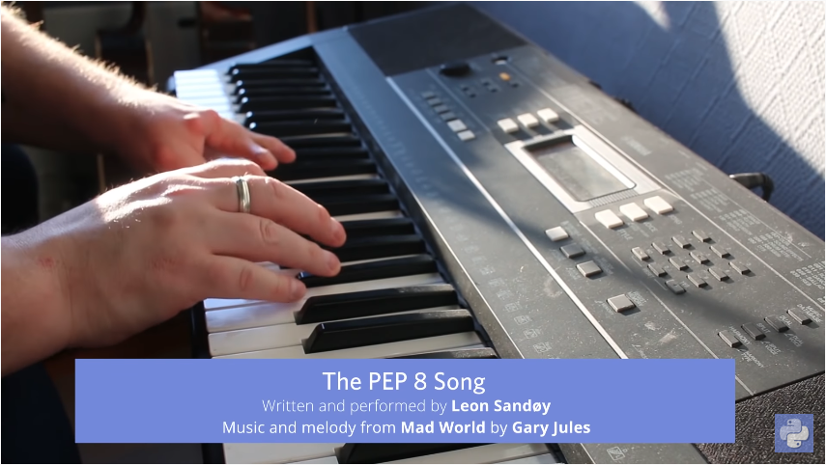
https://www.youtube.com/watch?v=hgI0p1zf31k

Slide 2


PYTHON BÁSICO – FUNCIONES
Prof. Manoel Gadi
mfalonso@faculty.ie.edu

Slide 3

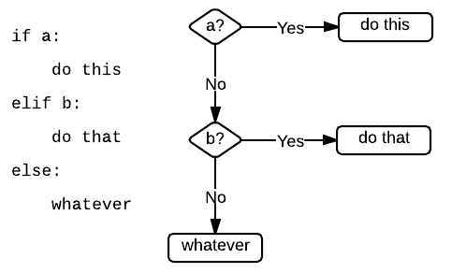
If – elif - else

Slide 4
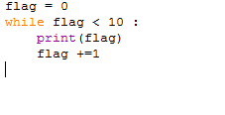
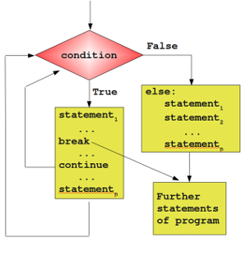
While Loop

Slide 5
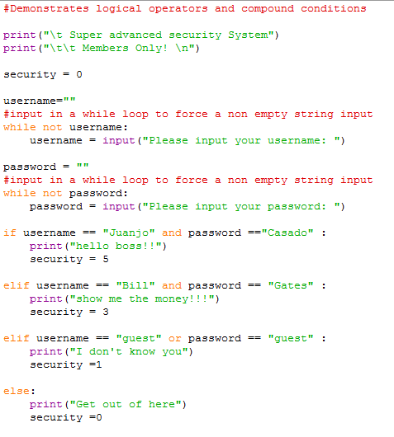
While and if

Slide 6
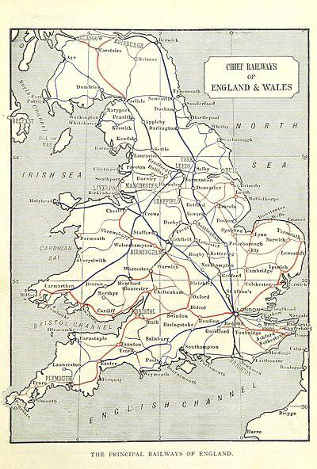

ONE SINGLE TRAIN (no parallelism) and while and if code

Slide 7
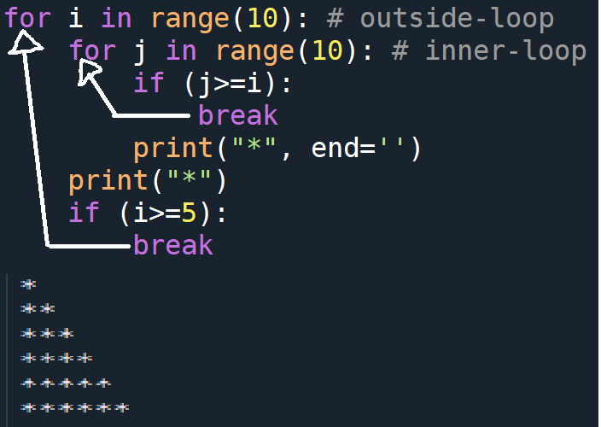
When we use 'break‘, does 'break' exit the immediate loop it is part of or does it exit the outermost loop?

Slide 8
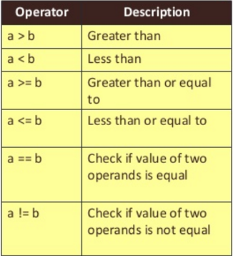
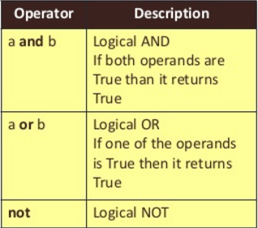
Logical operators

Slide 9
CPU
ROM
DATOS:
VELOCIDAD
VOLUMEN
VARIABILILDAD (estructuras)
HD
95% de los problemas
CÓDIGO:
ENTENDIBLE (documentación)
CORRECTO (testeo)
REUTILIZABLE (funciones, clases y paquetes)

Slide 10

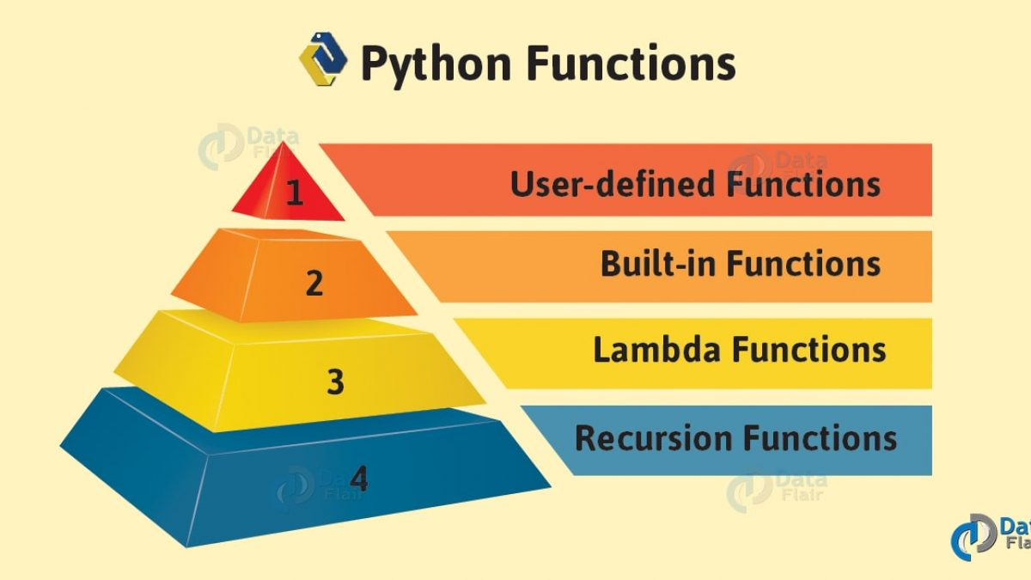
Functions
a named section of a program that performs a specific task

Slide 11
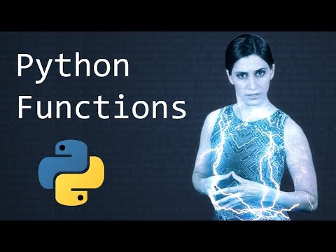
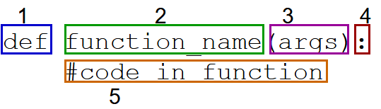
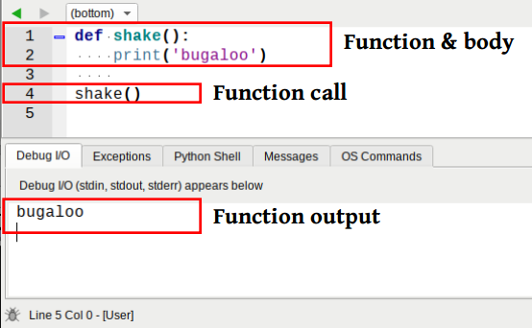
User defined functions

Slide 12
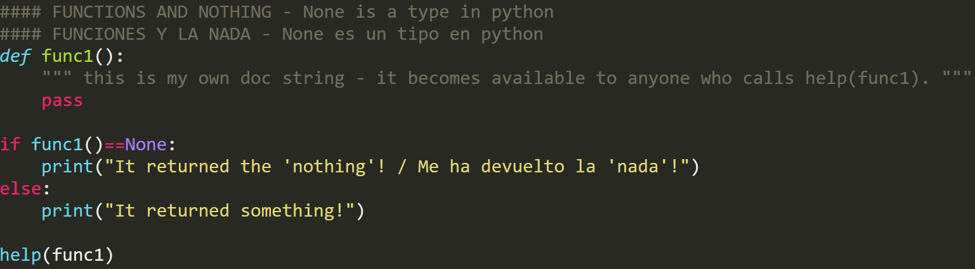
#### FUNCTIONS AND NOTHING - None is a type in python
#### FUNCIONES Y LA NADA - None es un tipo en python
def func1():
""" This is my own doc string - it becomes available to anyone who calls help(func1)."""
pass
if func1()==None:
print("It returned the 'nothing'! / Me ha devuelto la 'nada'!")
else:
print("It returned something!")
help(func1)

Slide 13
Numeric Strings Constructors Iterables (Lists, Dicts,…) |  | Built-in Functions |  | Python Functioning Iinput / Output
abs() – Numeric | delattr() | hash() | memoryview() | set() - Constructors
all() | dict() - Constructors | help() | min() - Numeric | setattr()
any() | dir() | hex() - Constructors | next() | slice()
ascii() | divmod() | id() | object() | sorted()
bin() | enumerate() | input() - Iinput / Output | oct() | staticmethod()
bool() - Constructors | eval() - Python Functioning | int() | open() - Iinput / Output | str()
breakpoint() | exec() | isinstance() | ord() | sum()
bytearray() | filter() | issubclass() | pow() | super()
bytes() - Constructors | float() | iter() | print() - Iinput / Output | tuple()
callable() | format() - Strings | len() | property() | type()
chr() - Strings | frozenset() | list() - Constructors | range() - Iterables | vars()
classmethod() | getattr() | locals() | repr() | zip()
compile() - Python Functioning | globals() | map() | reversed() - Strings | __import__()
complex() - Constructors | hasattr() | max() -Numeric | round()
https://docs.python.org/3/library/functions.html

Slide 14
Python Basic Exercises 3 - function
Write a function which can compute the factorial of a given numbers. Suppose the following input is supplied to the program: 8
Then, the output should be: 40320
Hint: x=int(input("Enter the n to obtain the factorial(n):"))

Slide 15
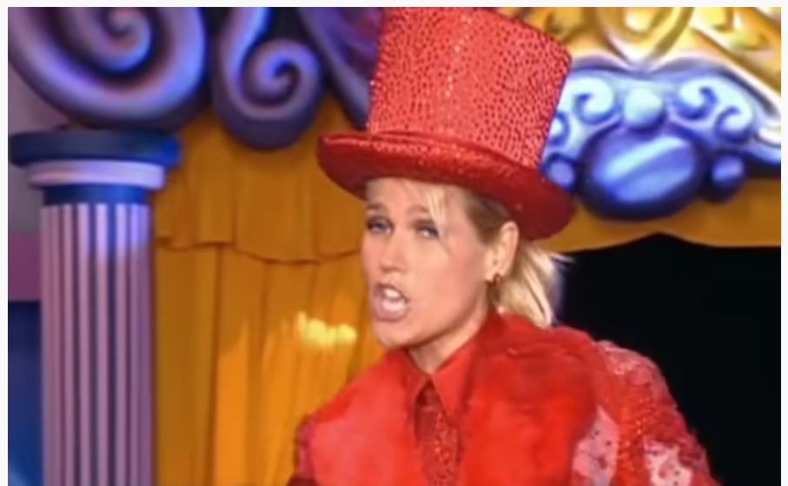
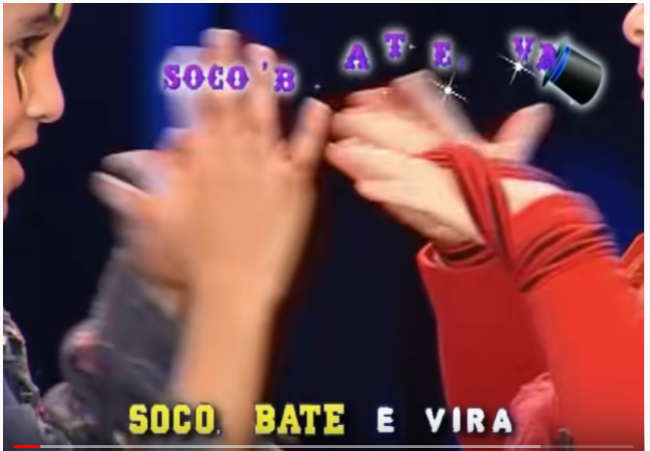
Optional exercise for the forum:
Listen to the song, find the pattern, then write a function: soco_bate_vira(n)
That receives:
> soco_bate_vira(2)
[1] Soco Soco Bate Bate Soco Soco Vira Vira
> soco_bate_vira(1)
[1] Soco Bate Soco Vira
> soco_bate_vira(0)
[1] Soco Bate Vira
What is the result of soco_bate_vira(3)?
and soco_bate_vira(4)?
and soco_bate_vira(5)?
https://www.youtube.com/watch?v=VZGcm_JYOKM
Chocolate prize next F2F class for anyone that can do this version in class:
https://www.youtube.com/watch?v=zk_3onMpwwU

Slide 16
Python Basic Exercises 4 - function
Write a program that invokes a function that calculates and returns the value according to the given formula:
Q = [(2 * C * D)/H]
Call your function several times, using integer values of your choice to C, D and H. The output of your function should always be integer.
Hint: If the output received is in decimal form, it should be rounded off to its nearest value (for example, if the output received is 26.1, it should be printed as 26)

