Slide 1

https://www.youtube.com/watch?v=hgI0p1zf31k

Slide 2


PYTHON BÁSICO – FUNCIONES vs MÉTODOS y Clase STRING
Prof. Manoel Gadi
mfalonso@faculty.ie.edu

Slide 3

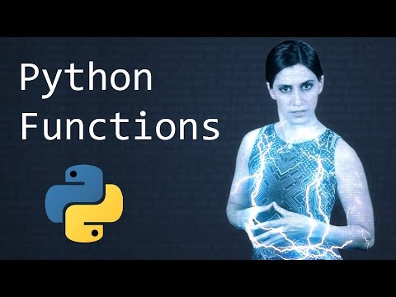
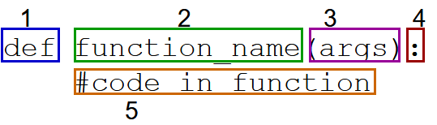
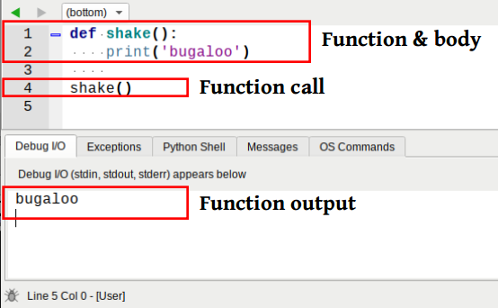
User defined functions

Slide 4
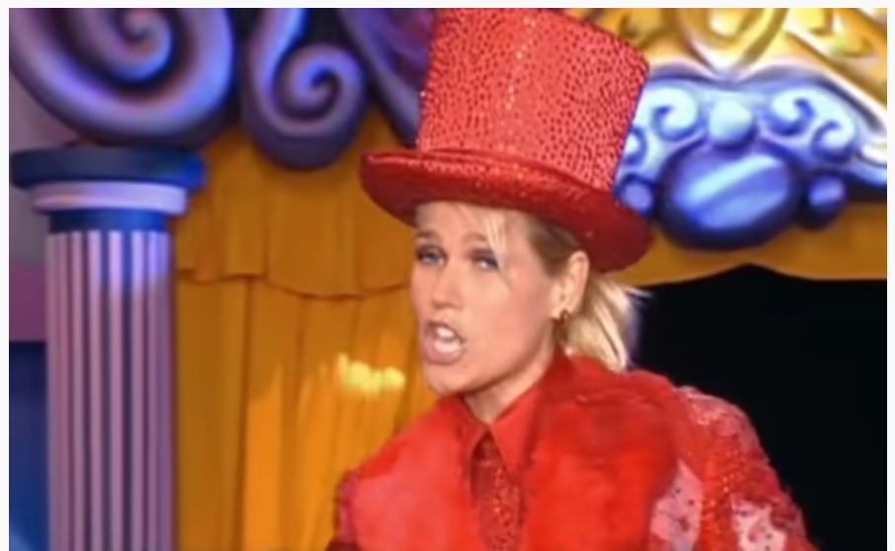

Optional exercise for the forum:
Listen to the song, find the pattern, then write a function: soco_bate_vira(n)
That receives:
> soco_bate_vira(2)
[1] Soco Soco Bate Bate Soco Soco Vira Vira
> soco_bate_vira(1)
[1] Soco Bate Soco Vira
> soco_bate_vira(0)
[1] Soco Bate Vira
What is the result of soco_bate_vira(3)?
and soco_bate_vira(4)?
and soco_bate_vira(5)?
https://www.youtube.com/watch?v=VZGcm_JYOKM
Chocolate prize next F2F class for anyone that can do this version in class:
https://www.youtube.com/watch?v=zk_3onMpwwU

Slide 5
Exercise for next Face to Face Class: SOLUTION
POSSIBLE SOLUTION
def soco_bate_vira(n):
""" Singing ('printing') along with Xuxa:
https://www.youtube.com/watch?v=VZGcm_JYOKM """
(a,b,c)= ("Soco","Bate","Vira")
if n == 0:
print(a,b,c)
else:
print("{} ".format(a)*n, "{} ".format(b)*n, "{} ".format(a)*n, "{} ".format(c)*n)
soco_bate_vira(4)
soco_bate_vira(3)
soco_bate_vira(2)
soco_bate_vira(1)
soco_bate_vira(0)
---
http://attendance.pythonanywhere.com/participation_redeem?sharedlink=1&code=P25IUNU

Slide 6
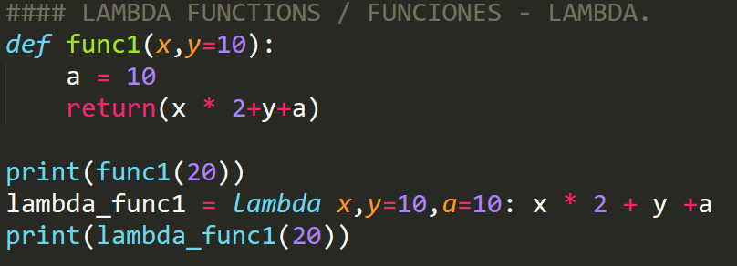
#### LAMBDA FUNCTIONS / FUNCIONES - LAMBDA.
def func1(x,y=10):
a = 10
return(x * 2+y+a)
print(func1(20))
lambda_func1 = lambda x,y=10,a=10: x * 2 + y +a
print(lambda_func1(20))

Slide 7
Exercise for next Face to Face Class: SPECIAL SOLUTION
POSSIBLE SOLUTION
def soco_bate_vira(n):
""" Singing ('printing') along with Xuxa:
https://www.youtube.com/watch?v=VZGcm_JYOKM """
(a,b,c)= ("Soco","Bate","Vira")
print("{} ".format(a)*max(1,n), "{} ".format(b)*n, "{} ".format(a)*max(1,n), "{} ".format(c)*max(1,n))
soco_bate_vira(4)
soco_bate_vira(3)
soco_bate_vira(2)
soco_bate_vira(1)
soco_bate_vira(0)
----
WITH LAMBDA SPECIAL FUNCTION:
soco, bate, vira = "soco ", "bate ", "vira "
soco_bate_vira = lambda n: soco*max(1,n) + bate*n + soco*max(1,n) + vira*max(1,n)
print(soco_bate_vira(10))
---

Slide 8
Python Basic Exercises 3 – function - SOLUTION
Write a function which can compute the factorial of a given numbers. Suppose the following input is supplied to the program: 8
Then, the output should be: 40320
Hint: x=int(input("Enter the n to obtain the factorial(n):"))
def factorial(n=0):
""" returns the factorial of n (default 0) and assuming factorial of any number smaller than 1 to be zero. """
if(type(n) != int):
try:
n = int(n)
except:
print("Error: n must be numeric, you provided: '{}'".format(n))
return(0)
if n <= 0:
return (0)
if n == 1:
return (1)
return (n*factorial(n-1))
print(factorial(-10))
print(factorial(0))
print(factorial(8))
print(factorial("Hacked!"))

Slide 9
Python Basic Exercises 4 – function - SOLUTION
Write a program that invokes a function that calculates and returns the value according to the given formula:
Q = [(2 * C * D)/H]
Call your function several times, using integer values of your choice to C, D and H. The output of your function should always be integer.
Hint: If the output received is in decimal form, it should be rounded off to its nearest value (for example, if the output received is 26.1, it should be printed as 26)
def calculate_q(c=0,d=0,h=1):
""" returns the Q = [(2 * C * D)/H] with (default c=0, d=0 and h=1 as it is denominator). """
try:
q = [(2 * c * d)/h]
except ZeroDivisionError:
if c * d < 0:
q = -float('inf')
else:
q = float('inf')
return (q)
print(calculate_q(c=-10,d=20,h=0))
print(calculate_q(c=10,d=20,h=0))
print(calculate_q(c=10,d=20,h=1))
print(calculate_q(c=10,d=20,h=2))
print(calculate_q(c=10,d=20,h=3))

Slide 10
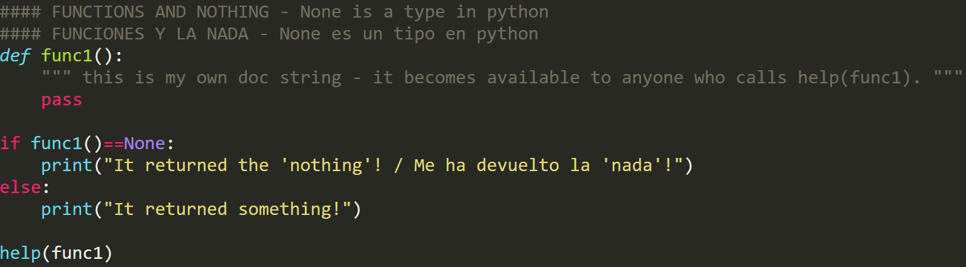
#### FUNCTIONS AND NOTHING - None is a type in python
#### FUNCIONES Y LA NADA - None es un tipo en python
def func1():
""" This is my own doc string - it becomes available to anyone who calls help(func1)."""
pass
if func1()==None:
print("It returned the 'nothing'! / Me ha devuelto la 'nada'!")
else:
print("It returned something!")
help(func1)

Slide 11
PYTHON BÁSICO – FUNCIONES vs MÉTODOS y Clase STRING
Prof. Manoel Gadi
mfalonso@faculty.ie.edu

Slide 12
functions vs. methods
A function looks like this: function(something)
And a method looks like this: something.method()
>>> a = ' BiG MuG '
>>> a.lower()
' big mug '
>>> a.upper()
' BIG MUG '
>>> a.strip()
'BiG MuG'
>>> a.strip().upper()
'BIG MUG'
>>> a.strip().upper().split(' ')
['BIG', 'MUG']
>>> ';'.join(a.strip().upper().split(' '))
'BIG;MUG’
A function can be applied to one or more type of things (objects), while methods are specific and can only be applied to “things” (objects) of one given type (one given class)

Slide 13
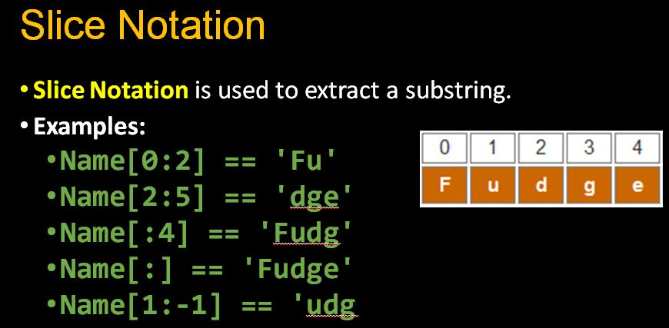
Python list slicing

