Slide 1





Welcome to the
GenAI Tutorial
Manoel Gadi
Dean & Professor
IE School of Science & Technology
https://www.techventurebootcamp.org/

Slide 2
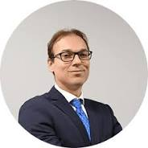
IE Professor with Phd in Cryptocurrency, Manoel Gadi is a highly experienced analytics and business intelligence professional with a strong background in the financial sector. He holds a Master of Science in Computer Engineering from the University of São Paulo, Brazil, and an MBA from IE Business School in Madrid, and a PDH in cryptocurrency and AI from Universidad de Alcalá.
Throughout his career, Prof. Gadi has held key positions at prominent financial institutions, including Banco Santander and Citibank Brazil, where he specialized in leveraging data analytics for risk management, marketing, and sales optimization.
He possesses deep expertise in risk analytics, model management, Big Data, machine learning, and financial analytics, with a particular focus on credit risk modeling.
Currently, Prof. Gadi leads SunCaged Analytics Consulting Europe SL, providing specialized analytics consulting services.

Slide 3
Also available to developers via OpenAI API
Using ChatGPT

Slide 4
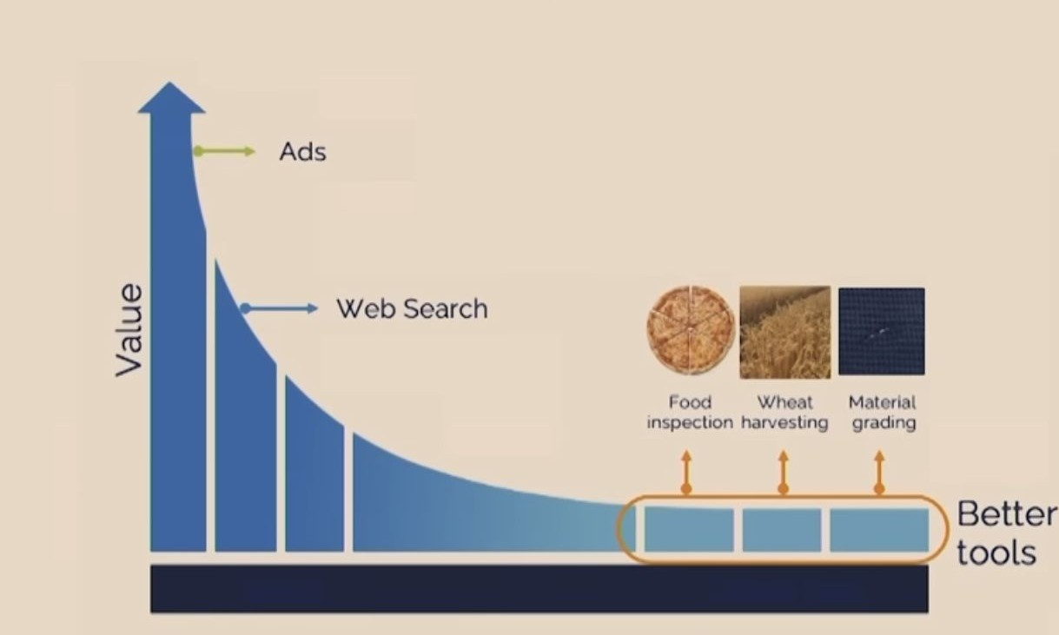
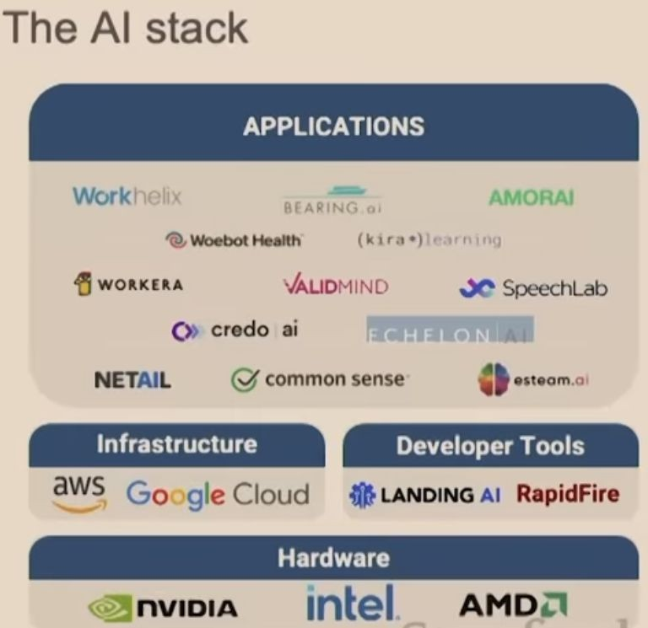
Why are AI Applications not yet widely adopted?
The long tail of AI applications will change due to low code and prompt-based development
OpenAI, Bard, and more APIs
From Andrew Ng, Stanford

Slide 5


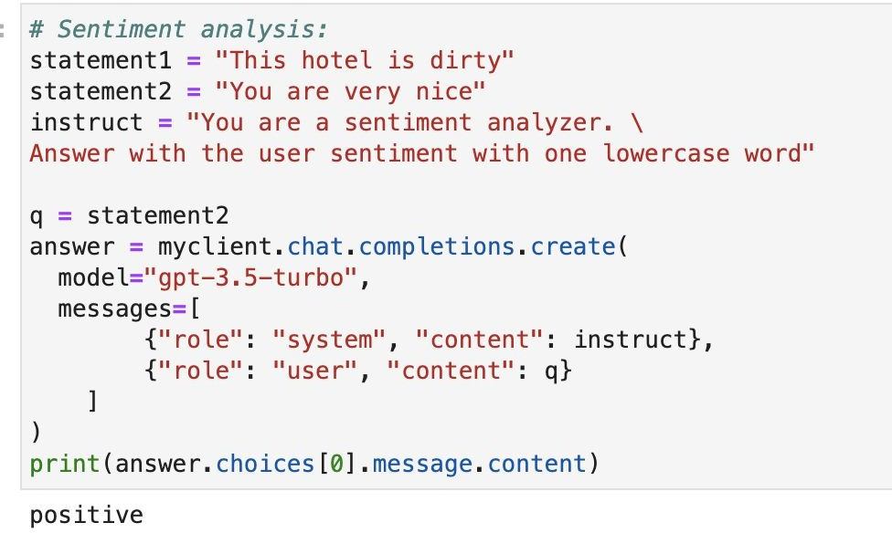

Calls OpenAI with API
—-
Server with your code in Cloud
Calls API for sentiment analysis
Open AI with API
sentiment
recommendation
AI services / prediction
translation
presentation layer
….
User on App on mobile or browser…

Slide 6
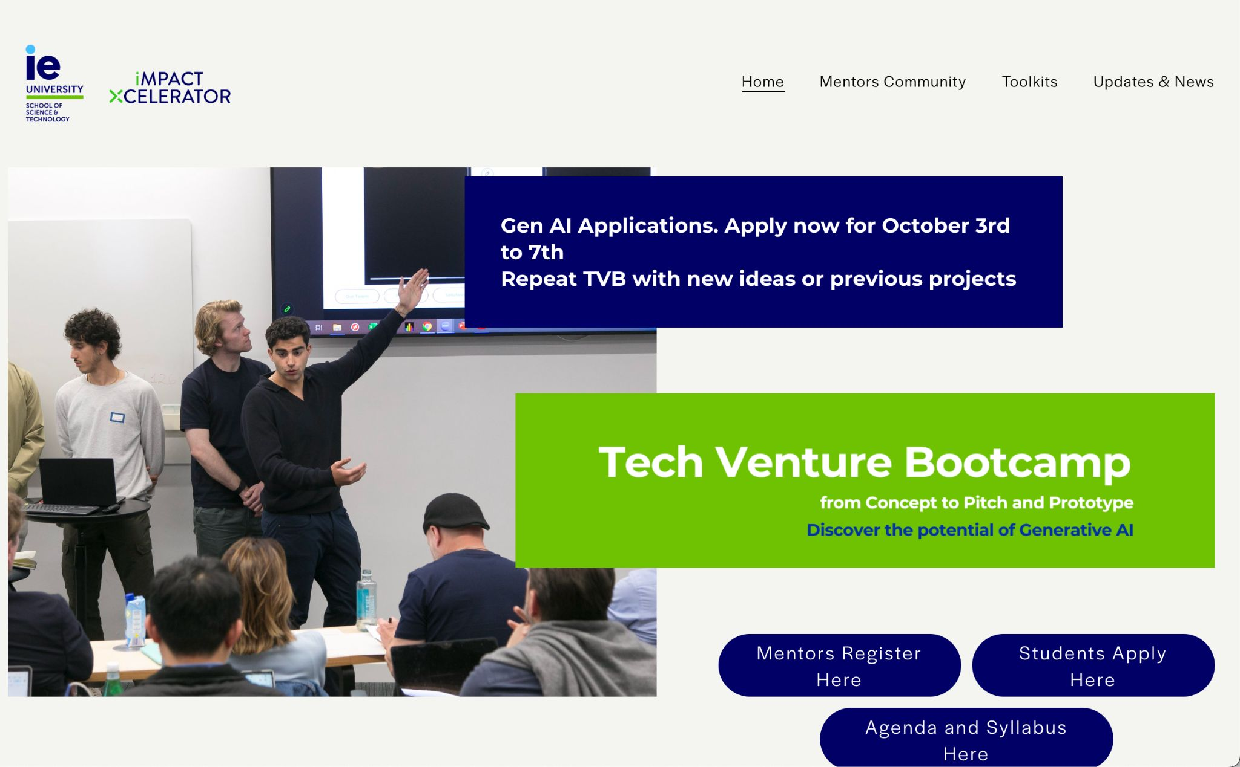
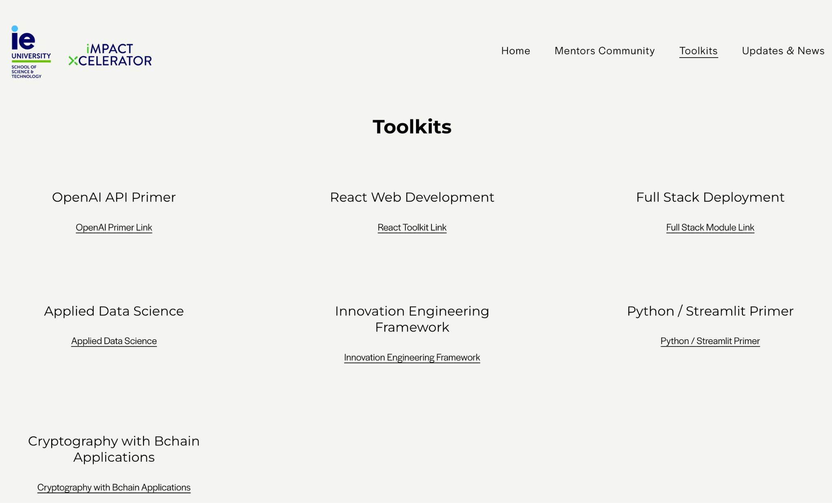
https://www.techventurebootcamp.org/
https://www.techventurebootcamp.org/toolkits

Slide 7
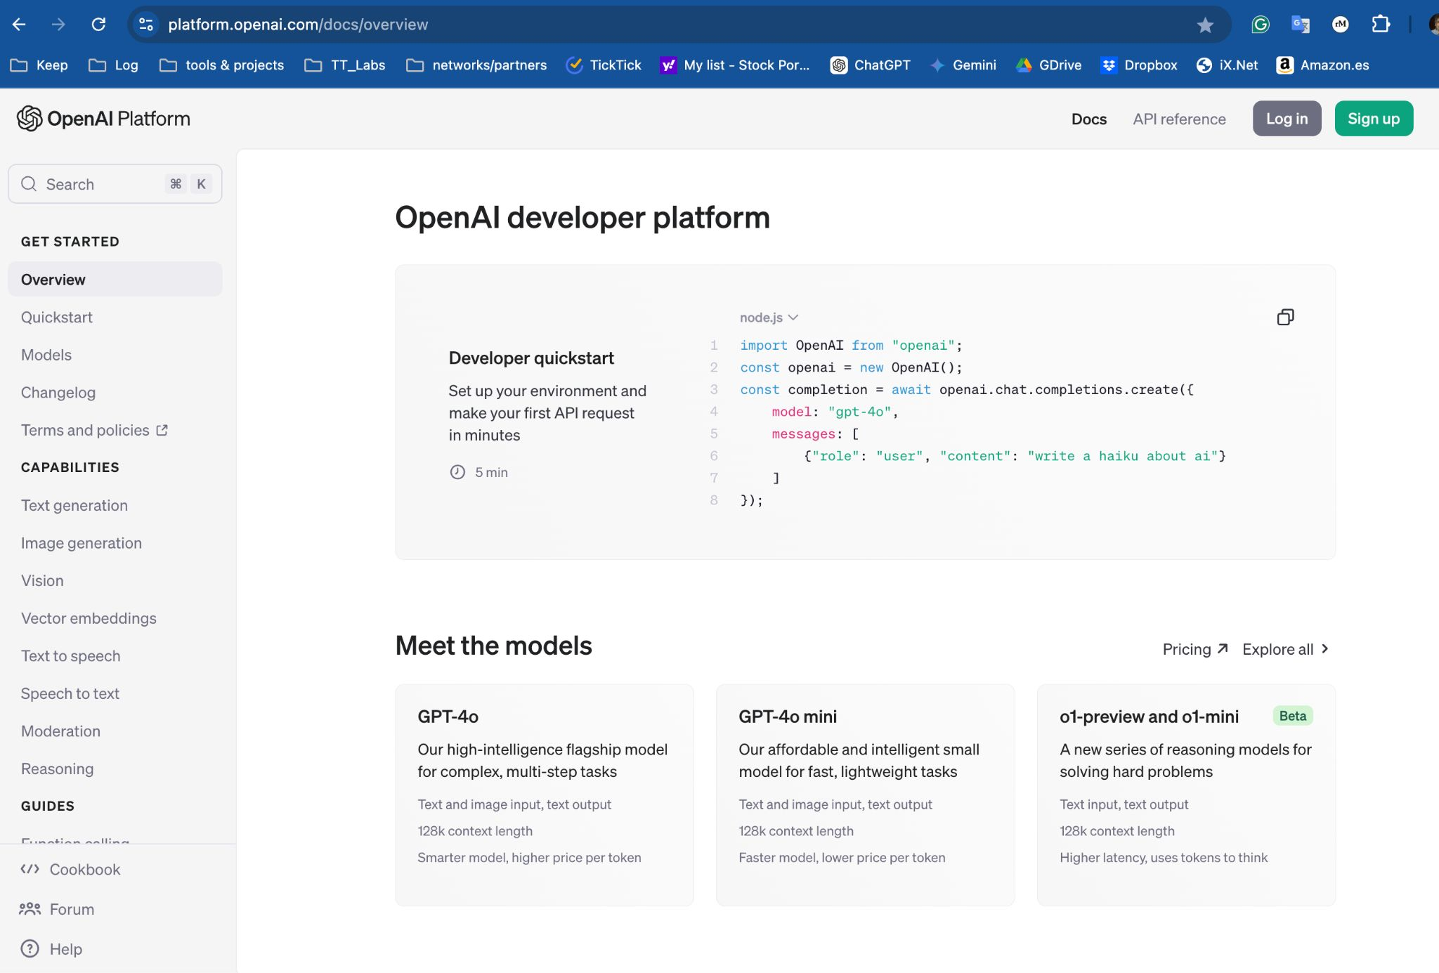
platform.openai.com
This is where you get sign up for an account and get key.
All the tutorials you will need are here:
1

Slide 8
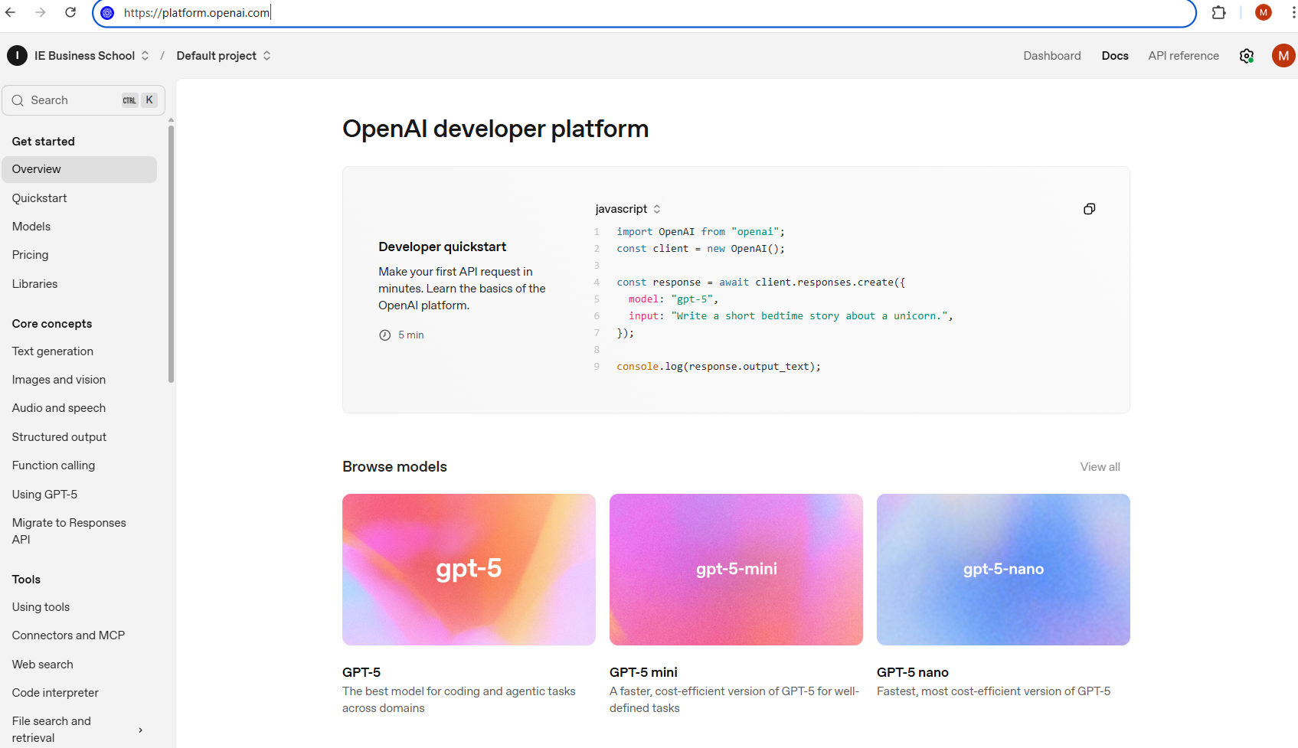
1

Slide 9
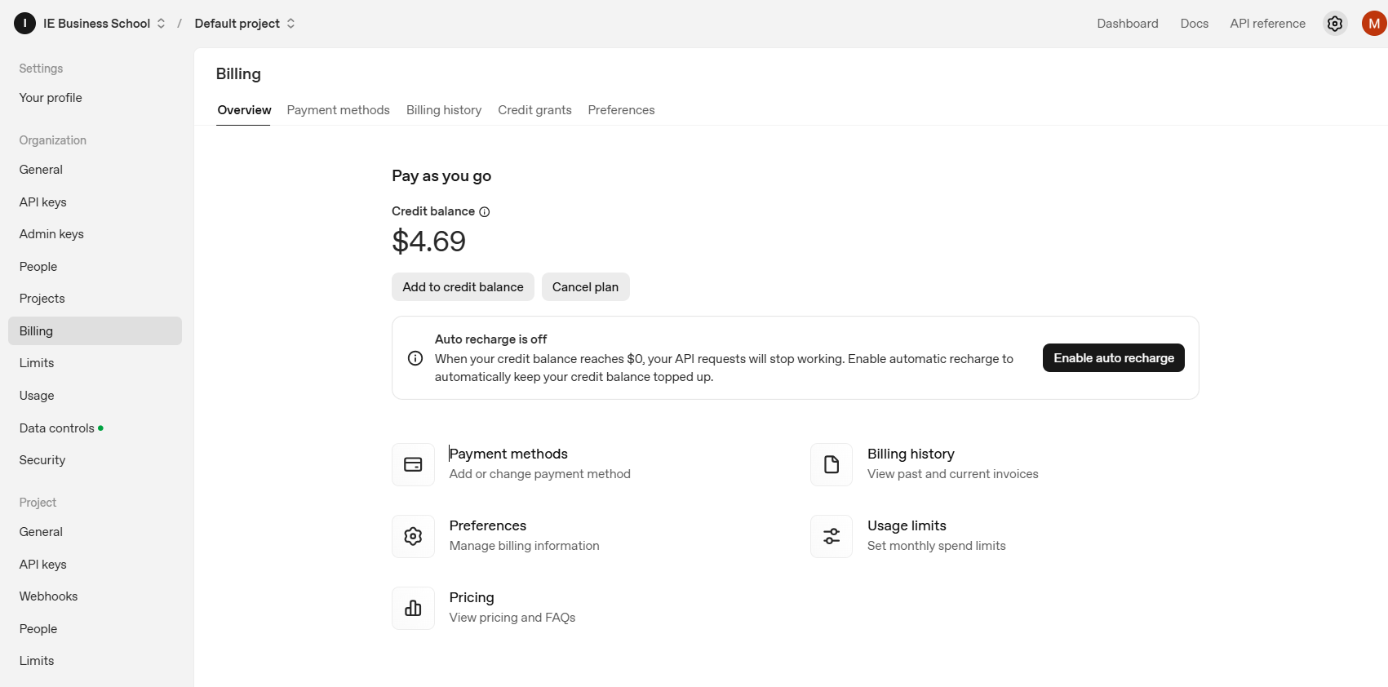
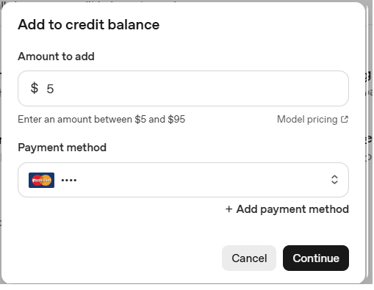
1
3
2
4

Slide 10
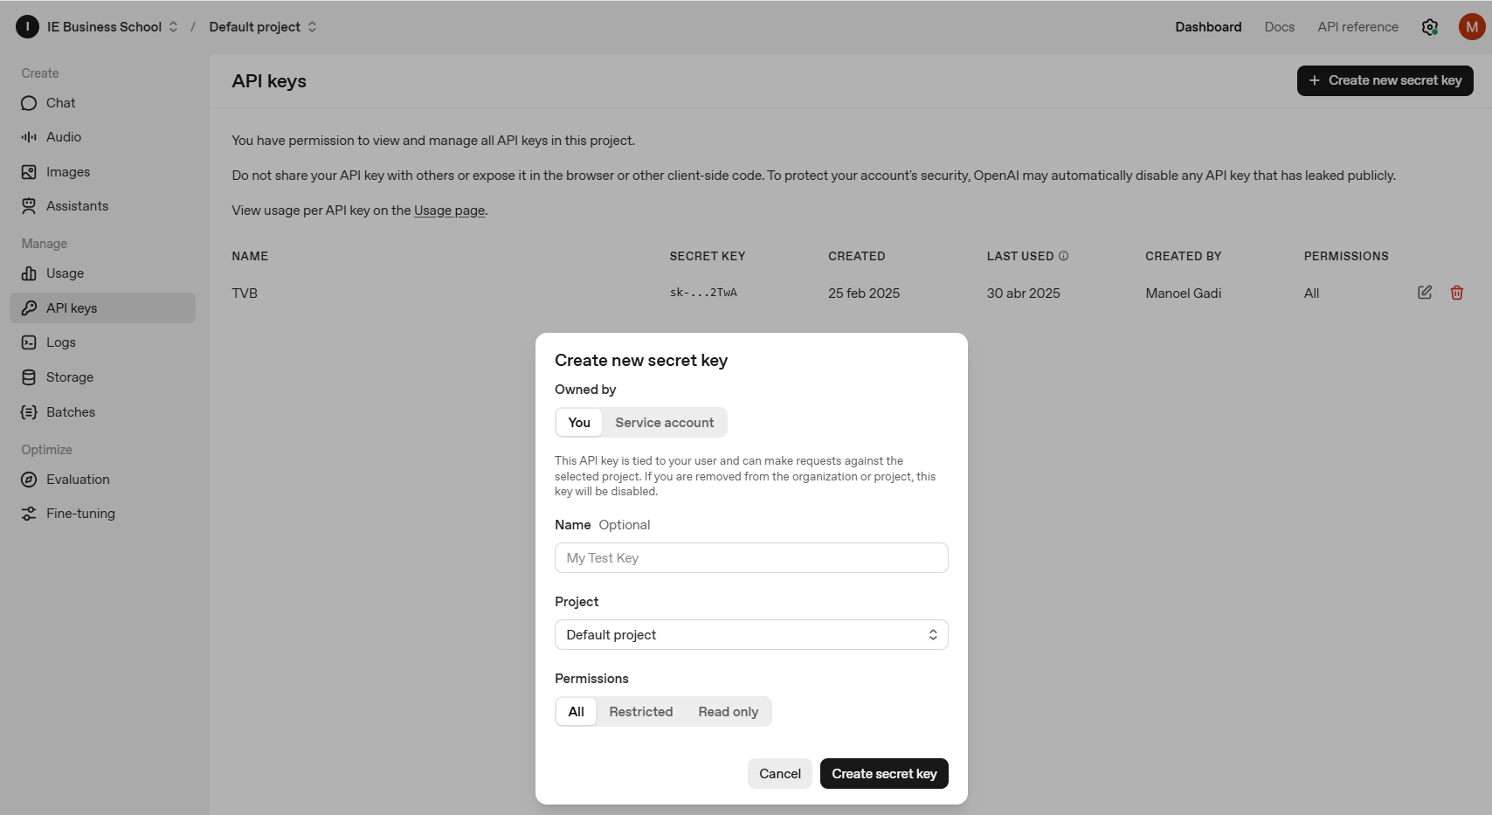
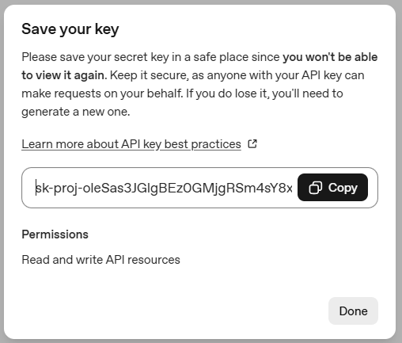
2
1
3
5
6
4

Slide 11
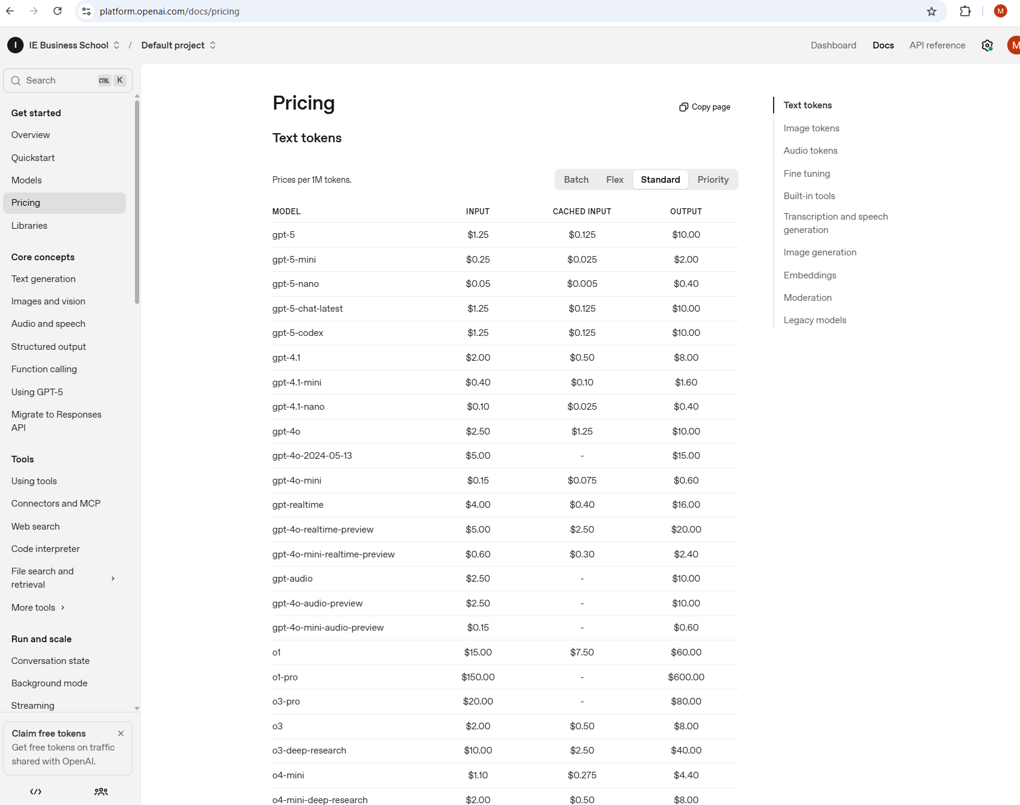

Slide 12
