Slide 1
Shape Launcher
For Facial Hares
Ben Casey
Matt Jordan
Josh Wretlind

Slide 2
Design
The art of the game is to get the missile into the target shape. The target shape is the same shape as the missile. Shape changes based on stages.
Win by: getting shape in shape.
Loose: try again!
Change angle and magnitude by the sliders on the left.

Slide 3

Design #2
Environment
  It’s the drawing board for the game.
  Contains things such as gravity, wind, target and the “shooter”.
  Represents a sort of world type class
    It houses all the objects that a stage would contain.

Slide 4
Design #3
Missile
  Has a Shape, position, and an amount rotated
  It can be 3 different shapes; Circle, Rectangle, Triangle.
  “shot” by setting the angle and magnitude at various numbers.
Shape
  Abstract, different shapes inherit from here
  Each on can draw itself and know if an Object is inside of it. (Collision detection)

Slide 5
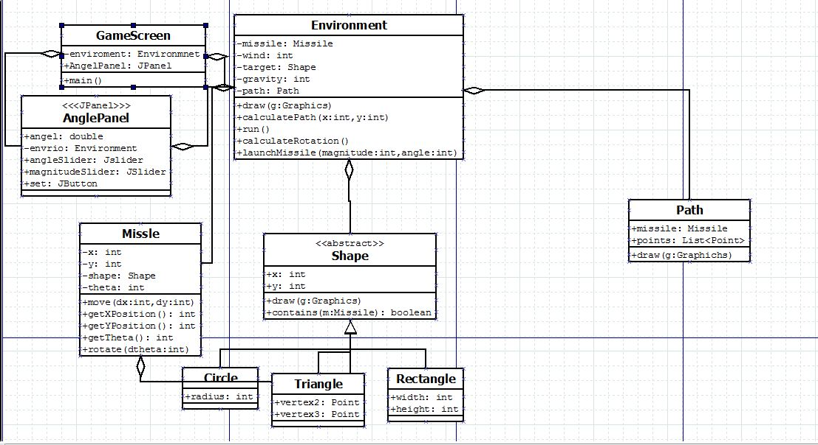
UML

Slide 6
Lessons learned
Make simplifying assumptions
  Particularly with Fluid mechanical equations
  A more accurate view of the world vs an easier one to code
  Time crucial “coding spots” need not be put done by 1 person late at night.
  Hard to draw things in the mind and show onto screen.
  Make sure everyone knows the direction that project needs to go.

