Slide 1

Construction Helmet Use Recognition
Benchmarking a custom CNN against transfer learning for hard-hat compliance
Iyallareddy Likith Reddy · MSc Data Science, Arden University
Notes:
This project asks a narrow, practical question: given a cropped image of a construction worker's head, can a CNN reliably tell whether a hard hat is being worn? I compare a CNN trained from scratch with two ImageNet-pretrained models.

Slide 2



Why automate helmet checks?
Head injuries are severe
Manual checks don't scale
Cameras are already there
Falling objects and falls from height make the head one of the most exposed body parts on site.
Supervisors walking the site miss short lapses and cannot watch every area at once.
Most large sites run CCTV, so recognising helmet use from video is a natural next step.
Notes:
Hard hats are mandatory on active sites, but checking compliance still depends on people. Since most sites already have cameras, the aim is to build the recognition step: is this particular head wearing a helmet?

Slide 3





End-to-end pipeline
Dataset
Crop
Clean
Train
Evaluate
5,000 site images with VOC boxes
Head boxes cut out with 10% padding
Duplicates and blurry crops removed
Custom CNN, MobileNetV2, ResNet50
Metrics, ROC, latency, Grad-CAM
Framing: image classification, not detection. Heads are assumed already located, so the models only decide helmet vs no_helmet.
Notes:
The pipeline turns a detection dataset into a classification problem. Each annotated head is cropped, the crops are cleaned, three models are trained, and all of them are evaluated on the same metrics plus Grad-CAM.

Slide 4
From 24,751 boxes to 17,044 clean crops
24,751
helmet + head boxes
−7,673
boxes under 20 px
17,078
crops written
−34
27 duplicates, 7 blurry
17,044
final dataset
Imbalance 13,410 ÷ 3,634 = 3.69 : 1. An always-helmet model would already score 78.7% accuracy.
Notes:
The Kaggle Hard Hat Workers dataset has 18,966 helmet and 5,785 head boxes. About 31 percent were too small to crop. Cleaning removed 34 more. The final set is 3.69 to 1 in favour of helmets, so accuracy alone is misleading: predicting helmet every time gives 78.7 percent.

Slide 5
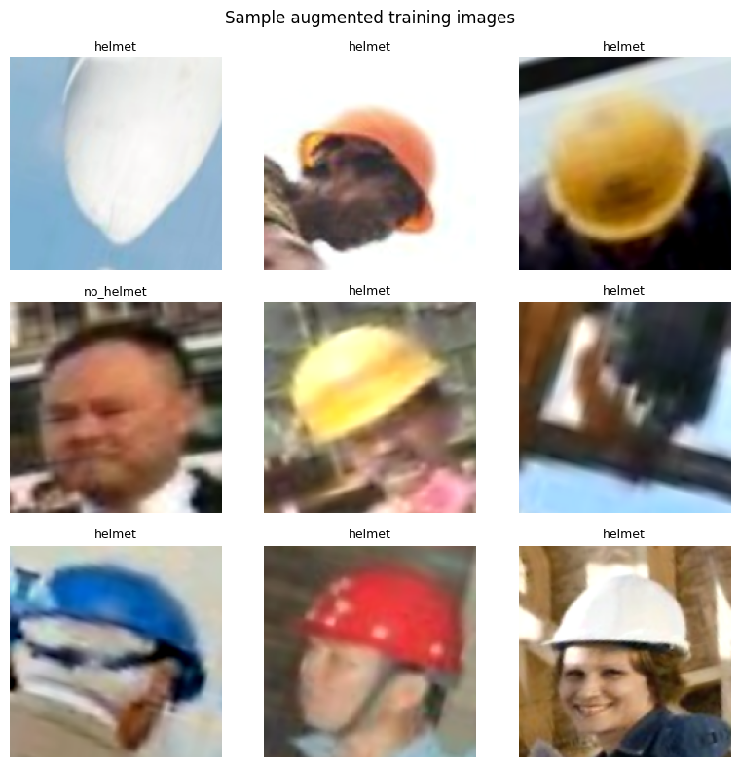
Split and augmentation
11,931
2,560
2,553
train · 70%
validation · 15%
test · 15%
160 × 160 input, batch size 32, seed 42
Horizontal flip, ±5% rotation, ±15% brightness and contrast
No vertical flip: an upside-down worker is not a realistic view
Notes:
A 30 percent holdout was split in half by batches into validation and test. Augmentation mimics realistic site variation: workers facing either way, slightly tilted cameras, and changing light.

Slide 6



Three models compared
Custom CNN
MobileNetV2
ResNet50
258,881
2,259,265
23,589,761
parameters
parameters
parameters
4 × (Conv → BN → MaxPool), GAP, Dense 128, dropout 0.4. Trained from scratch on [0, 1] input.
ImageNet backbone, frozen. New head: GAP, dropout 0.3, sigmoid output.
ImageNet backbone, frozen. Same head as MobileNetV2.
All models: binary cross-entropy, Adam (lr 1e-3), early stopping on val_loss (patience 5), 2 epochs
Notes:
The custom CNN is about a tenth of the size of MobileNetV2 and a hundredth of ResNet50. Its parameter count works out as 896 + 18,496 + 73,856 + 147,584 for the convolutions, 1,408 for batch norm, and 16,512 + 129 for the dense layers, giving 258,881.

Slide 7
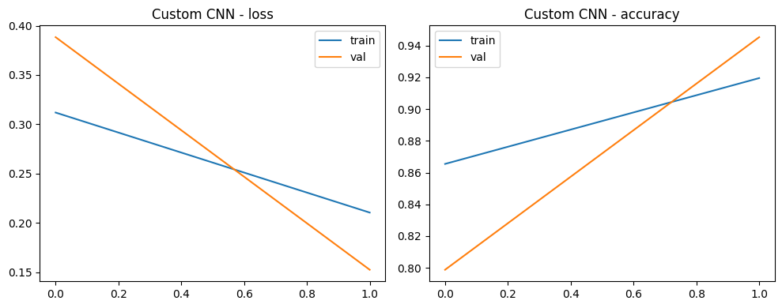
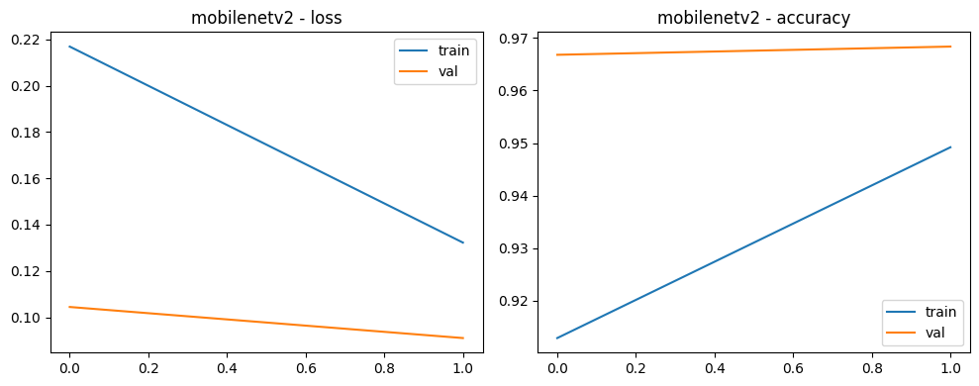
Training: two epochs per model
Model | Epoch | Train acc | Val acc | Val loss
Custom CNN | 1 | 0.8655 | 0.7988 | 0.3884
 | 2 | 0.9195 | 0.9453 | 0.1526
MobileNetV2 | 1 | 0.9129 | 0.9668 | 0.1044
 | 2 | 0.9492 | 0.9684 | 0.0910
ResNet50 | 1 | 0.9411 | 0.9750 | 0.0771
 | 2 | interrupted before validation
Custom CNN validation accuracy jumped 79.9% → 94.5% in one epoch, and was still rising.
Notes:
Training ran on CPU, so each epoch took 6 to 26 minutes and only two epochs were possible. The custom CNN had clearly not converged. ResNet50 reached 97.5 percent validation accuracy after one epoch, but the run was interrupted during its second epoch, so it was not included in the test evaluation.

Slide 8
Test results: MobileNetV2 leads on every metric
97.3%
MobileNetV2 accuracy
0.933
MobileNetV2 F1
94.4%
Custom CNN accuracy
Notes:
Positive class is no_helmet, since missing a bare head is the costly error. MobileNetV2 beats the custom CNN on all five metrics. Note the y-axis starts at 0.7 to make the differences visible. ROC-AUC is high for both, so both models rank bare heads above helmets well.

Slide 9
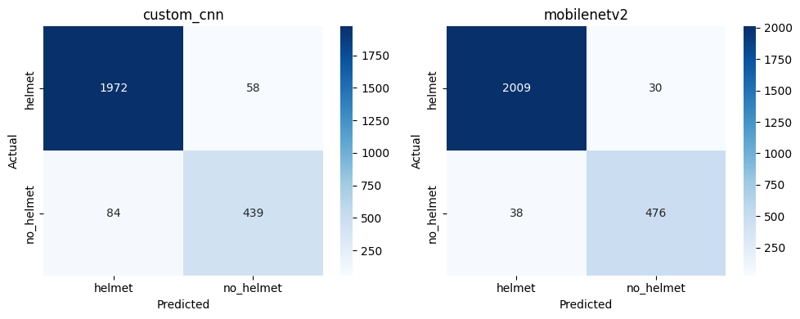
Where the errors fall
Custom CNN
Recall = 439 ÷ (439 + 84)
= 439 ÷ 523 = 0.839
MobileNetV2
Recall = 476 ÷ (476 + 38)
= 476 ÷ 514 = 0.926
MobileNetV2 misses 38 bare heads vs 84, and raises 30 false alarms vs 58.
Rows = actual class, columns = predicted class (test set, 2,553 crops)
Missed bare heads (false negatives) are the safety-critical error
MobileNetV2 halves both error types compared with the custom CNN
Notes:
Reading the matrices: for the custom CNN, 84 bare heads were predicted as helmet and 58 helmets as bare heads. MobileNetV2 cuts these to 38 and 30. Precision follows the same way: 439 over 497 is 0.883 for the custom CNN, and 476 over 506 is 0.941 for MobileNetV2.

Slide 10
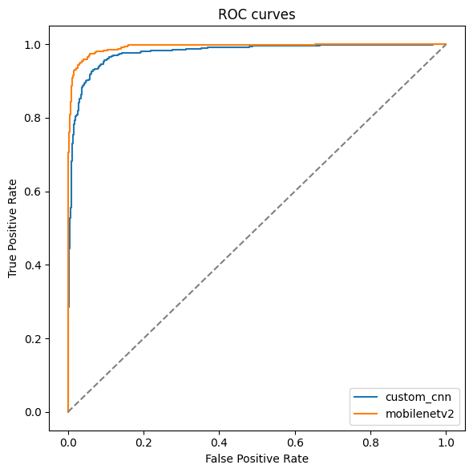
Ranking quality vs speed
AUC 0.977 vs 0.993: both rank bare heads well
Custom CNN is 22% faster (116.5 vs 149.6 ms)
Timed one image per predict() call on CPU, so absolute times are inflated
Notes:
Both ROC curves hug the top-left corner. The speed gain from the custom CNN is real but modest: 1 minus 116.5 over 149.6 is about 22 percent. These timings include Keras predict overhead, so batched GPU inference would be much faster for both.

Slide 11
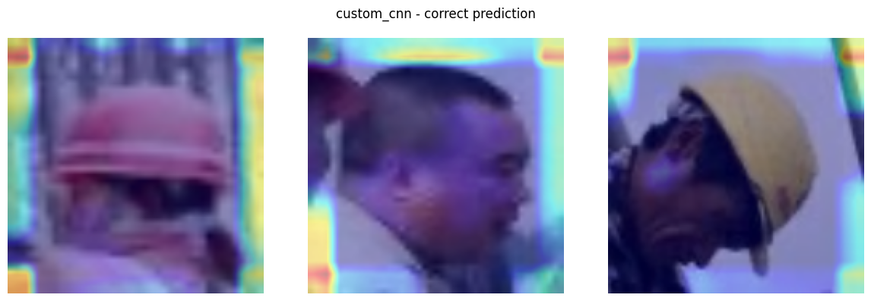

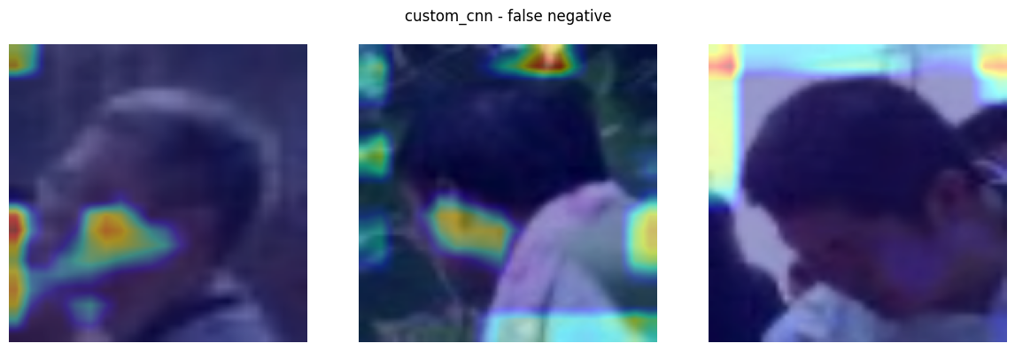
Grad-CAM: what the custom CNN looks at
Top: correct predictions
Heat sits mostly on crop borders, not the helmet shell.
Bottom: missed bare heads
Activation lands on the face and background.
The model partly relies on padding and edge cues.
Notes:
Grad-CAM weights the last conv layer's feature maps by their average gradient. For the custom CNN the activation often sits on the edges of the crop rather than on the helmet itself. Grad-CAM for MobileNetV2 failed with a KeyError, because the code targets a layer inside the nested backbone that Keras 3 does not connect to the outer model.

Slide 12






Limitations to fix in the next run
CPU only, 2 epochs
ResNet50 not evaluated
No GPU attached; the custom CNN was still improving.
Training was interrupted in epoch 2, so it has no test results.
Unstable val / test split
Crop-level split
take()/skip() on a reshuffled dataset: test counts differ (523 vs 514).
Crops of the same scene can sit in train and test.
No class weights or tuning
Grad-CAM fails for transfer models
Fixed 0.5 threshold on 3.69 : 1 imbalanced data.
KeyError on the nested backbone layer.
Notes:
These are the honest caveats. The biggest ones are the short CPU training and the validation/test split: because the holdout is reshuffled each time it is read, the two subsets are not fixed, which is why the test set has 523 no_helmet crops for one model and 514 for the other.

Slide 13
Transfer learning wins, but the custom CNN is close
MobileNetV2: 97.3% accuracy, 0.926 no-helmet recall
Custom CNN: 94.4% accuracy with about 1/9 of the parameters, 22% faster
Next: GPU training, fixed image-level split, class weights, threshold tuning, detector + classifier on site video
Notes:
MobileNetV2 is the best choice for deployment here: highest recall and accuracy at a modest size. The custom CNN gets within three points of accuracy with a ninth of the parameters, and would likely close more of the gap with proper GPU training. Thank you, happy to take questions.

