Slide 1
Student Name
BANDLAMUDI MANOGNA
3/21/2024 Annual Review

Slide 2
PROJECT TITLE Keylogger and Security
3/21/2024 Annual Review

Slide 3


AGENDA
1. Understanding Keylogger Threats
2. Importance of Security Measures
3. Detection and Prevention Techniques
4. Role of End Users in Security
5. Best Practices for Security Implementation
3/21/2024 Annual Review

Slide 4

PROBLEM STATEMENT
Keyloggers secretly record keystrokes,
capturing sensitive information like passwords and personal data. They can be introduced through malware, phishing, and physical access, often bypassing traditional security measures. Effective strategies are needed to prevent, detect, and respond to
keylogger threats to protect user data and privacy.
3/21/2024 Annual Review

Slide 5

PROJECT OVERVIEW
Developing robust keylogger detection and
security protocols is crucial for protecting sensitive data and maintaining system integrity. These measures enhance user privacy and bolster overall cybersecurity posture. However, implementing such strategies requires ongoing maintenance and resource allocation. Balancing the benefits of enhanced security with the challenges of resource-intensive implementation is essential. By prioritizing keylogger detection and security, organizations can mitigate risks and safeguard against unauthorized access to sensitive information. This proactive approach strengthens resilience against evolving cyber threats, ensuring the integrity and confidentiality of data across various computing environments.
3/21/2024 Annual Review

Slide 6

WHO ARE THE END USERS?
IT Organizations
Families and Business people
Law Enforcement
Software Developers
Criminals
Employers
3/21/2024 Annual Review

Slide 7

YOUR SOLUTION AND ITS VALUE PROPOSITION
Value Proposition:
Effective Detection: Our software swiftly identifies and blocks keyloggers, protecting sensitive data and user privacy.
Proactive Defense: With advanced algorithms, it preemptively detects threats, minimizing the risk of data breaches.
User-Friendly Interface: Easy-to-use interface facilitates seamless integration and operation.
Cost-Effective Security: Provides robust protection at an affordable price, reducing financial risks associated with breaches.
Comprehensive Protection: Ensures data integrity and confidentiality, safeguarding against evolving cyber threats.
3/21/2024 Annual Review

Slide 8

THE WOW IN YOUR SOLUTION
Proactive Approach
Comprehensive Security
User Awareness
Effective Countermeasures
Holistic Protection
Real-Time Monitoring
User Experience
Continuous Improvement
Wow Factor: Our software swiftly detects and neutralizes keyloggers, ensuring your data's safety
3/21/2024 Annual Review
8

Slide 9
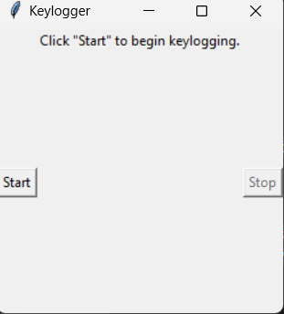
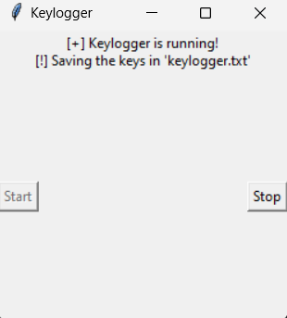
MODELLING
Teams cam add wireframes
Before start of keylogger
After start of keylogger
3/21/2024 Annual Review
9

Slide 10
RESULTS
Incorporating wireframes into keylogger and security modeling enhances clarity, collaboration, and efficiency throughout
the development lifecycle. It provides a visual representation of security measures, improving communication among stakeholders and developers. Wireframes facilitate rapid prototyping and iteration, leading to early detection and resolution of usability and security issues. This ensures that security features align with user needs, resulting in a more user-friendly and effective security solution. Overall, wireframes streamline the development process and reduce the risk of security vulnerabilities in keylogger and security systems.
3/21/2024 Annual Review
10

