Slide 1
Image Caption Generation using ResNET-50 and LSTM
Guide: N.Srikanth
Team-5
1) B.Manogna- Y22CM011
2) G.Thandava Krishna- Y22CM051
3) Ch.Madhavi- Y22CM032

Slide 2
Introduction
Generating meaningful textual descriptions (captions) from images remains a challenging task, because it requires a deep understanding of image content and how objects relate.
Unlike object classification (just naming what’s in an image), image captioning must describe relationships, context, and semantics (who, what, where) in natural language.
The proposed work leverages a combination of vision and language models — specifically, the CNN ResNet‑50 and the RNN variant LSTM — to bridge image content and text.

Slide 3
2. Literature Survey
Literature Survey:
Early methods: Basic CNN + RNN models, moderate accuracy (~40–50%).
Recent works improved context understanding but still lack fluency.
Existing studies highlight the power of ResNet-based encoders for feature learning.
Proposed Solution:
Encoder: ResNet-50 extracts rich image representations.
Decoder: LSTM generates captions word-by-word using visual embeddings.
Pipeline: Image → ResNet-50 → Feature Vector → LSTM → Caption.
Outperforms previous models in semantic accuracy and naturalness of generated captions.

Slide 4
3. Research Gap and Project Objectives
Research Gap:
•Existing models often generate incomplete or contextually weak captions.
•Difficult to maintain semantic relevance and sentence fluency simultaneously.
Project Objectives:
•Develop hybrid CNN–LSTM models for image captioning.
•Use ResNet-50 as encoder to capture deep image features.
•Employ LSTM decoder to generate grammatically correct captions.
•Train on benchmark dataset Flickr8k for performance evaluation.
•Build interactive Streamlit web app with URL/camera/upload options.
•Integrate text-to-speech audio narration for generated captions.
•Achieve improved BLEU accuracy and caption coherence compared to earlier models.

Slide 5
4. Proposed Model
The system follows an encoder–decoder architecture for image captioning. It consists of a visual encoder and a language decoder.
The encoder uses CNN models to extract image features. Models include VGG16, and ResNet50.
The decoder generates captions using sequential model LSTM.
Image features are combined with word embeddings. Captions are generated one word at a time.
Different CNN–RNN combinations are implemented.
Their performance is compared using BLEU score and accuracy.

Slide 6
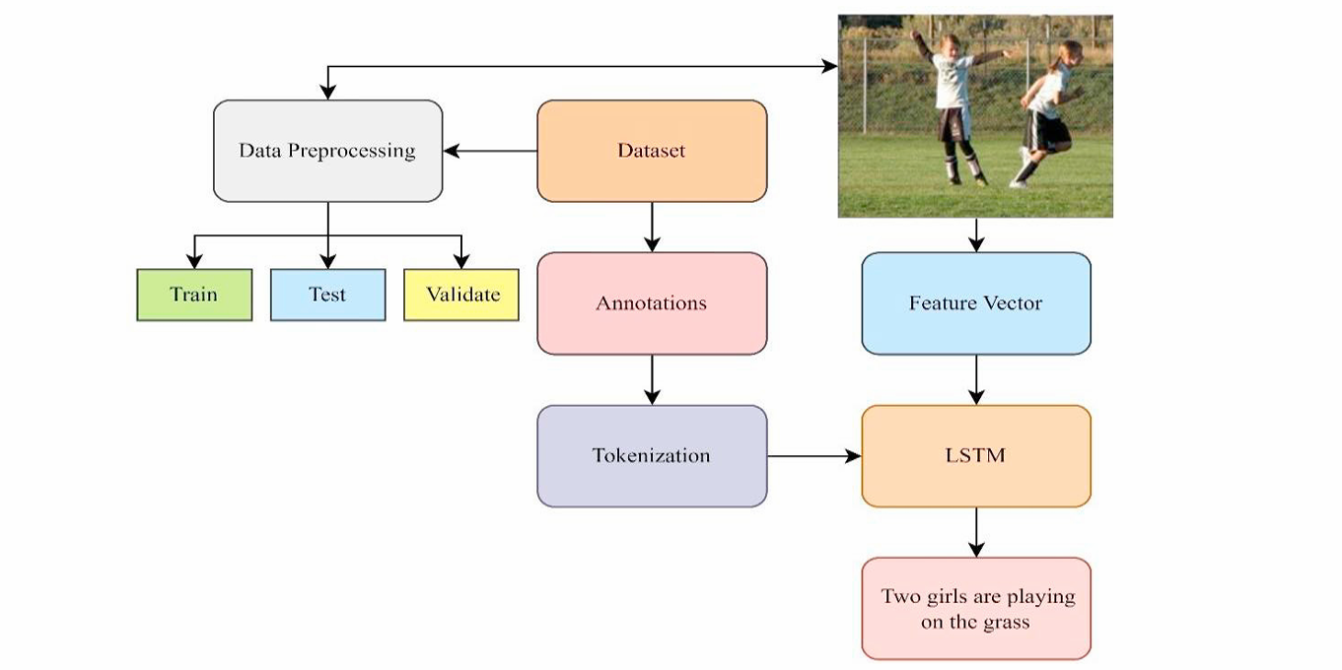
Fig. Working model of Proposed system model

Slide 7
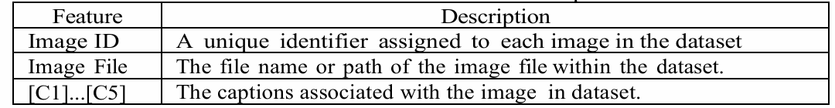
5. Datasets
Flickr8k is a benchmark dataset containing 8,000 images.
Each image is associated with five human-annotated captions.
The dataset provides diverse scenes and objects.
It is commonly used for evaluating image captioning models.
Fig. Dataset Description

Slide 8
6. Algorithms used for implementation
1. Image Feature Extraction Algorithm
Pre-trained Convolutional Neural Networks (CNNs): Utilized ResNet50 and VGG16 models (pre-trained on ImageNet) to extract high-level features from input images.
Process: Images are resized to 224x224 pixels, preprocessed (e.g., normalization), and passed through the CNN to obtain feature vectors (e.g., 2048-dim for ResNet50, 4096-dim for VGG16).
Purpose: Captures semantic information from images without training the CNN from scratch, enabling efficient transfer learning.
2. Text Preprocessing and Tokenization Algorithm
Caption Cleaning: Convert text to lowercase, remove special characters/numbers, eliminate single characters, and add start/end tokens ("startseq" and "endseq").
Tokenization: Use Keras Tokenizer to convert captions into sequences of integers, building a vocabulary and determining maximum sequence length.
Purpose: Prepares textual data for sequence modeling, ensuring consistency and handling variable-length inputs.

Slide 9
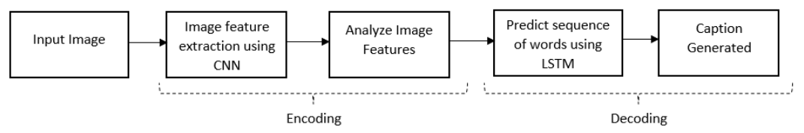
6. Algorithm used for implementation
3. Sequence-to-Sequence (Seq2Seq) Modeling with Encoder-Decoder Architecture
Encoder: Processes image features through dense layers to reduce dimensionality (e.g., to 256 units).
Decoder: Employs Long Short-Term Memory (LSTM) networks for generating captions word-by-word, combining image features with partial text sequences.
Attention Mechanism: Uses dot-product attention to focus on relevant parts of the image features during decoding, improving caption relevance.
Training: Uses data generators create batches of image features + partial captions as inputs, predicting the next word.
Purpose: Enables end-to-end training for generating coherent, context-aware captions from images.

Slide 10
6. Algorithm used for implementation
4. Inference and Caption Generation Algorithm
Starts with "startseq", predicts the next word iteratively using the trained model, appends words until "endseq" or max length is reached.
Post-Processing: Removes start/end tokens and strips extra spaces for clean output.
Purpose: Converts model predictions into human-readable captions for new images.
5. Evaluation Algorithm
BLEU Score Calculation: Computes BLEU-1 to BLEU-4 metrics by comparing generated captions against ground-truth references using NLTK's corpus bleu with smoothing functions.
Purpose: Quantifies caption quality based on n-gram overlap, assessing model performance on unseen data.
Key Differences Between Implementations:
ResNet50 + LSTM: Simpler decoder with residual connections; focuses on basic seq2seq without explicit attention.
VGG16 + LSTM: Includes bidirectional LSTMs and attention mechanism for better context handling; uses a more customized decoder.

Slide 11
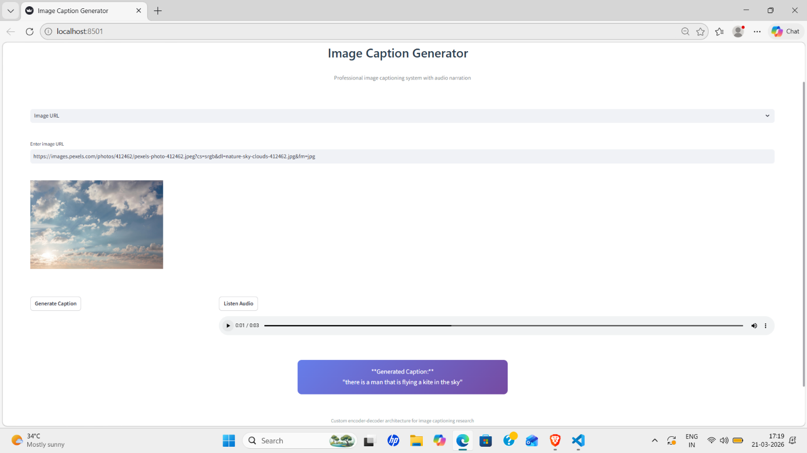
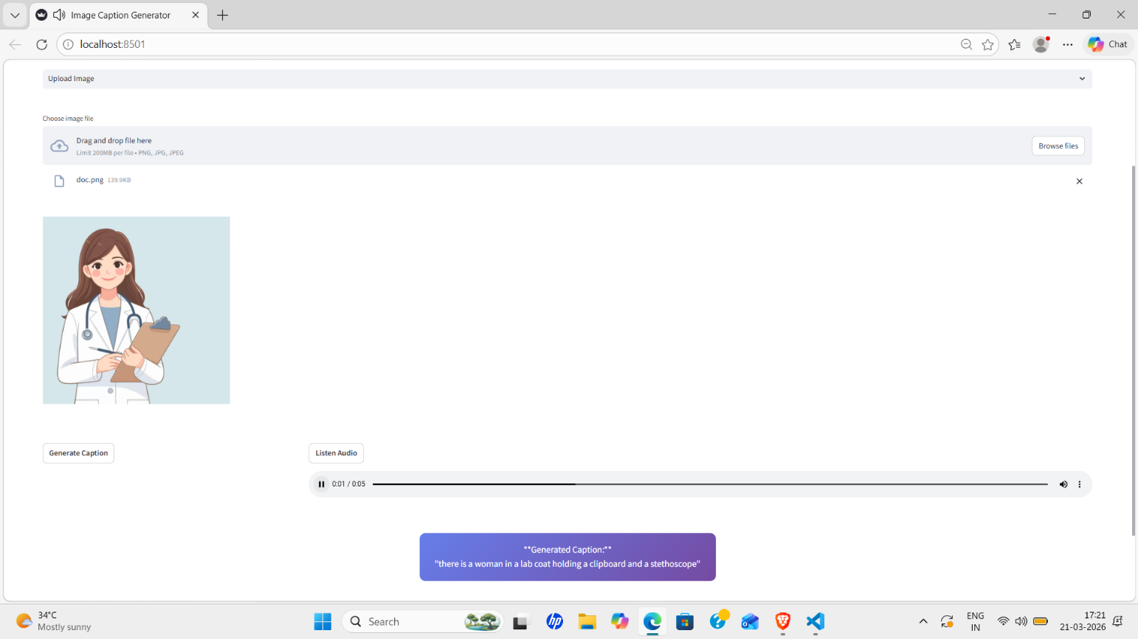
7. Results and Analysis
ResNet50 outperforms VGG16 by 37.6% in BLEU-1, demonstrating deeper CNNs capture superior image features
Sample Caption Predictions:
Image Type | ResNet50 Generated Caption | VGG16 Generated Caption
Doctor | "woman in lab coat holding clipboard and stethoscope" | "woman in white coat"
Sky scene | "man is flying kite in the sky" | "view of cloudy sky"
Web Application Results:

Slide 12
8. Conclusion
Image captioning system successfully deployed with Streamlit web app (URL/camera/upload inputs)
Dual CNN-LSTM models trained on Flickr8k: ResNet50+LSTM & VGG16+LSTM architectures
Audio narration integrated for accessibility using text-to-speech
ResNet50+LSTM outperforms VGG16 by significant margin (BLEU: 0.754 vs 0.547)
CNN-LSTM framework validated for production-ready image caption generation
Results demonstrate superior performance of deeper CNN encoders with LSTM decoders for accurate, fluent captions.
Model | BLEU-1 Score
ResNet50+LSTM | 0.7540
VGG16+LSTM | 0.5479

Slide 13
9. References
[1] Goyal, D., Prasad, S. (2022) “Performance enhancement of image captioning technique using machine learning approach” Mathematical Statistician and Engineering Applications 71(3s2), 2054–2066.
[2] Omri, M., Abdel-Khalek, S., Khalil, E.M., Bouslimi, J., Joshi, G.P. (2022) “Modeling of hyperparameter tuned deep learning model for automated image captioning” Mathematics 10(3), 288.
[3] Ulyanov, D., Vedaldi, A., Lempitsky, V. (2016) “Instance normalization: The missing ingredient for fast stylization” arXiv preprint arXiv:1607.08022. [7] Lu, J., Xiong, C., Parikh,

Slide 14


