Slide 1
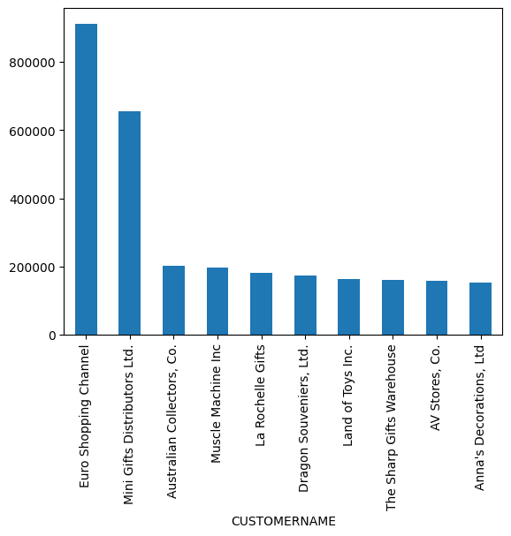
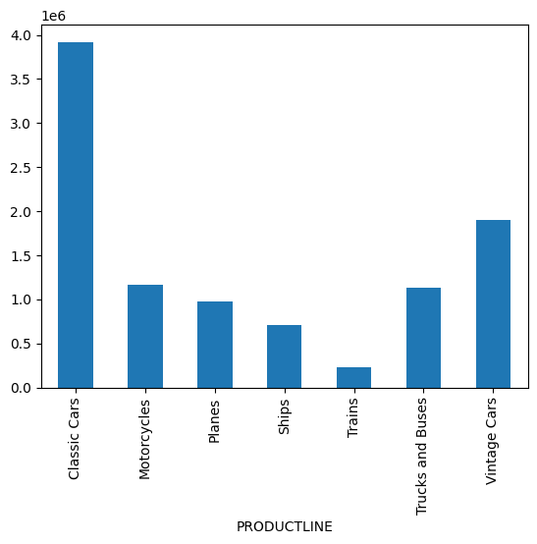
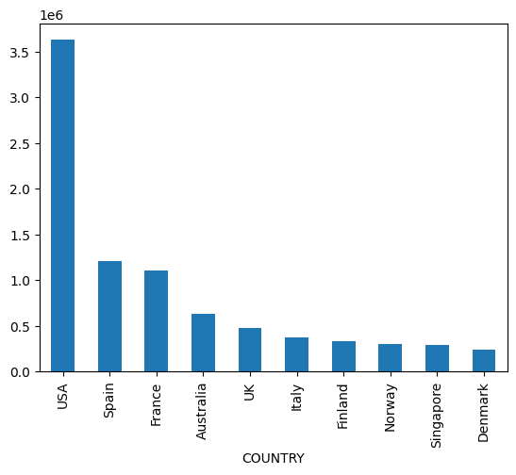
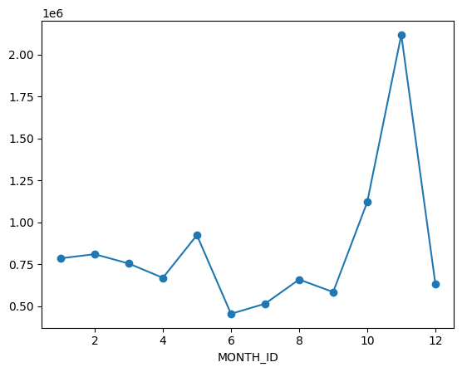
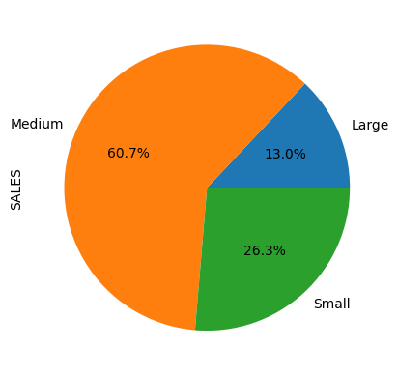
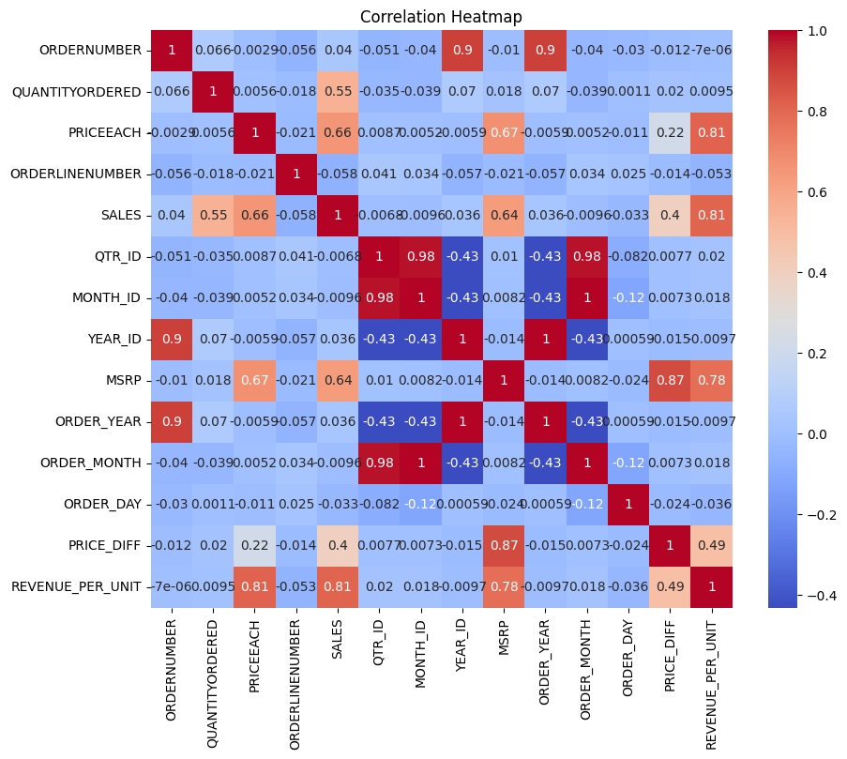
Sales Dashboard - EDA & Business Intelligence
Total Sales
10,032,628.85
Top Customer
Euro Shopping Channel
Top Product
Classic Cars
Top Country
USA
Top Month
November
Insert Screenshot:
Top Customers Chart
Insert Screenshot:
Product Line Chart
Insert Screenshot:
Country Sales Chart
Insert Screenshot:
Monthly Trend Chart
Insert Screenshot:
Deal Size Pie Chart
Insert Screenshot:
Correlation Heatmap

