Slide 1
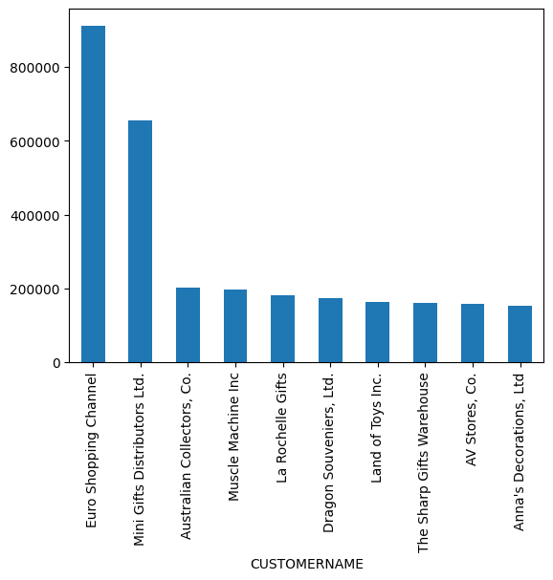
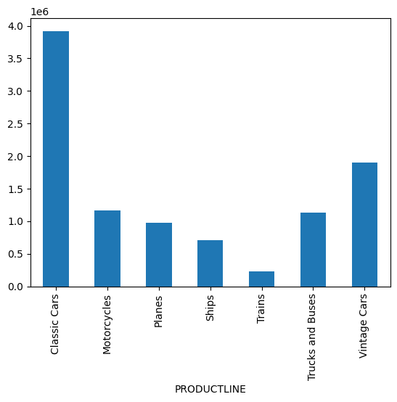
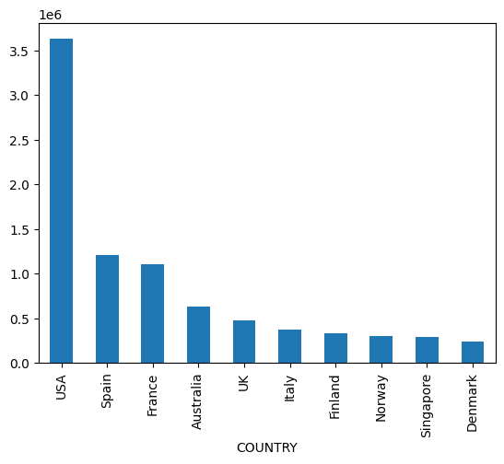
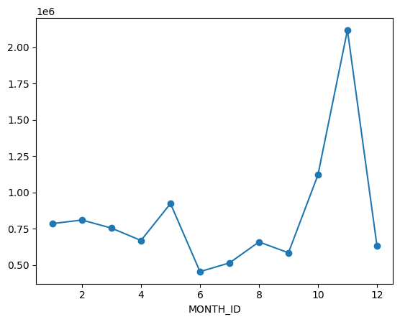
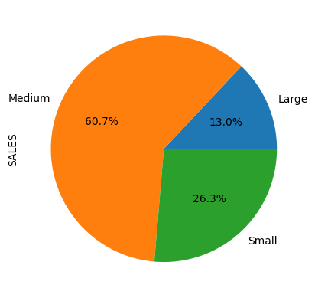
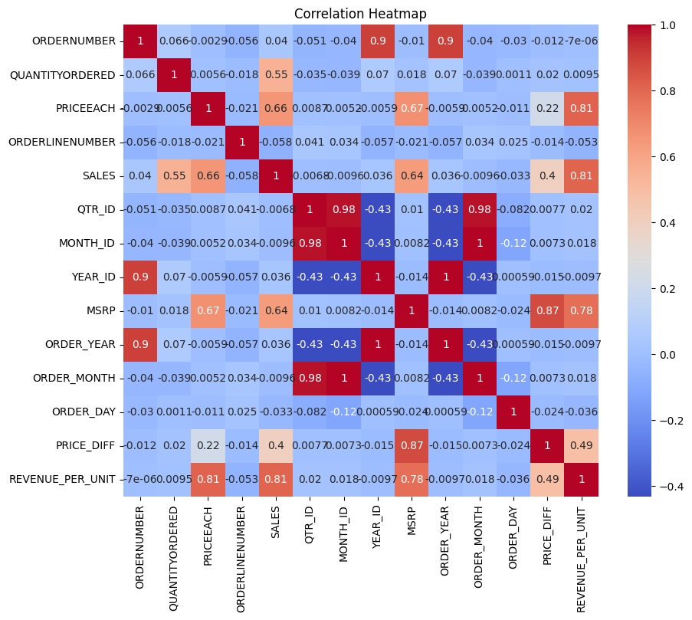
SALES PERFORMANCE DASHBOARD - Task 3
TOTAL SALES
10.03 Million
TOP CUSTOMER
Euro Shopping Channel
TOP PRODUCT
Classic Cars
TOP COUNTRY
USA
Insert Top Customers Bar Chart
Insert Product Line Chart
Insert Country Sales Chart
Insert Monthly Sales Trend
Insert Deal Size Pie Chart
Insert Correlation Heatmap
KEY FINDINGS:
• Euro Shopping Channel is the highest revenue customer
• Classic Cars generated the highest revenue
• USA is the top-performing market
• November recorded the highest sales
• Medium-sized deals contribute the largest revenue share

