Slide 1
Types of Parallel/Distributed Computations

Slide 2
1. Embarrassingly Parallel Computation
also called naturally parallel
Dividin the problem into completely independent parts that can be executed simultaneously
There is no communication between the separate processes
Simply distribute the data and start the process
Appropriate for SPMD model

Slide 3
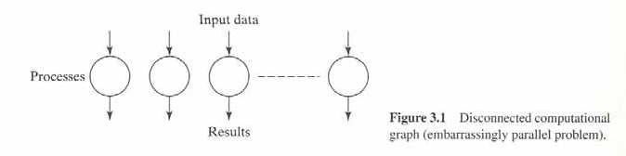
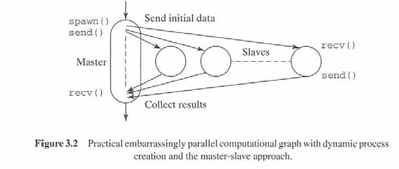
contd..
A master process is started that spawns identical slaves

Slide 4

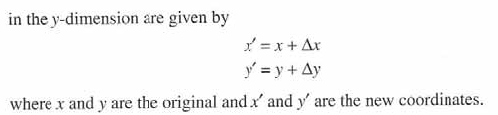
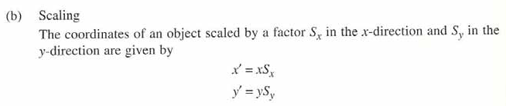
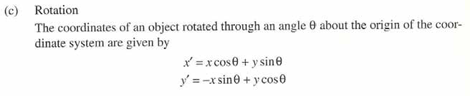
Example
Geometrical transformation of images

Slide 5
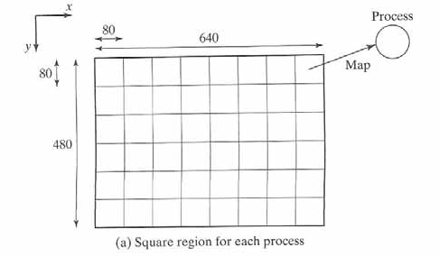
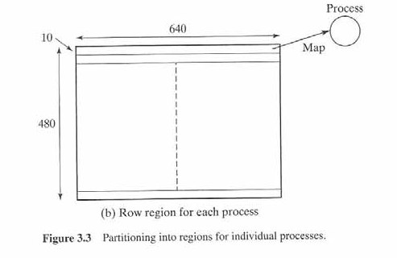
Partitioning for n=48 processes

Slide 6
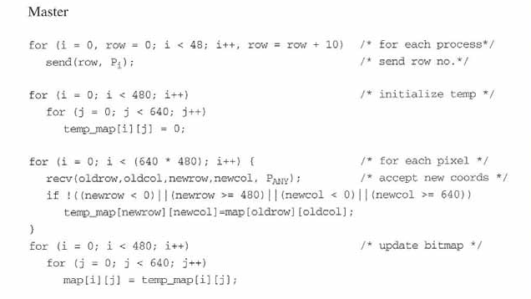
Parallel code

Slide 7
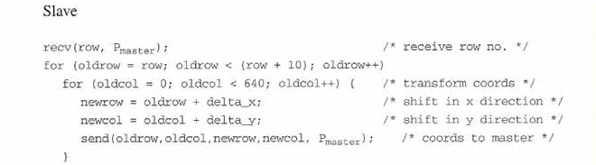
contd..

Slide 8
Parallel code

Slide 10
contd..

Slide 11



Analysis
Sequential complexity
Parallel complexity

Slide 12
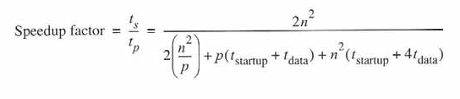
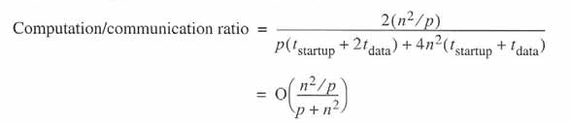
Overall speedup

Slide 13
2. Partitioning and Divide and Conquer
In partitioning, the problem is divided into separate parts and each part is computed separately
In divide and conquer, the partitioning is applied recursively, solving the smaller parts and combining the results

Slide 14
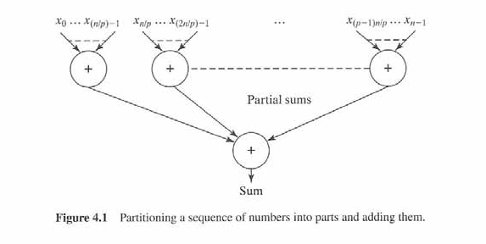
Partitioning example

Slide 15
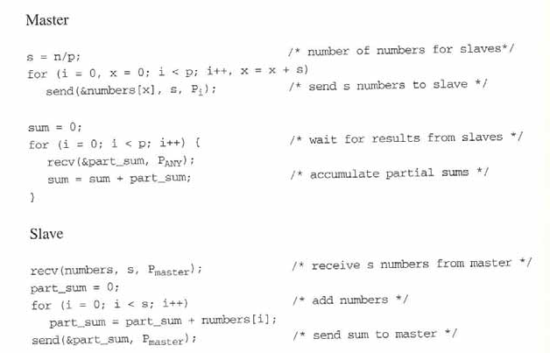
Example-sum of n numbers

Slide 16




Example-sum of n numbers

Slide 17
Analysis

Slide 18
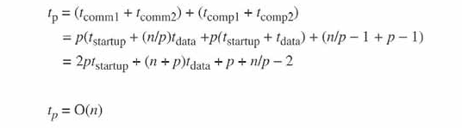


Overall execution time

Slide 19
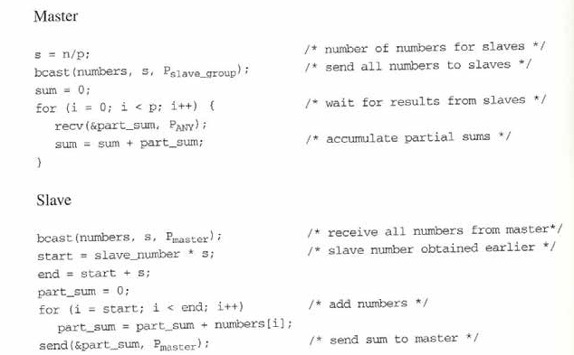
Using broadcast routine

Slide 20
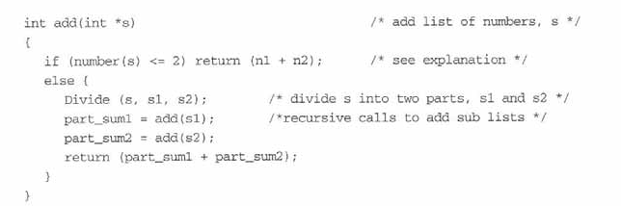
3. Divide and Conquer

Slide 21
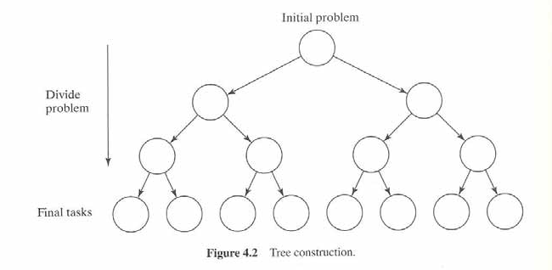
Parallel version
Needs 2^{m+1}-1 processors

Slide 22
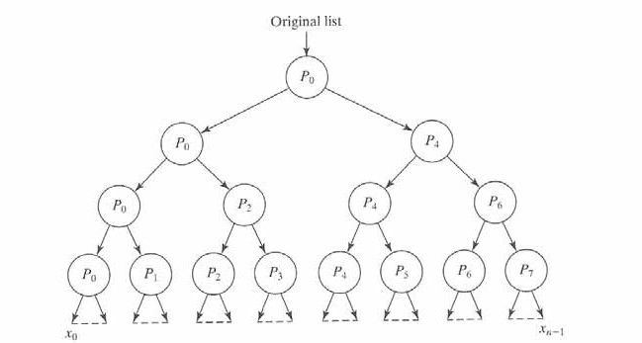
Parallel version (with processor reuse)
Divide Operation

Slide 23
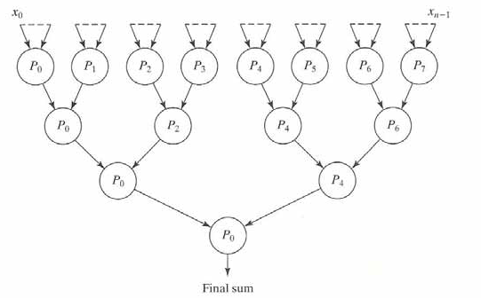
contd..
Conquer Operation

Slide 24
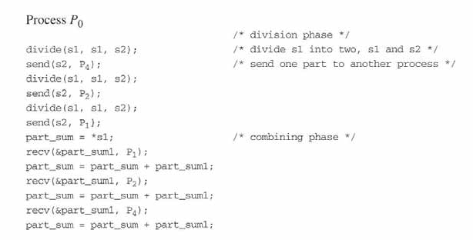
Code for Process 0

Slide 25
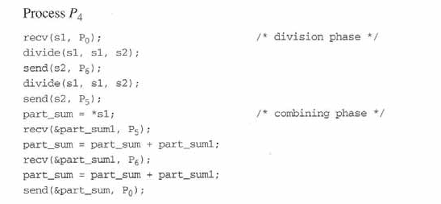
Code for Process 4

Slide 26



Parallel version (with processor reuse)
Divide Operation

Slide 27

Analysis

Slide 28
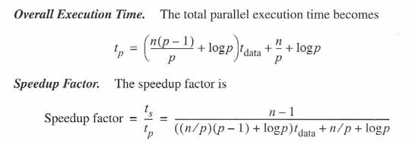

contd..

Slide 29
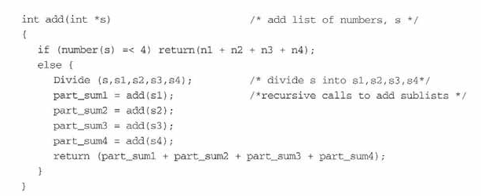
M-ary divide and conquer

Slide 30
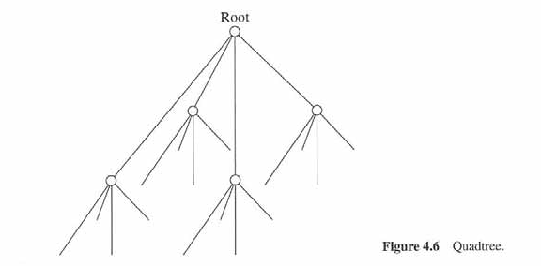
contd..

Slide 31
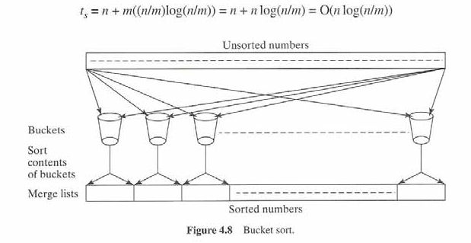
4. Partitioning and Divide-and-Conquer Approach (BLENDED)
Sorting using bucket sort

Slide 32
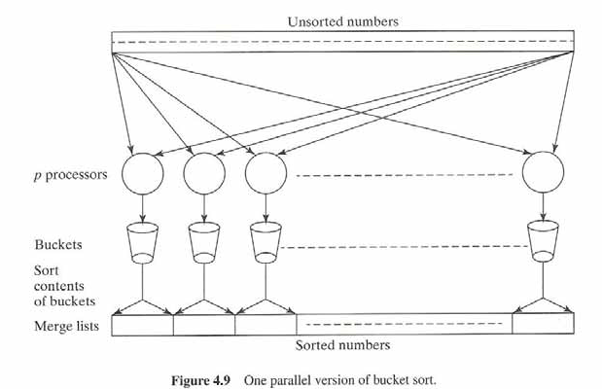
Parallel Version
One processor for each bucket
broadcast

Slide 33



n/p numbers are placed by each processor

Slide 34
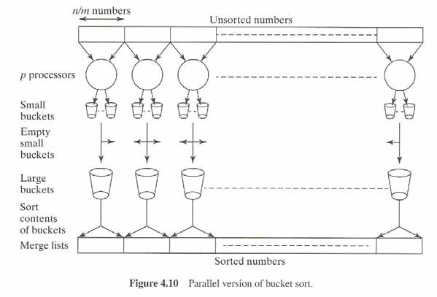
contd..
No broadcast

Slide 35

contd..
Numbers in smaller bucket:
n/m*p = n/p²
(m is the number of buckets
P is the number of processors
If m is same as p (n/p² )
)
tcomm 1 = tstart_up + (n/p)tdata
No broadcast
Each small bucket will comm with p-1 buckets

Slide 36
Analysis

Slide 37
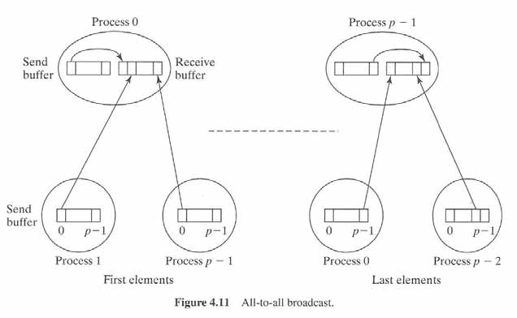
All-to-all broadcast

Slide 38
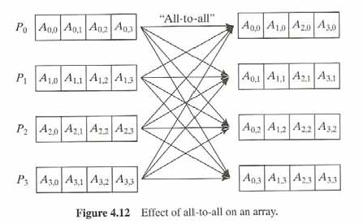
contd..

Slide 39
Implementation Note
We can use any of the group routines while implementation:
Alltoall
Reduce
Gatherv
The synchronization will be taken care. All these routines are blocking.
We need not worry if the capability of the processors are different (the child processors)
If we use send and recv then we need to take care of the synchronization.

Slide 40
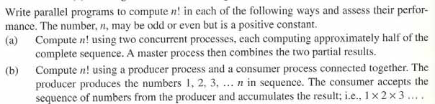
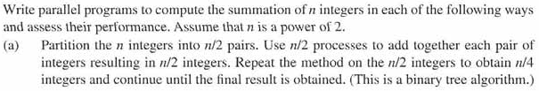
Exercises

Slide 41
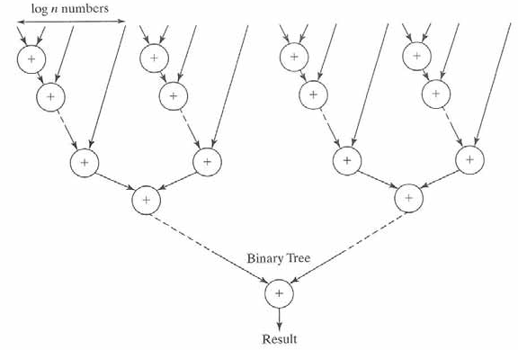
contd..

Slide 42


5. Pipelining
It is a form of functional decomposition
Consider a simple loop

Slide 43
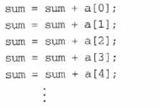

contd..
The loop can be unrolled as
Pipelining solution is to separate as
where i^{th} stage (processor) performs adding of i^{th} array element to the previous accumulated sum

Slide 44
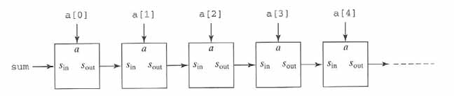
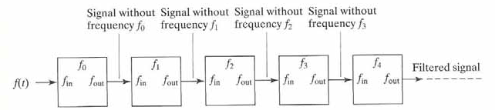
contd..
Example: Frequency Filter

Slide 45
Types of Pipelining
If more than one instance of the complete problem is to be executed – TYPE 1 (fetch, decode, execute)
If a series of data items must be processed, each requiring multiple operations – TYPE 2
Ex: (Frequency filter)
If the information to start the next process can be passed forward before the process has completed all its internal operations – TYPE 3

Slide 46
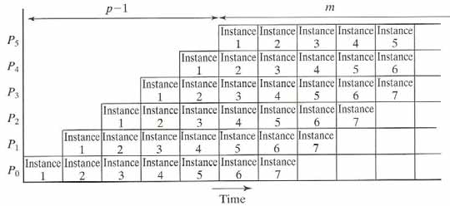
Type 1
Each time period is one pipeline cycle
Each instance of the problem requires six sequential processes. Space time diagram is shown below:
m + p -1 clock cycles

Slide 47
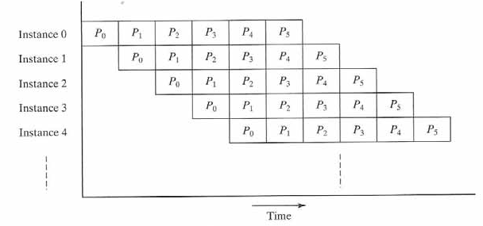
contd..
Alternate space time diagram

Slide 48
contd..
The number of pipelining cycles to execute all m instances is (m+p-1)
Average number of cycles is (m+p-1)/m (i.e) one cycle per problem instance for large m
One instance of the problem will be completed in each pipeline cycle after p-1 cycles (pipeline latency)

Slide 49
Type 2
Here, series of data items are processed in a sequence
With p processors, and n data items, the overall execution time is (p-1)+n pipeline cycles

Slide 50
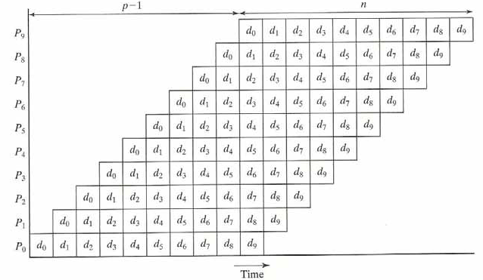
contd..
p -1 + n clock cycles

Slide 51
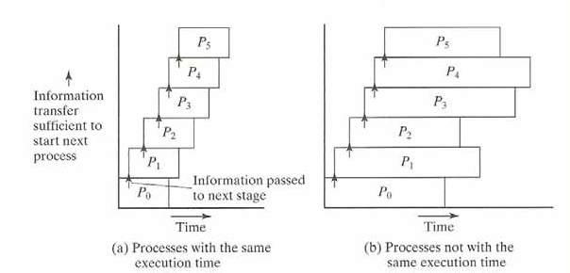
Type 3

Slide 52
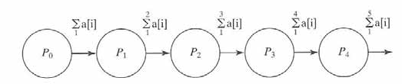

Type 1 - Example
Adding of list of numbers
Code for process P_{i}

Slide 53


contd..
Code for process P₀
Code for process P_{p-1}

Slide 54
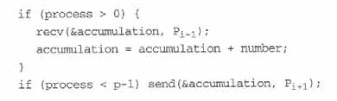
contd..

Slide 55


Analysis for Type 1
where there are m instances of a problem, and p pipeline stages.
Average time for computation is

Slide 56

Type 1 - Example
Adding of list of numbers
Code for process P_{i}

Slide 57


contd..
Single instance of a problem
m+ p -1
1(1instance)+p-1
p
Let p is same as n
(number of processors same as numbers to be added)

Slide 58


contd..
Multiple instance of a problem
we have m groups of n numbers to add, resulting in a separate result
For large m, the average execution time is approximately

Slide 59

contd..
Data partitioning with multiple instances of a problem (each processor is adding d numbers)
m+ p -1
p = n/d

Slide 60

Type 2 - Example
Prime Number Generation (sieve of Erathosthenes)

Slide 61
Prime Numbers (Ways)
For loop from 1 to n-1 O(n)
For loop from 1 to n/2 O(n/2)
For loop from 1 to sqrt(n) O(sqrt(n)) (winner)

Slide 62
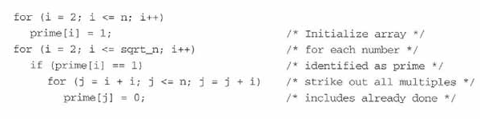

contd..
Sequential code

Slide 63
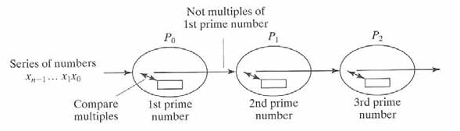
contd..
Parallel version
No. of processors required is: sqrt(n)
All processors are not working with the equal amount of data. P0 working with n numbers, P1 with less than n/2… p2 with less than n/3 and so on

Slide 64

contd..
Code for process Pi

Slide 65
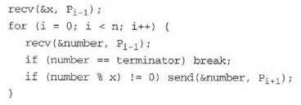
contd..
Rewritten code (using terminator)
t_{comm}=2(t_{startup}+t_{data})
t_{comp}=1
Let say we have -2 as the terminator to know that we need to stop receiving

Slide 66
Analysis
t_{comp}=1
t_{comm}=2(t_{startup}+t_{data})
t_{total}=t_{cycle}*no.of cycles
t_{cycle}= 2(t_{startup}+t_{data})+1
no. of cycles=(m+p-1) =
m is number of instances, in this case,
m is no of data items(n),
p is number of processors (sqrt n)
t_{total}=(2(t_{startup}+t_{data})+1)( )

Slide 67
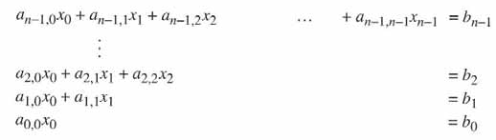
Type 3 - Example
Solving system of linear equations
Consider the upper triangular form of the linear equations:
a’s and b’s are constants and x is the unknown

Slide 68
Type 3 - Example
2x + 3y + 2Z = 9
5x + 4y = 8
3x =10
Find x first
Find y next
Find z next

Slide 69





Slide 70
contd..
First find x₀
Substitute x₀ and find x₁

Slide 71
contd..
Now, substitute x₀ and x₁ to obtain x₂ and so on..
The first stage of pipelining computes x₀ and passes on to second stage
Second stage computes x₁ from x₀ and passes both x₁ and x₀ to next level and so on..

Slide 72
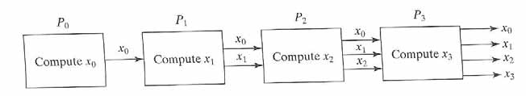
contd..
Each stage is implemented with one processor
Assume there are n processors for n equations (p=n)

Slide 73
contd..
The i^{th} process (0 < i < p) receives the values x₀, x₁, x₂, …x_{i-1} and computes x_{i} from the equation

Slide 74
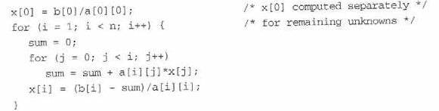
Sequential code

Slide 75
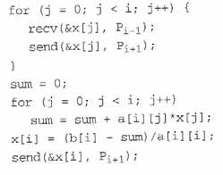
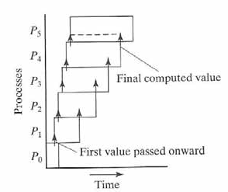
Parallel code
Algorithm for P_{i} (1 < i < p) is given as

Slide 76
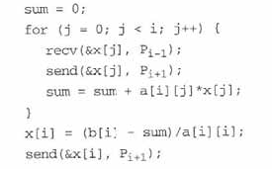
contd..
The modified code is

Slide 77

Analysis

Slide 78
contd..
First process performs one divide and one send
Each of the i^{th} process performs i recvs() and i sends(), i multiply/add, one divide /subtract and final one send() , Total of 2i+1 communication times and 2i+2 computation steps
Last process performs, p-1 recvs(), p-1 multiply/add, one divide/subtract, Total of 2p computation steps and p-1 communication times

Slide 79
contd..
Final t_{cycle} includes: time taken for the execution of the statements by the last process, plus, p-1 send()s plus one divide.
Overall complexity is O(n)
where n=p

Slide 80

Exercises

Slide 81
6. Synchronous Computations
Barrier
It is a mechanism that prevents any process from continuing past a specified point until all the processes are ready.
It helps in synchronizing the processes
It is applied in both shared memory and message passing systems

Slide 82

contd..

Slide 83

contd..

Slide 84

Barrier Implementations
Counter or Linear implementation
Centralized implementation

Slide 85

contd..
Counter implementation

Slide 86

contd..
Implementation – arrival phase and departure phase
Arrival phase can also be implemented using a gather routine and departure phase by a broadcast routine
Complexity – O(P)

Slide 87

contd..
Tree implementation
Efficient method of barrier implementation
Complexity - O(2log P) ≈ O(log P)

Slide 88


contd..

Slide 89
contd..

Slide 90

contd..

Slide 91

contd..
Butterfly barrier
Variation of tree implementation
Complexity – O(log P)

Slide 92

contd..

Slide 93

Example: Data Parallel Computations
Data Parallel computation: same operation is performed on different data elements simultaneously (SIMD model)

Slide 94


contd..
A special construct in parallel programming helps to perform this (forall)

Slide 95

Example: Prefix Sum problem
Given a list of numbers, x₀, x₁, … x_{n-1}, all the partial summations are computed in the prefix sum problem.
(i.e) x₀, x₀+x₁, x₀+x₁+x₂, x₀+x₁+x₂+x₃ , ……)
The sequential code is
Complexity – O(n)

Slide 96

contd..
Data Parallel Method

Slide 97


contd..
Sequential version (using data parallel approach)
Parallel version (for SIMD computers)
Complexity – O(logn) – both computations and communications

