Slide 1

DETECTION OF HATE SPEECH IN MEMES THROUGH MULTIMODAL INTEGRATION
TEAM MEMBERS
Sai Shishir Ailneni
Priyaanka Reddy Boothkuri
Manogna Tummanepally
1

Slide 2
INTRODUCTION
In the realm of digital communication, memes have emerged as powerful tools for conveying ideas, emotions, and cultural references.
Challenges :
As digital platforms struggle to moderate content effectively, detecting and mitigating hate speech within memes has become increasingly critical.
The complexity arises from the nuanced expressions of language and imagery used in memes, which conventional moderation tools often fail to address adequately.
A multimodal approach combines various techniques, including natural language processing, image recognition, and contextual analysis, to comprehensively assess the content and intent of memes.
By leveraging diverse data modalities, we can enhance the accuracy and efficiency of hate speech detection within memes, thus fostering a safer and more inclusive digital environment.

Slide 3
PROBLEM STATEMENT
Current content moderation systems struggle to detect hate speech within memes due to their inability to analyze the complex interplay of text and imagery, leading to oversights and errors.
This project aims to develop a machine learning framework that synthesizes multimodal data to accurately identify and classify instances of hate speech in memes.
Importance of synthesizing multimodal data :
Comprehensive Understanding
Contextual Enrichment
Improved Performance
Limitations
Unimodal Analysis
Contextual Ambiguity
Dynamic Nature of Memes
3

Slide 4
BACKGROUND AND RELATED WORK
Recent advancements in image and text analysis :
Image Analysis: Convolutional Neural Networks (CNNs) have shown effectiveness in identifying visual patterns associated with hate symbols and offensive imagery (Sabat et al., 2021).
Text Analysis: Recurrent Neural Networks (RNNs) have been utilized to track temporal patterns in text, identifying linguistic cues typical of hate speech (Greevy and Smeaton, 2020).
Integration of CNNs, RNNs, and LSTMs for multimodal analysis :
Combining Modalities: Studies have advocated for integrating both image and text analyses to tackle the multimodal nature of digital content (Kumar and Sachdeva, 2022).
Hybrid Models: Hybrid models incorporating CNNs for image analysis and RNNs/LSTMs for text analysis have demonstrated superior hate speech detection rates in multimedia content (Kumar and Sachdeva, 2022).

Slide 5
DATASET DESCRIPTION
Overview of the Facebook Hate Meme Dataset
Collection Process, Structure, Utility, and Applications
Ethical Considerations
Meticulously assembled by a team of researchers affiliated with Facebook AI
Encompasses diverse meme styles and content, reflecting the dynamic nature of social media expressions
Globally sourced data from Facebook's international user base
Dataset comprises thousands of annotated memes with image files, text captions, and binary annotations for hate speech
Comprehensive metadata includes origin, publication date, and contextual details
Utilized by researchers to refine detection techniques
Governed by strict ethical standards
Deployment in research closely monitored to prevent misuse or unethical applications
Researchers urged to handle data responsibly, focusing on outcomes promoting inclusivity and safety online
5

Slide 6
MODELING APPROACH
A. Image-Only Model
B. Text-Only Model
C. Combined Text-Image Model
Proposed Model: CNN enhanced by an Autoencoder for feature extraction.
Justification: CNNs are effective in capturing visual hierarchies, while Autoencoders enhance feature extraction for nuanced cues.
Preliminary Data Processing: Resize, normalize images, apply augmentation for robustness.
Implemented Model: Pipeline with lemmatization, TF-IDF vectorization, Truncated SVD, and a feedforward neural network.
Justification: TF-IDF highlights relevant words, SVD reduces feature space for efficiency.
Preliminary Data Processing: Lemmatization, TF-IDF vectorization for meaningful representation.
Implemented Model: Dense Neural Network integrating pre-trained image features and TF-IDF text vectors.
Justification: Utilizes pre-trained models for efficient feature extraction and integration.
Preliminary Data Processing: Resize, normalize images; tokenization, TF-IDF for text, padding for alignment.
6

Slide 7
EVALUATION METRICS
A. Definition of Metrics
Accuracy: Proportion of correct predictions (true positives and true negatives) out of all predictions made.
Area Under the ROC Curve (AUC-ROC): Likelihood that the model ranks a random positive example higher than a random negative example.
B. Justification of Metrics
Accuracy: Provides a quick overview of performance, but must be considered alongside other metrics, especially with imbalanced datasets.
AUC-ROC: Evaluates the model's capability to distinguish between classes under different thresholds, crucial for practical applications.

Slide 8
RESULT
Model Description | Accuracy | Precision | Recall | F1 Score | AUC
Text-based Neural Network | 69.41% | 64.79% | 36.80% | 46.94% | 62.59%
Combined Text and Image Model | 65.12% | 52.68% | 50.24% | 51.43% | 66.25%
Image-based Convolutional Network | 58.71% | 40.41% | 48.40% | 37.99% | 53.62%
Autoencoder with Classification | 51.15% | 50.00% | 11.07% | 18.13% | 50.25%

Slide 9
CONCLUSION AND FUTURE RESEARCH
Developed ML models for hate speech detection in memes using text and image data.
Utilized TF-IDF, pre-trained image models, and Dense Neural Networks for multimodal analysis.
Methodology significantly enhances accuracy and processing efficiency, validated by comprehensive performance metrics.
Future Research
Advanced Model Architectures: Experiment with deep learning transformers for better contextual understanding.
Adaptation Across Platforms: Evaluate models' adaptability across diverse digital platforms.
Real-time Application: Implement models in real-time moderation systems for effectiveness assessment.
Multimodal Integration Techniques: Explore advanced methods like attention mechanisms for enhanced understanding of text-image relationships.

Slide 10
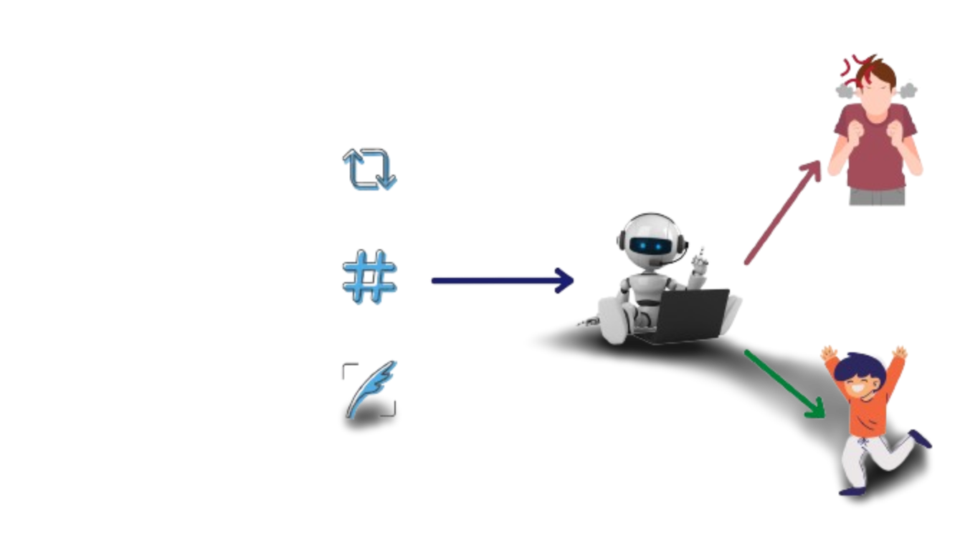
THANK
YOU
10

