Slide 1
Blinkit sales
performance analysis

Slide 2
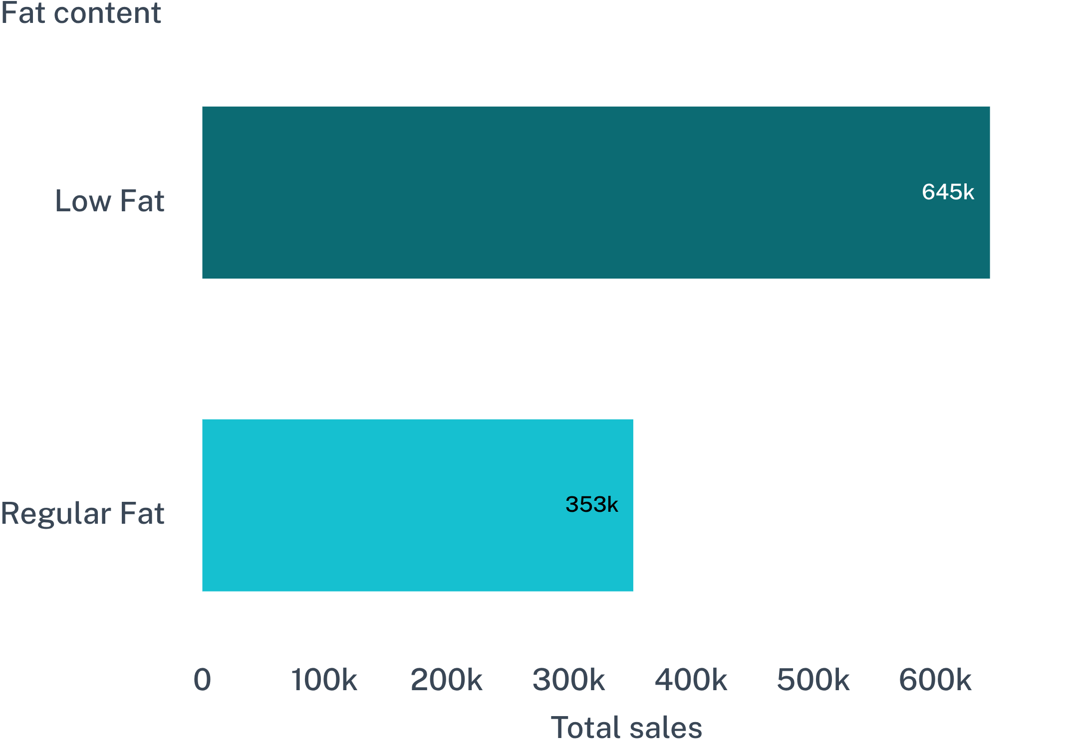
Low-fat products lead the portfolio
LEADING SEGMENT
644,516.73
Low Fat total sales
352,642.49
Regular Fat total sales
02

Slide 3
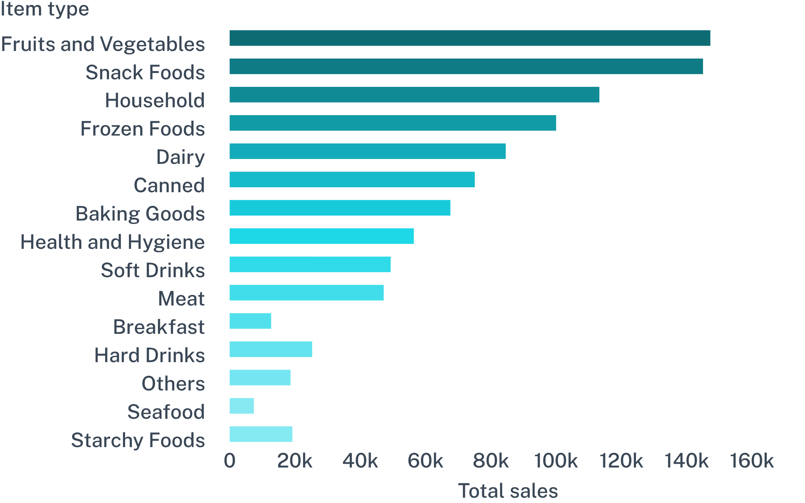
Fruits and vegetables are the largest item category
Top three categories
Fruits and Vegetables
147,188.96
Snack Foods
144,949.13
Household
113,210.14
The top three categories create a clear availability priority.
03

Slide 4
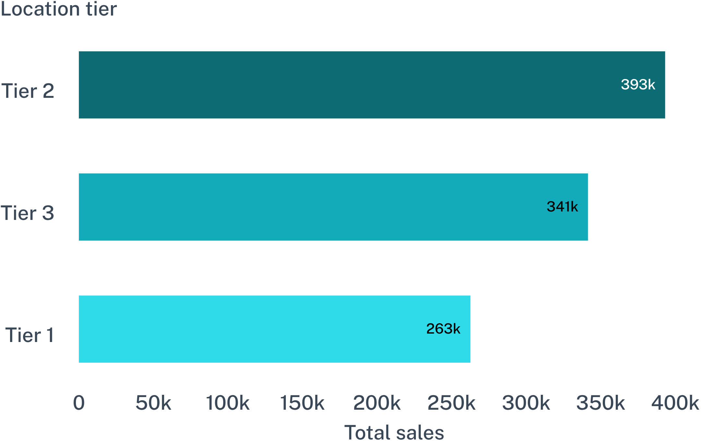
Tier 2 and Tier 3 locations carry the sales engine
SALES LEAD
Tier 2
393,150.64
Tier 3 follows at 341,418.35; Tier 1 records 262,590.23.
04

Slide 5
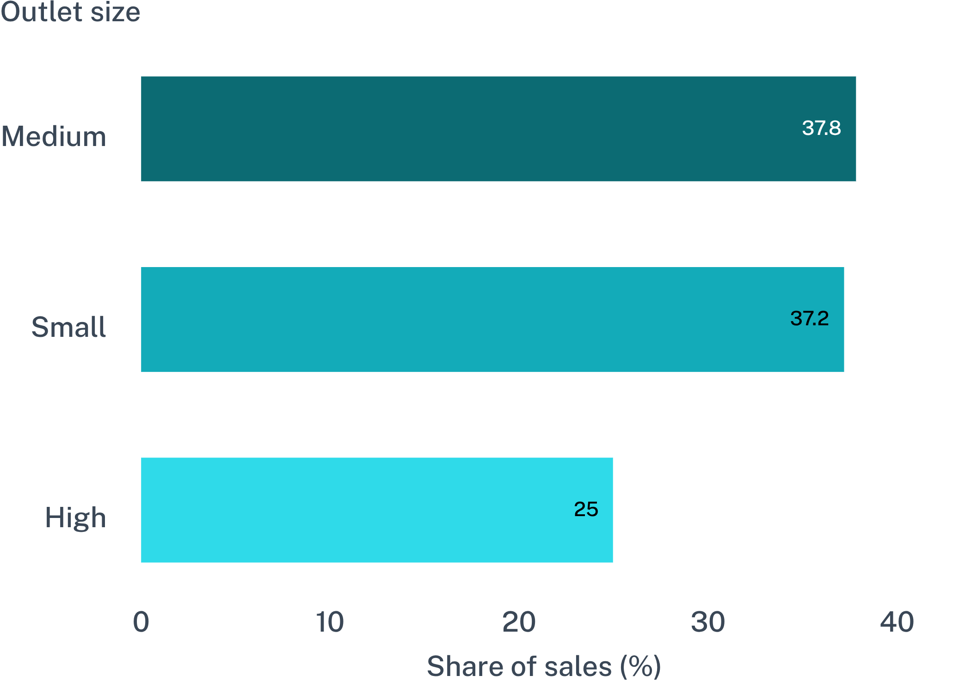
Medium and small outlets account for most sales
05

Slide 6
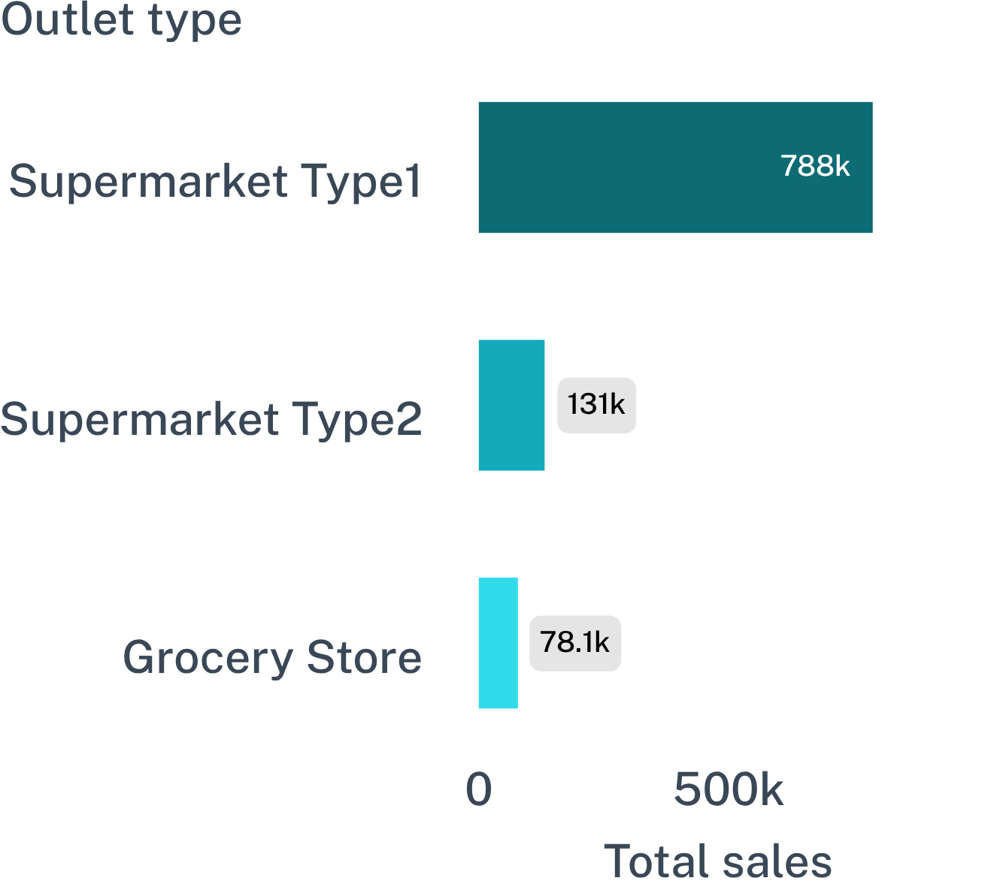
Outlet format performance is concentrated in Supermarket Type1
OUTLET TYPE | ITEM COUNT | TOTAL SALES | AVG SALES | AVG RATING
Supermarket Type1 | 5,577 | 787,549.89 | 141.21 | 3.95
Supermarket Type2 | 928 | 131,477.77 | 141.68 | 3.95
Grocery Store | 555 | 78,131.56 | 140.78 | 3.97
Supermarket Type1 leads total sales by a wide margin.
06

Slide 7
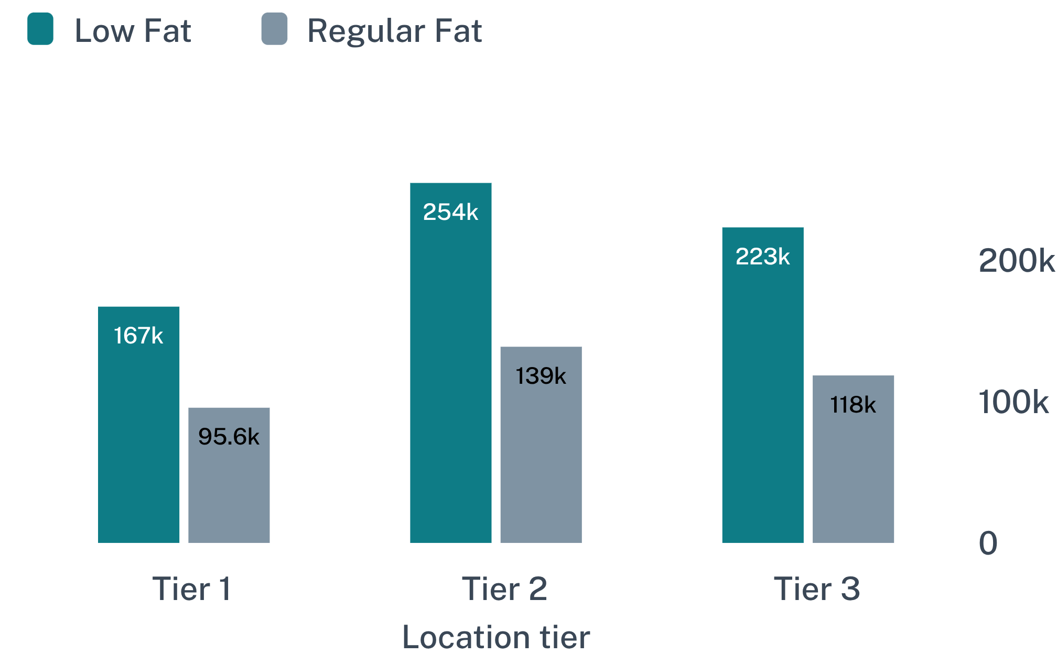
Low-fat demand is strongest in Tier 2 and Tier 3
Tier 2 · Low Fat
254,464.77
Tier 3 · Low Fat
223,032.58
Tier 1 · Low Fat
167,019.38
07

Slide 8
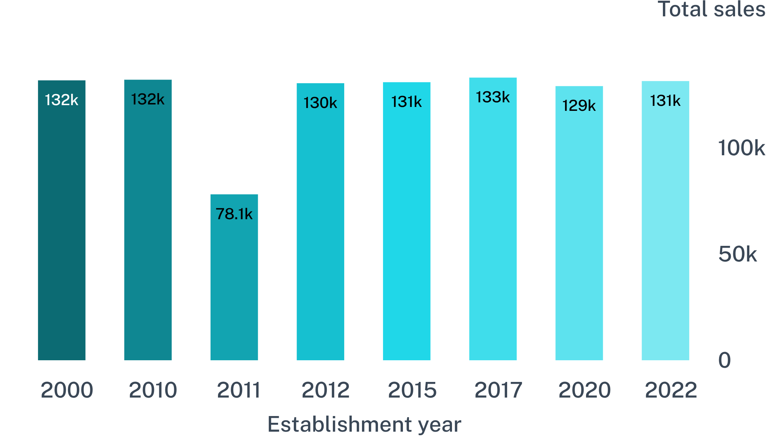
Sales are broadly stable across outlet establishment years
OBSERVED RANGE
78,131.56 — 133,103.91
Recorded outlet-year sales range from 78,131.56 in 2011 to 133,103.91 in 2017.
2012, 2017, 2010, 2000, 2015, and 2022 sit near the 129K–133K band.
08

Slide 9
Customer satisfaction is steady, with limited differentiation
3.95–3.97
FORMAT READOUT
3.97 · Grocery Store
3.95 · Supermarket Type1
3.95 · Supermarket Type2
Average ratings cluster tightly across outlet formats.
09

Slide 10
10

