Slide 1
SQL analysis of consumer shopping behavior

Slide 2
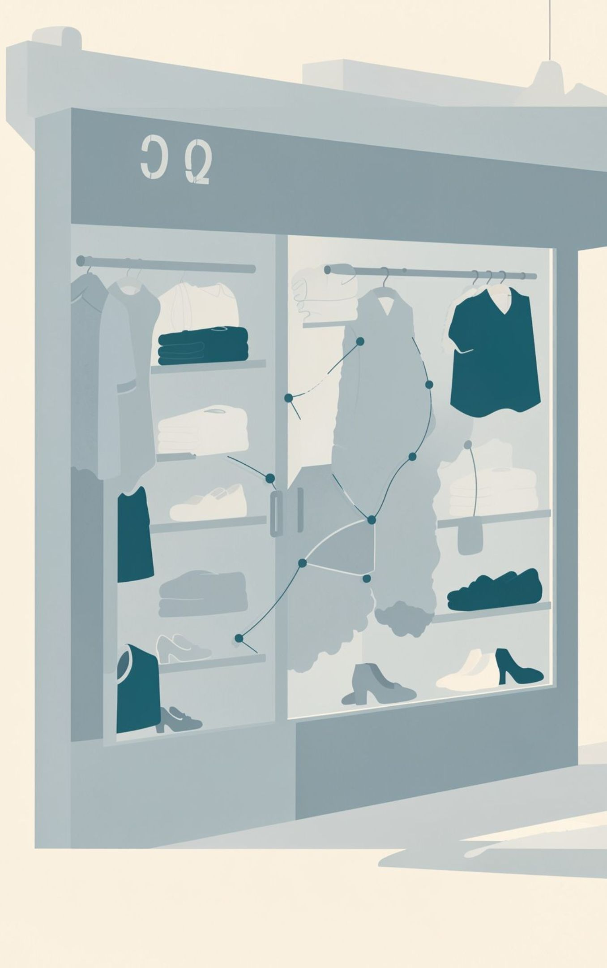
Turn transactions into better decisions
Read the customer mix
01
Understand changes across demographics, product categories, and online versus offline channels.
Test purchase drivers
02
Explore discounts, reviews, seasons, payment preferences, and subscriptions.
Make the analysis actionable
03
Translate findings into customer engagement, product, and marketing recommendations.
02

Slide 3
Python, SQL, Power BI, and delivery form one path
01
02
03
04
Prepare
Query
Surface
Deliver
Clean and transform the raw dataset in Python.
Structure transactions and query customer segments and purchase drivers in SQL.
Show patterns in an interactive Power BI dashboard.
Package findings in a report, presentation, and organized GitHub repository.
03

Slide 4
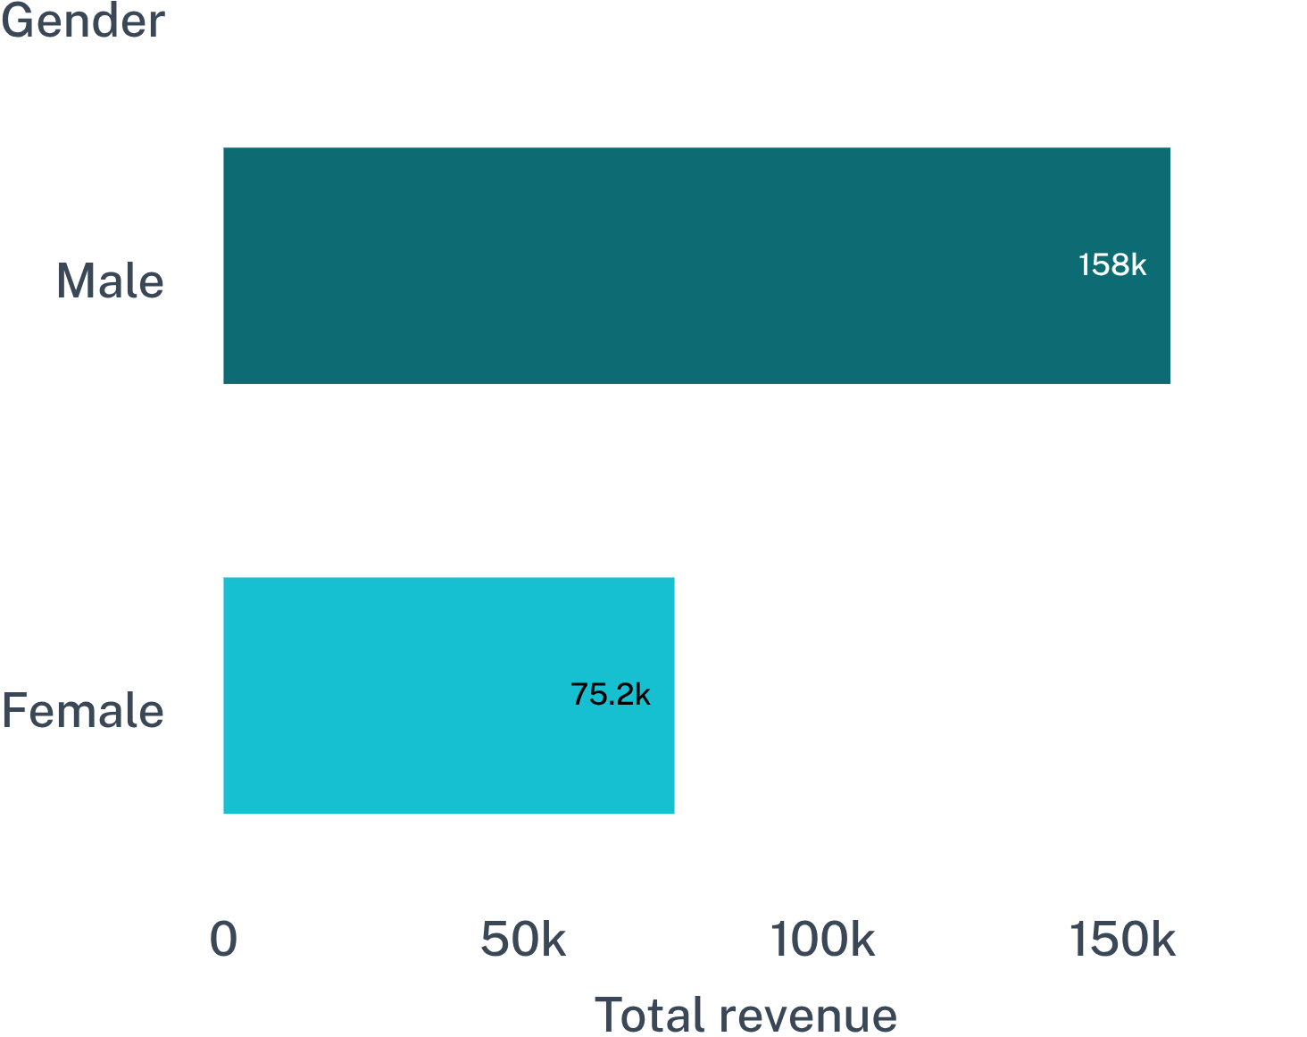
Revenue is concentrated in the male customer segment
Male customers generated 157,890 in total revenue versus 75,191 for female customers, about 2.1× higher in this dataset.
04

Slide 5
Discounts reach high-value purchases, too
CUSTOMER | PURCHASE AMOUNT
Customer 9 | 97
Customer 4 | 90
Customer 20 | 90
Customer 7 | 85
Customer 16 | 81
Customer 3 | 73
Customer 13 | 72
Customer 12 | 68
Customer 2 | 64
Customer 22 | 62
10
customers used a discount and purchased at or above the dataset average.
05

Slide 6
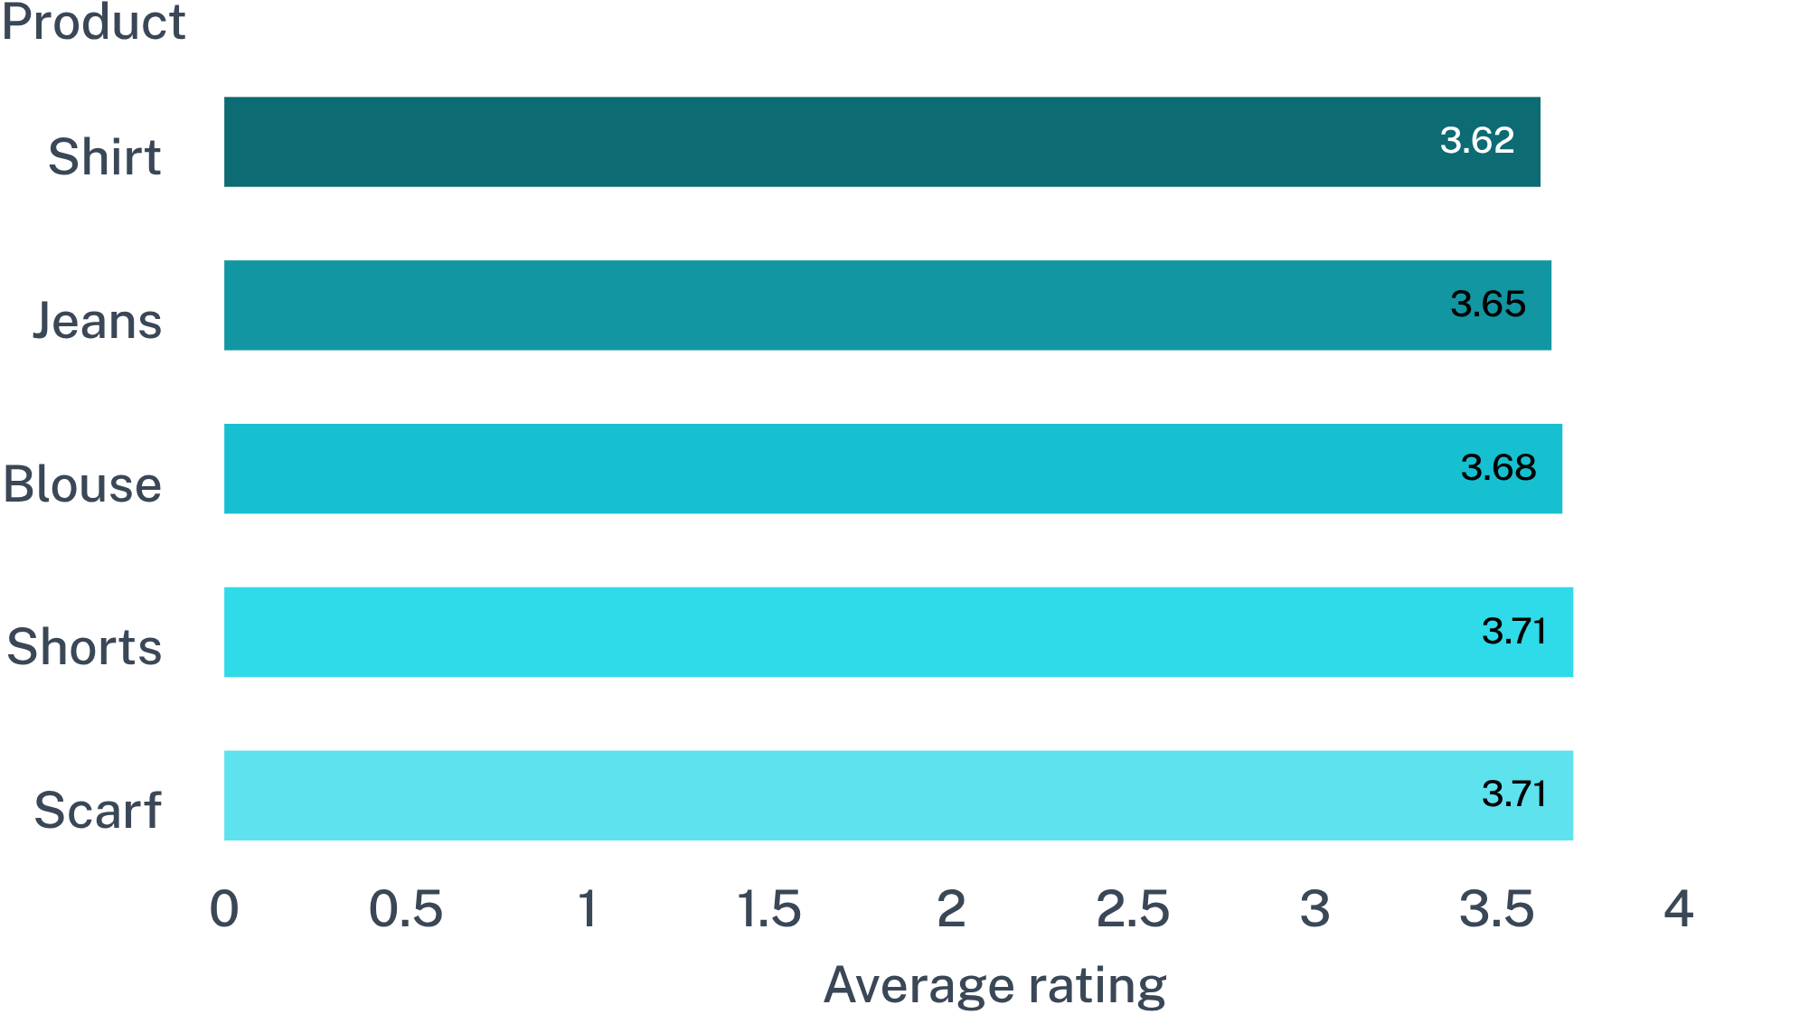
Product ratings are tightly clustered, so small gaps matter
T
06

Slide 7
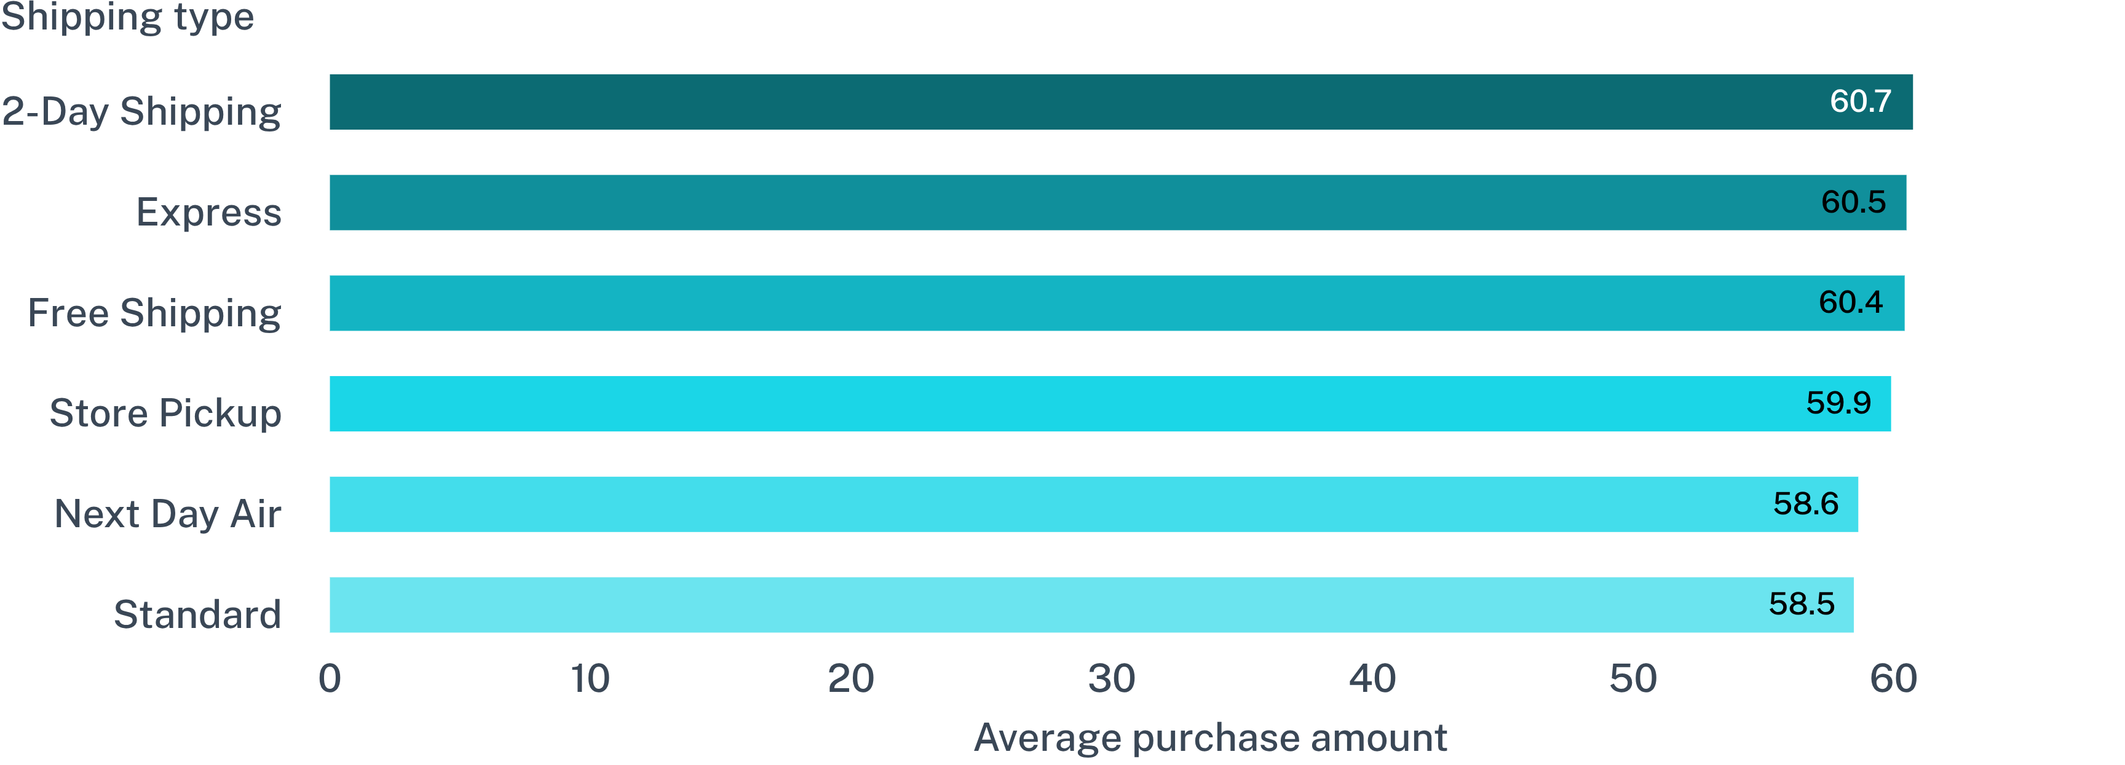
Shipping choice barely changes average basket size
07

Slide 8
Subscriptions have not yet lifted average sales
SUBSCRIPTION STATUS | CUSTOMERS | AVERAGE SALE | TOTAL SALES
Subscribers | 1,053 | 59.49 | 62,645
Non-subscribers | 2,847 | 59.87 | 170,436
59.49 vs 59.87
Average sale · subscribers versus non-subscribers
08

Slide 9
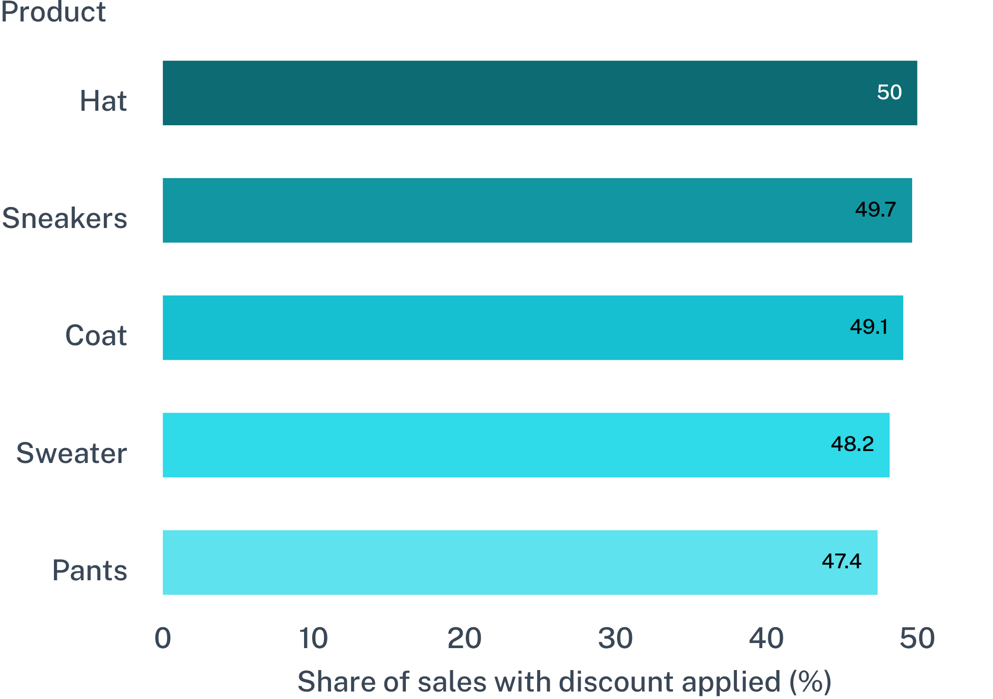
Discount dependence is broad across the leading products
09

Slide 10

Three actions follow from the analysis
Segment smarter
Design campaigns around high-value discount users and gender-specific revenue patterns.
Improve the offer
Focus product and review interventions on the lowest-rated items rather than treating all categories equally.
Prove subscription value
Test benefits that move average sale or repeat purchase, not just sign-ups.
10

