Slide 1
DataBase Management System
Online Shopping System
Cornerstone (Project - 6)
Presented By
25B11DS213-K.G.V.S.SRI RAM(Team Leader)
25B11DS485-R.M.GANAPATHI (Team Member)
26B21DS336-M.SATHWIK (Team Member)
25B11DS029-A.THARUN (Team Member)
Under The Guidance
P.Keerthana
Assistant Professor
Department of Data Science

Slide 2

DATABASE IMPLEMENTATION OVERVIEW
• The Online Shopping Management System database was implemented to manage customer, product, category, order,
order item, and payment information.
• Database and tables were created with appropriate constraints.
• Sample data was inserted into all tables.
• DDL, DML, and DQL operations were performed.
• CRUD operations were implemented.
• SQL queries using Joins and Aggregate Functions were executed.
• Views were created for retrieving required information.
• Data integrity and validation were maintained using database constraints.
2

Slide 3
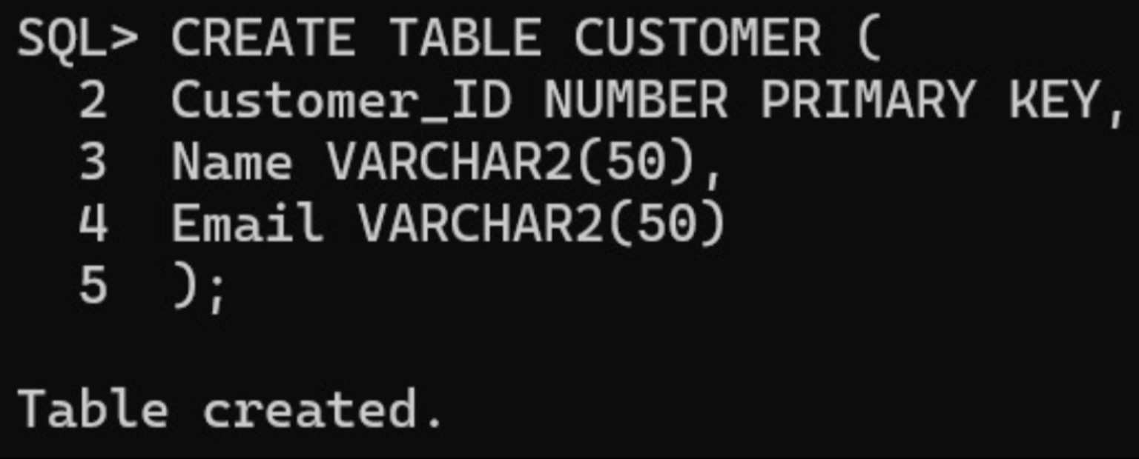
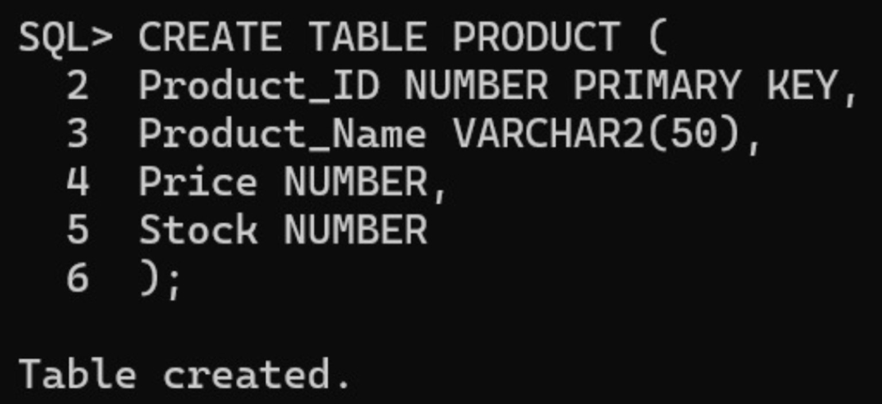
DATABASE & TABLE CREATION
Database Name: OnlineShopping
Tables Created:
• CUSTOMER – Customer details
• CATEGORY – Product category details
• PRODUCT – Product information
• ORDER – Customer order details
• ORDER_ITEM – Products included in each order
• PAYMENT – Payment information
Constraints Used:
• Primary Key
• Foreign Key
• NOT NULL
• UNIQUE
3

Slide 4
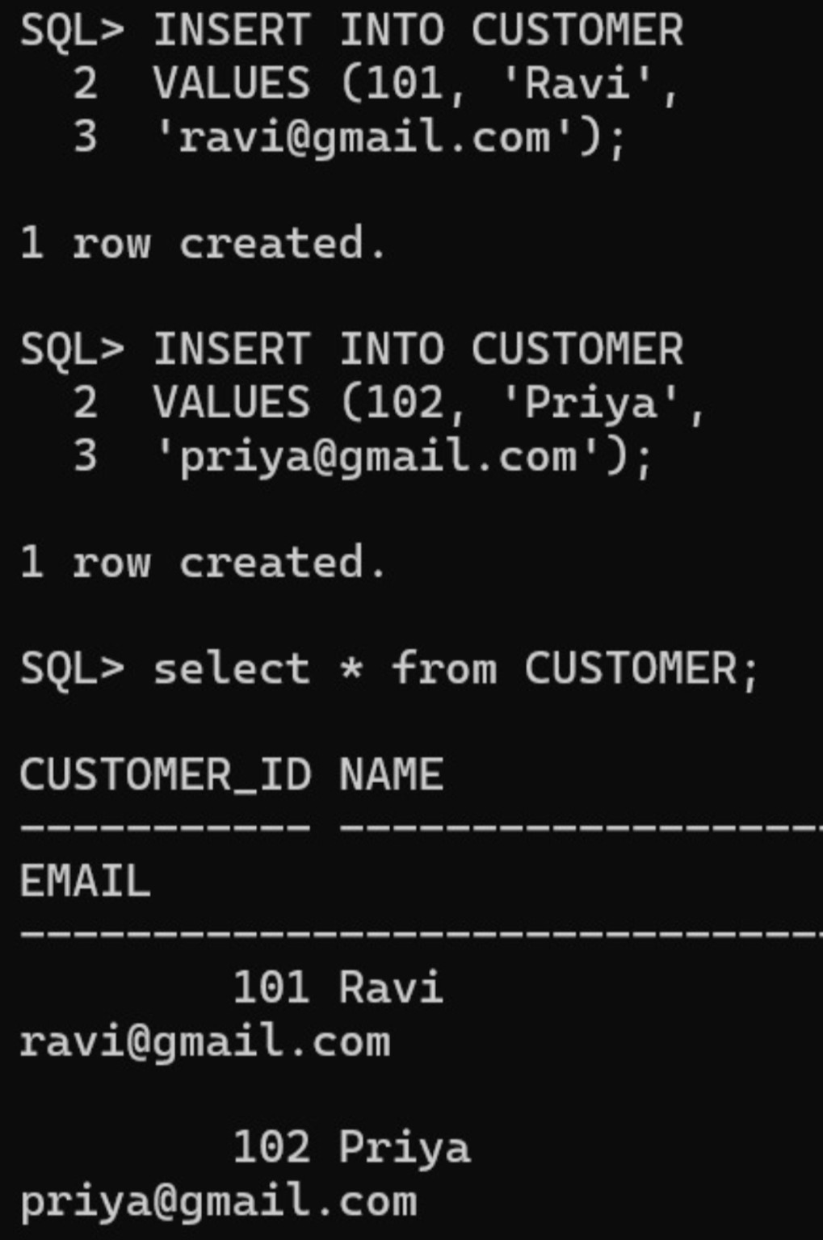
SAMPLE DATA INSERTION
Sample data was inserted into all tables to test and validate the database.
Customer Data
Customer_ID | Name | Email
C101 | sathwik | sathwik@gmail.com
C102 | harisha | harisha@gmail.com
Product Data
Product_ID | Product_Name | Price | Stock
P101 | Smart Watch | 2499 | 25
P102 | Headphones | 1499 | 40
Data inserted into:
CATEGORY • ORDER • ORDER_ITEM • PAYMENT
4

Slide 5
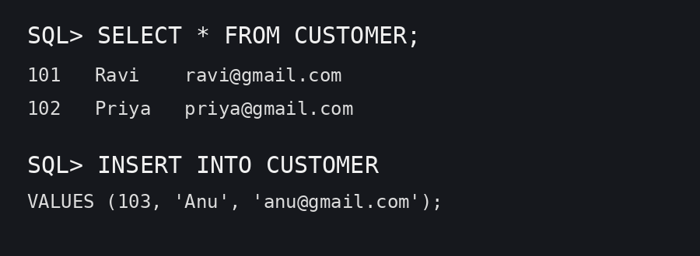
DDL, DML & DQL OPERATIONS
DDL – Data Definition Language
DML – Data Manipulation Language
DQL – Data Query Language
• CREATE – Creates database objects such
as tables.
• INSERT – Adds new records.
• SELECT – Retrieves data from the
database.
• ALTER – Modifies the structure of a table.
• UPDATE – Modifies existing records.
• DELETE – Removes records.

Slide 6
CRUD OPERATIONS
CRUD operations were implemented to manage records in the database.
+
CREATE
Adds new records to the database.
⌕
READ
Retrieves existing records from the database.
↻
UPDATE
Modifies existing records.
−
DELETE
Removes records from the database.

Slide 7
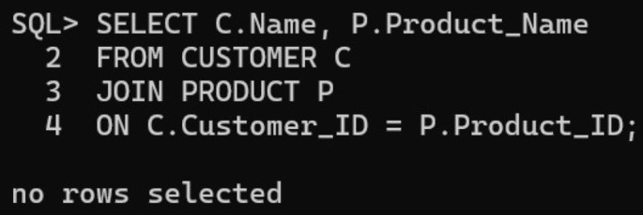
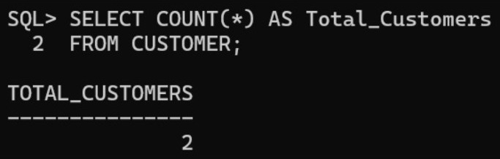
JOINS & AGGREGATE FUNCTIONS
Joins
Joins are used to retrieve related information from
multiple tables.
Aggregate Functions
• COUNT() – Counts records
• SUM() – Calculates total
• AVG() – Calculates average
• MIN() – Finds minimum value
• MAX() – Finds maximum value
7

Slide 8
VIEWS, DATA INTEGRITY & VALIDATION
Views
A view is a virtual table created from one or more tables to simplify frequently used queries.
Example:
Data Integrity
CREATE VIEW CustomerOrders AS
SELECT Customer_ID, Order_ID, Order_Date
FROM ORDERS;
• Primary Keys ensure unique records.
• Foreign Keys maintain relationships between tables.
• NOT NULL ensures required fields are not empty.
• UNIQUE prevents duplicate values where required.
Validation
• Appropriate data types are used.
• Database constraints help prevent invalid data.
8

Slide 9
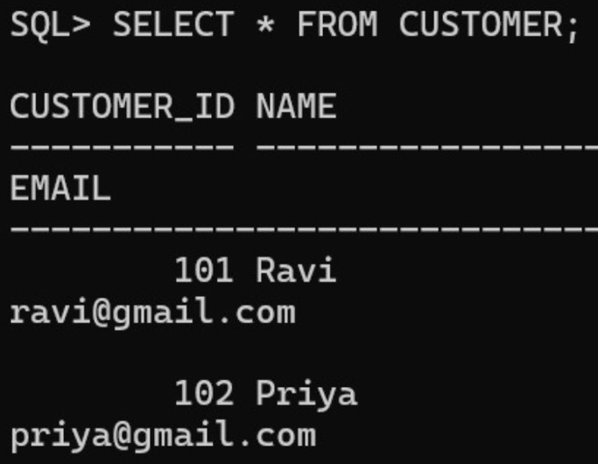
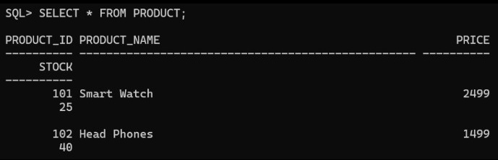
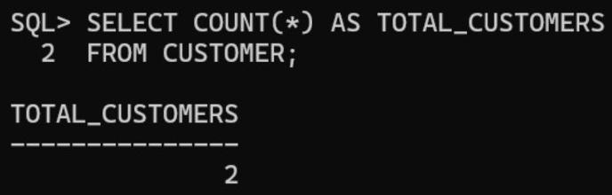
SQL RESULTS & DATABASE SCREENSHOTS
Implementation Results
• Database and tables were successfully created.
• Sample data was inserted into all tables.
• DDL, DML, and DQL operations were performed.
• CRUD operations were successfully implemented.
• Joins and Aggregate Functions were executed.
• Views were created and tested.
• Data integrity and validation were maintained.
Documentation Includes:
• ER Diagram • Database Schema • SQL Queries
• Query Outputs • Database Screenshots
9

Slide 10
THANK YOU
Online Shopping Management System

