Slide 1
HEALTHVAULT
CSE7101- Capstone Project
Review-2
Batch Number: CSE_259
20221CSE0691 | MANOHARA S
20221CSE0729 | VINAY KUMAR J K
20221CSE0683 | K C DARSHAN
Under the Supervision of,
Mr. Gyanesh Verma
Assistant Professor
School of Computer Science and Engineering
Presidency University
Roll Number | Student Name
Name of the Program: B.TECH - Computer Science and Engineering
Name of the HoD: Dr. Asif Mohammed
Name of the Program Project Coordinator: Dr. Jayavadivel Ravi
Name of the School Project Coordinators: Dr. Sampath A K , Dr. Geetha A

Slide 2
Content
Problem Statement
Objectives
Background and Related work for title Selection
Analysis of Problem Statement
Innovation or Novel Contributions
Literature Survey
Git-hub Link
Existing Methods & Drawbacks
Proposed Methods & Feasibility Study
Modules
Hardware and Software Details
Architecture Diagram
Timeline of the Project
References

Slide 3
Problem Statement Number: PSCS_486
Organization : Null
Category (Hardware / Software / Both) : Software
Problem Description: Automatic Health Monitoring System: In present days, the patients belonging to rural and sub-urban communities do not maintain the diagnosis reports for which they frequently go for regular checkups wasting their valuable money. Thus, an automatic report maintaining system is to be developed to avoid repetative diagnosing of the patients.

Slide 4
Objectives
Create a cross-platform mobile app using React Native.
Implement multi-profile management in a single account.
Enable offline-first data storage with automatic cloud synchronization.
Provide secure digital storage for health documents and reports.
Integrate push notifications for medical reminders and checkups.
Design an icon-driven, elder-friendly interface.

Slide 5
Background and Related Work for Title Selection
Existing Solutions:
  Practo, mFine → urban-focused, limited offline support.
  WHO mHealth Guidelines → recommend low-literacy, offline-friendly design.
  iCare (IEEE 2010) → elderly health monitoring, but lacks multi-profile capability.
  Opportunistic mHealth Architecture (HotMobile ’19) → focuses on intermittent connectivity, but not family-based record management.
Gap Identified: Need for a family-managed, offline-first, elder-friendly mobile health record app.
Chosen Title: HealthVault
– Family Health Record & Monitoring System.
- conveys security (“vault”) and health data focus.

Slide 6
Analysis of Problem Statement
🔹 Current Situation
Rural & semi-urban communities face difficulties in maintaining consistent medical records.
Patients often undergo repeated diagnostic tests → financial & time burden.
Elderly individuals struggle with digital literacy, making current apps inaccessible.
🔹 Challenges Identified
Poor Record Maintenance → Reports are misplaced, not portable across hospitals.
Connectivity Barriers → Existing mHealth apps rely heavily on internet access.
Elderly Accessibility Issues → Current solutions are text-heavy, not elder-friendly.
Fragmented Healthcare Access → Patients are unaware of nearby medical services.
Lack of Integration with Hospitals → No direct communication or pre-sharing of reports.
🔹 Gap in Existing Solutions
Most mobile health apps focus on fitness or personal monitoring, not family-centric record keeping.
Telemedicine apps exist but fail in low-connectivity rural environments.
Hospital EHR systems are isolated and proprietary; no cross-hospital sharing.
🔹 Need for a Solution
An offline-first, cloud-synced, family-managed health vault is required.
Must provide profile switching, simple visual UI, and secure hospital integration.
Ensures cost savings, faster healthcare access, and better elderly inclusion.

Slide 7
Innovation or Novel Contributions
Multi-profile management in a single login.
Offline-first architecture for rural deployment.
Simplified, icon-based UI for elders.
Emergency medical info accessible from lock screen.
Easy sharing of reports with healthcare providers.

Slide 8
Literature Survey
No. | Title | Authors | Year | Advantages | Disadvantages
1 | iCare: A Mobile Health Monitoring System for the Elderly | Y. Yuan, J. Xu, J. Zhang, G. Yu | 2010 | Early mobile-based monitoring for elderly; continuous data collection | Limited scalability; no offline support
2 | Opportunistic mHealth Architecture for Remote Patient Monitoring | A. Vahdatpour, M. Amini, M. Sarrafzadeh | 2019 | Supports opportunistic data collection; adaptive monitoring | Dependent on stable connectivity; complex for rural areas
3 | Remote Based Patient Monitoring with Wearable Sensors | K. S. Abhishek, P. Kumar, A. Sharma, P. Kumar | 2017 | Wearables + mobile app; supports online/offline mode | Device dependency; limited user-friendliness for elderly
4 | IoT for Healthcare: A Comprehensive Survey | S. M. R. Islam, D. Kwak, M. H. Kabir, M. Hossain, K. S. Kwak | 2015 | Broad overview of IoT in healthcare; strong technical foundation | Lacks focus on usability and rural deployment
5 | IoT-Enabled Low-Cost Fog Computing for Rural Healthcare | H. Maneshti, M. Dadashi, K. Rostami | 2023 | Low-cost fog computing; real-time heart monitoring | Requires technical infrastructure; not family-centric

Slide 9
Literature Survey
No. | Title | Authors | Year | Advantages | Disadvantages
6 | mHealth Interventions in Low-Resource Settings | S. Agarwal, L. LeFevre, S. Lee | 2019 | Demonstrates mHealth success in rural communities | Limited scalability; specific to case studies
7 | mHealth for Aging Populations: A Review | D. Boulos, N. Yang | 2015 | Focus on elderly adoption; identifies accessibility barriers | Mostly conceptual review; no full solutions
8 | mHealth for Chronic Disease Management in Developing Countries | D. Aranda-Jan, N. Mohutsiwa-Dibe, S. Loukanova | 2014 | Reviews chronic disease interventions; highlights benefits | Connectivity dependence; limited offline access
9 | Digital Health for Rural Communities: Opportunities & Challenges | A. J. Hall, S. R. Smith, L. S. Baker | 2020 | Identifies rural digital health gaps; practical insights | General discussion; lacks implementation details
10 | Assistive Technologies in mHealth for Elderly Care | P. Marasinghe | 2020 | Reviews assistive tech for elderly; accessibility-focused | More theoretical; lacks large-scale testing

Slide 10
Links
Github Link: https://github.com/manohara-s-1110/vital-vault.git
Figma Link: https://www.figma.com/design/MSM5UB5bnSRkfe5q7a2jD1/CapStone_project?node-id=1-2&t=iVBhDrIzWhj0R1qc-1

Slide 11
Existing Methods & Drawbacks
Paper-based medical records
  Easily lost, damaged, or inaccessible.
  No central storage for multiple family members.
Standalone mHealth Apps (Fitbit, Google Fit, etc.)
  Focus on fitness, not diagnostic reports.
  Require tech literacy → not suitable for elderly.
Hospital-based EHR Systems
  Restricted to specific hospitals.
  Patients in rural areas cannot maintain continuity across clinics.
Telemedicine Solutions
  Dependent on stable internet.
  Limited offline support → not viable for rural settings.
Drawbacks Summary:
Lack of family profile switching
Connectivity dependence (no offline mode)
Elderly accessibility issues
Fragmented health data across systems

Slide 12
Proposed Method & Feasibility Study
Proposed Solution:
A mobile-first, offline-enabled app (Health Vault) with:
  Multi-profile switching for families
  Secure cloud storage (Firebase) for reports
  Offline-first access with auto-sync
  Elder-friendly UI with icons & minimal text
  Hospital integration module → share recent reports with nearby healthcare providers
Feasibility:
Technology Feasibility: Built using React Native (cross-platform), Firebase (easy backend), Node.js microservices → all widely adopted.
Cost Feasibility: Leverages free-tier Firebase + scalable cloud options. Development costs limited to software.
Resource Feasibility: Small dev team can implement core MVP within semester (frontend + backend + Firebase integration).
Operational Feasibility: Easily deployable via Play Store. Designed for low digital literacy users (signs/icons, no language barrier).
Scalability Feasibility: Later enhancements like AI-based report insights, wearable device integration.

Slide 13
Modules
User Authentication Module
Secure login and signup using Firebase Authentication.
Role-based access (family member, elder, healthcare provider).
Profile Management Module
Create and manage multiple family health profiles.
Profile switching for younger members to manage elders’ records.
Health Record Management Module
Upload, store, and view diagnostic reports, prescriptions, and medical history.
Offline-first access with auto cloud sync.
Notification & Reminder Module
Medication reminders, appointment alerts, and follow-up notifications.
Push notifications via Firebase Cloud Messaging.
Nearby Hospitals & Services Module (new feature)
Locate hospitals/clinics using geolocation.
Share patient’s recent report securely with selected healthcare providers.
Emergency Access Module
Quick access to critical medical info from lock screen.
Contact info + emergency medical conditions.

Slide 14
Hardware & Software Details
Hardware Requirements:
End Users:
  Smartphone with Android 8.0 (Oreo) or higher
  Minimum 2 GB RAM, 16 GB storage
  GPS enabled for hospital locator
Developer Environment:
  Laptop/PC with 8 GB RAM, Node.js runtime, and emulator (Android Studio or Expo Go).
Software Requirements:
Frontend: React Native (Expo framework)
Backend: Node.js (Express.js for APIs)
Database: Firebase Firestore (NoSQL)
Storage: Firebase Cloud Storage (for medical documents)
Authentication: Firebase Authentication
Push Notifications: Firebase Cloud Messaging (FCM)
Maps & Location: Google Maps API / OpenStreetMap
Version Control: Git + GitHub
IDE/Tools: VS Code, Expo CLI, Postman (API testing)

Slide 15
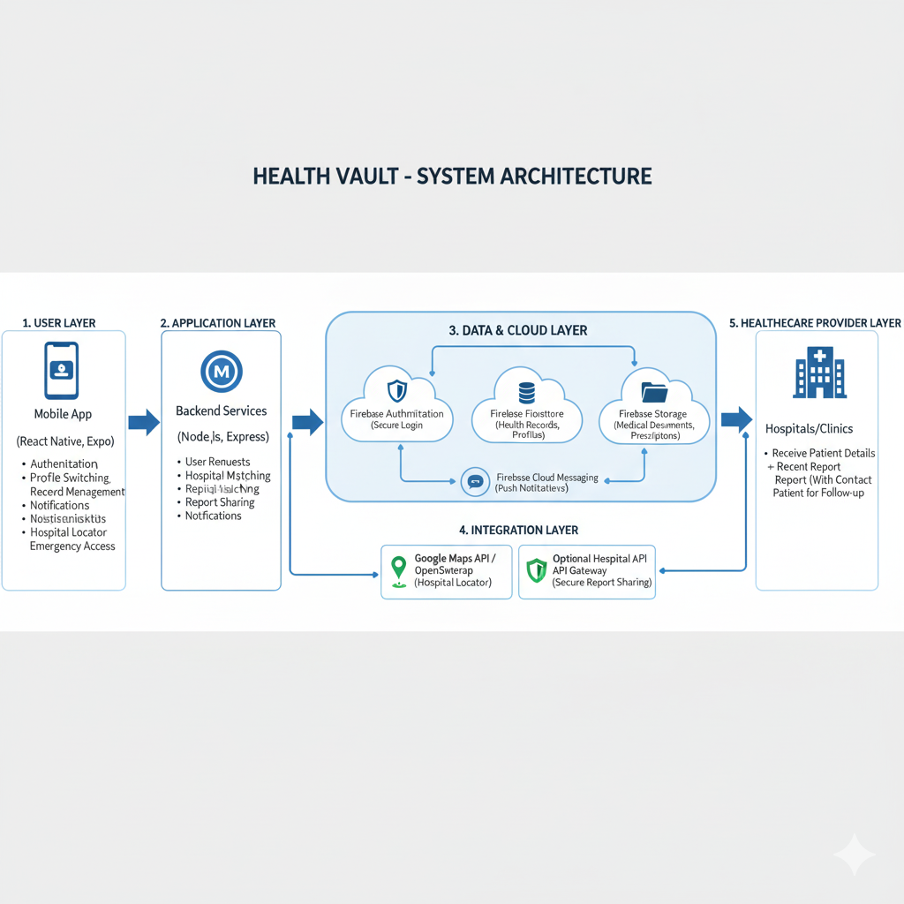
Architecture Diagram

Slide 16
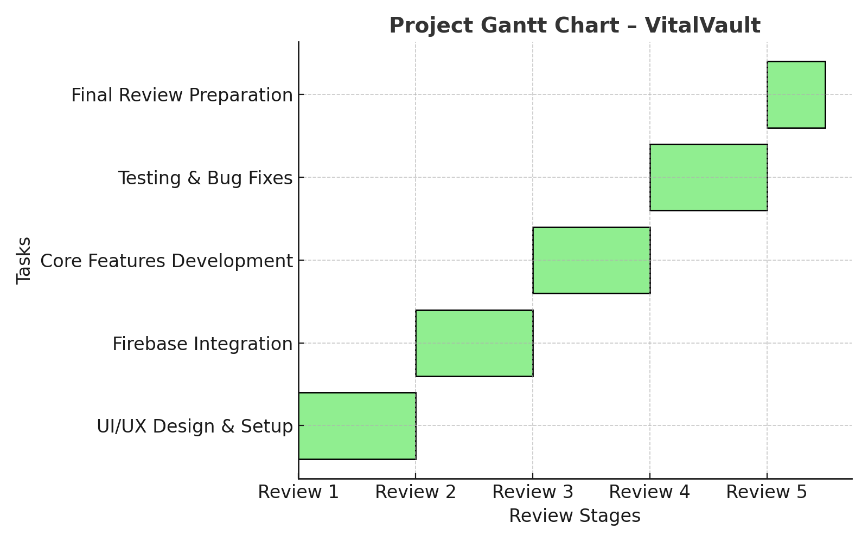
Timeline of the Project (Gantt Chart)

Slide 17
References (IEEE Paper format)
1] Y. Yuan, J. Xu, J. Zhang, and G. Yu, "iCare: A Mobile Health Monitoring System for the Elderly," Proc. 2010 IEEE 3rd Int. Conf. Biomedical Engineering and Informatics (BMEI), Yantai, China, Oct. 2010, pp. 1-5, doi: 10.1109/BMEI.2010.5639705.
[2] A. Vahdatpour, M. Amini, and M. Sarrafzadeh, "An Opportunistic mHealth Architecture for Remote Patient Monitoring," Proc. 20th Int. Workshop on Mobile Computing Systems and Applications (HotMobile '19), Santa Cruz, CA, USA, Feb. 2019, pp. 57-62, doi: 10.1145/3301293.3309558.
[3] K. S. Abhishek, P. Kumar, A. Sharma, and P. Kumar, "Remote Based Patient Monitoring System Using Wearable Sensors Through Online and Offline Mode for Android Based Mobile Platforms," Proc. 2017 Int. Conf. Computer, Communications and Electronics (Comptelix), Jaipur, India, Jul. 2017, pp. 227-231, doi: 10.1109/COMPTELIX.2017.8003982.
[4] S. M. R. Islam, D. Kwak, M. H. Kabir, M. Hossain, and K. S. Kwak, "The Internet of Things for Healthcare: A Comprehensive Survey," IEEE Access, vol. 3, pp. 678-708, 2015, doi: 10.1109/ACCESS.2015.2437951.
[5] H. Maneshti, M. Dadashi, and K. Rostami, "IoT-Enabled Low-Cost Fog Computing System with Online Machine Learning for Accurate and Low-Latency Heart Monitoring in Rural Healthcare Settings," Proc. 2023 4th Int. Conf. Electrical, Communication and Computer Engineering (ICECCE), Kuala Lumpur, Malaysia, Jun. 2023, pp. 1-6, doi: 10.1109/ICECCE57971.2023.10159458.

Slide 18
References (IEEE Paper format)
[6] S. Agarwal, L. LeFevre, and S. Lee, "Mobile Health (mHealth) Interventions in Low-Resource Settings: A Systematic Review," BMC Public Health, vol. 19, no. 1, pp. 1-15, 2019. [Online]. Available: https://bmcpublichealth.biomedcentral.com/articles/10.1186/s12889-019-7890-7
[7] D. Boulos and N. Yang, "mHealth for Aging Populations: A Review," JMIR mHealth and uHealth, vol. 3, no. 1, pp. e1, 2015. [Online]. Available: https://mhealth.jmir.org/2015/1/e1/
[8] D. Aranda-Jan, N. Mohutsiwa-Dibe, and S. Loukanova, "Systematic Review on mHealth Interventions for Chronic Disease Management in Developing Countries," JMIR mHealth and uHealth, vol. 2, no. 1, pp. e25, 2014. [Online]. Available: https://mhealth.jmir.org/2017/2/e25/
[9] A. J. Hall, S. R. Smith, and L. S. Baker, "Digital Health for Rural Communities: Opportunities and Challenges," Frontiers in Public Health, vol. 8, pp. 598235, 2020. [Online]. Available: https://www.frontiersin.org/articles/10.3389/fpubh.2020.598235/full
[10] P. Marasinghe, "Assistive Technologies in mHealth for Elderly Care: A Review," Healthcare (MDPI), vol. 8, no. 3, pp. 257, 2020. [Online]. Available: https://www.mdpi.com/2227-9032/8/3/257

Slide 19


